Slide 1
Language Learning Platform

Slide 2
Users
1.Language Learners: Individuals of various proficiency levels seeking to learn or improve their skills in a foreign language.
2.Educators/Tutors: Language teachers or tutors who may use the platform to supplement their teaching materials or guide their students.
3.Administrators: Those responsible for managing and maintaining the platform, including content moderation, user management, and technical support.

Slide 3
User Requirements
1.Language Learners: Access to a user-friendly interface for easy navigation. Availability of audio playback for listening comprehension. Interactive pronunciation practice activities. Personalized learning paths based on proficiency levels and learning preferences. Progress tracking and performance assessment tools.
2.Educators/Tutors: Ability to create and customize learning materials and assignments. Monitoring tools to track students' progress and performance. Access to teaching resources and professional development materials.
3.Administrators: User management functionalities for registration, authentication, and profile management. Content management tools for uploading, organizing, and updating learning materials. System monitoring and maintenance features to ensure platform stability and security.

Slide 4
Functional Requirements
1.User Interface: Navigation system. Responsive design for compatibility across devices. Clear presentation of learning materials and activities.
2.Audio Playback: Integration of audio files for listening exercises. Play/pause, rewind, and volume control options. Compatibility with various audio formats.
3.Pronunciation Practice: Interactive pronunciation exercises. Recording and playback functionalities for user-generated audio. Comparative analysis tools for self-assessment.

Slide 5
Cont…
4.Learning Materials: Vocabulary lists, grammar lessons, dialogues, and reading exercises. Integration of multimedia content (e.g., images, videos) to enhance learning experiences.
5.Personalization and Progress Tracking: User profiles with customizable preferences and learning goals. Algorithm-driven recommendations for tailored learning paths. Visual representations of progress through dashboards and reports.

Slide 6
Non-Functional Requirements
1.Performance: Low latency and fast response times to ensure smooth user experience. Scalability to accommodate a growing user base without degradation in performance.
2.Security: Secure authentication and authorization mechanisms. Encryption of sensitive user data (e.g., login credentials, progress tracking information).
3.Reliability: High availability and uptime to minimize service disruptions. Automated backup and recovery procedures to prevent data loss.
4.Accessibility: Compliance with accessibility standards (e.g., WCAG) to ensure inclusivity for users with disabilities. Support for multiple languages and localization options.

Slide 7
Domain Requirements
1.Language Learning Pedagogy: Incorporation of evidence-based language learning methodologies and best practices. Alignment with proficiency standards and frameworks (e.g., CEFR, ACTFL). Collaboration with linguists and language education experts for content development and curriculum design.
2.Technology Infrastructure: Utilization of cloud-based hosting services for scalability and reliability. Integration with third-party APIs for language processing and pronunciation analysis. Compatibility with modern web browsers and operating systems.
3.Regulatory Compliance: Adherence to data protection regulations (e.g., GDPR, CCPA) for handling user data and privacy.

Slide 8
User Analysis
1.Language Learners:
Demographics: Varied age groups, backgrounds, and proficiency levels.
Needs: Desire to learn a new language or improve existing language skills.
Goals: Achieving fluency and confidence in speaking, listening, reading, and writing.
Preferences: Prefer interactive and engaging learning experiences; value flexibility and personalization in learning paths.

Slide 9
Cont…
2.Educators/Tutors:
Demographics: Language teachers, tutors, or language enthusiasts.
Needs: Access to effective teaching resources and tools to support students' language learning journey.
Goals: Enhancing students' language proficiency; providing engaging and comprehensive learning materials.
Preferences: User-friendly platforms with customizable content creation features; tools for progress monitoring and assessment.

Slide 10
Task Analysis
1.Language Learners:
Accessing learning materials: Navigating the platform to find relevant lessons, exercises, and resources.
Listening and pronunciation practice: Engaging in audio playback activities and pronunciation exercises.
Progress tracking: Monitoring their learning progress, setting goals, and accessing personalized learning paths.
Interacting with quizzes and assessments: Participating in interactive quizzes to gauge learning outcomes and receive feedback.

Slide 11
Cont…
2.Educators/Tutors:
Creating and customizing learning materials: Developing or curating vocabulary lists, grammar lessons, dialogues, and reading exercises.
Monitoring students' progress: Tracking students' performance, providing feedback, and adjusting teaching strategies accordingly.
Assigning tasks and assessments: Designing quizzes, assignments, and assessments to evaluate students' language proficiency.

Slide 12
Domain Analysis
1.Language Learning Pedagogy: Incorporating evidence-based language learning methodologies and best practices. Alignment with proficiency standards and frameworks (e.g., CEFR, ACTFL). Collaboration with linguists and language education experts for content development and curriculum design.
2.Technology Infrastructure: Utilization of cloud-based hosting services for scalability and reliability. Integration with third-party APIs for language processing and pronunciation analysis. Compatibility with modern web browsers and operating systems.
3.Regulatory Compliance: Adherence to data protection regulations (e.g., GDPR, CCPA) for handling user data and privacy.

Slide 13
Scenario
Sheillah, a busy professional, seeks to learn Mandarin Chinese for career growth. Finding our platform, she appreciates its flexibility. With daily dedication, she progresses through structured lessons. Empowered by newfound skills, she subscribes to premium membership, excited for future opportunities.
Sign Up: Sheillah creates an account on our platform, providing basic information.
Assessment Test: She takes an assessment test to determine her current English proficiency level.
Set Goals: Sheillah sets specific goals for her English learning journey, such as improving speaking skills for job interviews or enhancing writing skills for professional emails.
Choose Learning Path: Based on her assessment results and goals, Sheillah selects a learning path tailored to her needs, whether beginner, intermediate, or advanced.

Slide 14
Cont…
Engage in Lessons: She begins engaging in interactive lessons covering grammar, vocabulary, listening, speaking, and writing skills.
Practice Speaking: She practices speaking by recording herself and comparing it with native speakers. She also participates in speaking exercises and conversations with virtual tutors or language partners.
Enhance Listening Skills: She improves her listening skills by listening to audio recordings, podcasts, and watching videos with subtitles.
Strengthen Writing Skills: She works on her writing skills by completing exercises, writing essays, and receiving feedback from instructors or through automated tools.
Utilize Supplementary Resources: She takes advantage of additional resources such as grammar guides, vocabulary lists, quizzes, and interactive games to reinforce learning.
Track Progress: Sheillah regularly tracks her progress through quizzes, assignments, and assessments, adjusting her learning strategy.

Slide 15
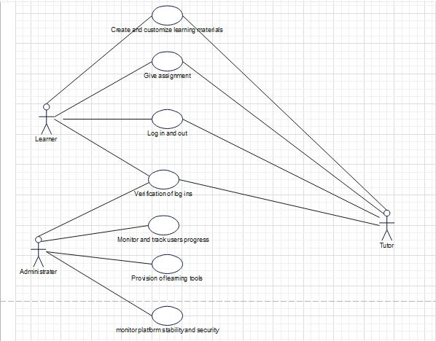
Use case diagram

Slide 16
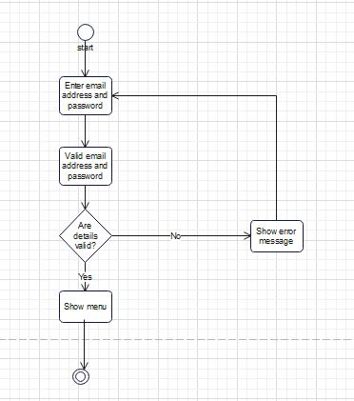
Activity diagram

Slide 17
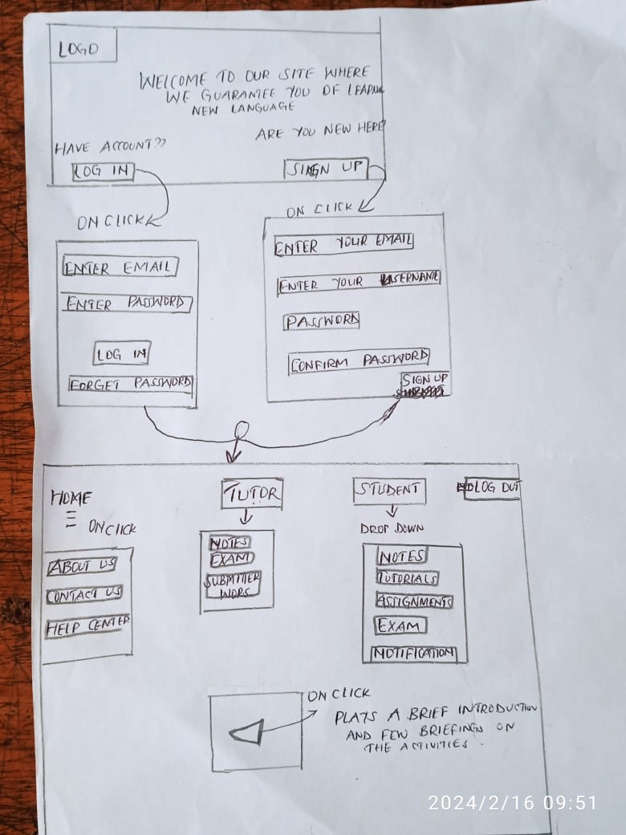
Conceptual design

