Slide 1
Language Learning Platform

Slide 2
User Analysis
Language Learners: Demographics: Varied age groups, backgrounds, and proficiency levels.
Needs: Desire to learn a new language or improve existing language skills.
Goals: Achieving fluency and confidence in speaking, listening, reading, and writing.
Preferences: Prefer interactive and engaging learning experiences; value flexibility and personalization in learning paths.
Educators/Tutors:
Demographics: Language teachers, tutors, or language enthusiasts. Needs: Access to effective teaching resources and tools to support students' language learning journey. Goals: Enhancing students' language proficiency; providing engaging and comprehensive learning materials.
Preferences: User-friendly platforms with customizable content creation features; tools for progress monitoring and assessment.
Administrators: Those responsible for managing and maintaining the platform, including content moderation, user management, and technical support.

Slide 3
Characteristics of Users
Adult Learners: The users of the system are adults seeking to enhance their reading, writing, and speaking skills in English. They may have varying levels of digital literacy and language proficiency.
High-Profile Individuals: The target users include high-profile individuals who value privacy and confidentiality. They may have specific scheduling constraints and require a flexible learning solution that respects their privacy needs.

Slide 4
Characteristics of User Tasks
Accessing Learning Materials: Users need to navigate the online platform to access a variety of learning resources, including interactive lessons, multimedia content, exercises, and quizzes.
Participating in Remote Classes: Users should be able to join virtual classrooms, engage in live or recorded sessions, interact with instructors and peers, and contribute to discussions or group activities.
Tracking Progress and Feedback: Users should have the ability to monitor their progress, receive personalized feedback on their performance, and set goals to track their language learning journey.
Customizing Learning Paths: Users should be able to tailor their learning experience based on their individual goals, interests, and skill levels, selecting specific topics or modules that align with their needs.
Seeking Support: Users may require assistance from instructors or tutors, either through online chat, email, or scheduled consultations, to address questions, clarify concepts, or seek guidance.

Slide 5
Characteristics of Task Environment
Digital Learning Environment: Users interact with the online learning platform through computers, laptops, or mobile devices with internet access.
Remote Learning Setup: Users engage in learning activities from their preferred location, such as their homes or private workspaces, to maintain privacy and convenience.
Connectivity and Technology: Users rely on stable internet connectivity and compatible devices to access the system, stream content, and participate in virtual classes.
Time Flexibility: The system should accommodate users' varying schedules and provide asynchronous learning options, allowing them to study at their own pace.

Slide 6
TASK ANALYSIS
Main task: Access and participate in an online English language learning.
Subtask 1: Log in to the online learning platform.
Enter username and password
Click on "Login" button
Verify credentials and gain access to the platform
Subtask 2: Navigate to the desired course or learning materials.
Browse through available courses or subjects
Select the desired course or learning materials
Click on the course to access its content

Slide 7
TASK ANALYSIS
Subtask 3: Access interactive lessons, multimedia content, and exercises.
Open the selected course or module
View the lessons and topics available
Click on a lesson or topic to access its content
Engage with interactive elements such as videos, audio exercises, and quizzes
Subtask 4: Join virtual classrooms or recorded sessions.
Explore the course menu or navigation options
Look for virtual classrooms or recorded sessions
Click on the desired session or enter the virtual classroom
Follow instructions to join the session or play the recording

Slide 8
TASK ANALYSIS
Subtask 5: Engage in discussions, group activities, or assignments.
Find discussion boards, group activities, or assignments within the course
Click on the relevant section or topic
Read and respond to discussion posts or prompts
Collaborate with other learners, provide feedback, or submit assignments
Subtask 6: Monitor progress and receive personalized feedback.
Access the progress or dashboard section
View overall progress, achievements, and areas for improvement
Receive personalized feedback on performance and suggested learning paths
Set goals and track progress over time

Slide 9
TASK ANALYSIS
Subtask 7: Seek support from instructors or tutors, if needed.
Locate the support or contact information section
Find instructor or tutor availability details
Use provided communication channels (e.g., email, chat) to reach out for support
Ask questions, seek clarification, or request assistance
Subtask 8: Customize learning paths and set goals based on individual needs.
Explore the customization or personalization options
Modify learning preferences or settings
Set specific learning goals based on individual needs and aspirations
Adjust the learning path, pace, or content according to personal requirements

Slide 10
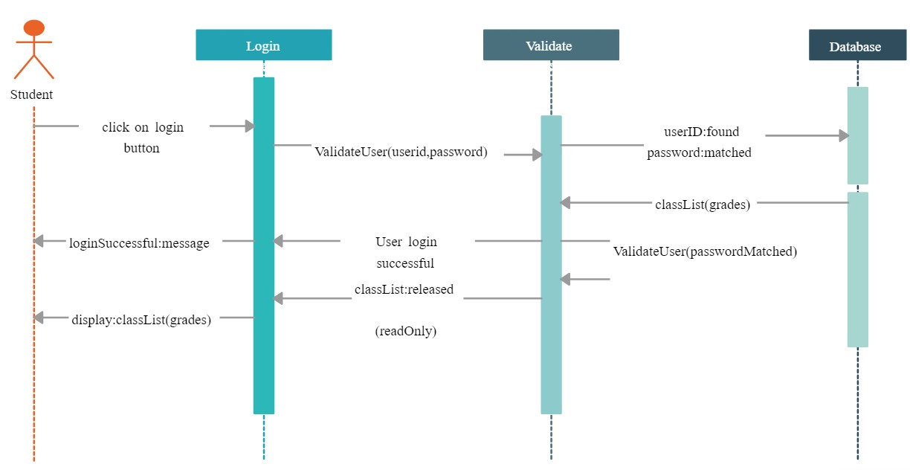
Login Task Process

Slide 11
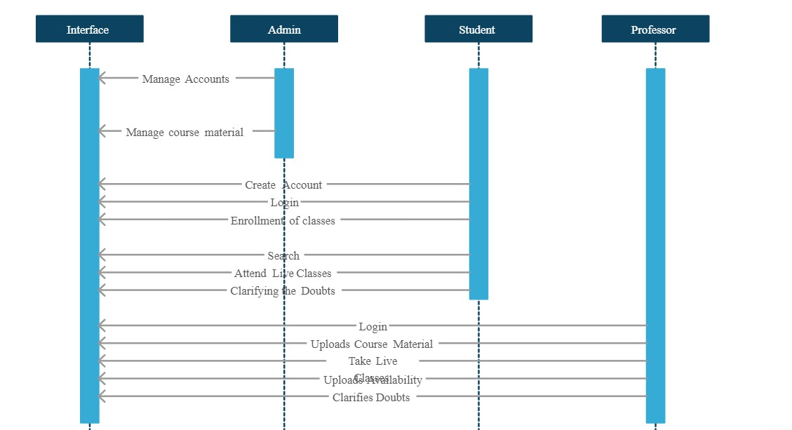
Learning process

Slide 12
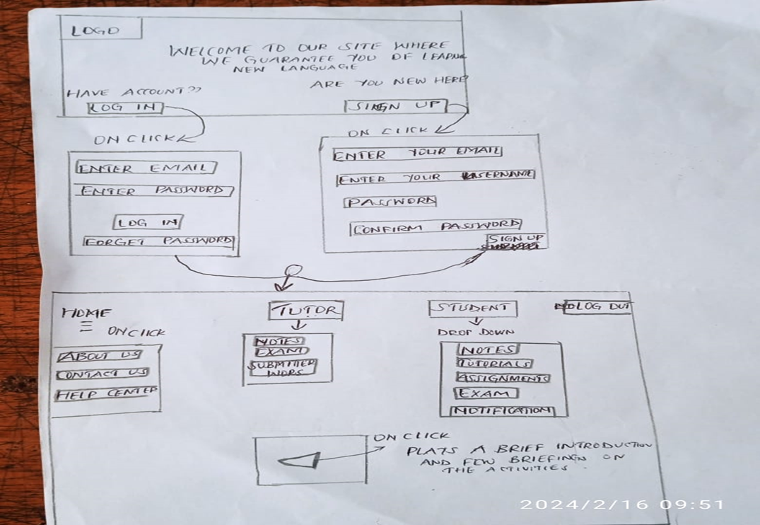
Conceptual design

Slide 13
Description of Larger System
The online learning system developed by Pixel Company for the Destined Adult School will participate in a larger technical and social organization. This organization comprises the school administration, instructors, adult learners, and the virtual learning community. The system will serve as a centralized platform for delivering educational resources, facilitating remote classes, and supporting communication and collaboration among users.

Slide 14
Analysis of Existing System
Currently, the Destined Adult School may have a traditional classroom-based system for English language instruction. However, this system faces deficiencies when it comes to accommodating high-profile individuals who prefer not to be physically present in class.

Slide 15
Advantages
In-person interaction between instructors and learners.
Immediate clarification of doubts through face-to-face communication.
Group dynamics and peer learning opportunities.

Slide 16
Disadvantages
Lack of privacy for high-profile individuals attending physical classes.
Limited flexibility in scheduling classes, hindering learners with busy schedules.
Potential stigma associated with adult learners being visibly taught basic literacy skills.

Slide 17
Initial Usability Criteria
Privacy and Confidentiality: The system should prioritize user privacy and provide secure access to ensure the confidentiality of high-profile individuals.
User-Friendly Interface: The interface should be intuitive, easy to navigate, and cater to users with varying levels of digital literacy.
Flexibility and Adaptability: The system should offer flexible scheduling options, asynchronous learning opportunities, and adaptive content based on user needs.

Slide 18
Initial Usability Criteria Cont..
Engagement and Interactivity: The system should incorporate interactive learning materials, multimedia content, and opportunities for collaboration and discussion.
Progress Tracking and Personalized Feedback: Users should be able to track their progress, receive personalized feedback, and set goals to monitor their language learning journey.
Support and Communication: The system should facilitate effective communication channels between learners, instructors, and support staff, allowing for timely assistance and guidance.

Slide 19
Gathering of Information
The above information was gathered through a combination of analysis of the given problem scenario and the general knowledge base of the language learning domain. No specific references to existing literature or online material were used in completing this stage of the project. The information presented is based on the understanding of educational systems, adult learning principles, and user-centered design considerations.

Slide 20
Interface designs for the online learning system
Interface Design 1: Discussion Hub
Rationale:
This design focuses on promoting active discussions and collaboration among learners. It provides a centralized hub for learners to engage in threaded discussions, ask questions, and share insights, fostering a sense of community and facilitating peer-to-peer learning.
Illustration:
The interface includes a main discussion feed displaying recent posts, a search function to find specific topics, and options to filter discussions by category or relevance. Each discussion thread shows the post content, comments, and likes.

Slide 21
Interface design 1
Scenario:
Otieno, an adult learner, accesses the discussion hub to seek clarification on a grammar rule. He posts his question in the relevant category and receives responses from other learners and instructors within a few hours. He engages in a back-and-forth discussion, gaining a deeper understanding of the concept.
Assessment:
User feedback indicates that the discussion hub enhances learner engagement, encourages interaction, and provides a valuable platform for knowledge sharing. Learners appreciate the ability to connect with peers, receive diverse perspectives, and receive timely responses from instructors.

Slide 22
Interface designs
Interface Design 2: Virtual Classroom
Rationale:
This design focuses on replicating the traditional classroom experience in a virtual setting. It enables live interactions, real-time discussions, and instructor-led sessions, allowing learners to actively participate and engage with course content.
Illustration:
The interface features a virtual classroom with video conferencing capabilities. It includes a main screen displaying the instructor's video feed, a chat window for text-based communication, and a shared whiteboard for collaborative activities. Learners can raise hand, ask questions, and participate in polls.

Slide 23
Interface design 2
Scenario:
Victor, an adult learner, joins a virtual classroom session conducted by his instructor. He sees the instructor's video feed and presentation on the main screen. He actively participates by typing questions in the chat window and contributing to the discussion. The instructor addresses his questions and encourages input from other learners.
Assessment:
Feedback from users indicates that the virtual classroom design provides a dynamic and engaging learning experience. Learners appreciate the ability to interact with instructors and peers in real-time, fostering a sense of connection and active participation

Slide 24
Interface designs
Interface Design 3: Personalized Progress Tracker
Rationale:
This design focuses on empowering learners to track their progress and set goals. It provides personalized feedback, performance analytics, and goal-setting features, enabling learners to monitor their language learning journey and stay motivated.
Illustration:
The interface includes a dashboard displaying a learner's progress, achievements, and recommendations. It shows completed lessons, quiz scores, and areas for improvement. Learners can set goals, track their performance over time, and receive personalized feedback from instructors.

Slide 25
Interface design 3
Scenario:
Sally, an adult learner, logs into her account and accesses her personalized progress tracker. She sees her completion percentage, recent achievements, and areas she needs to focus on. She sets a goal to improve her vocabulary and receives recommendations for relevant lessons and exercises to work on.
Assessment:
User feedback indicates that the personalized progress tracker design motivates learners and provides them with a clear overview of their language learning journey. Learners appreciate the ability to set goals, track their improvement, and receive tailored recommendations for their individual needs.

Slide 26
Explanation for Design Choices
These three interface designs were chosen to explore different aspects of the online learning system that support communication and collaboration among users. The discussion hub emphasizes peer-to-peer interaction and knowledge sharing, the virtual classroom focuses on real-time engagement and instructor-led sessions, and the personalized progress tracker empowers learners to monitor their own progress and receive personalized feedback.

Slide 27
Modifications to Requirements Specification and Usability Criteria
Based on the exploration of these interface designs and user feedback, the requirements specification and usability criteria may be modified to include specific features related to the discussion hub, virtual classroom, and personalized progress tracker. The modifications will reflect the importance of promoting collaboration, real-time interactions, personalized tracking, and feedback in the design of the online learning system.

Slide 28
Overall Description of Final Design
The final design of the online learning system is a comprehensive platform that incorporates key features to support effective language learning, communication, collaboration, and progress tracking. The design aims to create an engaging and user-friendly interface that caters to the needs of adult learners, instructors, and support staff. It emphasizes personalized learning, interactive experiences, and seamless communication channels.

Slide 29
Prototypes
Prototype 1: Interactive Lesson Module
Visual Material: The prototype includes a lesson module interface with interactive elements such as videos, audio exercises, and interactive quizzes.
Scenario: Sarah, an adult learner, accesses a lesson module on verb tenses. She watches a short instructional video, practices verb conjugation through interactive exercises, and completes a quiz to test her understanding.
Assessment: User feedback indicates that the interactive lesson module design enhances learner engagement, provides multimedia learning experiences, and allows for immediate feedback on performance.

Slide 30
Prototypes
Prototype 2: Collaborative Project Workspace.
Visual Material: The prototype showcases a collaborative project workspace where learners can collaborate on group assignments, share documents, and communicate with team members.
Scenario: Sam, Nelson, and Esther form a study group and access the project workspace. They create a shared document, discuss ideas through a chat feature, and contribute to the project simultaneously.
Assessment: User feedback suggests that the collaborative project workspace design fosters teamwork, facilitates effective communication and coordination among group members, and promotes a sense of shared responsibility and accomplishment.

Slide 31
Prototypes
Prototype 3: Personalized Progress Dashboard.
Visual Material: The prototype presents a personalized progress dashboard that displays a learner's overall progress, achievements, and areas for improvement.
Scenario: Esther logs into her account and views her progress dashboard. She sees her completion percentage, recent achievements, and a breakdown of her performance in different language skills. She sets new goals based on the feedback and recommendations provided.
Assessment: User feedback indicates that the personalized progress dashboard design empowers learners, provides a comprehensive overview of their language learning journey, and motivates them to achieve their goals.

Slide 32
Evaluation Plan
Usability Testing: Conduct usability testing exercises where representative users navigate the system, perform specific tasks, and provide feedback on the overall usability, intuitive design, and ease of use. This exercise will validate the usability criteria and identify areas for improvement.
Focus Groups: Organize focus groups with learners, instructors, and support staff to gather qualitative feedback on specific features, functionalities, and user experiences. This exercise will help identify user preferences, pain points, and suggestions for enhancing communication, collaboration, and personalization.

Slide 33
Evaluation Plan
Surveys and Feedback Forms: Distribute surveys and feedback forms to gather quantitative and qualitative data on user satisfaction, perceived effectiveness, and overall experience with the online learning system. This exercise will help assess the system's impact on learning outcomes, user engagement, and satisfaction.
Rationale for Evaluation Exercises:
Usability Testing: This exercise will validate the usability criteria and ensure that the system is easy to navigate, understand, and use, meeting the needs of users with varying levels of digital literacy.

Slide 34
Evaluation Plan
Rationale for Evaluation Exercises:
Focus Groups: By involving different stakeholders, this exercise will gather diverse perspectives, identify potential areas of improvement, and ensure that the system aligns with user expectations and preferences.
Surveys and Feedback Forms: These evaluation methods will provide quantitative and qualitative data to assess user satisfaction, effectiveness, and overall user experience, validating the usability criteria and requirements related to communication, collaboration, and progress tracking.

