Slide 1

CT290DS005
CERTIFICATE IN PYTHON WEB FRAMEWORK DEVELOPMENT ASSISTANT
Member:
Mak Wai Tat Victor
Cheung Chi Leung Tommy
Ng Wai Cheong
Fung Chin San

Slide 2

ITTC
Background Info
Name : Innovation, technology and training center, ITTC
Aim
Make human lives better
Provide one-stop services and information
Products
Courses
Activities

Slide 3
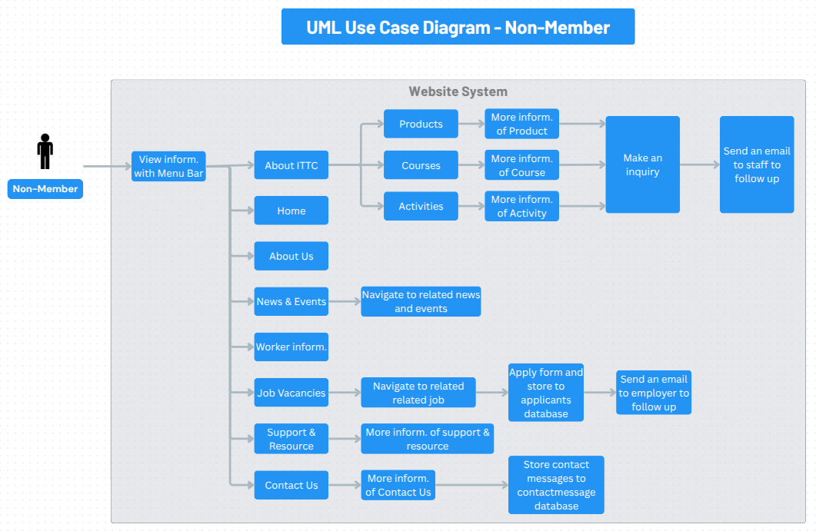
FLOW-CHART (NON-MEMEBER)
ITTC

Slide 4
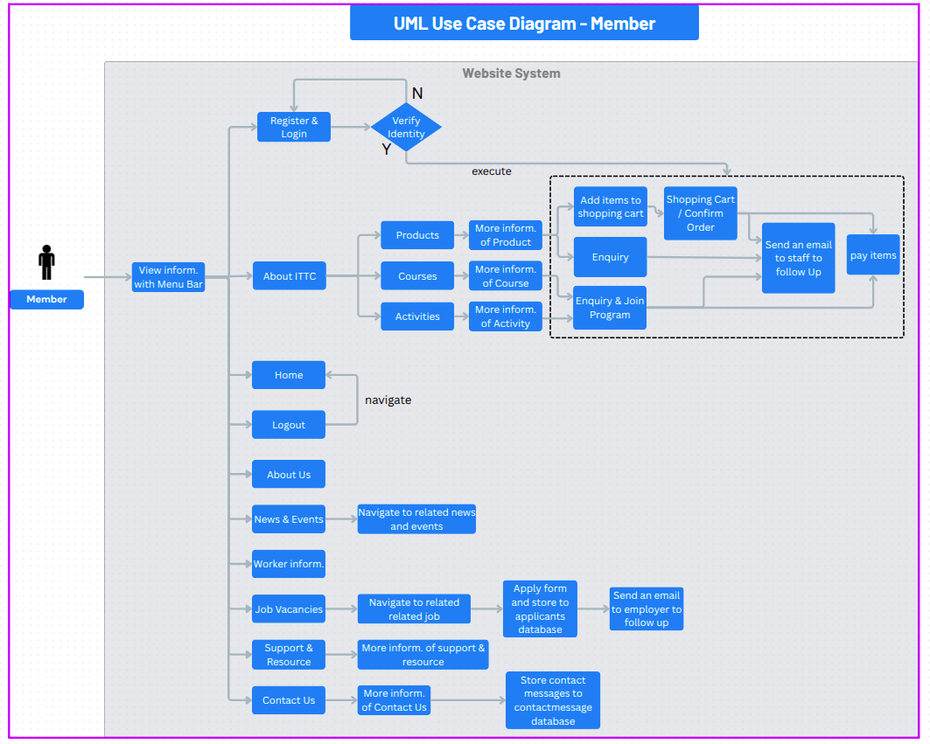
FLOW-CHART (MEMEBER)
ITTC

Slide 5
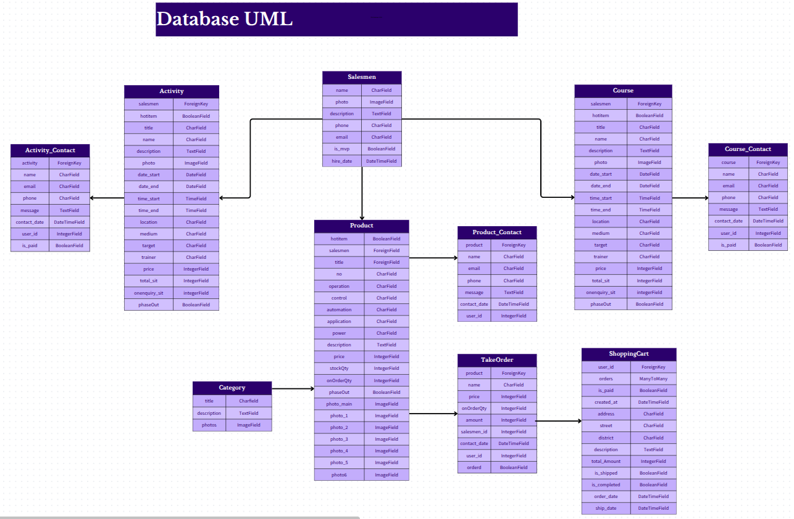
CLASS-DIAGRAM
ITTC

Slide 6
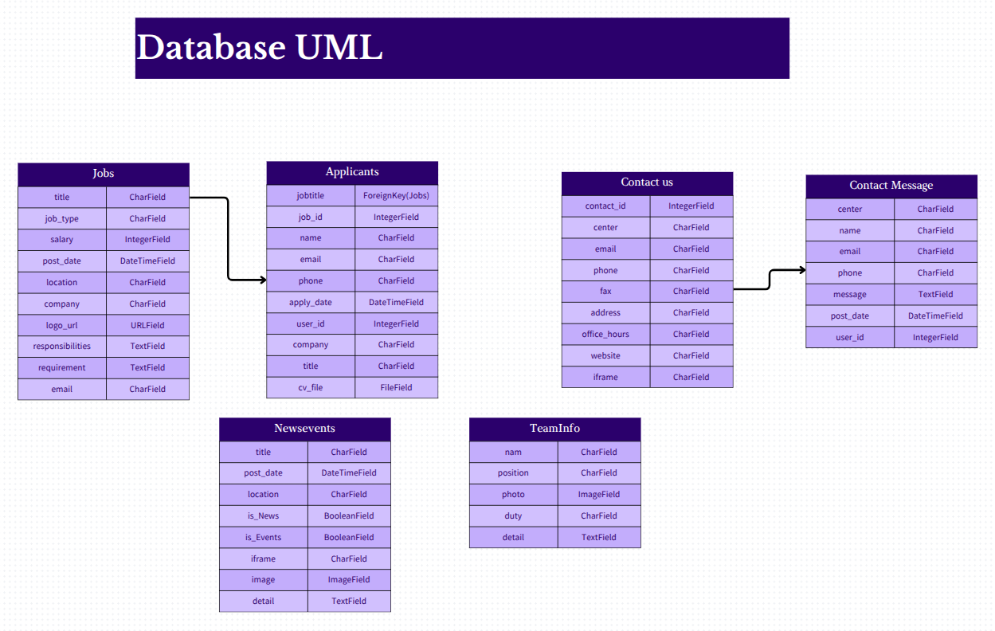
CLASS-DIAGRAM
ITTC

Slide 7
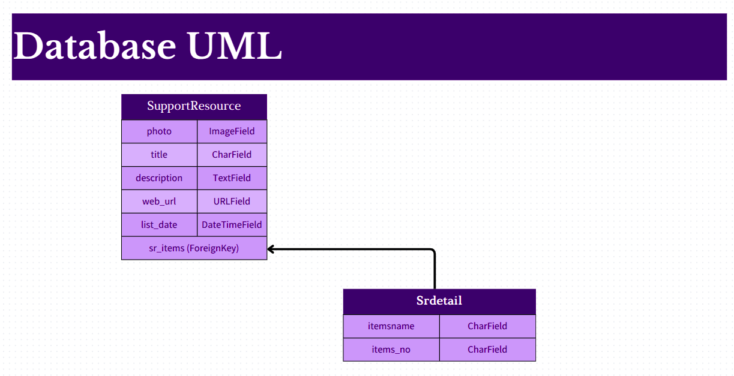
CLASS-DIAGRAM
ITTC

Slide 8
ITTC
Entity Relationship Diagram
JOB VACANCIES
JOBS LISTING
Job Title
Company
Address
Job Type: Full Time, Part Time, Contract, Internship, Temporary
Post Date
Salary
SEARCH BY
Location
Min. Salary
Job Type
Company
Key Word in Responsibilies
Key Word in Requirement
SEARCH BUTTON
Search Result
JOB DETAIL
Job Title
Responsibilities
Requirement
APPLY FORM
Job Title
Name
Email
Phone
CV File Attached
APPLICANTS POST
Job Title
Name
Email
Phone
CV File Attached
APPLICANTS ADD IN DATABASE
Job Title
Name
Email
Phone
CV File Attached
Job Selected
Apply button
Back key
Submit key
Save Request
Save Success & Send Email to Employer

Slide 9
ITTC
CONTACT US
NEWSEVENTS
CONTACT US
Center
Phone
Fax
Email
Office Hour
Web URL
SEARCH BY
Post Date
IS News
Is Event
Keyword in location, detail
CONTACT US FORM
Name
Email
Phone
Message
CONTACT US MESSAGE POST AND ADDED IN DATABASE
Name
Email
Phone
Message
NEWSEVENT
Title
Post Date
Location
SEARCH BUTTON
CONTACT BUTTON
Submit Button
Search Result
Save Success
NEWS EVENT
Titlw
Photo
detail
News Event Selected

Slide 10
ITTC
DEMO

Slide 11
ITTC
SUMMARY
Design the UML before starting the project
Create web pages using Bootstrap
Learned how to use PostgreSQL
Learned how to use python and Django Framework to achieve full-stack applications
Learned how to use git tool to manage group project
Learned how to use AI to solve the problem such as programming bug

Slide 12
ITTC
CHALLENGE
Installing many tools in short time
lack of frontend design knowledges
Database design
Merging program using git

Slide 13
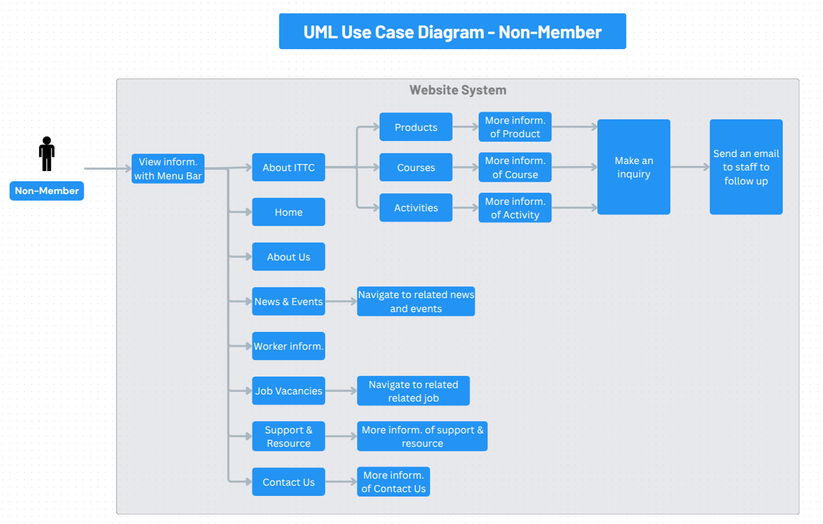
ORIGINAL (NON-MEMBER)
ITTC

Slide 14
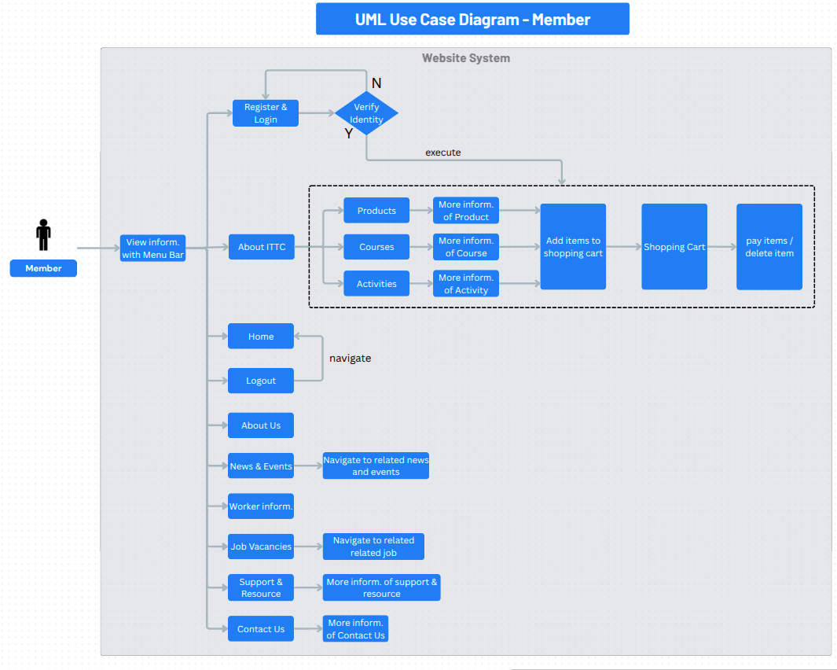
ORIGINAL (MEMBER)
ITTC

Slide 15
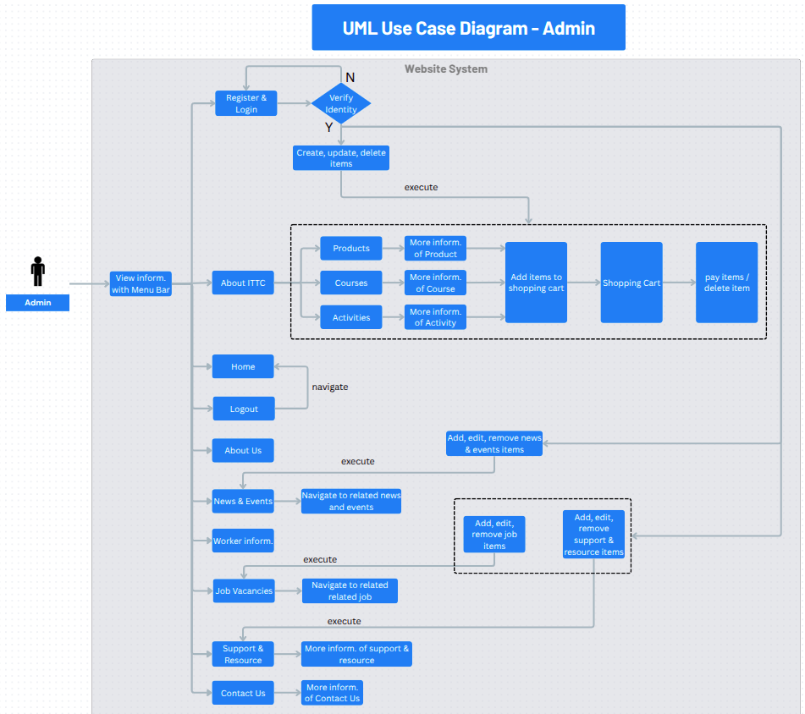
ORIGINAL (ADMIN)
ITTC

Slide 16
ITTC
THANK YOU

