Slide 1
null

Slide 2
Data Analytics and Visualization
of SP500 with Macroeconomics
Midterm Essay
Presented by Nguyen Quang Huy - Nguyen Gia Nhat Khanh
Faculty of Information Technology, Ton Duc Thang University
{nguyenquanghuy.st, 523h0149}@student.tdtu.edu.vn

Slide 3



QR Code
Presentation slide
Implementation
Github Resources

Slide 4
Outline
  Introduction
  Exploratory Data Analysis (EDA)
  Probability Distribution Analysis
  Hypothesis Testing
  Correlation Analysis
  Multiple Linear Regression
  Conclusion

Slide 5
1. Introduction
Objective: Analyze the dataset: EDA → distribution checks → hypothesis testing → correlation analysis → multiple linear regression.
Time-series dataset:
  Daily S&P 500 Index (close, open, high, low, volume) - Yahoo Finance.
  Daily Macroeconomics, asset proxies (CPI, GLD, IEF, VIXY, UUP, USO) - Alpha Vantage.
  Time range: Jan 4, 2011 to Dec12, 2023.
Research question:

Slide 6
2. Exploratory Data Analysis (EDA)
Daily SP500 Index
24367 entries, 1927-12-30 to 2024-12-31.
Date | Open | High | Low | Close | Volume
2024-12-24 | 5984.629883 | 6040.100098 | 5981.439941 | 6040.040039 | 1757720000
2024-12-26 | 6024.970215 | 6049.750000 | 6007.370117 | 6037.589844 | 2904530000
2024-12-27 | 6006.169922 | 6006.169922 | 5932.950195 | 5970.839844 | 3159610000

Slide 7
2. Exploratory Data Analysis (EDA)
Daily Macroeconomics Index & Asset Proxies
Proxies | Description
Consumer Price Index (CPI) | Measures inflation by tracking changes in consumer prices for goods and services.
SPDR Gold Shares (GLD) | Represents the price of gold through the SPDR Gold Shares ETF.
iShares 7–10 Year Treasury Bond (IEF) | Tracks U.S. Treasury bonds with 7–10-year maturities, reflecting long-term interest rates.
United States Oil Fund (USO) | Follows crude oil prices via the United States Oil Fund ETF.
Invesco DB U.S. Dollar Index Bullish Fund (UUP) | Reflects the strength of the U.S. dollar against major currencies through the Dollar Index ETF.
ProShares VIX Short-Term Futures (VIXY) | Represents market volatility based on short-term VIX futures, often called the “fear index.”

Slide 8
2. Exploratory Data Analysis (EDA)
Daily Macroeconomics Index & Asset Proxies
6000 entries, 2000-24-30 to 2024-12-31.
Date | Open | High | Low | Close | Volume
2024-12-24 | 5984.629883 | 6040.100098 | 5981.439941 | 6040.040039 | 1757720000
2024-12-26 | 6024.970215 | 6049.750000 | 6007.370117 | 6037.589844 | 2904530000
2024-12-27 | 6006.169922 | 6006.169922 | 5932.950195 | 5970.839844 | 3159610000

Slide 9
2. Exploratory Data Analysis (EDA)
Dataset Merging
                24367 entries, 11 features.
                Duplicate rows: 3856.
                Zero value: 5497 (Volume).
                Null value:
Macroeconomics & Asset Proxies
SP500
CPI: 20811 | USO: 19653
GLD: 19304 | UUP: 19876
IEF: 18720 | VIXY: 20846

Slide 10
2. Exploratory Data Analysis (EDA)
Data Preprocessing
3257 entries, 11 features.
Duplicate rows: 0.
Zero value: 0.
Null value: 0.
Crop from the first valid rows
Not valid
Not valid
Not valid
01/01/1927
02/01/1927
01/01/1927
...
01/01/2020
...
01/01/2025
Valid

Slide 11
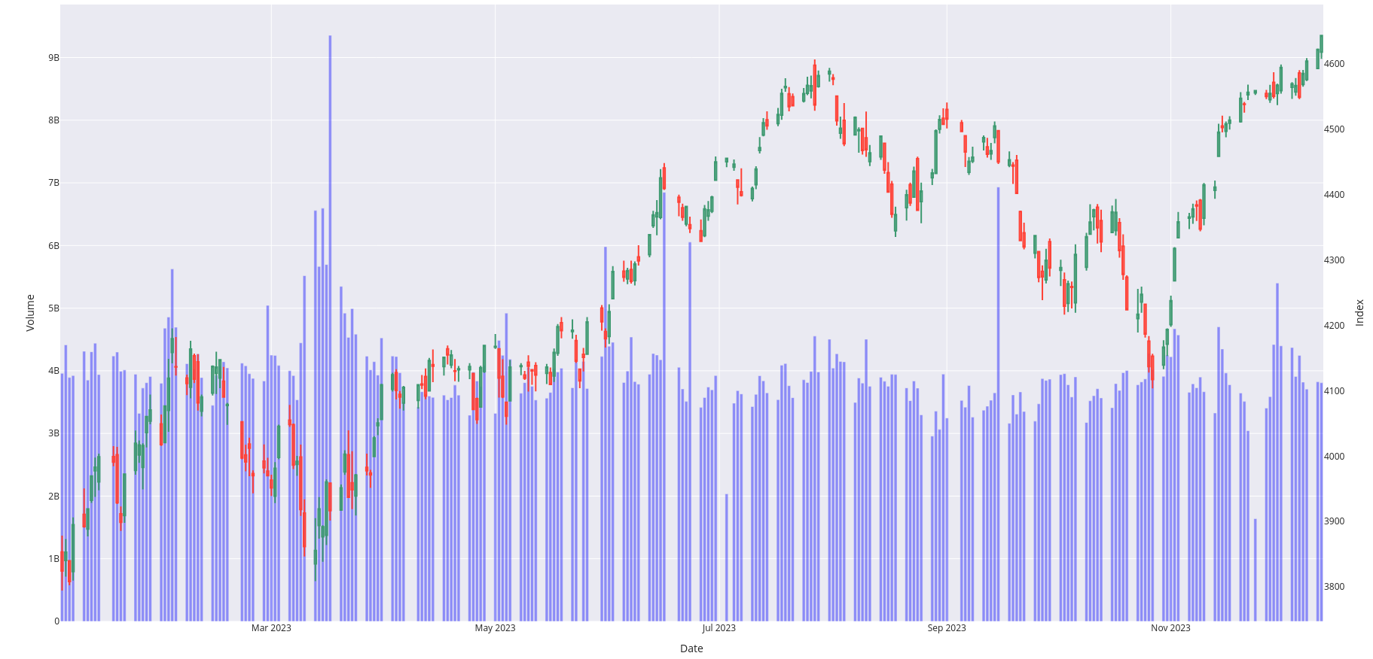
2. Exploratory Data Analysis (EDA)
Visualization (CandleStick) SP500 Index

Slide 12
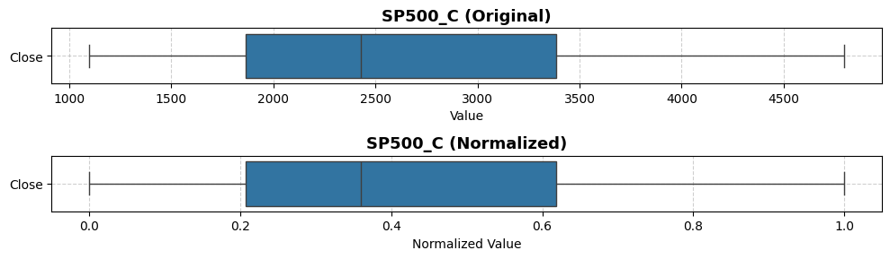
2. Exploratory Data Analysis (EDA)
Visualization (Boxplot) Close Index

Slide 13
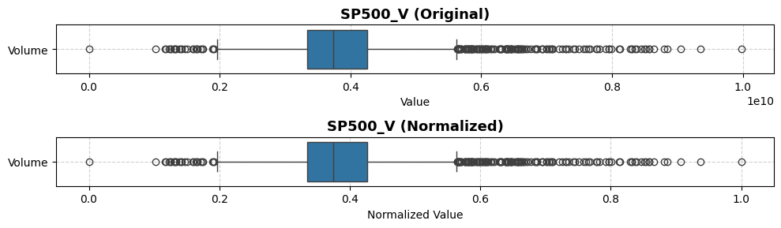
2. Exploratory Data Analysis (EDA)
Visualization (Boxplot) Trading Volume

Slide 14
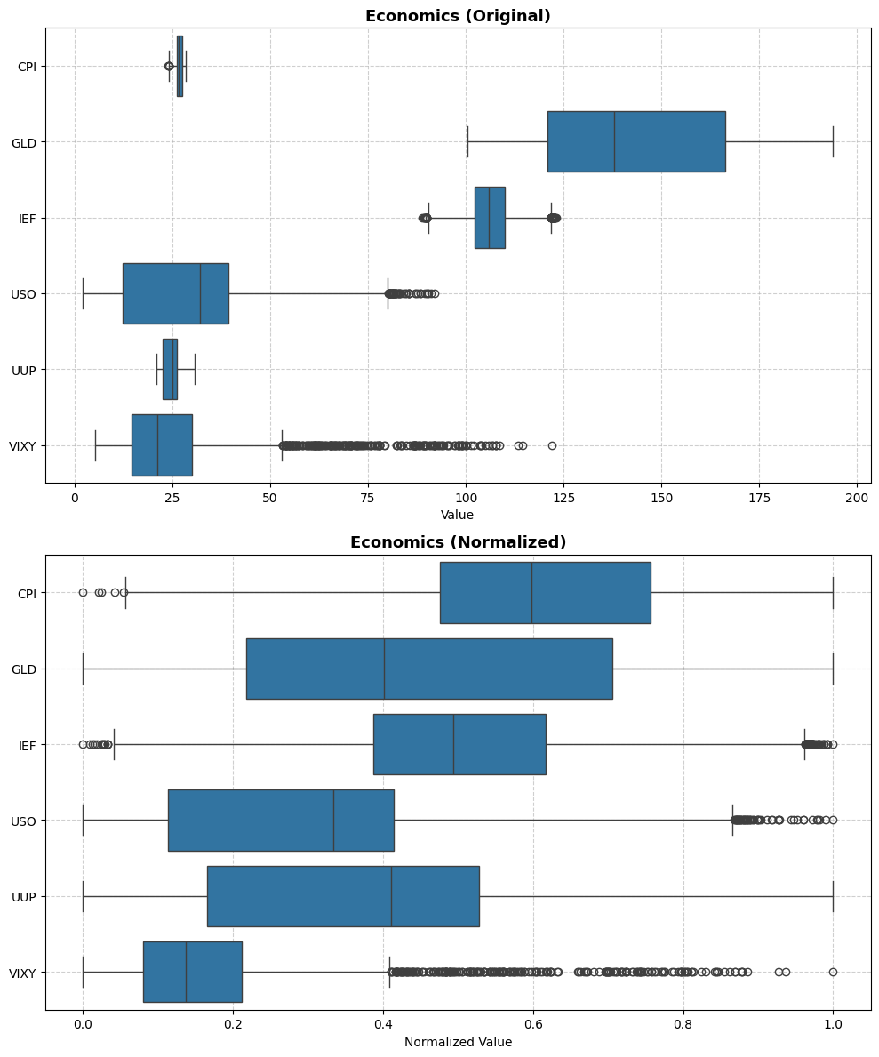
2. Exploratory Data Analysis (EDA)
Visualization (Boxplot) Macroeconomics

Slide 15
2. Exploratory Data Analysis (EDA)
Visualization (Boxplot) Macroeconomics

Slide 16
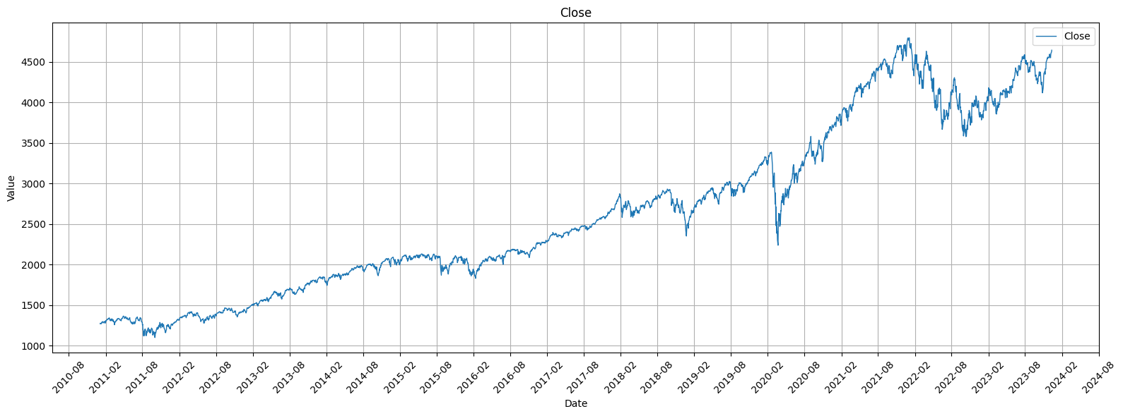
2. Exploratory Data Analysis (EDA)
Visualization (Line Chart) Close Index

Slide 17
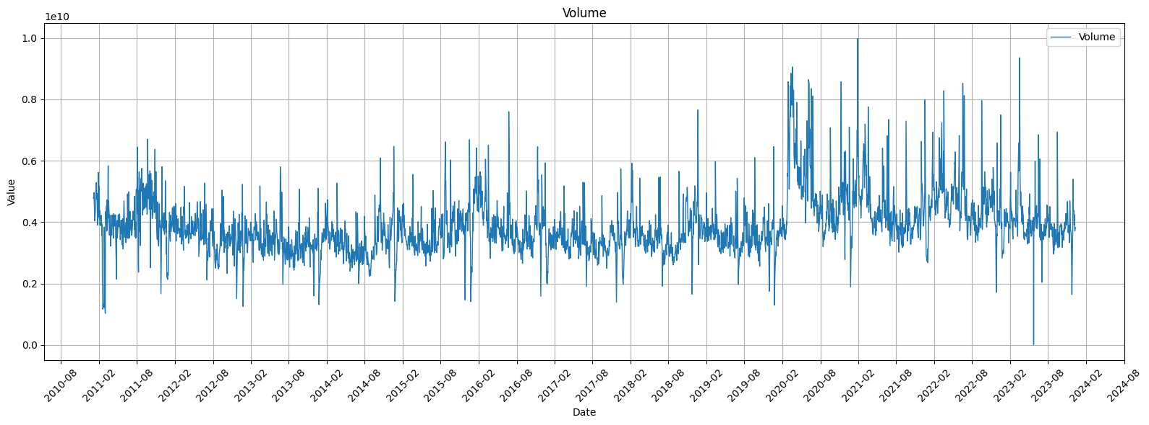
2. Exploratory Data Analysis (EDA)
Visualization (Line Chart) Close Index

Slide 18
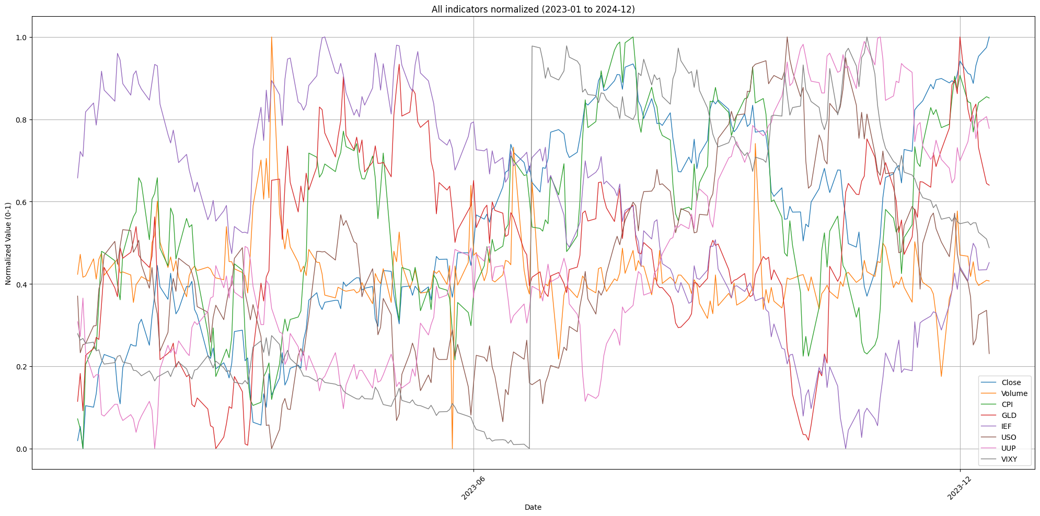
2. Exploratory Data Analysis (EDA)
Visualization (Line Chart) Close Index

Slide 19
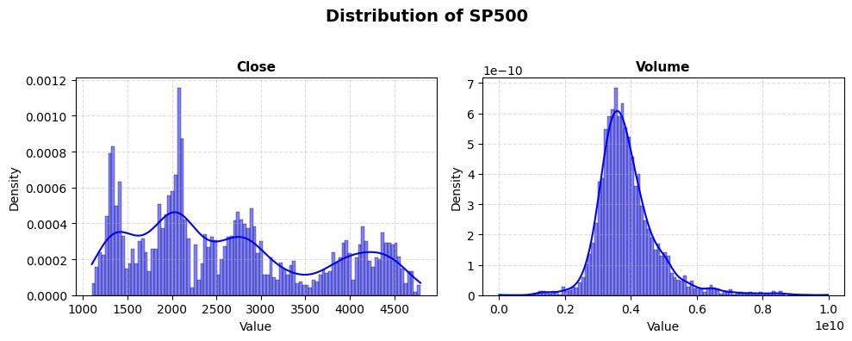
2. Exploratory Data Analysis (EDA)
Visualization (Histogram) Close Index & Trading Volume

Slide 20
2. Exploratory Data Analysis (EDA)
Anomaly Detection
1. Z-score: Identifies outliers by measuring how many standard deviations a point is from the mean.
2. IQR: Detects outliers as values falling below Q1 − 1.5×IQR or above Q3 + 1.5×IQR.
3. Rolling Z-score: Applies Z-score on a moving window to find outliers in time series data.
4. Seasonal Decomposition Residuals: Flags outliers as large deviations in the residual component after decomposing trend and seasonality.
5. Isolation Forest: Uses an ensemble of random trees to isolate anomalies that require fewer splits to separate.

Slide 21
2. Exploratory Data Analysis (EDA)
Anomaly Detection
Date | 2020-03-26 | 2020-03-26 | 2020-03-26 | 2020-03-26
z_close | True | True | False | False
iqr_close | False | False | True | False
decomp_close | False | True | False | False
arima_close | False | False | False | False
iso_multivariate | False | True | True | False
rolling_close | False | False | True | False
any_outlier | True | True | True | False
n_methods_flagged | 1 | 3 | 3 | 0

Slide 22
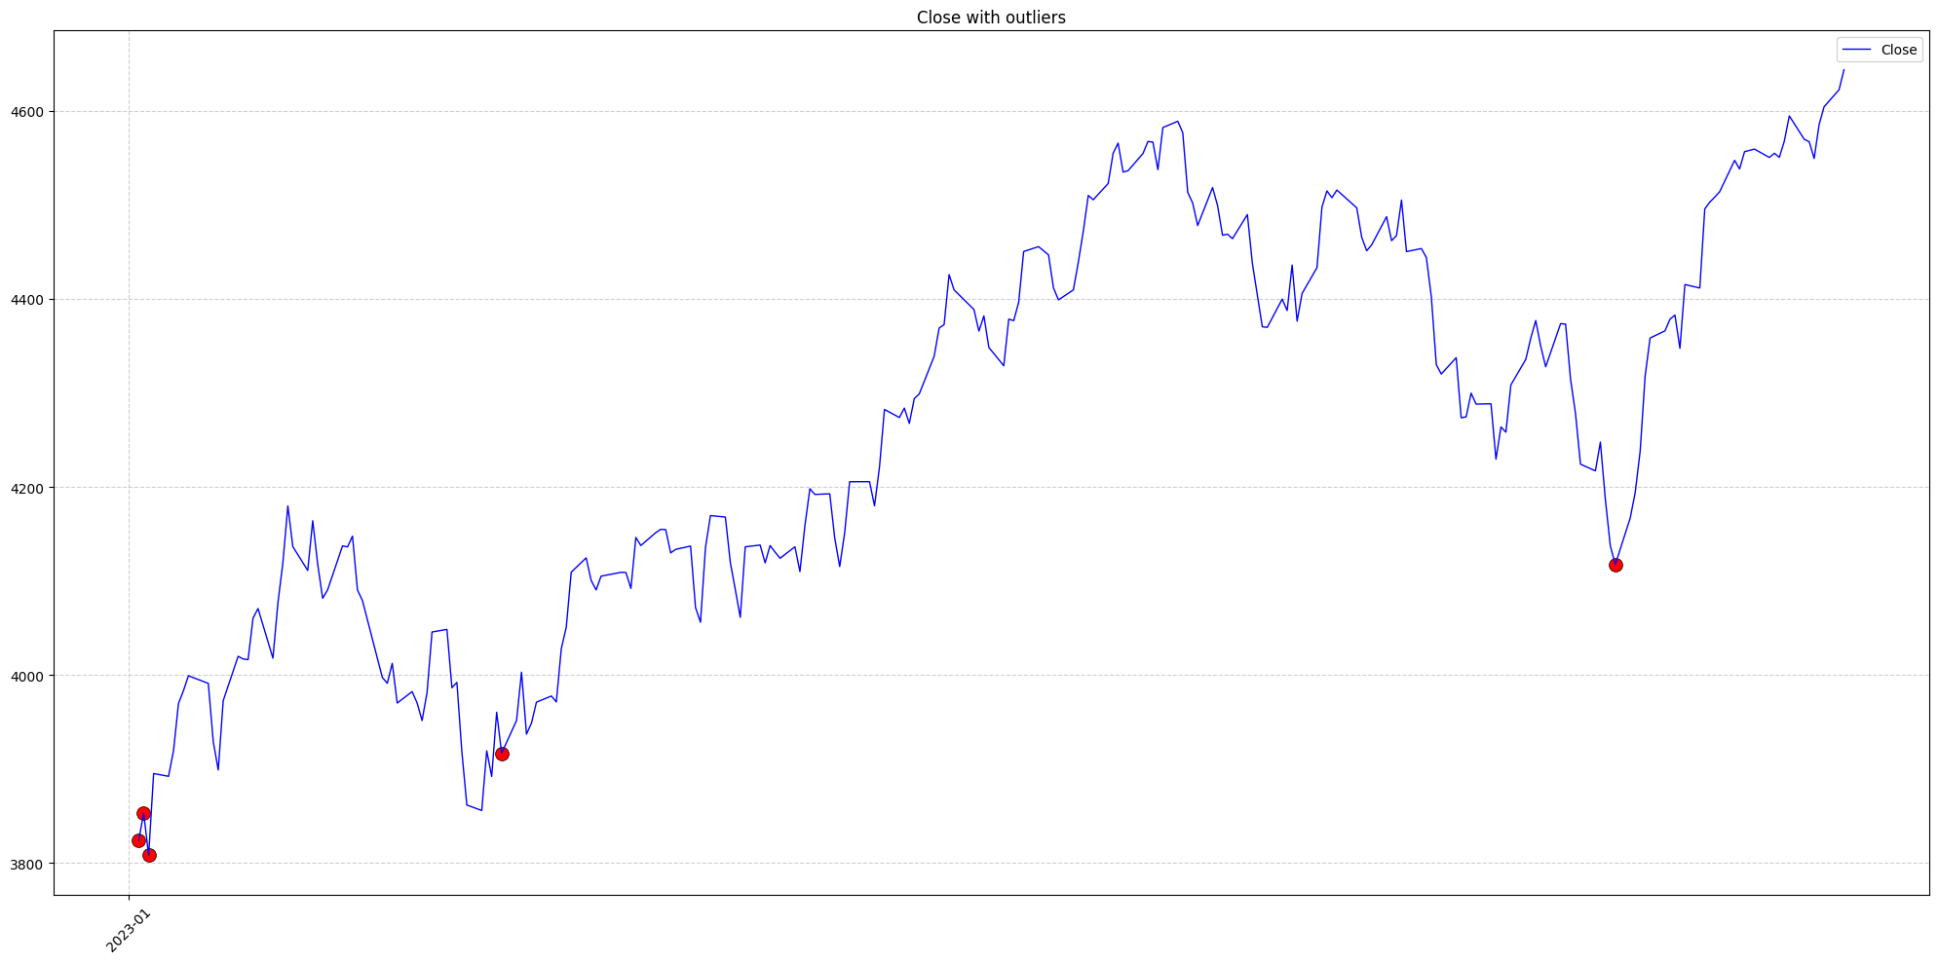
2. Exploratory Data Analysis (EDA)
Anomaly Detection

Slide 23
3. Proability Distribution Analysis
Close Index & Trading Volume

Slide 24
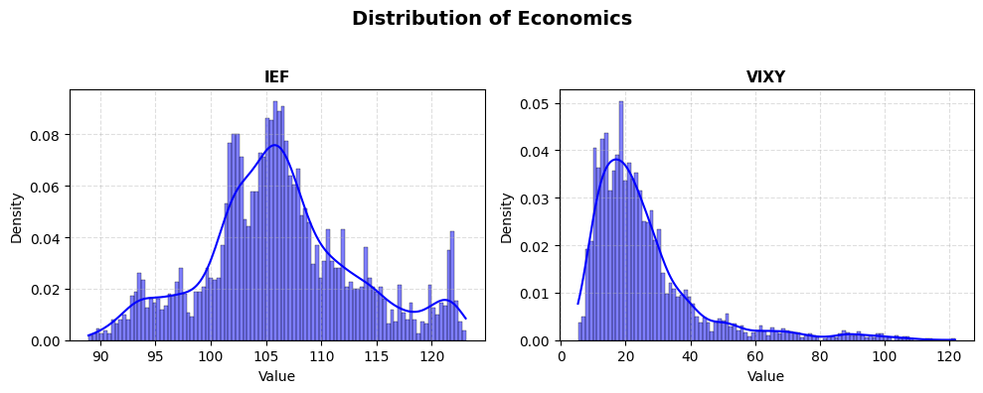
3. Proability Distribution Analysis
IEF & VIXY

Slide 25
3. Proability Distribution Analysis
Normality Test and Distribution Fit
Shapiro-Wilk: Specifically designed to test normality. It evaluates how well the data’s order statistics fit a normal distribution.
Kolmogorov-Smirnow: A general goodness-of-fit test comparing the empirical CDF (cumulative distribution function) of the data to a reference distribution
Index | Variable | Shapiro | KS | Distribution
0 | Close | 2.046193e-06 | 3.566853e-02 | Non-normal
1 | Volume | 2.518490e-18 | 1.548785e-06 | Non-normal
2 | IEF | 7.141461e-07 | 5.485859e-02 | Non-normal
3 | VIXY | 2.117785e-14 | 1.984101e-10 | Non-normal

Slide 26
4. Hypothesis Testing
T-test: Is there a significant difference in trading volume between periods of low volatility and high volatility in the stock market?
Null hypothesis: The mean trading volume during low-volatility and high-volatility periods are equal.
Alternative hypothesis: The mean trading volumes differ between the two periods.
The dataset was divided into two groups based on the median of VIXY:
Low-volatility period: VIXY < median(VIXY)
High-volatility period: VIXY ≥ median(VIXY)

Slide 27
4. Hypothesis Testing
T-test: Result
t-statistic: 2.325
p-value: 0.02012
Answer: There is a statistically significant difference in trading volume between low- and high-volatility periods

Slide 28
4. Hypothesis Testing
ANOVA test: Is there a significant difference in the S&P 500 closing price (Close) among different economic periods?
Null hypothesis: The mean closing prices are the same across all economic periods.
Alternative hypothesis: At least one period has a different mean closing price.
The data was divided into three economic phases:
Before COVID-19: 2011–2019
During COVID-19: 2020–2021
After COVID-19: 2022–2023

Slide 29
4. Hypothesis Testing
ANOVA test: Result
f-statistic: 4588.007
p-value: 0.0000
Answer: Therefore, there are significant differences in the mean closing price among three economic periods.

Slide 30
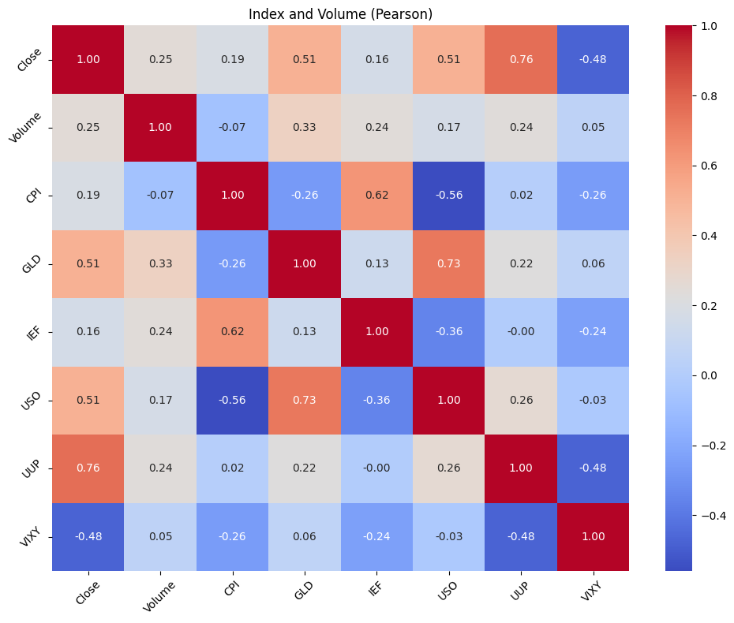
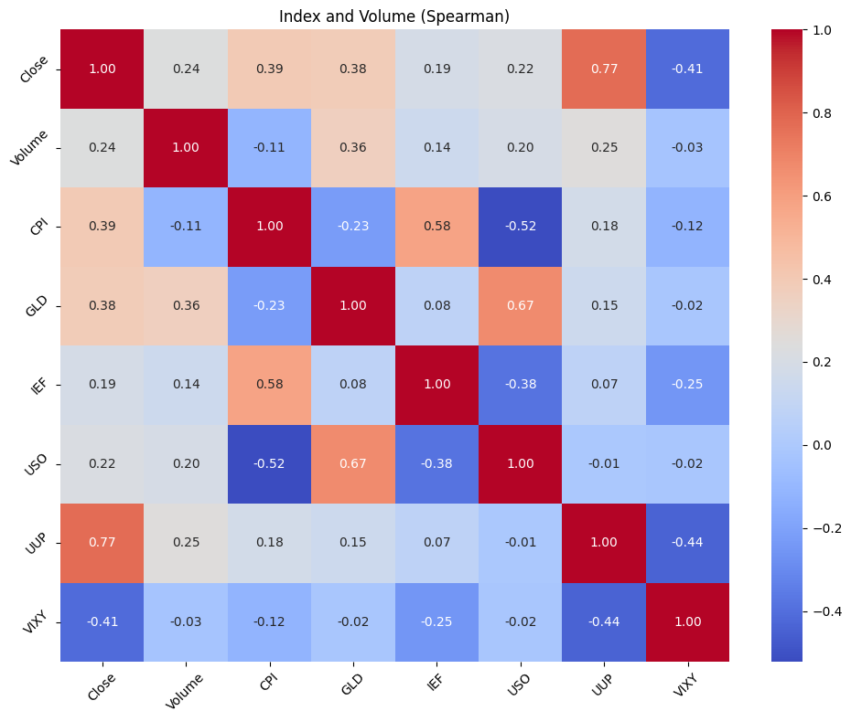
5. Correlation Analysis

Slide 31
6. Multiple Linear Regression
Model Implementation
Target (y): Close
Predictors (X): Open, High, Low, Volume, CPI, GLD, IEF, USO, UUP, VIXY, Close_lag1, Close_lag2, Close_lag3
The model was trained using Linear Regression with a time-based train-test split (80%-20%).

Slide 32
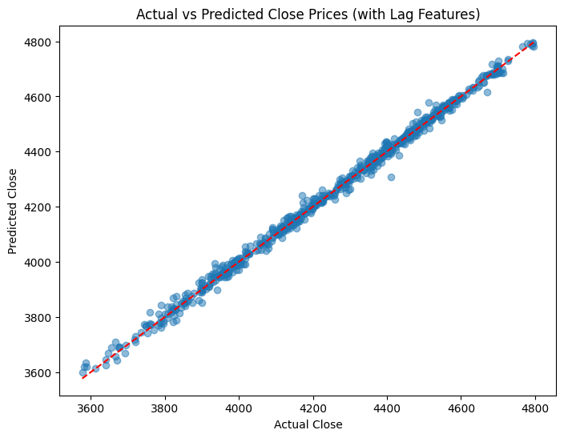
6. Multiple Linear Regression
Model Evaluation
R2: 0.9962
RMSE: 16.9717

