Slide 1
Data Analytics and Visualization
MIDTERM ESSAY
SP500 Index with Macroeconomics 2011 - 2023
Presented by Nguyen Quang Huy - Nguyen Gia Nhat Khanh
Faculty of Information Technology, Ton Duc Thang University
Email: {523h0140, 523h0149}@student.tdtu.edu.vn

Slide 2



QR Code
Presentation slide
Implementation
Github Resources

Slide 3
Outline
  Introduction
  Exploratory Data Analysis (EDA)
  Probability Distribution Analysis
  Hypothesis Testing
  Correlation Analysis
  Multiple Linear Regression
  Conclusion

Slide 4
1. Introduction
Analyze the S&P 500 Index by applying a structured data analysis approach, using a time series dataset combining the S&P 500 Index with macroeconomic indicators (CPI, GLD, IEF, VIXY, UUP, USO) from January 4, 2011 to December 12, 2023.

Slide 5
  2. Exploratory Data Analysis (EDA)
SP500 Daily index:
From 1927 to 2024 with 24367 record of 5 variables
Variable | Description
Open | Opening price of the index on a given trading day
High | Highest price of the index during the trading day
Low | Lowest price of the index during the trading day
Close | Closing price of the index at the end of the trading day
Volume | The total number of shares traded for the index constituents on that day

Slide 6
  2. Exploratory Data Analysis (EDA)
Macroeconomics Daily index:
From 2000 to 2024 with 6000 record of 6 variables
Variable | Description
VIXY | CBOE Volatility Index, representing expected market volatility
IEF | U.S. 10-Year Treasury Yield, reflecting long-term interest rate expectations
UUP | Measuring the value of the U.S. dollar against a basket of major currencies
USO | Crude oil price per barrel
GLD | Gold spot price per ounce, representing a key safe-haven asset
CPI | U.S. Consumer Price Index, representing inflation levels

Slide 7
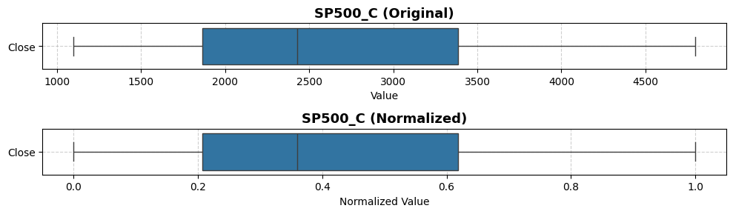
  2. Exploratory Data Analysis (EDA)
Close Index

Slide 8
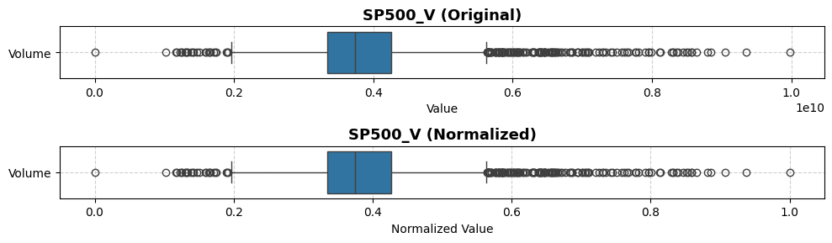
  2. Exploratory Data Analysis (EDA)
Trading Volume

Slide 9
  2. Exploratory Data Analysis (EDA)
Trading Volume

Slide 10
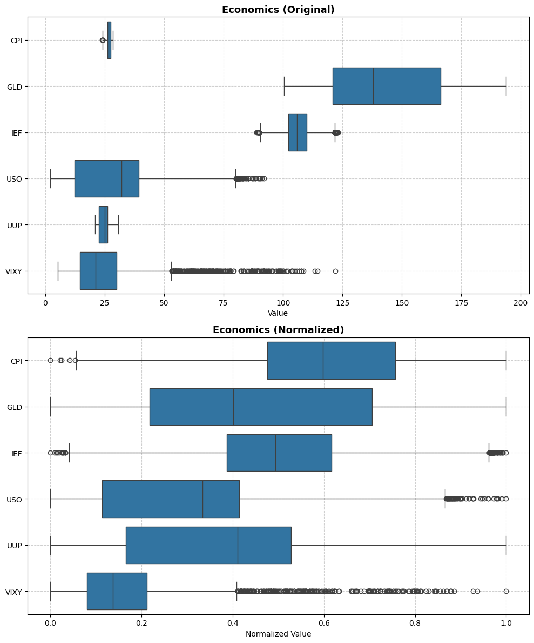
  2. Exploratory Data Analysis (EDA)
Macro economics

Slide 11
  2. Exploratory Data Analysis (EDA)
Macro economics (Normalized)

Slide 12
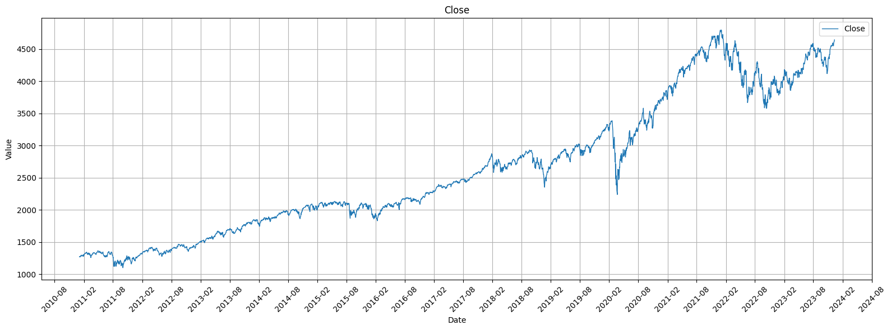
  2. Exploratory Data Analysis (EDA)
Line Chart (Close Index)

Slide 13
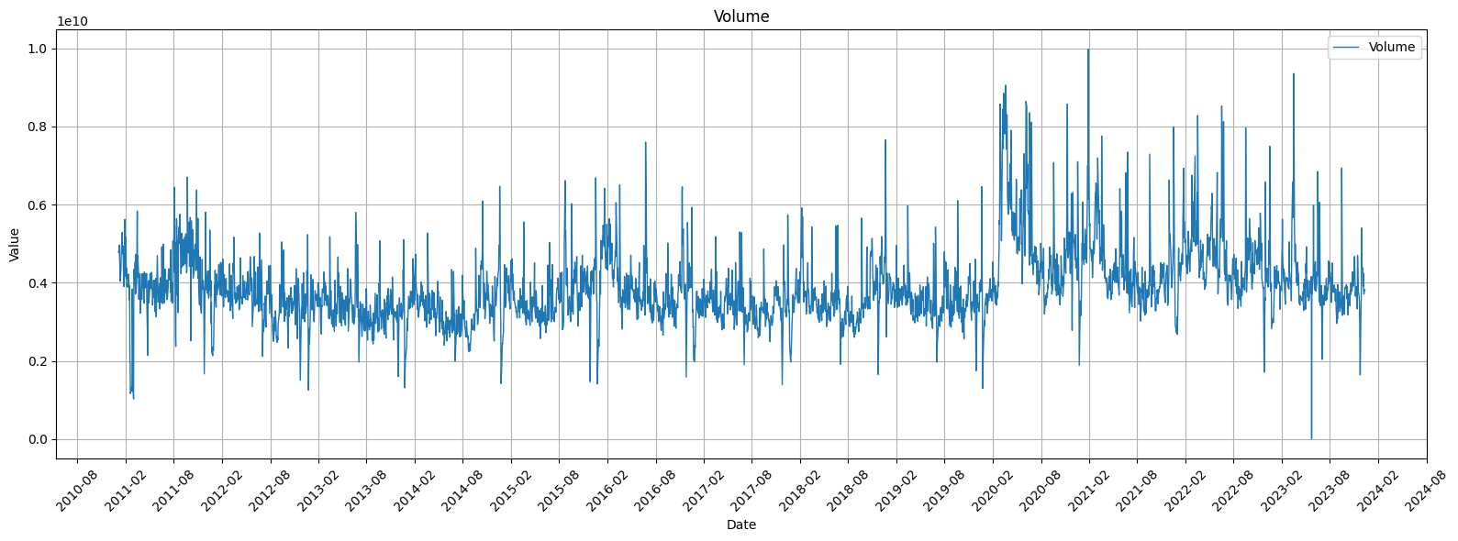
  2. Exploratory Data Analysis (EDA)
Line Chart (Trading Volume)

Slide 14
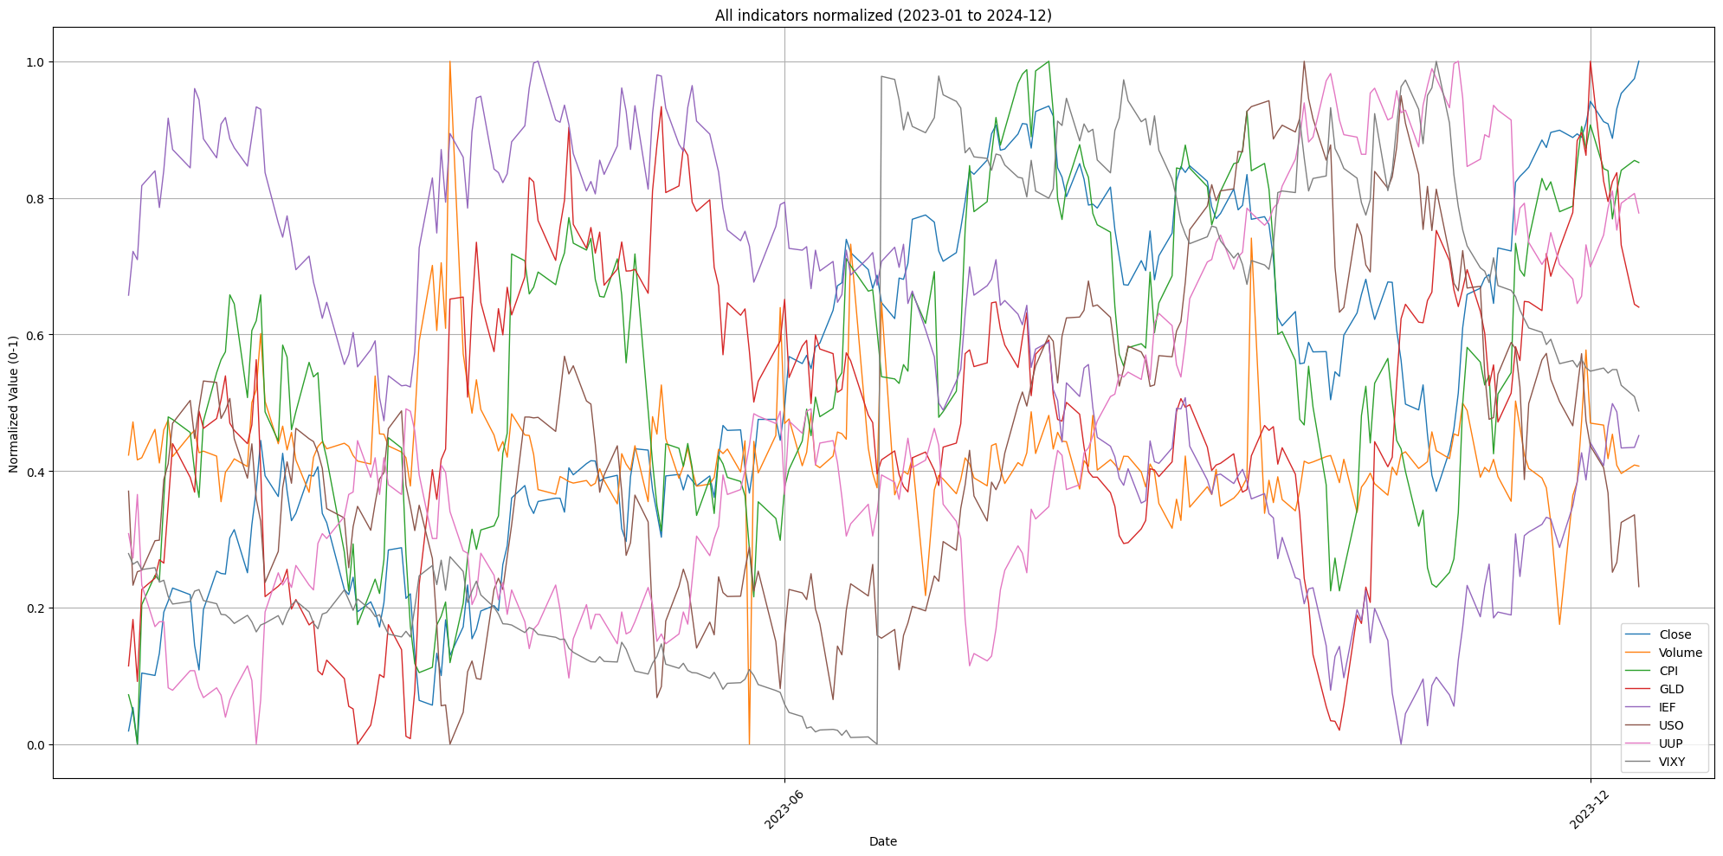
  2. Exploratory Data Analysis (EDA)
Line Chart (Combined)

Slide 15
  2. Exploratory Data Analysis (EDA)
Outlier Detection
1. Z-score: Identifies outliers by measuring how many standard deviations a point is from the mean.
2. IQR: Detects outliers as values falling below Q1 − 1.5×IQR or above Q3 + 1.5×IQR.
3. Rolling Z-score: Applies Z-score on a moving window to find outliers in time series data.
4. Seasonal Decomposition Residuals: Flags outliers as large deviations in the residual component after decomposing trend and seasonality.
5. Isolation Forest: Uses an ensemble of random trees to isolate anomalies that require fewer splits to separate.

Slide 16
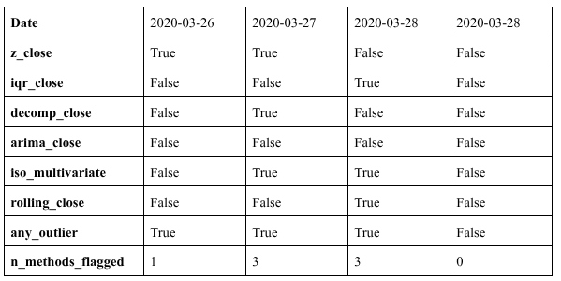
  2. Exploratory Data Analysis (EDA)
Outlier Detection

Slide 17
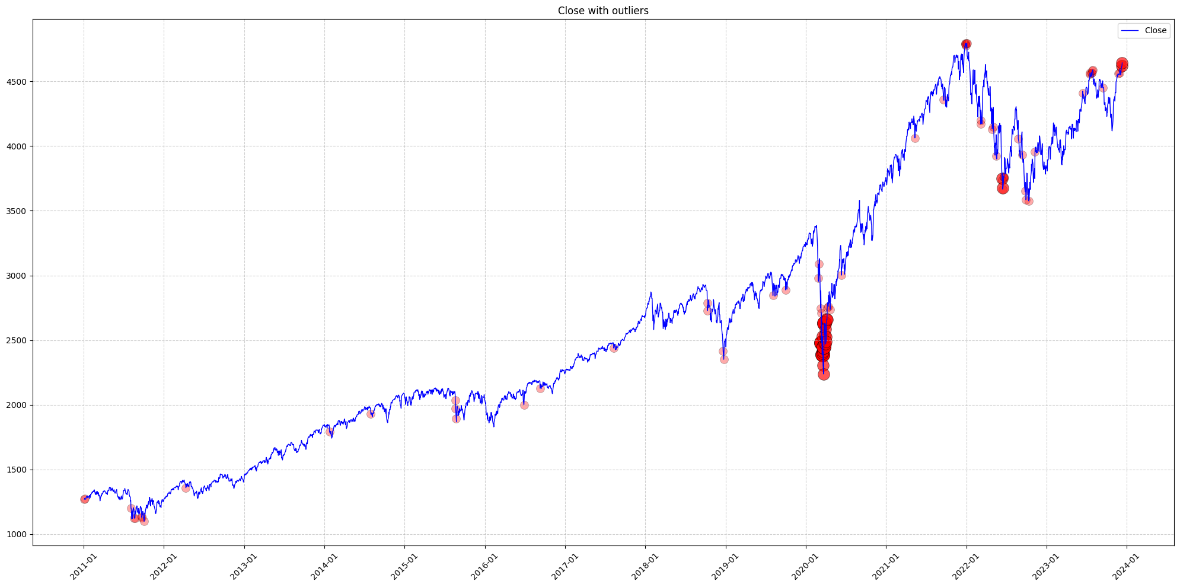
  2. Exploratory Data Analysis (EDA)
Outlier Detection

Slide 18
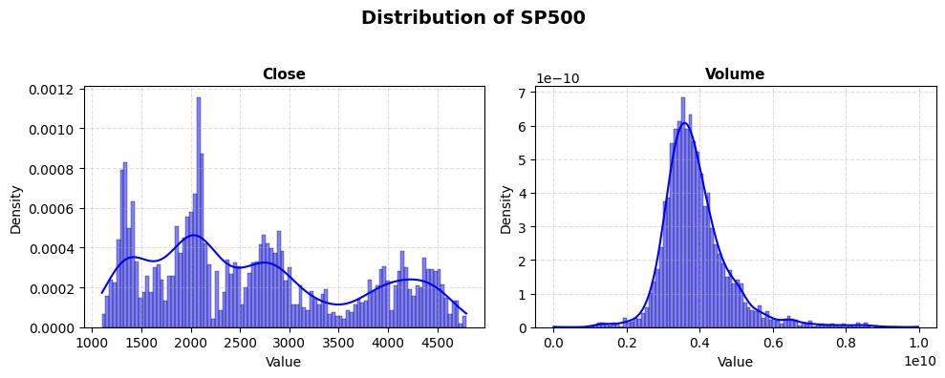
  3. Probability Distribution Analysis
Close Index and Trading Volume

Slide 19
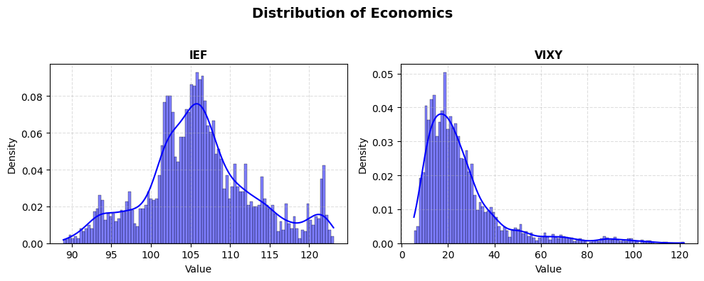
  3. Probability Distribution Analysis
VIXY and IEF

Slide 20
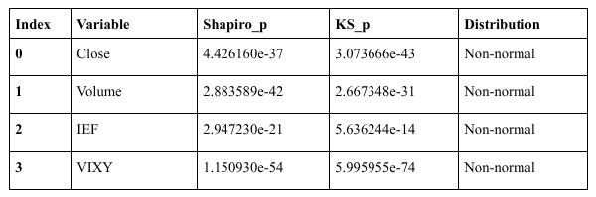
  3. Probability Distribution Analysis
Normality Test and Distribution Fit
Apply Shapiro-Wilk and Kolmogorov-Smirnow test

Slide 21
  4. Hypothesis Testing
T-test
Is there a significant difference in trading volume between periods of low volatility and high volatility in the stock market?
Null hypothesis: The mean trading volume during low-volatility and high-volatility periods are equal.
Alternative hypothesis: The mean trading volumes differ between the two periods.

Slide 22
  4. Hypothesis Testing
T-test
The dataset was divided into two groups based on the median of VIXY:
Low-volatility period: VIXY < median(VIXY)
High-volatility period: VIXY ≥ median(VIXY)
Answer: There is a statistically significant difference in trading volume between low- and high-volatility periods
Statistics | Value
t-staitstics | 2.325
p-value | 0.02012

Slide 23
  4. Hypothesis Testing
ANOVA test
Is there a significant difference in the S&P 500 closing price (Close) among different economic periods?
Null hypothesis: The mean closing prices are the same across all economic periods.
Alternative hypothesis: At least one period has a different mean closing price.
The data was divided into three economic phases:
Before COVID-19: 2011–2019
During COVID-19: 2020–2021
After COVID-19: 2022–2023

Slide 24
  4. Hypothesis Testing
ANOVA test
Answer: Therefore, there are significant differences in the mean closing price among three economic periods.
Statistics | Value
f-staitstics | 2.325
p-value | 0.02012

Slide 25
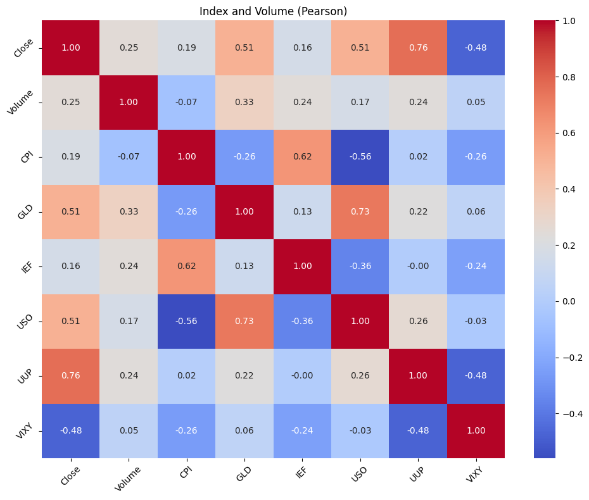
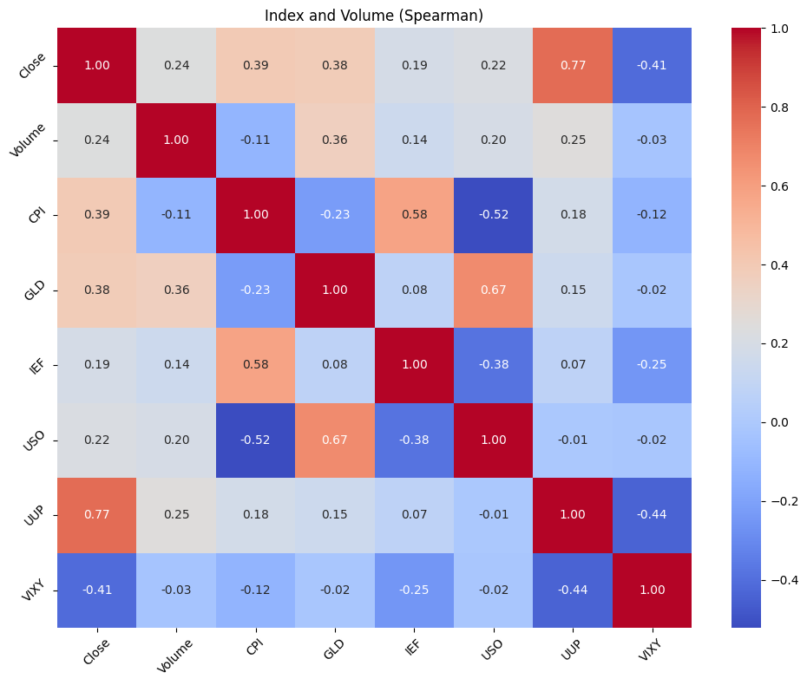
  5. Correlation Analysis
Pearson
Spearman

Slide 26
  6. Multiple Linear Regression
Model Implementation
Target (y): Close
Predictors (X): Open, High, Low, Volume, CPI, GLD, IEF, USO, UUP, VIXY, Close_lag1, Close_lag2, Close_lag3
The model was trained using Linear Regression with a time-based train-test split (80%-20%).

Slide 27
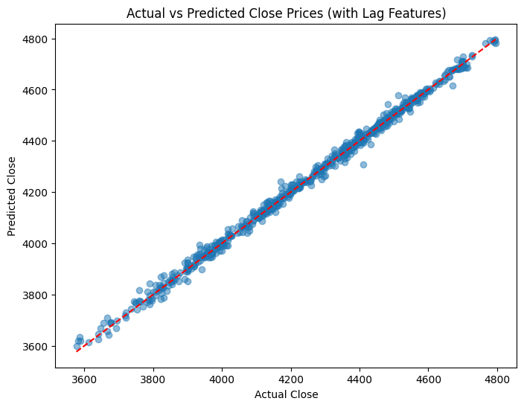
  6. Multiple Linear Regression
Model Evaluation
Metric | Value
R^2 | 0.9962
RMSE | 16.9717

Slide 28
References

