Slide 1
Automation Handbook
RPA DEVELOPMENT APPROACH

Slide 2


INFRASTRUCTURE

Slide 3






Six stages of an RPA project
ENABLE
DRIVE
DESIGN
BUILD
TEST
SUSTAIN
SET UP INFRASTRUCTURE
Designing server architecture
Installation and configuration
Providing dev & test environments
PROJECT GOVERNANCE
Agree to the project development approach
Review the RPA best practices
DESIGNING WORKFLOWS
Fill in the Process Design Document for each automated workflow
Create test cases and test data
DEVELOPING WORKFLOWS
Creating the deliverables
Creating the Design Solution Document
QUALITY ASSURANCE
Executing the test cases
Reporting the results
Go/No Go decision
HYPERCARE PERIOD
Workflow support
Changes and Improvements

Slide 4












UiPath high level architecture
The UiPath Orchestrator manages robots specifically developed for customer front and back office processes
ATTENDED ROBOTS
UNATTENDED ROBOTS
1. Attended Robot: delivers low costs and higher performance with front office agent- supporting automation features.
2. Unattended Robot: these robots utilize unattended automation to run high back office transaction volumes in batch mode.
3. UiPath Orchestrator: Enterprise architecture server platform supporting: release management, centralized logging, reporting, auditing and monitoring tools, remote control, centralized scheduling, queue/robot workload management.
Assets management.
4. UiPath Studio: enables users to automate with highly intuitive tools (not code): process recorders; drag & drop widgets & best practices templates.
Monitor Execute
3rd Party App
API
Deploy
Deploy
ORCHESTRATOR
STUDIO DESIGNER
STUDIO DESIGNER
Automate
</Mainframe>
Automate
</Web>
</Citrix>
</SAP>
</Desktop apps>
All our product’s components can run on both physical or virtual machines
All our products and features reside within a platform architecture designed to provide strong security, enterprise grade compliance & robust governance.
Notes:
UiPath Orchestrator is a browser-based server application that enables you to manage robots and processes. By using the server web console you can deploy, start, stop, and schedule processes and monitor their execution by the robots. UiPath Orchestrator facilitates both human-robot collaboration and business exception handling by using centralized work queue. In front office automation scenarios, the Orchestrator acts as a central repository for processes. It manages version control and aggregates robot logs. It also provides monitoring, reporting, and security capabilities. From its browser-based dashboard, dozens – or hundreds – of software robots can be deployed and monitored. In back office automation scenarios, the Orchestrator is an industry standard platform capable of queuing large volumes of transactions. It orchestrates and deploys dozens - or hundreds - of software robots in a synchronized, scheduled fashion to complete the work with remarkable speed.

Slide 5
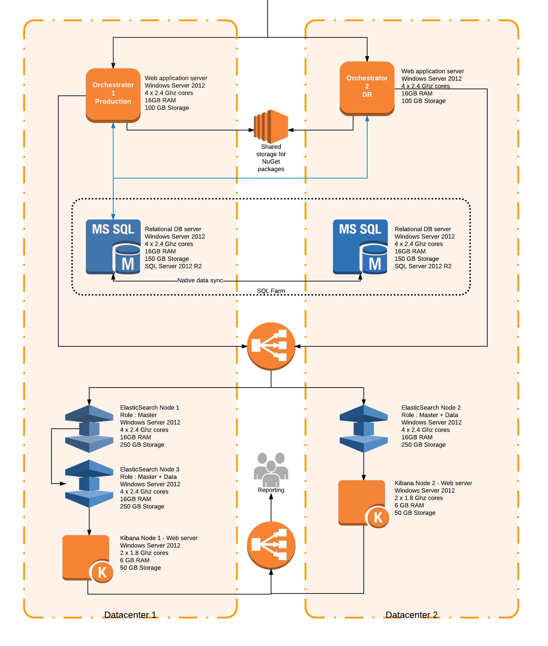
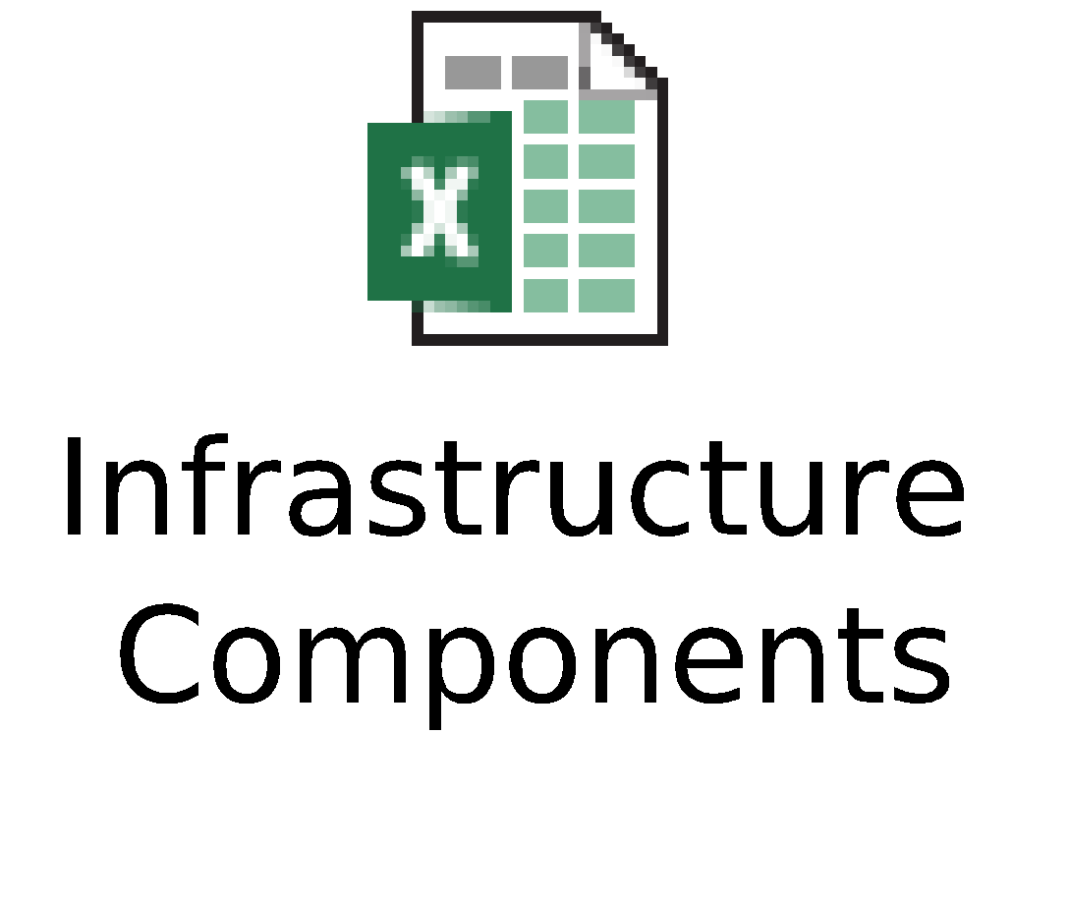
Typical architecture for disaster recovery
PROPOSAL
The proposed architecture adheres to the high standards of the organization for a Mission Critical application.
The architecture layout that is according to the enterprise redundancy requirements, being based on two independent data centres.
The test environments is an 1:1 clone of the Production environment and can be used to replace Prod in critical situations.
The Development environment will have limited capabilities and will only be used for the developers, not for end-to-end testing.
Detailed components:

Slide 6
PROJECT GOVERNANCE

Slide 7







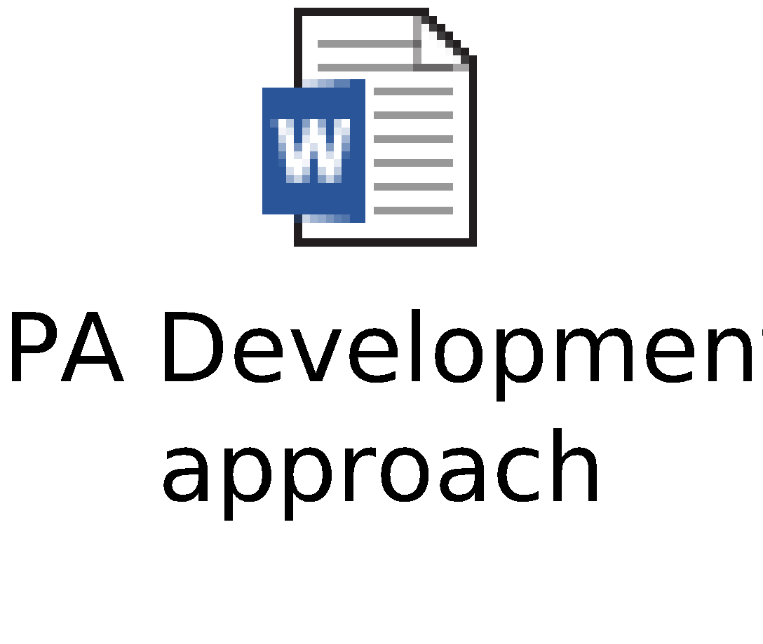
RPA Development approach
DEVELOPMENT MANAGEMENT
The development strategy is a mix between Agile and Waterfall methodologies, fine tuned for the specifics of RPA development.
The project phases will remain linear, nevertheless, we aim to preserve the benefits of an Agile approach.
DEVELOPER COLLABORATION
Choose the developer collaboration method within the RPA team.
Multiple technologies are supported, including TFS and SVN, which are natively integrated with UiPath Studio.
ENVIRONMENT SETUP
Decide on the split between the different robotic environments. The advantages offered by the different methods need to be weighted per each project.
ROBOT AUTHENTICATION
Decide between using one generic account, multiple technical accounts and user accounts for the robots. Analyze the benefits of each approach for the automated applications.
REUSABLE COMPONENTS
Pick a strategy for reusing and distributing the developed components. Save time and effort by defining the reusability of components cross-department or cross-company.
STORING CREDENTIALS
Select the best way of storing the credentials used for robot logging-in.
Pick a centralized or local strategy based on the specifics of the automated process.
NAMING STRATEGY
Adhere to the naming strategy standards suggested by our developers. Include internal best practices for consequent and reliable development.
GUIDE

Slide 8



Reusable components approach
SHARED COMPONENTS PACKAGE
FILE STORAGE
CUSTOM PACKAGING METHOD
Create one package containing shared components and distribute it using the Orchestrator embedded provisioning mechanism (RECOMMENDED)
PROS:
Out of the box solution
Guaranteed to work even without network connection (no downtime)
CONS:
More complex to implement than file storage solution
Use a file share location to store the reusable components and remotely invoke them
PROS:
Easiest to implement
CONS:
In case of network failure the robots will not be able to run
The robots can run slower due to network latency
Use a third party solution to create packages provisioning also the reusable components.
PROS:
An alternative to Shared Components approach
CONS:
Most complex approach, hardest to implement and maintain
Dependent on third party components

Slide 9
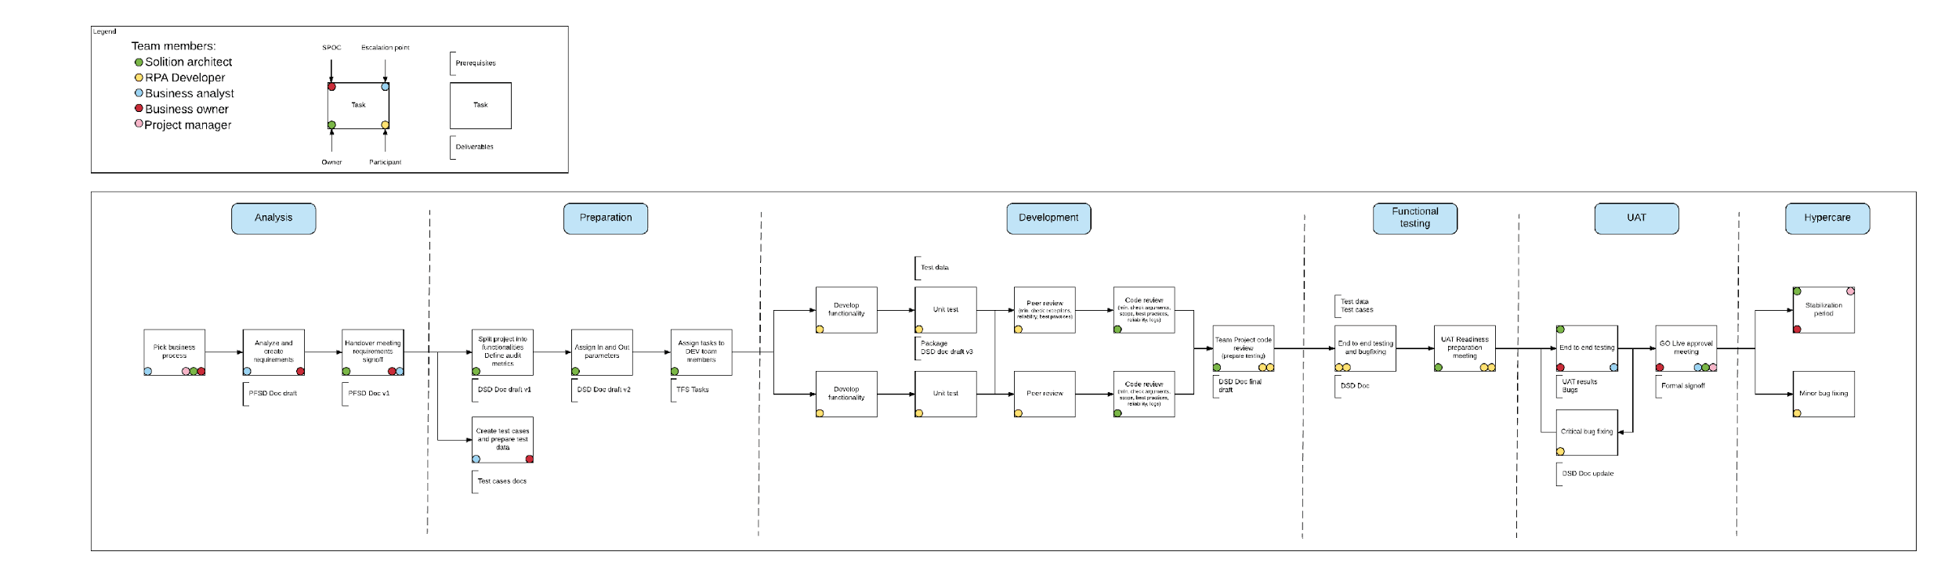
RPA Development stages

Slide 10




Defining automation complexity
Complexity is not determined by the number of applications involved, the number of screens, or the number of fields that should be filled with data or read into variables, but by the expertise required!
HIGH COMPLEXITY
A high complexity project is one that requires programming skills (.NET programmability) in terms of string manipulation functions, working with arrays, data tables, collections, data formatting, exception handling; complex SAP applications, and/or complex applications running in a Citrix environment, and/or terminal emulators. Development time is around 25 person-days (up to 40 days).
HIGH
LOW COMPLEXITY
A low complexity automation project is in general, one that can be easily created with the recorder and requires small customizations thereafter. This includes desktop applications as well as web applications. It can include scraping (web scraping, screen scraping) and it generally takes 2-3 person-days (up to 5 days).
MEDIUM COMPLEXITY
A medium complexity automation project could be one that requires the transfer of data between applications or one that involves SAP or applications running in a Citrix environment. It takes around 8-10 person-days (up to 15 days) to develop.
LOW
MEDIUM

Slide 11
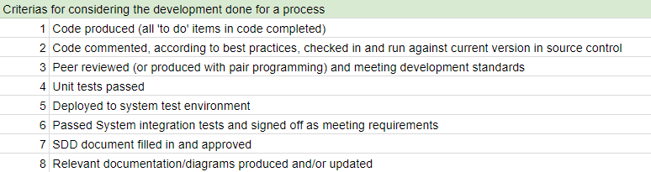
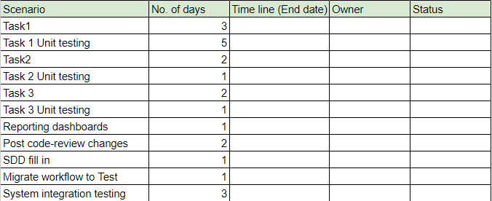
Tracking the progress

Slide 12
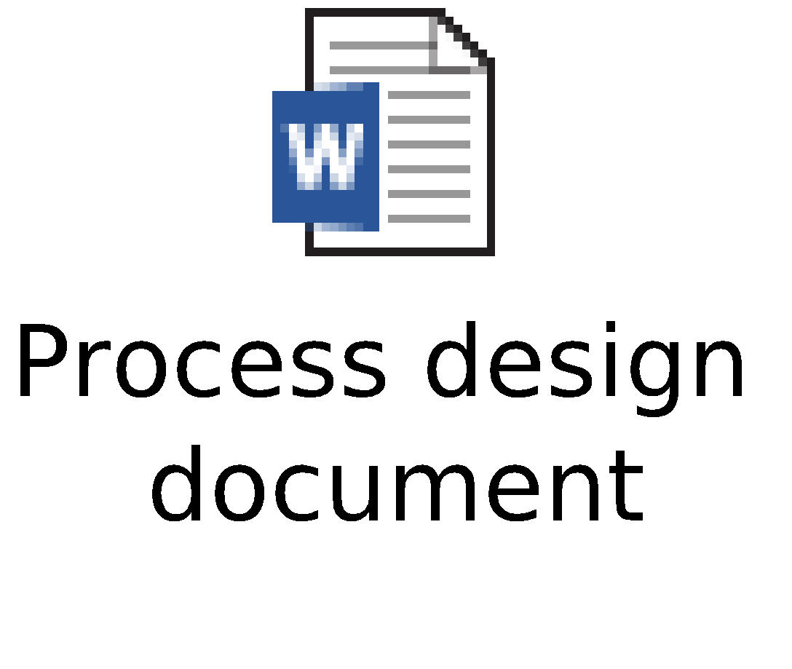
Designing Workflows
Process design document
<Business Process Name>
Process Design Document – (PDD)
<Client Name>

Slide 13

Developing Workflows
Development specifications document
<Process Name>
Development Specifications Document – (DSD)
<Company Name>

Slide 14
QUALITY ASSURANCE

Slide 15

Testing plan
UiPath has developed a three phase approach for the testing process, making sure no critical bugs will reach the production environment. Paired with code review sessions and approval board meetings, the methodology ensures quality in deliverables.
1.
Unit testing
2.
Functional testing
3.
User acceptance testing
End to end testing done by the development team on the QA environment, supervised by the solution architect.
End to end testing done by the product owner. Followed by the go-live meeting.
Individual testing each functionality of the automation, made by developer & discussed in code review sessions.
AUTOMATED TESTING
UiPath developed a framework for automated testing, ensuring that each piece of the code gets tested with numerous use cases and data sets.
MANUAL TESTING
Each code snipped is also manually tested and reviewed, to ensure that no possible scenario is left unchecked.

Slide 16

Hypercare Period
Handover after automation
DSD DOCUMENT
HANDOWER WORKSHOP
HYPERCARE PERIOD
SUPPORT STRATEGY
For each automated process, a Development Specifications Document will be created by the development team and approved by the Solution Architect.
The document will contain data relevant for the administration (runtime) and internal support teams, along with other relevant technical information.
A workshop between UiPath technical resources and Customer technical team will ensure a smooth transition of the process from the developers to the support team. The DSD document will be discussed and any further improvements or customizations will be addressed.
After the GoLive meeting, the new automation project will benefit from a Hypercare period, having the team dedicated to fast response times in case of any incidents. This ensures that for any potential issue, the support team will receive instant help directly from the people who developed the automation.
By using the support platform provided by UiPath, Zendesk, any issue will be addressed by a person with the right skillset in the shortest possible time. Every interaction will be logged for further reference, and the Customer will benefit from the embedded SLA system.
Implementing the 4 steps strategy for handover of the automated processes to the owners will provide a smooth transition from UiPath to the Customer.

Slide 17
SUPPORT MODEL

Slide 18
Support Model
Support model proposal – Business & IT HD
SUPER USERS | SUPPORT LEVEL 1 | SUPPORT LEVEL 2 (!)
ACTIVITIES
Start process on demand Review queue items (success, business errors, application errors) Reprocess queue item Mark queue item as manually processed View Kibana reports Change assets Change passwords | Business administrator roles + Schedule process Review logs Monitor robots Publish workflow in production Reallocate robots Configure Orchestrator envs Create Assets and Queues Create Orchestrator Users Edit mapping table | Create Kibana reports Make small changes to the code Review logs Add custom log fields Change workflow config file
ACCESS TO
Orchestrator & Kibana | Orchestrator & Kibana | Studio, Orchestrator & Kibana
REQUIRED SKILLS
Business superuser – an expert of the business processes Basic technical knowledge Trained as a Business Administrator | Good technical background UiPath Basic Academy completed Trained as a support specialist | Developer background (.NET or VBA) UiPath Advanced Academy completed Trained as a developer

Slide 19
Support Model Roles And Skills
Business Administrator |  | Level 1 Support L1 | Level 2 Support L2 | Deep Support L4
ROLES
Business superuser – an expert of the business processes Basic technical knowledge Trained by UiPath as a Business Administrator | Business administrator roles + Schedule process Review logs Monitor robots Monitoring Queue Items Monitor Jobs |  | Business administrator roles + Publish workflow in production(MTP) Reallocate robots Configure Orchestrator environments Create Assets, Queues and Orchestrator Users Edit mapping table Analysis the root cause and update the handbooks. |  | Create Kibana reports Changes to the code (CMR) Review logs Add custom log fields Change workflow config file Vendor engagement
SKILLS REQUIRED
Start process on demand Review queue items (success, business errors, application errors) Reprocess queue item Mark queue item as manually processed View Kibana reports Change assets Change passwords | Very good at browsing through the orchestrator application (Logs, queues, Jobs etc.) Should be able to differentiate between errors and successful transactions and know when to escalate to L2 UiPath Basic and Orchestrator Academy completed Trained by UiPath as a support specialist |  | Basic technical and analytical background. Should be able to analyse the log information, refer to Runbooks, diagnostic tasks and take relevant action UiPath Basic and Orchestrator Academy completed Trained by UiPath as a support specialist |  | Developer background (.NET or VBA) UiPath Advanced Academy completed Trained by UiPath as a developer

Slide 20

THANK YOU!

