Slide 1
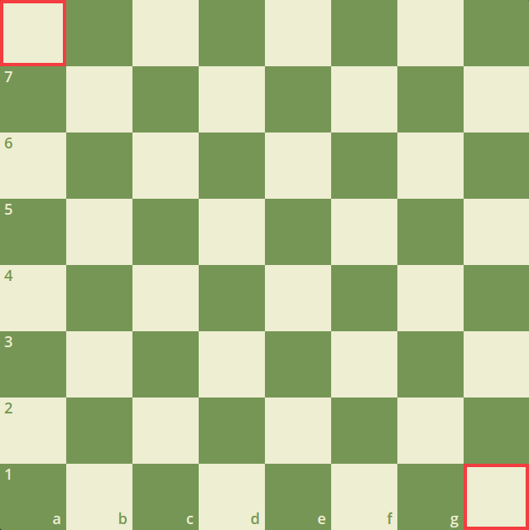



Slide 2

Blue

Slide 3
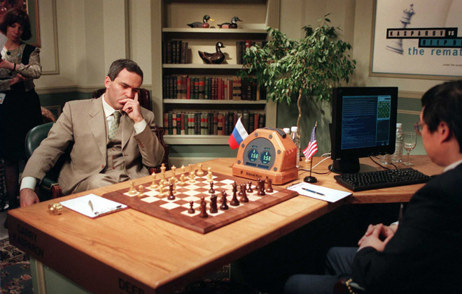
What is Deep Blue?
In 1997 Deep Blue defeated Garry Kasparov, the 6 time world champion. This is the first AI managed to win a game of chess against a reigning world champion.
Game | White | Black | Result
1 | Kasparov | Deep Blue | 1-0
2 | Deep Blue | Kasparov | 1-0
3 | Kasparov | Deep Blue | ½ - ½
4 | Deep Blue | Kasparov | ½ - ½
5 | Kasparov | Deep Blue | ½ - ½
6 | Deep Blue | Kasparov | 1-0

Slide 4
How do chess engines calculate positions
As everything in this world, there must be some parameters to calculate a chess position, there are a lot of parameters in chess and here are some of them.
c₁ * material + c₂ * mobility + c₃ * king safety + c₄ * center control + c₅ * pawn structure+ ..
A chess computer calculates every move and decides it assigns a rating for it, pretty easy, is it?

Slide 5
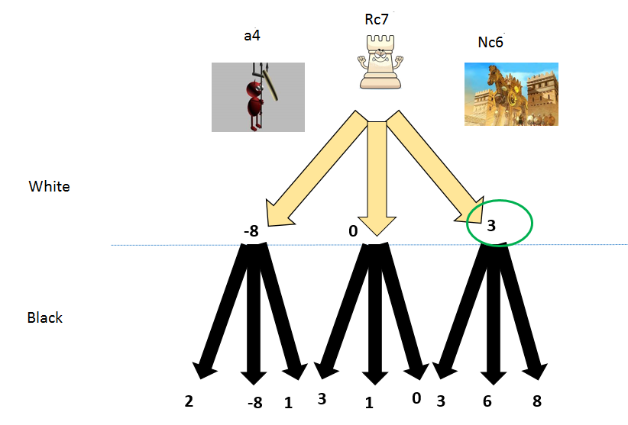

Slide 6
400

Slide 7
71,852

Slide 8
120,921,506

Slide 9
After just 3 moves
The number of positions in a game of chess is unfathomable huge.
A great and really hard to answer question is if there are more chess positions or particles in the observable universe.
It’s hard to know the exact number of both so we only have rough estimates.

Slide 10
Sources
https://en.wikipedia.org/wiki/Computer_chess
https://en.wikipedia.org/wiki/Deep_Blue_versus_Garry_Kasparov
https://www.kasparov.com/timeline-event/deep-blue/

