Slide 1
FIGURES
Victor Schwoertzig
28/04/2026

Slide 2
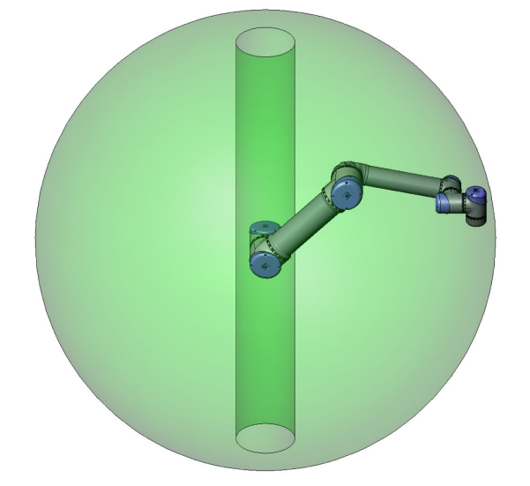
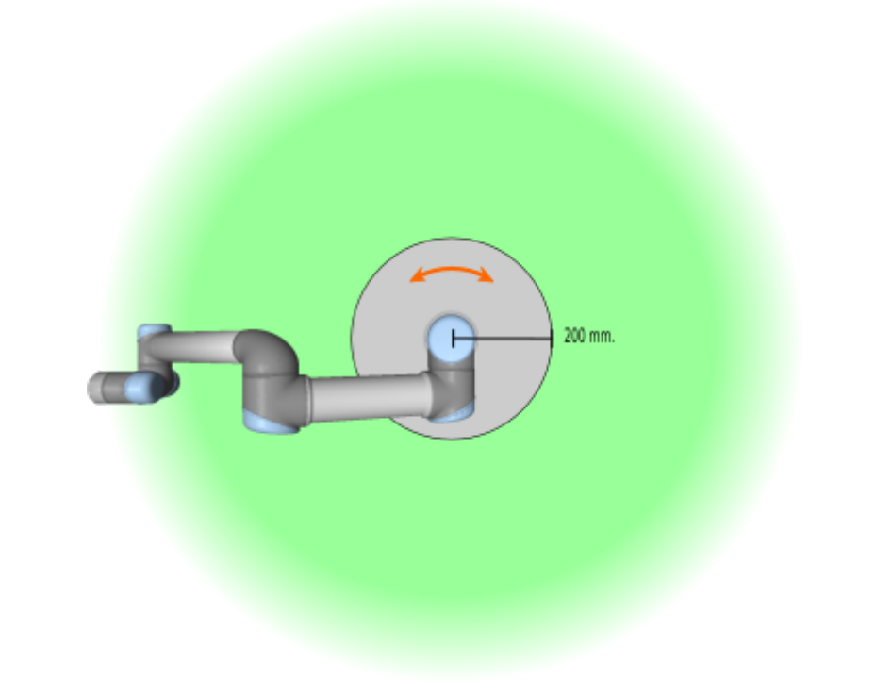

Slide 3






$$H_{C}^{R}$$
$$\left\{C\right\}$$
$$H_{B}^{C}$$
$$\left\{B\right\}$$
$$H_{B}^{R}$$
$$\left\{R\right\}$$

Slide 4
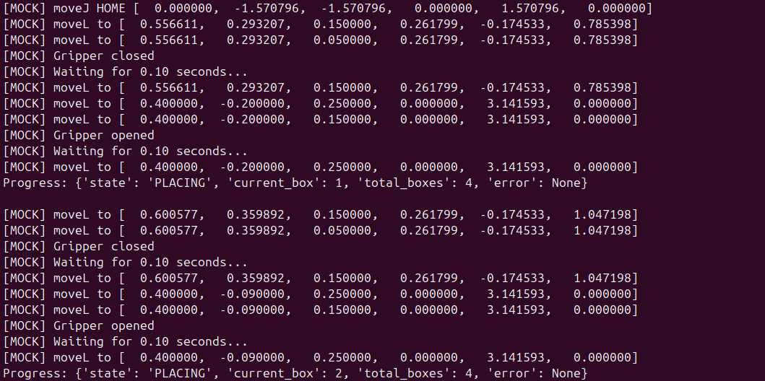
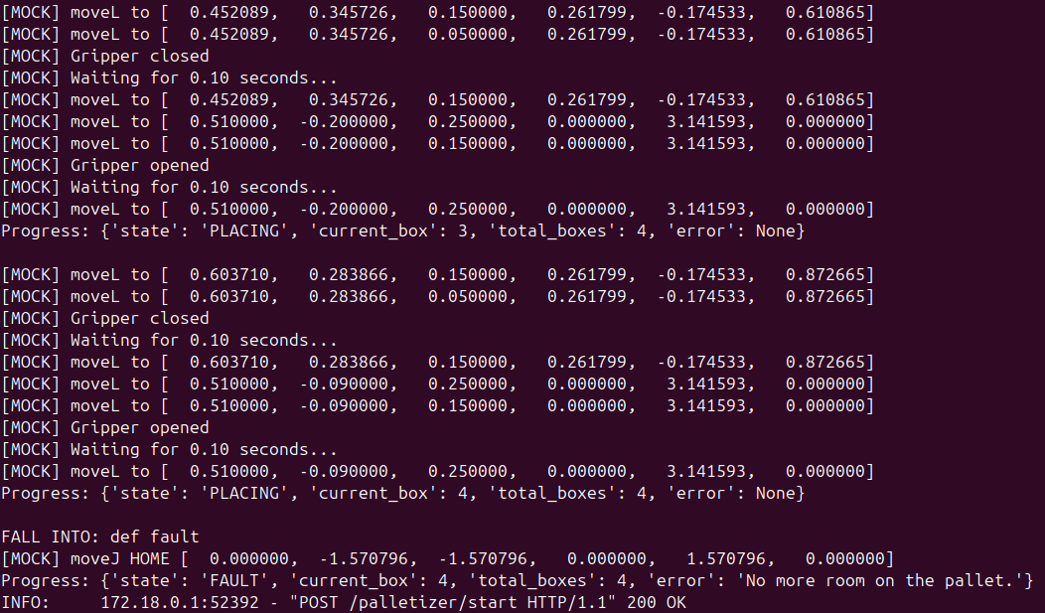

Slide 5
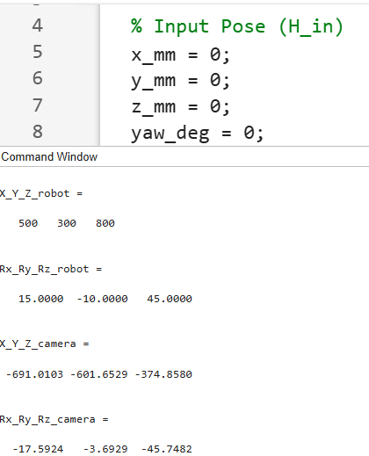
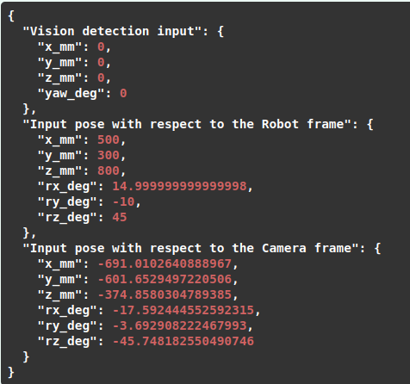
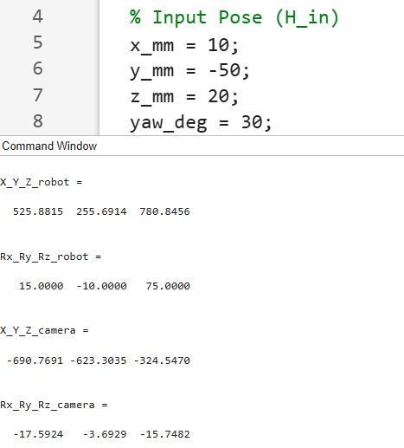
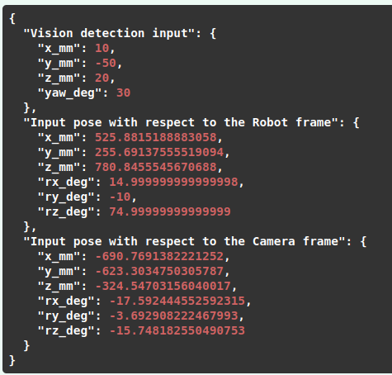
Scenario #1
Scenario #2

Slide 6
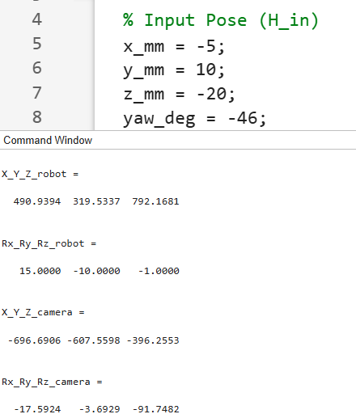
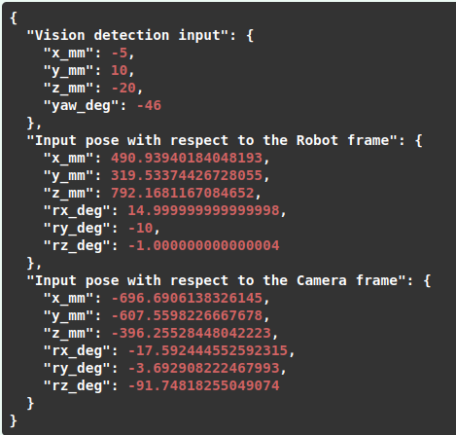
Scenario #3

