Slide 1

Time series forecasting with Deep Learning
Николай Велков, фн: 26001 Виктор Василев, фн: 45676

Slide 2
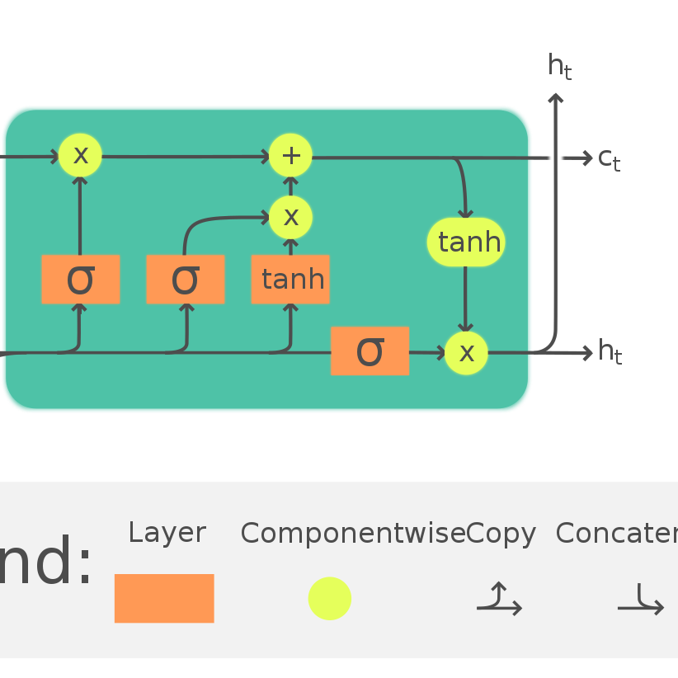
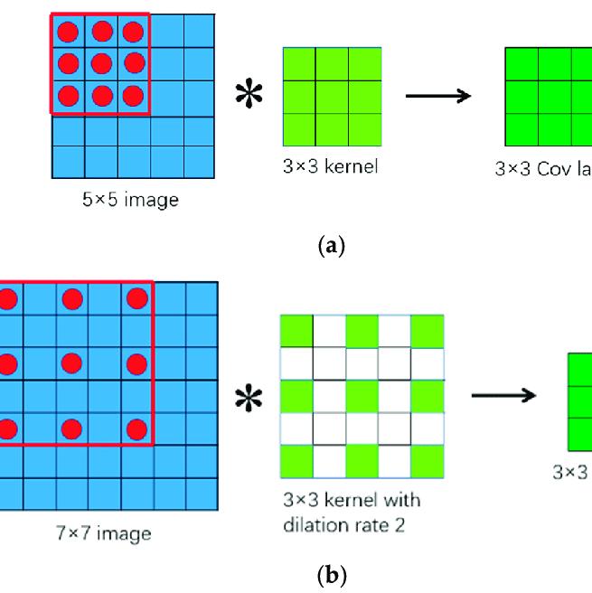
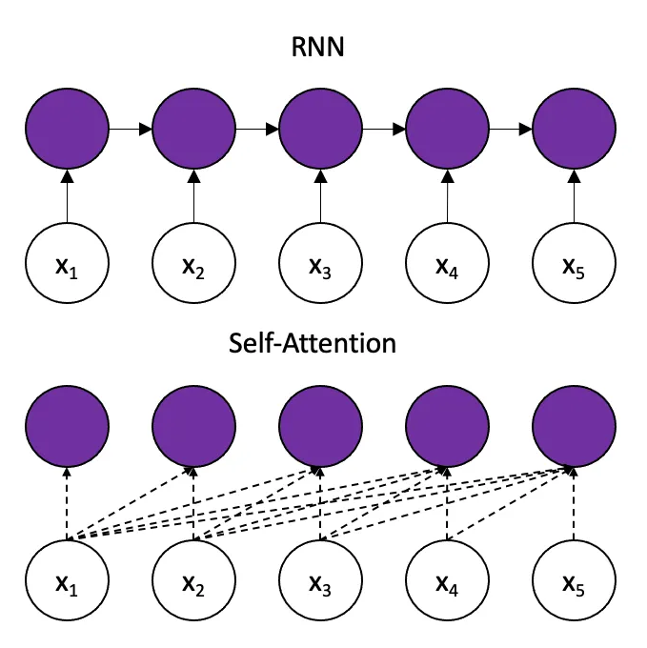
Time series forecasting with Deep Learning Models
RNN
LSTM
GRU
Conv1D, CNN(+Atrous Convolutions?)
Transformers

Slide 3

Time series forecasting with Deep Learning Improvements
For RNN, LSTM and GRU use univariate and multivariate predictions
For RNN, LSTM and GRU – first predict only one value in the future at a specific time. Then try to predict multiple values ahead in the future
Transformers – predict multiple values in the future
Use ensamble learning using different models

Slide 4
Time series forecasting with Deep Learning Data
https://www.kaggle.com/competitions/jpx-tokyo-stock-exchange-prediction/data
https://www.kaggle.com/competitions/store-sales-time-series-forecasting/data?select=test.csv
https://www.kaggle.com/competitions/web-traffic-time-series-forecasting/data
Use any data but make the models as generic as possible
Use additional information like financial results, sentiment analysis, etc.

Slide 5
Time series forecasting with Deep Learning Data
Data depends on the dataset from above that we choose
Example data:
+ additional engineered features
Date | Close/Last | Volume | Open | High | Low
11/30/2022 | 4080.11 | -- | 3957.18 | 4080.11 | 3938.58
11/29/2022 | 3957.63 | -- | 3964.19 | 3976.77 | 3937.65
11/28/2022 | 3963.94 | -- | 4005.36 | 4012.27 | 3955.77
11/25/2022 | 4026.12 | -- | 4023.34 | 4034.02 | 4020.76
11/23/2022 | 4027.26 | -- | 4000.3 | 4033.78 | 3998.66

Slide 6
Time series forecasting with Deep Learning Technologies
keras
tensorflow
Numpy
Pandas
matplotlib

Slide 7
Links
https://machinelearningmastery.com/multi-step-time-series-forecasting/
https://faculty.haas.berkeley.edu/odean/papers/Day%20Traders/Day%20Trading%20and%20Learning%20110217.pdf
https://www.researchgate.net/publication/279699523_The_profitability_of_day_trading_An_empirical_study_using_high-quality_data
https://www.hindawi.com/journals/sp/2022/4758698/
https://www.tensorflow.org/tutorials/structured_data/time_series
https://www.tensorflow.org/guide/keras/rnn

