Slide 1
Five Elements of Software Engineering for Mobile
Salinity and Climate Map Group
Chenhao Li
Notes:
So today we will talk about the five elements of software engineering

Slide 2
What are they
Technological platform choices
User experience
Methodologies
Web APIs
Tools
Notes:
There should be lots of components that will finally construct a software. It is a large topic that involves various fields, and today we will mainly discuss the following elements. technological platform choices, user experience, methodologies, web APIs and Tools.

Slide 3
Why they important?
Software Engineering involves the application of multiple fields to design and construct software systems.
Users’ behaviors are different on mobile compared with other media. Cognitive resources and attention time are limited. Hardware is limited such as screen size, battery, bandwidth and CPU.
Non-conventional input and output means. People interact with mobile with various methods — multi-point touch, gestures and motion detection and sensors.
Notes:
So why these elements are important to our development of a software. software engineering involves the application of multiple fields to design and construct software systems. It includes the fields in computer science, management science, business and so on. In this large topic, extracting and summarizing some essential elements will be helpful to the project.
On a mobile, users’ behaviors are quite different from other media. The Cognitive resources and attention time will be limited. Imagine when you are using your phone on your way home, it usually will not take too long time on a certain part of certain app. You may just check whether there’s new messages on WeChat, or you are just setting the destination on Google Map. Besides user behavior, hardware is also limited such as the screen size, battery, bandwidth and CPU. All these things affect the way we deliver the product.
Also, the non-conventional I/O means differ mobile apps from other media. People can interact with mobile in various ways, such as touch, motion detection, voice input and other sensors.
Thus, a summary of essential elements in software engineering can give a guide to us during development of a product.

Slide 4
Technological platform choices
Native, Web, Hybrid, Cross-platform…
Platform decides what devices or operating systems to deliver products
Laptop — Windows, Linux, macOS…
Phone — Android, iOS, windows phone…
Amazon Kindle, Tabs, Blackberry…
For developer team
Different languages — Java, Obj-C, C#…
Efficiency — trade between limits and generality
Platform affects target customers
Notes:
First is the technological platform choices.
A product can be delivered in lots of ways, which can be through mobile, web, laptop, or cross-platform.
So the platform decides what devices or operating systems to hold our products. For example, on a laptop, we need to consider Windows, Linux, macOS. On a phone, there’s difference between android and iOS system. And there are also other devices with different operating systems like Amazon Kindle, Blackberry. Or even some products are delivered through internet of things, like Amazon Echo dot.
For the developers, it means different languages such as Java to develop an Android App, Objective-C to develop an iOS app or C# for a game. There’s a problem of efficiency while choosing the technological platforms. Take the cross-platform for example, some service like Appcelerator can provide cross-platform app development which can work on multiple operating systems. Along with the convenience of development, there will be limits especially when people want to handle the functions that have conflicts on different operating systems.
Also the platform can affect the target customer choice. For example, in our project we may choose to develop an Android App as Android users are much more than other platforms like iOS.

Slide 5
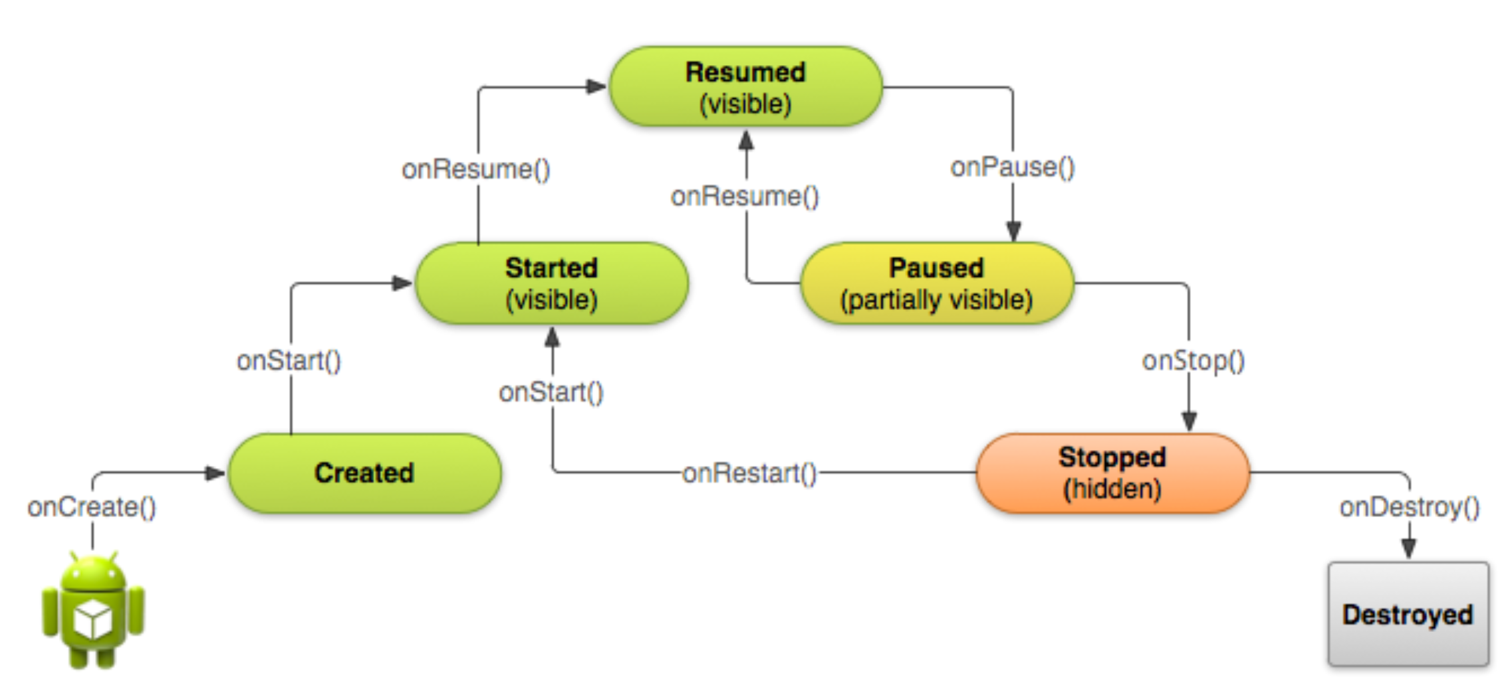
Technological platform choices
Android App Life Cycle
Source:http://www.android-studio.org
Notes:
In our project, we chose to develop an Android App. Like what just mentioned, based on the user base on different platforms.
Here gives a general Android app life cycle. There are five states in the life of an app: created, started, resumed, paused and stopped. The five states are quite related to the process people using an app. They open an app on the foreground, they move to other app but it is still running on background, they move back to our app and finally they remove the app from the process lists.
So with this figure, we can actually get a general idea about our project, which is a map that showing salinity in different areas. Before implementation, we can assign different tasks or behavior of our project to the five states of its life cycle.

Slide 6
Users’ Experience
“Everything” matters
functionality, marketing, input, mobile context, feedback…
For a “map” App
Interface design
GPS and basic search function
Access to background database
“Help”
Maintenance and feedback
Notes:
The second one is Users experience. It is quite a large topic because users’ experience actually involve everything of a product, like functionality, marketing, input means, mobile context, feedback system and so on. The summary of all these things contribute to the final user experience. Take an example, if an app has powerful functionality and people are definitely satisfied with its functions. And somehow there’s a small bug that might be not that serious. However, the app has a poor feedback system, and people find no way to report this bug. Now unfortunately, user experience will become poor and poor even though the functionality of the app is great. Thus, during development, consider as many parts as possible will contribute to a successful app.
For our project, what we should consider may be including the following parts, just mention some of them. Interface design which directly affect whether people will be willing to use our app. GPS and some basic map features such as destination search will decide whether the functionality of our app is powerful enough to satisfy people’s need. For researchers who should have the access to the background database, whether our app has a safe login system will affect the trustworthiness between our team and researcher customers. Also a “Help” tutorial will be friendly to users when they first enter our app. And just like what the example says, the maintenance and feedback will ensure that the app will become better and better.

Slide 7
Methodologies
Idea
Product
Data
Building a business
Customer development
Product development
Waterfall Development
Customer Discovery
Customer Validation
Customer Creation
Company Building
Notes:
Then is the methodologies. It is mainly divided into three parts: building a business, customer development and product development.
building a business is an iterative process. We first have an idea, from this idea we build a product, then we measure our product to get feedback and data. Based on the new data and feedback, we can develop new ideas. With this process cycle, a business can work properly.
For customer development, there are basically search and execution states. Search means before true implementation, we first try to discover potential customers and validate whether they can become our customers. Then in the execution state, after the product is produced, the team can create customers and build the company. Just like what we are doing now, we have identified government, researchers and ordinary people as our customer, then we need to do the customer interview to validate our target group. With the feedback, it can guide how we can develop or implement our product.
For the product development, it follows a waterfall development process: Analysis -> Requirements specification -> Design -> Implementation -> Testing and integration -> Operation and Maintenance. Like what we have done in past weeks, we first analyze the problem and settle the requirements with mentor. Now we enter the design and implementation states, including inspect the platform we use and design the user interface and functionality.

Slide 8
Web APIs
API — Application programming interface
a set of subroutine definitions, protocols, and tools for building software and applications
Benefits
Development Efficiency
Integrated function and methods
Convenient service
OS/Platform independent
Notes:
Web APIs is vital to software development. First what is API: the application programming interface means a set of subroutine definitions, protocols, and tools for building software and applications. Usually when developing a software or app, some functions we need may be already integrated in some open source APIs, what we can do is directly using the service of these APIs to implement our product.
There are many benefits. First is the efficiency brought by APIs, we no longer need to implement and integrate functions by developers themselves. The integrated function and methods can already satisfy the needs of a product. Some open-source APIs can also provide convenient service, like backend storage and data process. Also some APIs are operating system independent, which greatly improve the generality of a product.

Slide 9
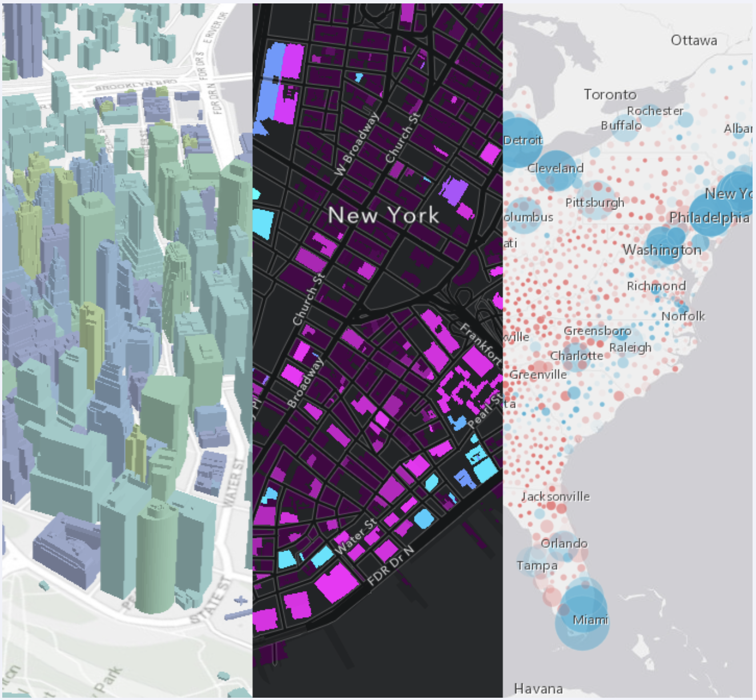
Web APIs
Map frameworks
ArcGIS, Carto, Leaflet
Source: https://developers.arcgis.com
Notes:
Take our project as example. To develop a map application, the most efficient way is to find a map API with powerful functions. There are many existing APIs like ArcGIS, Carto, Leaflet, Mapbox and so on. For now we are using the ArcGIS API to develop our application. Just mention a little. The API provides backend storage service. Once we created a map or layer online, we can grab the layer down into our app with minimal codes, which greatly improve the efficiency of development.

Slide 10
Tools
Powerful service
Backend service, database and storage
Feature Testing
Prototyping
Improve quality of development
Bug report service
User Analysis
Project Management
Notes:
Finally, let’s talk about the tools in software engineering. Tools includes everything that can help develop our product. Like the backend service, database and storage, feature testing, prototyping and so on.
Proper use of tools can improve the quality of development, such as the bug report service of some APIs, user analysis tools and project management tools.

Slide 11
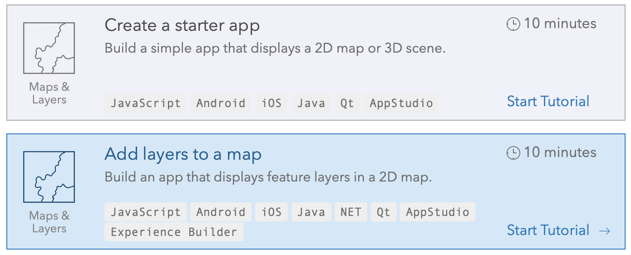
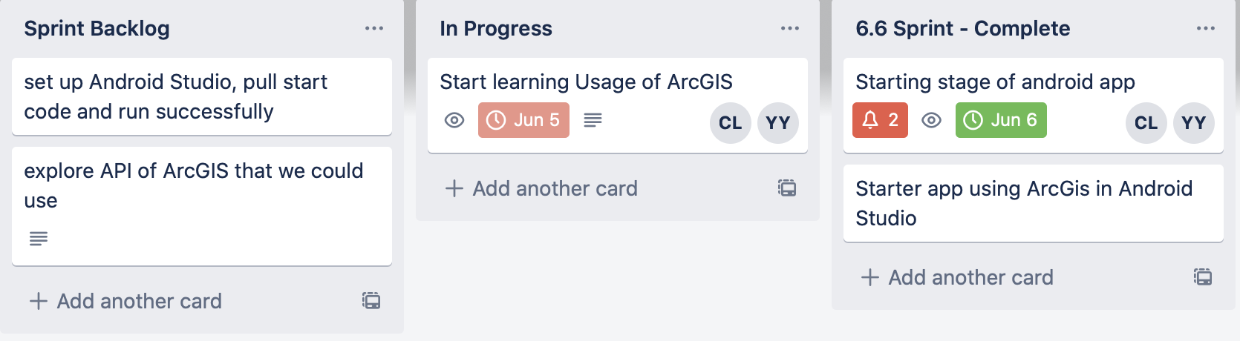
Tools
ArcGIS tutorial and online storage service
Trello project management tool
Notes:
In our project, the two important tools we use is the ArcGIS online tutorial and online storage service. As we are definitely new to developing a map application, a good documentation of an API is really helpful and important to our development.
Another one is the Trello project management. It can help us develop the product with a proper time span. We can also distribute the work to group members and inspect what is the most reasonable way to manage the time spent on different part of our project.

Slide 12
Bibliography
ICSE '76: Proceedings of the 2nd international conference on Software engineering, October 1976, Pages 116–122
What is Web API?. https://www.tutorialsteacher.com/webapi/what-is-web-api
Manfred Bortenschlager. “Five elements of software Engineering For Mobile”.
Android Studio. “http://www.android-studio.org”.
In Lee and Kyoochun Lee. The internet of things (iot): applications, investments, and challenges for enterprises. Business Horizons, 58(4):431 – 440, 2015.

Slide 13
Questions?

