Slide 1


T4: Compiling Sequential Code for Effective Speculative Parallelization in Hardware
Victor A. Ying, mark c. Jeffrey, Daniel Sanchez
Multicores are everywhere
Programmers write sequential code
Core
Core
Core
Core
…
…
…
Core
Core
Core
Core
Core
Core
Core
Core
Core
Core
Core
Core
Speculative parallelization: combining architectures and compilers to parallelize sequential code without knowing what is safe to run in parallel
Notes:
Thanks for the introduction. Hi everybody, I’m Victor Ying, and I’m presenting T4: Compiling Sequential Code for Effective Speculative Parallelization in Hardware.
Multicore machines have been ubiquitous for years, but most programmers still find it easier to write sequential programs.
To bridge the gap between sequential programs and parallel hardware, we build on work in speculative parallelization, which uses new architectural and compiler techniques to parallelize sequential code.
Speculative parallelization works by breaking a program into tasks and speculatively running some tasks in parallel without knowing whether it is safe to do so.
A system for speculative parallelization must detect dependencies that make parallel execution unsafe, and have some mechanism to recover on the fly.
Next slide please

Slide 2
Key idea: Task trees for effective parallelization
Prior work: chains of task spawns
Task trees avoid serial bottlenecks
Spawners
Workers
wr
Dependence ⇨ abort single leaf task
Data dependence
results in
many aborted tasks
Re-execution
wr
rd
rd
rd
rd
Time
…
Time
If dependence is violated, all later tasks abort and re-execute
Serial task spawn & commit
Independently spawned leaf tasks enable selective aborts
Distributed spawn & commit
Notes:
On the left, let’s look at an execution timeline showing how prior work has performed speculative parallelization:
Each box here represents a task, and the horizontal axis is time.
You can see that task execution overlaps, exploiting some parallelism.
But one task might write to a memory address that is read by another task!
This data dependence is shown by an orange arrow from the write to the read.
This dependence has been violated by the initial parallel execution.
To recover apparent sequential execution, prior architectures would abort the offending task *and* all later tasks, re-executing them at a later time.
These aborts can be very wasteful on a large machine, as many cores must stop and throw away their work.
Additionally, these systems form chains of tasks, where only a single task is being spawned at a time, and tasks also commit only one at a time, which is a serializing performance bottleneck.
On the right, we see an approach that addresses these problems.
First, there are spawner tasks, which are responsible for spawning other tasks.
The majority of the computation is in worker tasks at the leaves of the task tree.
These leaf tasks are spawned independently from each other, so they can abort independently, making recovery from misspeculation cheap.
Additionally, we can execute this tree of tasks using distributed hardware mechanisms that allow spawners to run in parallel, and also enable bulk commit of many tasks per cycle.
This approach eliminates any serializing per-task overhead, enabling speculative parallelization of smaller tasks to scale up to tens of cores.
Next slide please

Slide 3
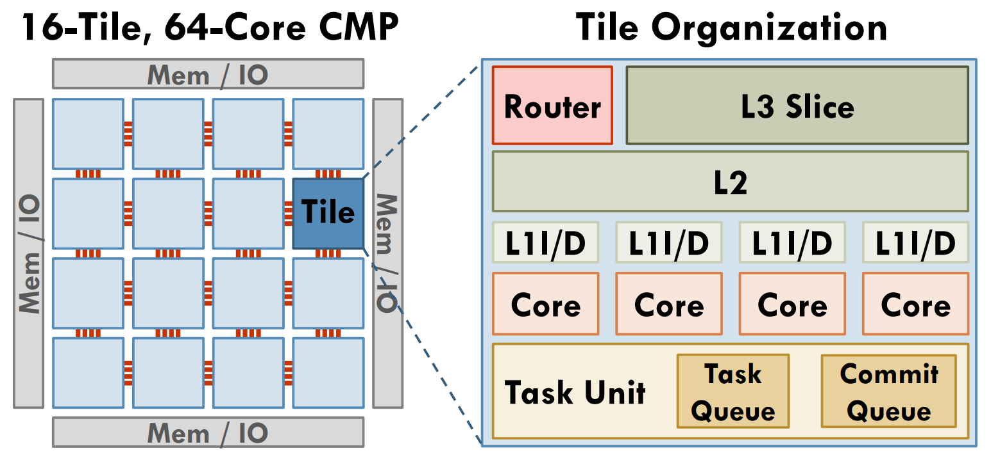
T4: Trees of Tiny Timestamped Tasks
T4 compiler systematically uncovers fine-grained parallelism
Timestamps encode order, let tasks spawn out-of-order
Trees unfold branches in parallel for high-throughput spawn
Efficient parallel spawns support tiny tasks (tens of instructions)
Tiny tasks can exploit locality, reduce communication
T4 exploits the Swarm architecture [Jeffrey et al. MICRO’15]
Tasks appear to run sequentially, in timestamp order
Selectively aborts dependent tasks
Distributed task units can
Spawn and commit many tasks per cycle
Runs hundreds of concurrent speculative tasks
Notes:
To systematically implement this approach to effective speculative parallelization, we have developed T4.
T4 breaks sequential code into trees of tiny timestamped tasks.
T4 assigns a timestamp to each task, to encode sequential program order. With the program order thus preserved,
Each task may spawn multiple children tasks out-of-order, forming a tree of tasks whose branches unfold in parallel for high-throughput task spawn.
These efficient parallel spawns allow us to parallelize tasks as tiny as tens of instructions.
This fine-grain parallelization creates new opportunities to schedule tasks to exploit locality and reduce communication.
T4 leverages the recently proposed Swarm architecture to perform scalable execution of tiny timestamped tasks.
Swarm can run tasks in parallel on hundreds of cores, and uses distributed mechanisms to detect order violations, guaranteeing that tasks will appear to run sequentially, in timestamp order.
Hardware implements this guarantee by *selectively* aborting individual tasks or small task subtrees.
Swarm provides task queuing units distributed throughout the chip, which can perform parallel task spawns and task commits,
And manage the speculative execution of hundreds of tiny tasks.
Next slide please

Slide 4

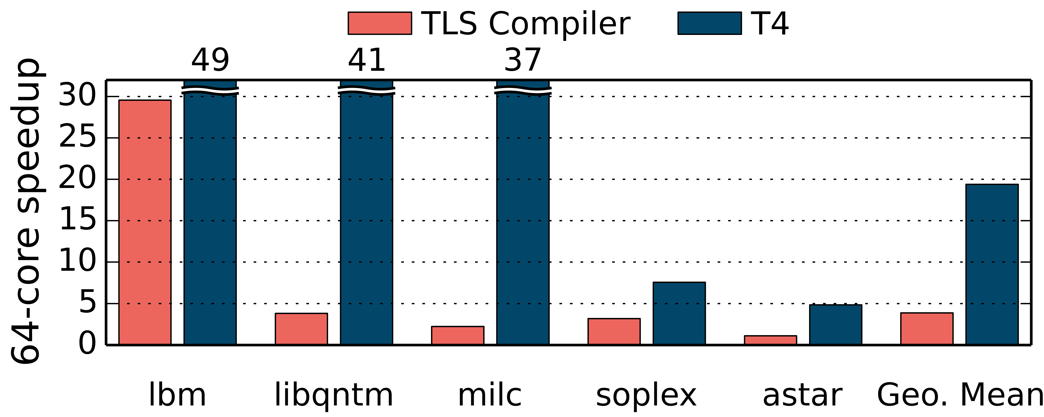
Parallelizing entire real-world programs
T4 automatically divides a whole program into tasks
Tasks boundaries at loop iterations and function calls
T4 introduces novel code transformations:
Progressive loop expansion
Call stack elimination
Optimizations to make task spawns cheap
Spatial-hint generation
T4 scales hard-to-parallelize C/C++ benchmarks from SPEC CPU2006
Modest overheads: 31% on 1 core
Speedups up to 49× on 64 cores
T4 is open source
swarm.csail.mit.edu
Notes:
Our T4 compiler leverages Swarm’s hardware features to perform whole-program parallelization, dividing the entire execution of sequential programs into tasks
T4 automatically builds nested task trees by dividing all loops and function calls into tasks.
To accomplish this, T4 introduces and automates several composable compiler techniques:
Progressive loop expansion creates exponentially expanding task trees to run many loop iterations in parallel, even for complex loops where the number of iterations to run is unknown
T4’s call stack elimination avoids serial bottlenecks in spawning functions in parallel.
T4 also introduces optimizations to the allocation of local values to make task spawns cheap.
Finally, T4 exploits tiny tasks that access only a single memory location by scheduling tasks according to the memory locations they write to, avoiding cache-line ping-ponging.
We evaluate T4 by parallelizing C and C++ benchmarks from SPEC CPU2006.
T4 imposes modest overheads to scale these real-world programs to tens of cores,
Achieving up to 49 times better performance than serial code on 64 cores.
That’s it for my lightning talk. Thank you for listening, and I will now be happy to take any questions.

Slide 5
Backup Slides

Slide 6
Progressive expansion of unknown-tripcount loops
Progressive expansion generates balanced spawner trees for loops with unknown tripcount
- loops with break statements
- while loops
6
iter(6)
iter(7)
2
10
iter(2)
iter(10)
0
iter(3)
iter(11)
4
8
iter(0)
iter(4)
iter(8)
iter(1)
iter(5)
iter(9)
Source code:
12
void iter(Timestamp i) { if (!done) {
if (!status[i]) done = 1;
else if (foo(i)) done = 1;
}
}
iter(12)
int i = 0;
while (status[i]) {
if (foo(i)) break;
i++;
}:
iter(13)
Notes:
To generate balanced spawner trees for arbitrary loops, T4 uses progressive expansion, which does not rely on static analyses to compute the loop’s trip count, or the number of iterations.
[click] For example, consider this while loop containing a break statement. It is impossible to know how many iterations it runs before it terminates.
[click,click,click] To parallelize this loop, T4 generates a progressively expanding tree of speculative spawners, in gray, with each spawner spawning a few workers, in blue, to run iterations of the loop.
To handle the control dependence of each loop iteration on previous iterations, T4 reuses Swarm’s mechanisms for data-dependence speculation to perform control speculation.
[click] To do this, T4 transforms the code as shown in this pseudocode, to use a new variable which is named “done”. T4 then transforms each task’s code to start by checking the variable to see whether to exit early, while also modifying any control flow path that would exit from the loop to set the done variable. These tasks can then be run speculatively in parallel. Whenever some iteration of the loop finally writes to the “done” variable, this quickly aborts any later iterations that should not have run.
Progressive expansion thus enables high scalability for loops that might terminate on any iteration.
Note that while I am showing only one task per loop iteration, the call to the function foo could generate nested parallel tasks within each iteration. Now let’s discuss how T4 allows nested function calls to be spawned in parallel.

Slide 7
Fractal topological ordering for timestamps
1
h(0,0)
1.1
void f() { g(0); g(1); g(42); g(43); }
void g(int i) { for (int j = 0; j < 3; j++) h(i,j); }
g(0)
h(0,1)
1.2
2
g(1)
h(0,2)
1.3
f()
3
g(42)
h(1,0)
2.1
g(43)
…
4
T4 assigns timestamps to one function or loop body at a time
Uses topological sorting of the CFG to determine program order
Fractal hardware [Subramanian et al. ISCA’17] provides additional timestamp resolution as needed for nested tasks

