Slide 1


Compiling Sequential Code for a Speculative Parallel Architecture
Victor A. Ying mark c. jeffrey Daniel Sanchez
ACM Student Research Competition @ PLDI 2019
Notes:
Hi, I’m Victor Ying, and I’m presenting SCC … This is joint work with my collaborators Mark Jeffrey and Prof. Daniel Sanchez at MIT.

Slide 2
How to parallelize sequential code?
Multicores are everywhere.
Parallel programming is hard.
We should parallelize sequential code to use multicores.

Slide 3
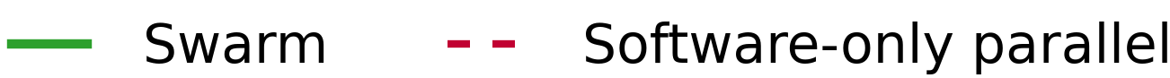
Background: Swarm architecture
Recent Swarm architecture [MICRO’15, MICRO’16, ISCA’17] parallelizes programs that were hard to parallelize
SCC: compile sequential C/C++ to exploit parallelism on Swarm.
Notes:
For years, we have had multicore machines, but most programmers struggle to use multicore parallelism
The Swarm hardware architecture was recently proposed to enable parallelization of programs that are hard to parallelize.
These programs were hard to parallelize due to having many indirect memory references
and they also requiring tasks to execute in a certain order.
Swarm was able to provide order-of-magnitude speedups over prior work in these programs
while providing apparent sequential execution,
But it required painstaking manual rewrites of these programs.

Slide 4
Swarm hardware attributes [Jeffrey et al. MICRO’15]
Execution model:
Program comprises timestamped tasks.
Tasks spawn children with greater or equal timestamp.
Tasks appear to execute in timestamp order.
9-tile, 36-core chip
Tile organization
Executes tasks speculatively and out of order.
Task units manage hundreds of tiny speculative tasks.
L3 & Dir Bank
Router
Mem controller/IO
L2
Mem controller/IO
Tile
Mem controller/IO
L1I/D
L1I/D
L1I/D
L1I/D
Core
Core
Core
Core
Task Queuing Unit
Mem controller/IO
Notes:
Swarm hardware exposes a task-based execution model.
To run on Swarm, programs must be broken into tasks,
And each task must be tagged with a timestamp when it is spawned.
Tasks can spawn children tasks with timestamp >= their own.
Hardware guarantees that tasks appear to execute sequentially, in timestamp order.
To exploit parallelism, Swarm executes many tasks speculatively and out of order on many cores.
Swarm requires modest changes to a standard shared-memory multicore chip.
We add task queuing units, distributed throughout the chip, so that each core can spawn more tasks
by communicating cheaply with its nearest task queuing unit.
(These task units autonomously distribute tasks across the system,
and can queue hundreds of tasks as short as tens of instructions each.)

Slide 5
Parallelizing sequential code
Example: maximal independent set:
Iterates through vertices in graph.
One task per outer-loop iteration.
Each tasks spawns the next.
Hardware tries to run tasks in parallel.
Hardware tracks memory accesses to discover data dependences.
for (int v = 0; v < numVertices; v++) {
if (state[v] == UNVISITED) {
state[v] = INCLUDED;
for (int nbr = 0; nbr < numNeighbors(v); nbr++)
state[neighbors(v)[nbr]] = EXCLUDED;
}
}
Indirect memory accesses
A
B
wr
C
rd
D
E
F
…
Time
Notes:
Let me show you how this works through the example of parallelizing a simple graph algorithm
[click] Each iteration of outer loop, highlighted in blue, reads and possibly updates the state of a vertex.
[click] Notice that it may also iterate through the vertex’s neighbors through indirect memory references to update their states in the body of the inner loop, highlighted here in orange.
[click] We shall attempt to parallelize the iterations of the outer loop, so each outer loop iteration is a task.
Here, task A will run the first iteration of the loop, but first it spawns task B, which is responsible for running the second iteration of the loop, and so on.
Notice that no more than one task is being spawned at a time.
That’s not the worst of our problems…
[click] If we imagine that these tasks take 100 cycles to execute on average, and we have a 100-core system, we must sustain an average spawn rate of one task per cycle. No system could do this!

Slide 6
Task chains incur costly misspeculation recovery
Tasks abort if they violated data dependence.
Tasks that abort must roll back their effects, including children they spawned.
for (int v = 0; v < numVertices; v++) {
if (state[v] == UNVISITED) {
state[v] = INCLUDED;
for (int nbr = 0; nbr < numNeighbors(v); nbr++)
state[neighbors(v)[nbr]] = EXCLUDED;
}
}
A
A
B
B
wr
RE-EXECUTE
C
C
rd
rd
D
D
D′
ABORT
E
E′
Cascading aborts waste a lot of work.
E
F
F′
F
…
…
…
Time
Notes:
Suppose task C writes to a location read by task D, so task D must abort.
[click] When aborting task D, we must undo its effects, including aborting other tasks that D spawned or passed data to, such as task E and F.
[click] In general, prior TLS systems always recover from misspeculation by aborting all later tasks across the system,
Bringing the whole system to a halt. Then, it would take some time after execution resumes for later tasks like E’ or F’ to be spawned again.
Notice how this single misspeculation delays the ultimate execution of *all* later tasks,
even if task E and F are not dependent on data from task D.

Slide 7
SCC’s decoupled spawn enables selective aborts
for (int v = 0; v < numVertices; v++) {
if (state[v] == UNVISITED) {
state[v] = INCLUDED;
for (int nbr = 0; nbr < numNeighbors(v); nbr++)
state[neighbors(v)[nbr]] = EXCLUDED;
}
}
Put most work into worker tasks at the leaves of the task tree.
Use Swarm’s mechanisms for cheap selective aborts.
A
Workers
B
C
wr
RE-EXECUTE
rd
rd
D
D′
ABORT
E
Spawners
F
…
Time
Notes:
In SCC, we introduce a simple solution to the problem that aborting tasks must also abort their children:
We implement a compiler transformation that splits the work of executing loop iterations into worker tasks, separate from spawner tasks whose only job is to do the computation necessary to spawn other tasks.
Now, the majority of computation time is in the leaves of a task tree, so task D can abort and re-execute cheaply, without affecting the execution of later tasks E and F.
Once we’ve split worker tasks from spawners, we can perform additional optimizations to the spawners, which might still account for a significant portion of work if each worker task is very short.

Slide 8
SCC’s balanced task trees enable scalability
Spawners recursively divide the range of iterations.
for (int v = 0; v < numVertices; v++) {
if (state[v] == UNVISITED) {
state[v] = INCLUDED;
for (int nbr = 0; nbr < numNeighbors(v); nbr++)
state[neighbors(v)[nbr]] = EXCLUDED;
}
}
Balanced spawner trees reduce critical path length to O(log(# iterations)).
Spawners
Workers
A
B
C
wr
RE-EXECUTE
…
D
rd
rd
E
ABORT
D′
…
…
F
…
…
Time
Notes:
For example, we can transform the spawners from a serial chain into a balanced tree, where each spawner recursively divides the range of loop iterations among its children.
This asymptotically increases parallelism and enables scalability even with fine-grain worker tasks.
Prior systems cannot parallelize loops where each iteration must run to completion to determine whether to run the next iteration.

Slide 9
Progressive expansion: parallelizing irregular loops
Progressive expansion generates balanced spawner trees for loops with unknown tripcount.
6
iter(6)
Source code:
iter(7)
2
10
for (i = 0; ; i++)
if (foo(i)) break;
iter(2)
iter(10)
0
iter(3)
iter(11)
4
8
iter(0)
iter(4)
iter(8)
iter(1)
iter(5)
iter(9)
void iter(Timestamp i) { if (!done)
if (foo(i)) done = 1;
}
12
iter(12)
iter(13)
Notes:
For example, consider this loop, which contains a break statement, so it is impossible to know how many iterations it runs before it terminates.
[click] To parallelize this loop, SCC generates a progressively expanding tree of speculative spawners, with each spawner spawning a few workers to run iterations of the loop.
[click] SCC reuses Swarm’s mechanisms for data-dependence speculation to perform control speculation by creating a new variable named done, and transforming each task’s code to start by checking the variable to see whether to exit early, and also modifying any control flow path that would exit from the loop to set the done variable.
Progressive expansion enables high scalability for loops that might terminate on any iteration.

Slide 10
SCC implementation in LLVM/Clang
Clang
frontend
LLVM backend
C/C++ source code
Optimizations
(e.g., -O3)
Parallelization
x86_64 codegen
Object file
Notes:
We implement SCC by modifying the popular LLVM/Clang compiler.
Our implementation simply splits loop iterations into tasks, as well as splitting all non-inlined function calls and their continuations into separate tasks.
In some cases, we find it profitable to further split straight-line code into finer grained tasks, and for now we annotate the code to suggest these additional task boundaries to the compiler. Note that these annotations have no effects and convey no information to the compiler about program semantics.
We expect that some simple heuristics can automate the selection of fine-grain tasks in the future.
[click] SCC is implemented by splitting the code into parallel tasks and generating spawner trees after most compiler optimizations, so parallelization does not impede code optimization.
[click] In addition, all of our compiler passes are intra-procedural, that is, they act on one function at a time without requiring information on other functions. Thus, compile times stay proportional to code size.

Slide 11
Evaluation Methodology
Simulated 1-, 4-, and 36-core systems.
Simulated hardware consistent with prior work [Jeffrey et al. MICRO’15].
Tile:
Mem controller/IO
L3 & Dir Bank
Router
L2
Mem controller/IO
Tile
Mem controller/IO
L1I/D
L1I/D
L1I/D
L1I/D
Core
Core
Core
Core
Task Queuing Unit
Mem controller/IO

Slide 12
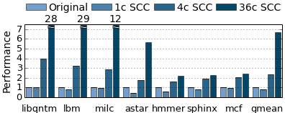
Results
SPEC CPU2006 C/C++ benchmarks compiled with -O3.
6.7×
2.4×
Rare data dependences, high scalability
Frequent data dependences, modest scalability
Notes:
And SCC achieves gmean 6.7x speedup on 36 cores. Notice that on some applications with high parallelism SCC scales linearly.

Slide 13
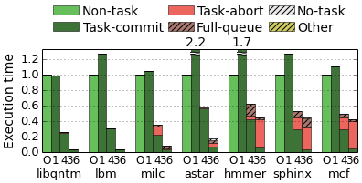
Results: Overheads are moderate
Serial code, -O3. Parallelized with SCC.
Notes:
Now, to present an alternate view of the data, I’ll show you a plot of execution time, so lower is better.
Here, we again compare the original serial code compiled with -O3, which are the light green bars,
With the “parallelized” code generated by SCC, which is then run on a single core. Compared to prior work, SCC adds relatively low overheads (gmean 31%) to the serial code due to our efforts to ensure SCC’s parallelization passes do not impede ordinary compiler optimizations.

Slide 14
Results: Cores busy most of the time
Cores spend most time executing useful work, not aborting.
Notes:
Now we add the execution time of SCC-parallelized code on 4 cores. Within each bar, I’ve broken down execution time to how cores spend time, averaged across the 4 cores.
Notice that SCC-parallelized code spends most of it’s time executing useful work in tasks that commit! This stands in sharp contrast to prior work,
where inefficient task spawn or commit, or expensive mass aborts, took up most of execution time.

Slide 15
Results: Cores busy most of the time
Cores spend most time executing useful work, not aborting.
Notes:
We can further look at the execution time breakdown at 36 cores, and see that in the four benchmarks on the left, more time is still spent executing tasks that commit than is wasted on aborted tasks.
Across all benchmarks, very little time is spent idle, waiting for tasks to become available to run, because of SCC use of efficient spawner tasks.

Slide 16
Contributions
Parallel programming is hard. Sequential code has latent parallelism.
We present SCC: A C/C++ compiler that effectively parallelizes sequential code by exploiting the recent Swarm architecture.
Speedups of 6.7× gmean and up to 29× on 36 cores.
Techniques:
Balanced spawner trees: decouple task spawn from most work.
Progressive expansion: speculative spawners for irregular loops.

Slide 17
Questions?
Parallel programming is hard. Sequential code has latent parallelism.
We present SCC: A C/C++ compiler that effectively parallelizes sequential code by exploiting recent Swarm architecture.
Speedups of 6.7× gmean and up to 29× on 36 cores.
Techniques:
Balanced spawner trees: decouple task spawn from most work.
Progressive expansion: speculative spawners for irregular loops.
Email: victory@csail.mit.edu

Slide 18
Backup Slides

Slide 19
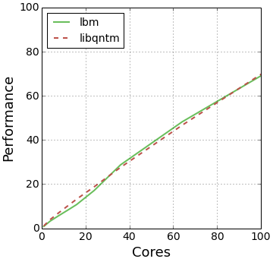
Results: Scalability
69×
Linear scalability in 462.libquantum and 470.lbm up to 100 cores!
Notes:
On these two benchmarks, we can continue to run the same code on systems with more cores, and achieve rougly linear speedup all the way to 100 cores. This demonstrates how SCC’s balanced spawner trees enable distributing work efficiently, in contrast to prior speculative systems that could only scale to 4 or 8 cores.

Slide 20
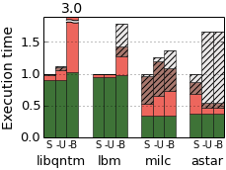
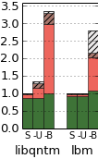
Balanced spawner trees are key to scalability
4 Cores
36 Cores

Slide 21
Fine-Grained Task Selection
Task heuristics:
Split loop iterations
Split non-inlined function calls and their continuations.
Manual annotations suggest additional task boundaries without affecting semantics.
Ongoing work: heuristics to fully automate task selection

Slide 22
Progressive expansion: parallelizing irregular loops
Progressive expansion generates balanced spawner trees for loops with unknown tripcount.
void spawner(Timestamp i, int stride) {
if (!done) {
swarm_spawn(iter, i);
swarm_spawn(iter, i + 1);
swarm_spawn(spawner, i + stride, 2*stride);
swarm_spawn(spawner, i + 2*stride, 2*stride);
}
}
6
iter(6)
iter(7)
2
10
Source code:
iter(2)
iter(10)
0
iter(3)
iter(11)
4
8
for (i = 0; ; i++)
if (foo(i)) break;
iter(0)
iter(4)
iter(8)
iter(1)
iter(5)
iter(9)
void iter(Timestamp i) { if (!done)
if (foo(i)) done = 1;
}
12
iter(12)
iter(13)
Notes:
Prior systems cannot parallelize loops where each iteration must run to completion to determine whether to run the next iteration.

Slide 23
Hierarchical timestamps preserve program order
Must generate timestamps for arbitrary control-flow graph.
Topological sorting gives timestamps for acyclic control-flow (sub)graphs.
Targeting Fractal extension of Swarm hardware architecture [ISCA’17].
Loops, function calls handled by creating subdomains of timestamps.
Fractal hardware tracks hierarchy of timestamps, preserves apparent sequential execution.
foo(ptr)
bar()
entry:
x = load ptr
br x, then, end
entry:
br loop
TS=1
loop:
i = φ([0,entry];[inc,loop])
store arr[i], 42
inc = i + 1
br (i < N), loop, exit
then:
call bar()
br end
TS=2
TS=i
end:
store ptr, 0
ret
TS=3
exit:
ret
Notes:
Now to do all this, SCC must first preserve the program’s sequential semantics.
We do this with a general algorithm that can generate timestamps that record program order given the control-flow graph of any function.
First, consider the control flow graph of the function foo, and suppose we want to break it into three tasks: the load, the conditional call to another function bar, and a store.
A simple topological sort of this acyclic control flow graph can be used to generate unique timestamps 1, 2, and 3, that will

Slide 24
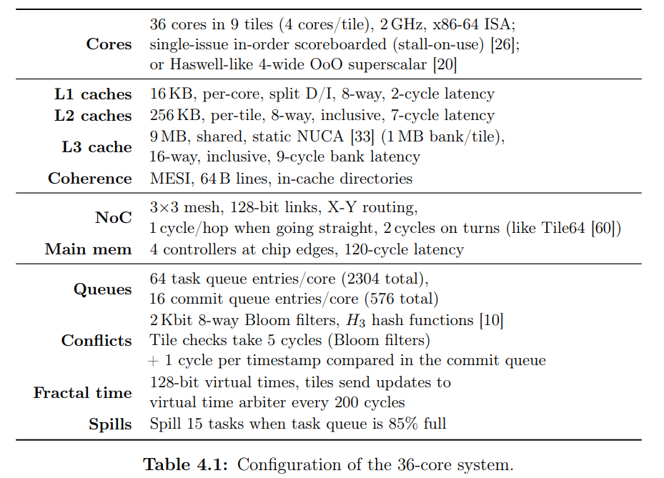
Hardware Configuration

