Slide 1
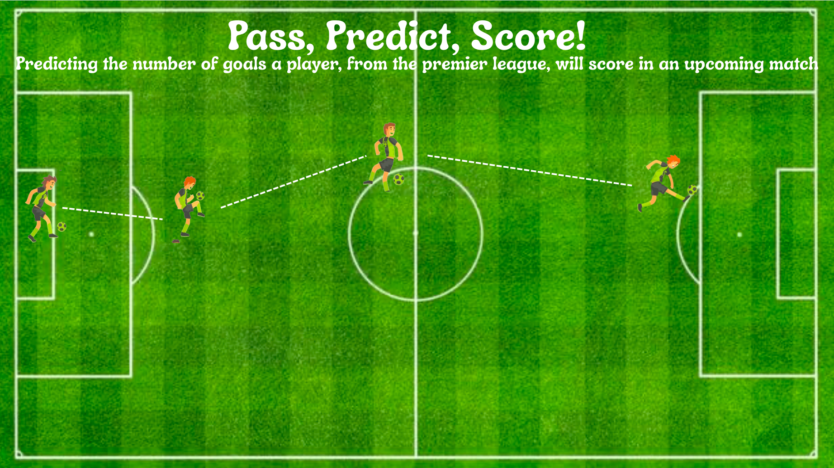
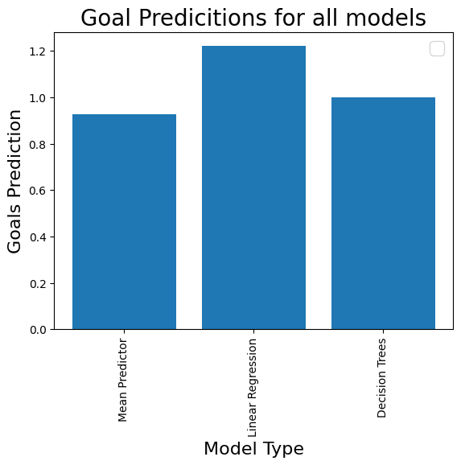

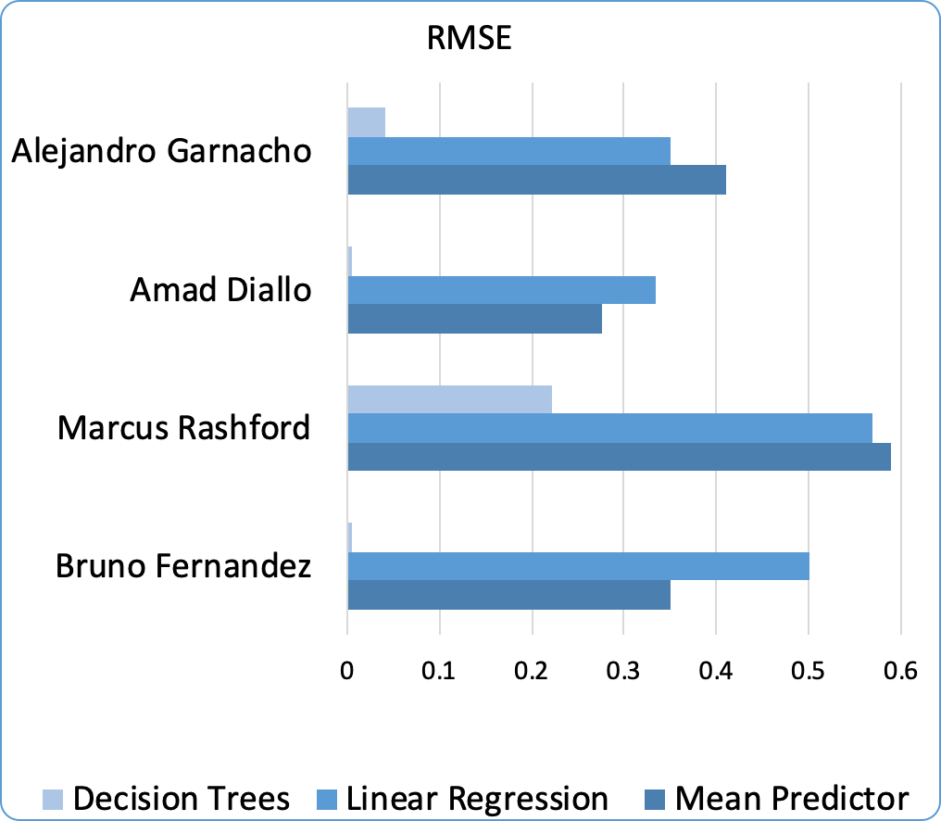

Loading Dataset
Cleaning and Splitting
data
Which “tactic” should I use?
DECISION TREES!
Use the tactic with the lowest error!

