Slide 1
TUBERCULOSIS RISK ANALYSIS
VICTORIA JEMUTAI
1O^{TH} JUNE 2025

Slide 2
PROBLEM STATEMENT
TB is one of the major leading causes of death in the world from a single infectious agent, following three years in which it was replaced by coronavirus disease (COVID-19).
The aim of the project is to analyze the burden of TB in high risk WHO regions in terms of incidence and mortality rates.
Visualize the health systems performance in response to TB and finally build a logistic model to predict case detection rate for the disease.
The insights drawn from the analysis would help inform public health decision making in policies aimed at preventing TB in populations.

Slide 3
DATA UNDERSTANDING
The datasets used in the project are sourced from World Health Organization (WHO) https://www.who.int/data/gho/data/themes/tuberculosis.
They include three csv files:
MDR_RR_TB_burden_estimates_2025-06-06
Contains data on MDR-TB which is a form of TB caused by bacteria that do not respond to isoniazid and rifampicin, the two most effective first-line TB drugs.
TB_burden_countries_2025-06-07
Captures the overall burden estimates of disease in the WHO regions
TB_data_dictionary_2025-06-06.
Provides description of the data variables in the other two csv files which is also provided by the text description file.

Slide 4
OBJECTIVES
The project aims to answer the following questions;
What are the countries in the WHO region that have a high burden of TB both in terms of mortality and incidence?
The WHO guidelines categorize countries that have an incidence of greater than 100 per 100 000 population as high-risk
regions.
How is the health system performance in diagnosing TB?
We have data on case detection including for Lab-confirmed resistant TB. This will allow us to identify underdiagnosis of
the disease and data quality of cases reported.
What is the accuracy of test in detecting TB cases?
Is the test sensitive enough to detect less false negative cases?

Slide 5
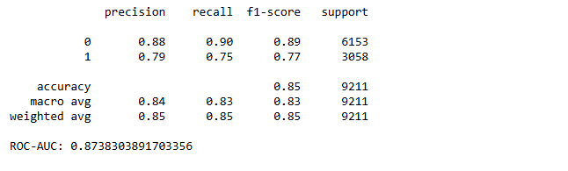
RESULTS
Incidence levels in different regions
A logistic regression model was built to identify high and low risk regions.
The model achieves an overall accuracy of 85% and a strong ROC-AUC of 0.87, indicating excellent ability to distinguish between high-risk and not-high-risk cases.

Slide 6
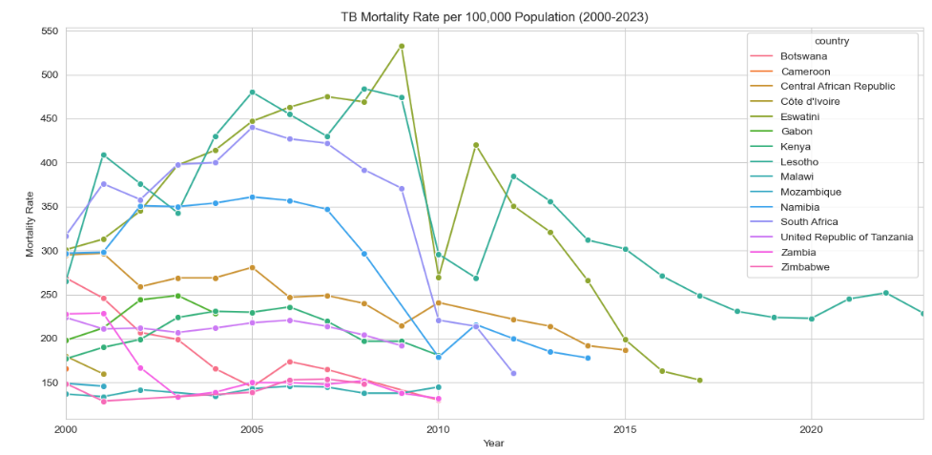
Mortality rates in different regions

Slide 7
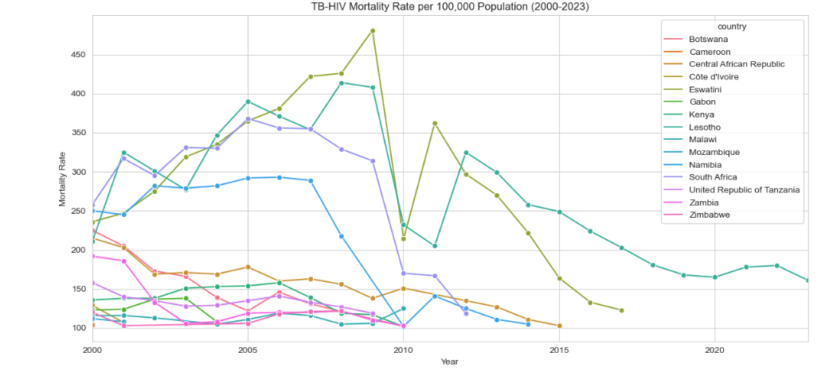
Both show broadly similar trends, with many countries experiencing a peak in mortality rates in the early to mid-2000s, followed by a general decline.
This suggests that the decline in overall TB mortality is significantly influenced by the reduction in TB-HIV co-mortality.

Slide 8
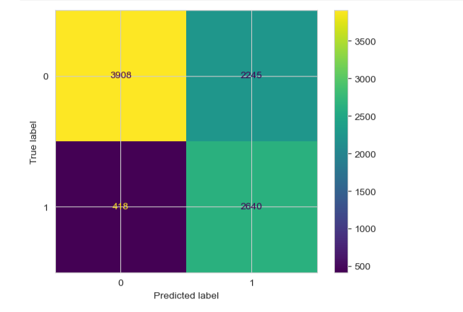
TB case detection accuracy
In identifying as many true positives as possible , this model's high recall is a strength.

Slide 9
RECOMMENDATIONS
The logistic model works well in identifying high risk and non-high-risk regions
The model with an overall accuracy of 85% and a strong ROC-AUC of 0.87 works well in distinguishing the two classes and can be used in public health to drive intervention efforts to these countries.
TB and HIV are co-morbid
From the visualizations, it is clear that people with HIV are more susceptible to getting TB due to weak immunity. The two are a lethal combination each speeding the other's progress.
TB case detection

Slide 10
NEXT STEPS
Further analysis on:
Health system performance
Using variables like bacteriologically confirmed TB cases, case detection and case fatality rate, we could give insights in to the health system performance in diagnosis of TB.
Use the mortality rates to estimate impact of TB.
Identify treatment coverage areas
Using the case detection rate, we can map out the treatment coverage

