Slide 1
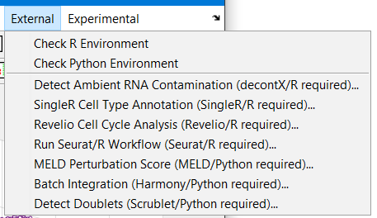
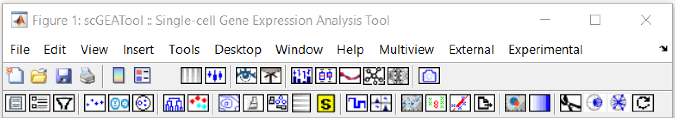
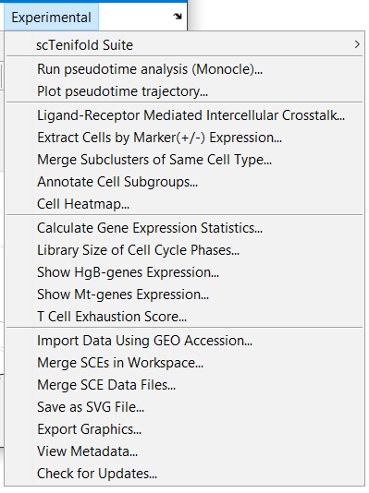
Multiview of Cells
Cross Tabulation
Build Gene Regulatory Network
Compare 2 Networks
Compare Differentiation Potency
Show DE between groups
DE analysis
HVG genes
Select a gene to show expression
Show cell states
Select cells by class
Switch marker type
Switch color maps
Refresh
Embedding
Switch 2D/3D
Label clusters
Add brushed cells to a new cluster
Merge brushed cells to same cluster
Show clusters individually
Assign cell type to brushed cells
Assign cell type to clusters
Rename cell type
Marker genes of brushed cells
Marker gene heatmap
Delete selected cells
Export & save data
Clustering using embedding S
Clustering using expression matrix X

Slide 2
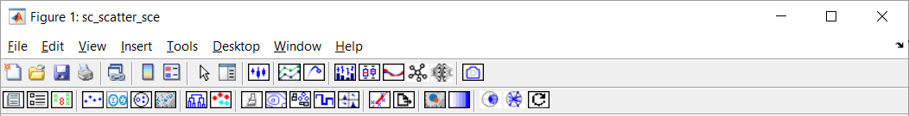
Run pseudotime analysis (Monocle)
Plot pseudotime trajectory
Compare Differentiation Potency
Build Gene Regulatory Network (GRN)
Compare 2 Networks
Select a gene to show expression
Show cell states
Select cells by class
Show DE between groups
Compare 2 groups (DE analysis)
Function enrichment of HVG genes
Switch marker type
Switch color maps
Refresh
Embedding
Switch 2D/3D
Label clusters
Add brushed cells to a new cluster
Merge brushed cells to same cluster
Show clusters individually
Assign cell type to brushed cells
Assign cell type to clusters
Rename cell type
Marker genes of brushed cells
Marker gene heatmap
Delete selected cells
Export & save data
Clustering using embedding S
Clustering using expression matrix X

Slide 3
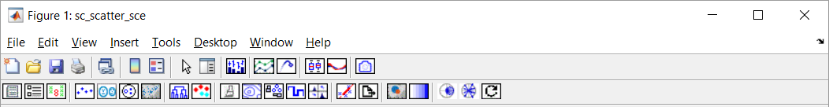
Run pseudotime analysis (Monocle)
Plot pseudotime trajectory
Compare Differentiation Potency
Select a gene to show expression
Show cell states
Select cells by class
Switch scatter plot marker type
Switch color maps
Refresh
Compare 2 groups (DE analysis)
Function enrichment of HVG genes
Embedding
Switch 2D/3D
Label clusters
Add brushed cells to a new cluster
Merge brushed cells to same cluster
Show clusters individually
Assign cell type to brushed cells
Assign cell type to clusters
Rename cell type
Marker genes of brushed cells
Marker gene heatmap
Delete selected cells
Export & save data
Clustering using embedding S
Clustering using expression matrix X

Slide 4
