Slide 1
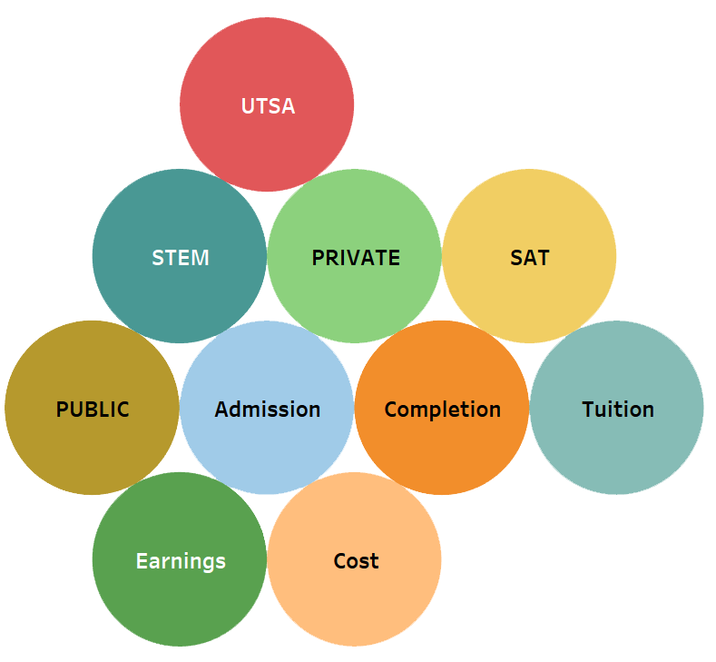
Do expensive schools guarantee a higher income?
Hanane Mirza
Oscar Ferreiro
Victoria Miner
Problem Description:
DataSet : College Scorecards
https://collegescorecard.ed.gov/data/
Notes:
problem description

Slide 2
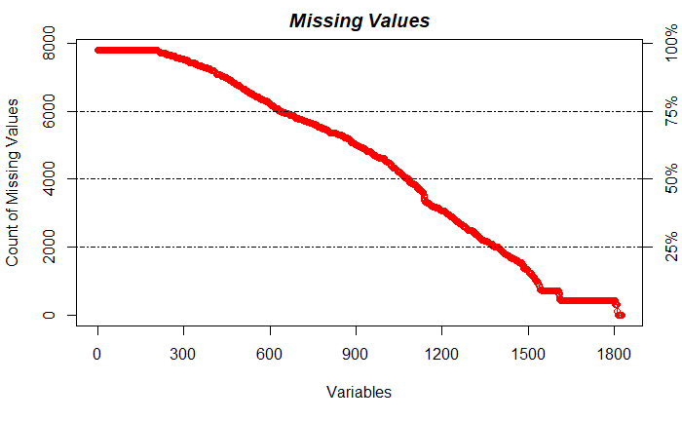
Challenges
1825 variables. 7804 observations
Extensive data cleaning.
We need a reliable variable selection method.
Interpretability may be complex due to big amount of variables.

Slide 3
Uniqueness
No predictive study was ever done Other studies storytell
US News & World Report
The New York Times
The Atlantic
Addressing the ROI aspect
Notes:
uniqueness
key: other factors* model building not telling a story/looking for causation
we will have technical audience

