Slide 1
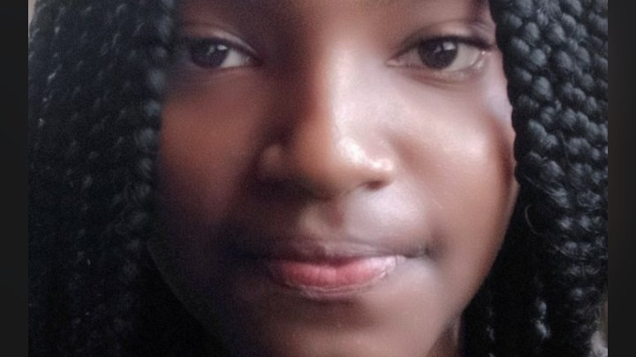
Victoria Riri Wagura — Why Brown
Applicant | Module 2
Notes:
Quick greet: Hello — I’m Victoria Riri Wagura. This short deck explains why Brown’s Open Curriculum and research environment are the natural next step for my interdisciplinary work in perception and systems engineering.

Slide 2
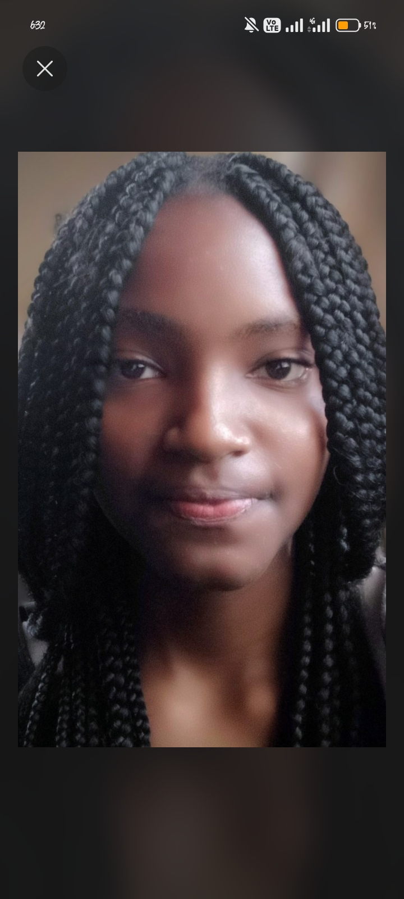
About
Name: Victoria Riri Wagura
Home country: Kenya
Module: 2
Intended major: Computer Engineering / Robotics (flexible)
Notes:
Short personal context: I build systems that connect people and machines. My background spans deployed products and perception research prototypes — I care about engineering that serves people.

Slide 3
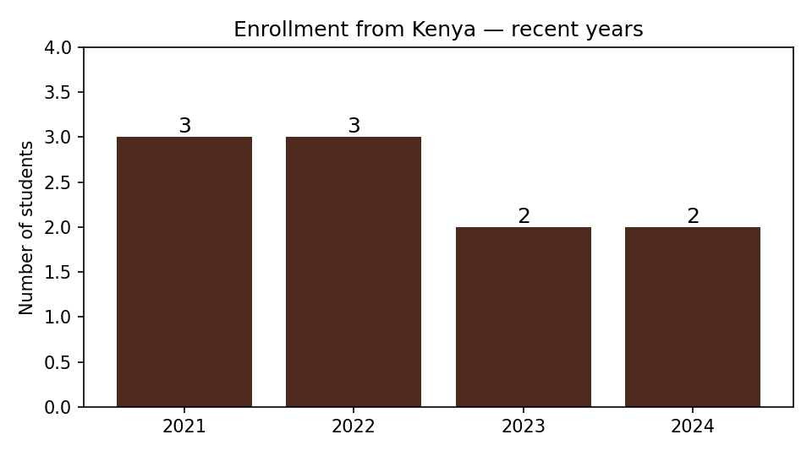
Counts reflect enrolled students from Kenya. Source: Francis Parserio (LinkedIn).
Notes:
This small but stable set of students from Kenya highlights how each admits' experience matters. I’m citing Francis Parserio’s note on enrollment trends (link in Sources).

Slide 4
Why Brown
Brown’s Open Curriculum is the environment I need to grow as a generalist who pursues deep technical work across multiple domains. I’m one of those learners with many loves: a curiosity for movement perception, a builder’s instinct for systems integration, and a commitment to technology that serves communities. At Brown I can explore these threads freely — testing ideas through Satisfactory/No Credit while discovering whether a subject is a passing interest or a true intellectual home. That freedom, paired with Brown’s culture of collaborative scholarship, is the reason I want four focused years to turn exploratory projects into rigorous research and impact.
Notes:
Expand briefly on personal examples: MotionTrace (perception), Jewellery818 (systems), Smartsolve (human-centered service).

Slide 5
Academic interests
• Intended major: Computer Engineering / Robotics (open to interdisciplinary pathway)
• Concentrations: perception & human-robot interaction, systems engineering, AI & society
• Course types: advanced robotics, probabilistic perception, ethics & society seminars
Notes:
Mention eagerness to take advantage of cross‑department advising; intent to work with labs and take S/NC to explore.

Slide 6
Project portfolio — how the pieces connect
MotionTrace — pose estimation and perception. MotionTrace extracts structure from human movement; it’s the perception problem that lets machines see bodies.
Jewellery818 — full-stack systems engineering & deployment. Integration: CMS, JSONBin sync, Vercel; built the muscle of product engineering.
Smartsolve — free tool for Kenyan students; demonstrates human-centered motive and community focus.
Notes:
Narrative: Jewellery818 taught systems and deployment; limited traction led to MotionTrace — perception; Smartsolve shows ethics & access. This arc maps to Tellex’s lab interests.

Slide 7
Why Professor Tellex’s lab
Shared core question: before a system can respond to people, it must first perceive them accurately.
My interest: developing algorithms to connect perception (pose, gesture) with interactive response.
MotionTrace made me confront the same central problem Professor Tellex addresses: a system can’t respond meaningfully to a person until it can see what the person is doing.
Notes:
Tie to lab methods or proposed work: e.g., integrating pose outputs into dialogue and robot action pipelines.

Slide 8
Campus life and landmarks
• Granoff Center for the Creative Arts — interdisciplinary creative space.
• Van Wickle Gates — ceremonial campus gateway; a community gathering place.
• Sciences Library — central STEM study resource.
• Main Green — historical gathering place; where students heard news of the Open Curriculum.
Notes:
Include these places because they speak to Brown’s culture — public, collaborative, and creative.

Slide 9
News & context
Recent reporting by Francis Parserio highlights enrollment counts and campus context — included here for transparency and context.
Article link (see Sources): https://share.google/yhBkQuBqDMW9zZ94v
Notes:
This article is included as context for the enrollment numbers and as a public source. It does not change my application narrative; it situates the statistics.

Slide 10
Sources & image credits
• Enrollment statistics: Francis Parserio — LinkedIn / article
• News article: https://share.google/yhBkQuBqDMW9zZ94v
• Portrait: supplied by applicant (used with permission)
• Campus images: use Brown University official pages or campus photos with attribution
Notes:
If the application requires the official logo or color usage rules, confirm and I’ll adjust.

Slide 11
Thank you
Victoria Riri Wagura
Email: victoriawagura@gmail.com
I welcome the opportunity to discuss research fit and coursework.

