Slide 1
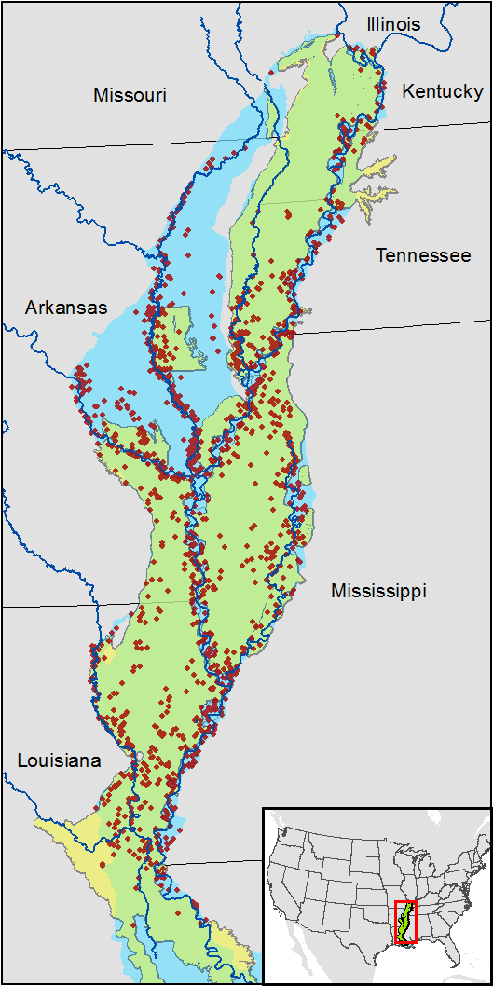

Slide 2
xS
S
M
L
xS
S
M
L
area (ha)
length (km)
width (m)
length/width
inundation index
disconnection (km)
agriculture cover (%)
P depth > 2 m
wetland
forest
cover (%)
within batture (%)
Cluster
Cluster

