Slide 1

STARK HEALTH CLINIC
DIABETES PREDICTION PROJECT
A Data-Driven Approach for Early Detection and Intervention
Victoria Baba
Data scientist
15/02/2025

Slide 2

BackGROUND
Current State at Stark Health Clinic
  Leading healthcare provider leveraging technology.
  Integrating machine learning to improve operations.
  Current early diabetes detection lacks precision.
Problem Statement
  Missed early interventions due to inaccurate detection.
  Increased health risks and financial burden.
  Need for a precise predictive mode.

Slide 3

Project Objective
Current State at Stark Health Clinic
Develop a robust diabetes prediction model using
advanced machine learning techniques.
Improve early identification of high-risk individuals.
Enable timely preventive measures for better patient outcomes.
Key Challenges
Ensuring model accuracy and interpretability.
Handling data privacy and compliance.
Integrating predictions into clinical workflows.

Slide 4
Data Exploration Process
Data collection
Data cleaning
Data visualization using Univariate, Bivariate, Multivariate Analysis for both categorical and numerical data
Correlations
Feature Engineering
Model Selection
Model Training & Evaluation
Conclusion and Recommendations

Slide 5
data Description
Data Collection: Technology stack used are Python, NumPy, Pandas, MatPlotLib/Seaborn, SciKitLearn,
Anaconda & JupyterNotebook
Patient demographics, medical history, lifestyle factors, outliers.
Number of patients : 99999
Features are 9 namely: Gender, Age, Hypertension, Heart disease, Smoking history,
BMI, HbA1c level, Blood glucose level, Diabetes

Slide 6
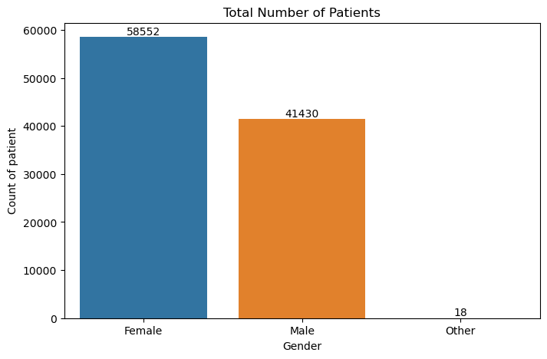
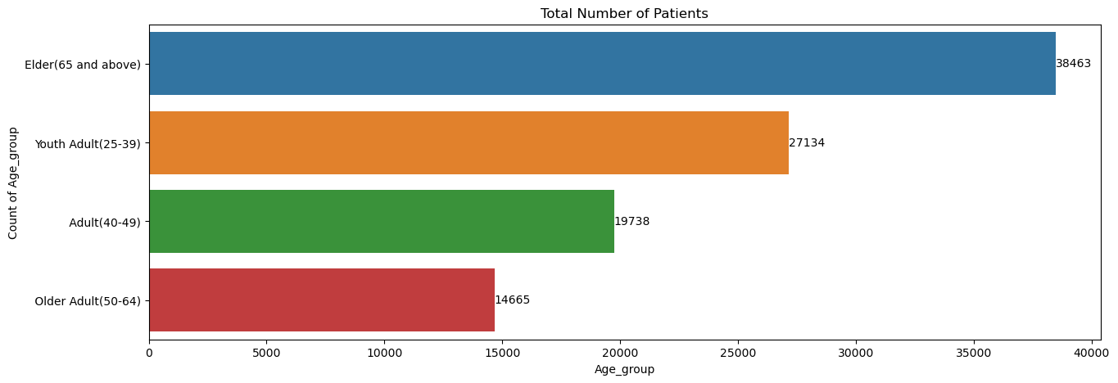
Patients aged 65 and above were the most prevalent, followed by young adults.
Among the total patients, females outnumbered males.

Slide 7
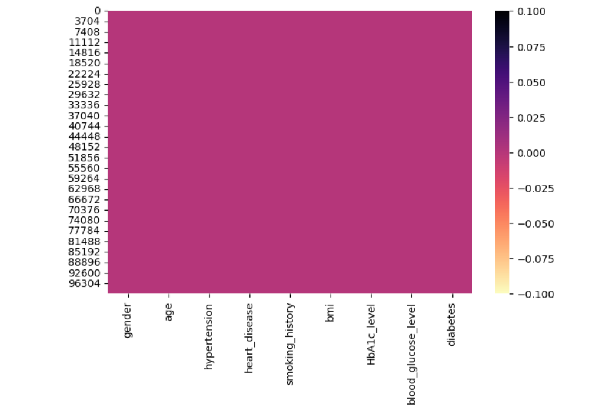
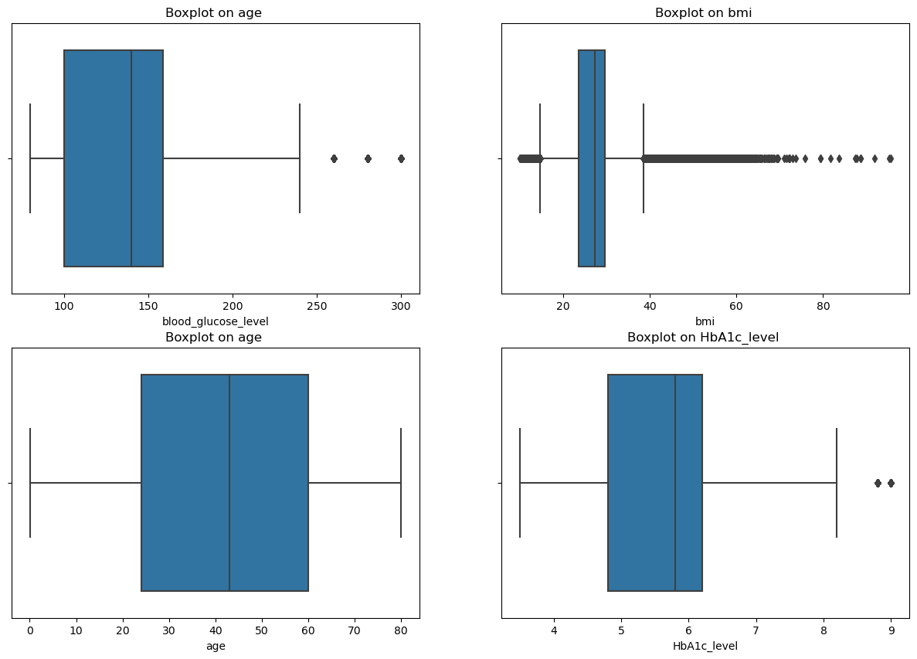
Outliers: Bmi feature had a lot of outliers while blood glucose and HbA1C had outliers but not as much as the bmi
Missing Value: no missing value

Slide 8
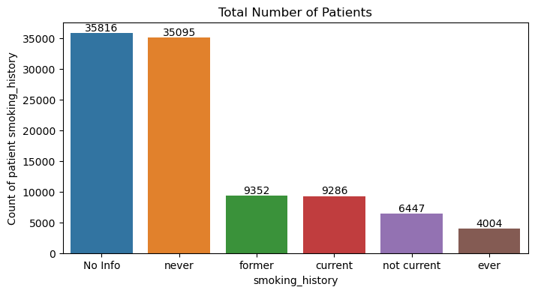
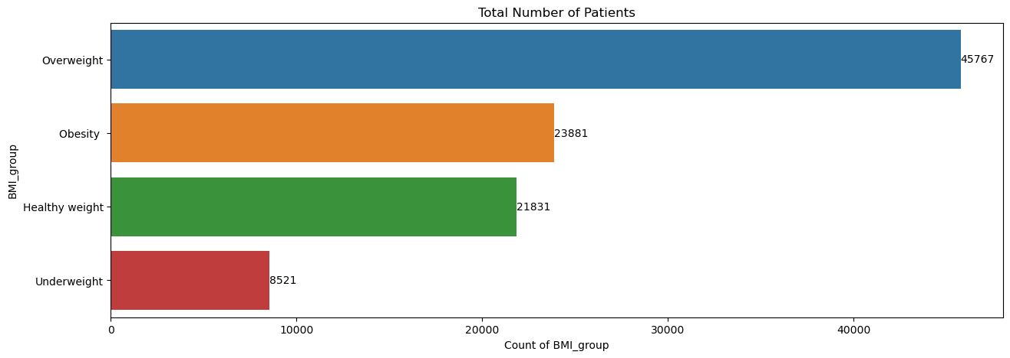
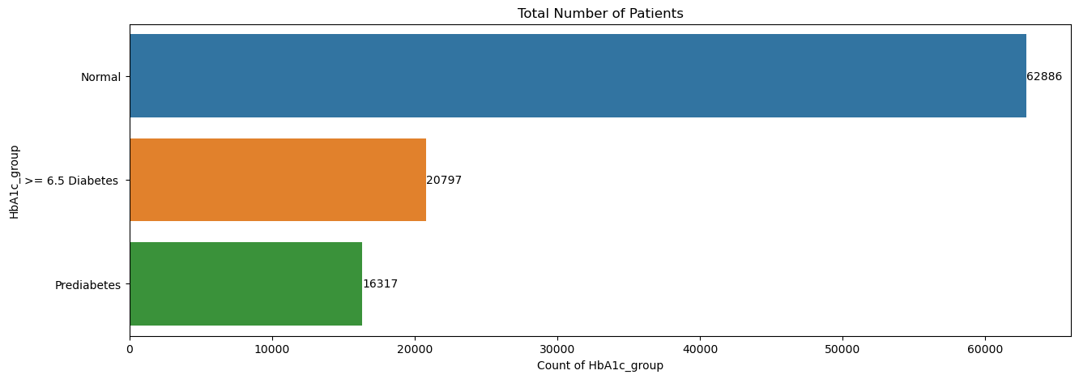
Univariate Analysis
Patients we have no information about there smoking habits and the ones that have never smoked toped the chart.
Patients that were overweight topped the chart and were followed closely by obese patients.
In this data set the patient that had normal HbA1c levels were more .

Slide 9
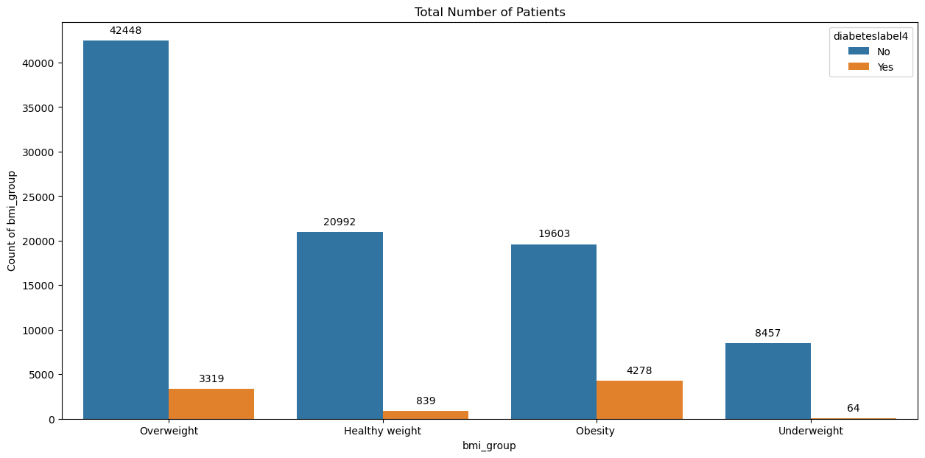
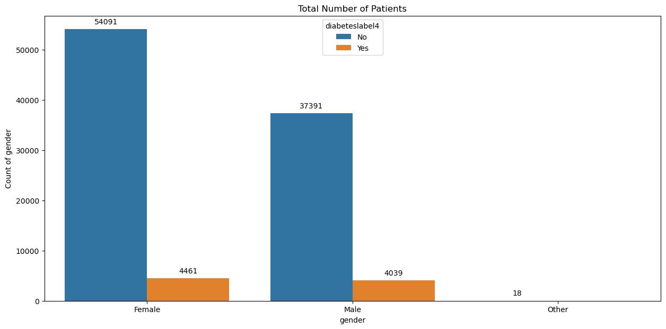
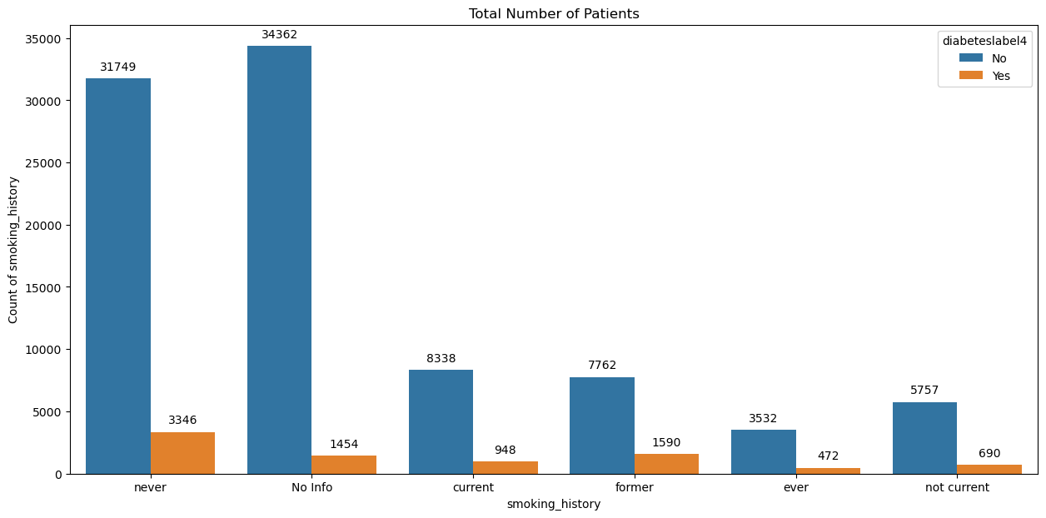
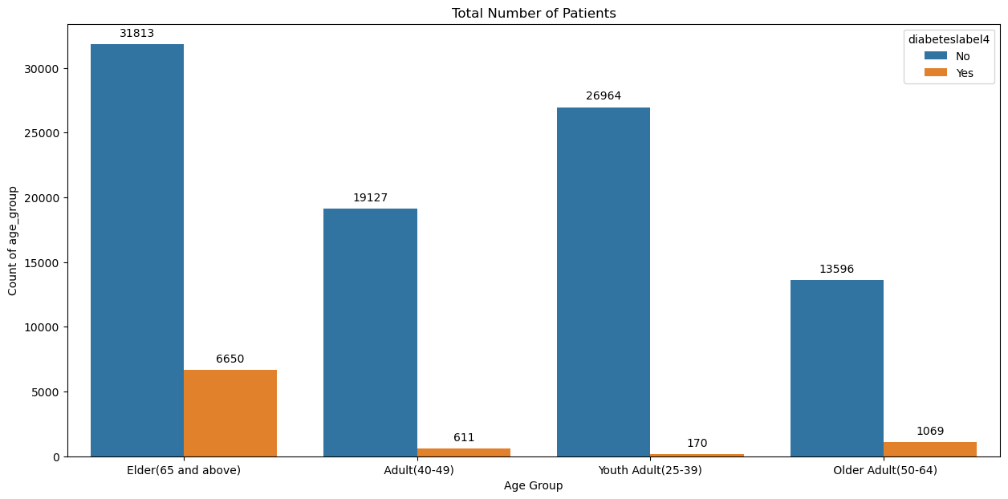
Bivariate Analysis
No significant difference in the gender
The people aged 65 and above had more people with diabetes
Overweight and obese people were topping the chart
People that had never smoked had more diabetic patients

Slide 10
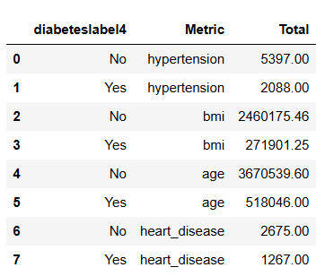
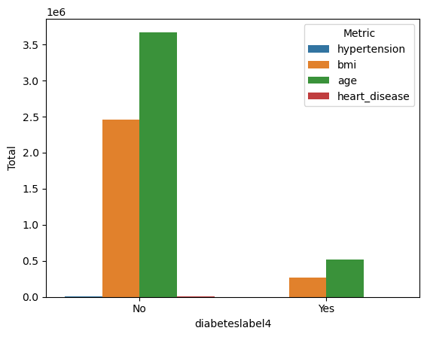
Multivariate analysis of 4 features : BMI was the highest among diabetic patients, likely due to the high prevalence of obesity and overweight individuals.

Slide 11
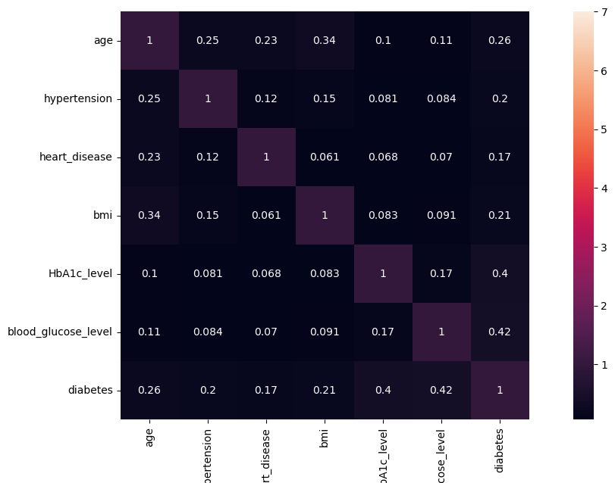
Correlation
Strongest correlations: Blood Glucose (0.42) and HbA1c (0.40) are the most significant predictors of diabetes risk.
Moderate correlations: Age (0.26), Hypertension (0.20), BMI (0.21), and Heart Disease (0.17) are all linked to increased diabetes risk, but with weaker correlations.

Slide 12
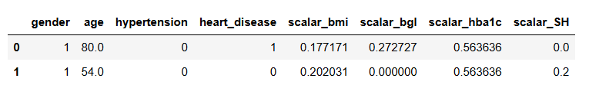
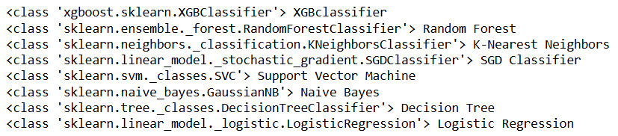
Feature Engineering: Encoding the gender and smoking history columns.
Normalization of the data between
Model Selection

Slide 13
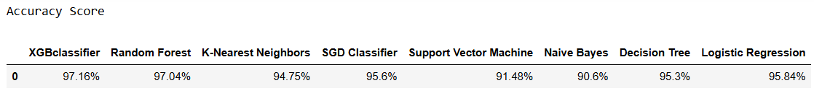
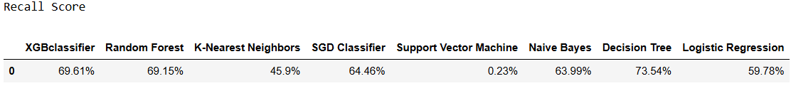
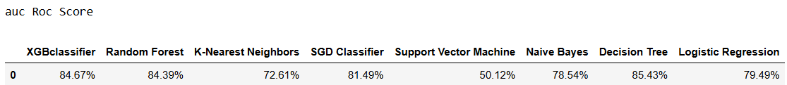
Model Training & Evaluation: Precision, Recall, F1-Score metrics
.

Slide 14
Findings
Blood glucose levels and HbA1c are the most significant predictors of diabetes, while age and BMI also contribute, albeit to a lesser extent.
The Logistic Regression model performed well overall, but there is room for improvement, particularly in reducing false negatives (missed diabetic cases). While the model correctly identifies diabetic cases, it could be refined to minimize these false negatives.
The model demonstrates high accuracy and strong specificity, which means it effectively identifies non-diabetic individuals with minimal false positives. However, the relatively high number of false negatives is concerning, as it indicates that some diabetic cases are being overlooked—a critical issue in medical applications.
To address this, the model should be optimized to improve sensitivity, ensuring a better identification of diabetic cases.

Slide 15
Conclusion/ Recommendations
To improve diabetes detection, address class imbalance, adjust the decision threshold to prioritize recall, and implement cost-sensitive learning to penalize misclassifications.
Using ensemble methods and tuning model hyperparameters can boost predictive performance.
Further improvements may include exploring advanced algorithms and additional features.
GITHUB
https://github.com/VictoriaVB/STARK-HEALTH-CLINIC-DIABETES-PREDICTION-PROJECT

Slide 16

Thank You
LOOKING AHEAD

