Slide 1
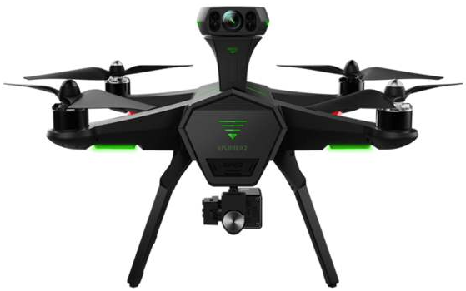
G2A
 | Restored Areas
 | UAV
 | Base Station
Degradation Degree
0.1 | 0.3 | 0.5 | 0.7 | 0.9

Slide 2
G2A
G2A
G2A
G2A
 | Restored Areas
 | UAV
 | Fusion Center
Degradation Degree
0.1 | 0.3 | 0.5 | 0.7 | 0.9

