Slide 1

Project Title
MediMind: AI-Powered Hospital Appointment & Patient Care Platform
SOA Project Review-2
Date& Time
Thursday, 24th September 2026
 | Under the Guidance of Dr.Neelima Gogineni Associate Professor, Department of Computer Science and Engineering, KLH CSE Bowrampet Campus
Team Members Name G. Vidya Roll Number 2420030386 Name M. Yasasvi Roll Number 2420030388 Name S. Gagan Sai Roll Number 2420030352
Notes:
MediMind AI is an AI-powered hospital appointment and patient-care platform that uses Agentic AI and Service-Oriented Architecture to make healthcare appointment workflows more intelligent, personalized, and efficient.
Normally, a hospital appointment system lets a patient search for a doctor and book an appointment. Our system goes a step further. It uses AI agents to understand the patient's requirements, help them identify the appropriate healthcare service, plan possible next steps, consider hospital availability, and maintain a useful summary of their healthcare information."

Slide 2
Outline of Project Work
Focus
Introduction
System Architecture
Challenges
Methodology
Conclusion & Future Work
References
Publications Details
Notes:
Good morning ma’am. Our project is MediMind AI, an AI-powered hospital appointment and patient-care platform. Traditional hospital appointment systems mainly focus on basic functions such as searching for doctors and booking appointments. However, they provide limited intelligent assistance to patients and do not actively coordinate the different parts of the healthcare workflow.
MediMind addresses this by integrating Agentic AI with Service-Oriented Architecture. The system uses AI to assist patients, support appointment coordination, and provide a more personalized healthcare experience.”

Slide 3
Problem Statement
Traditional hospital appointment systems mainly focus on basic appointment scheduling and record management.
They provide limited support for:
Understanding patient requirements
Guiding patients towards suitable healthcare services
Coordinating appointments efficiently
Managing hospital and department workload
Providing personalized healthcare assistance
Therefore, there is a need for a secure, scalable, and intelligent healthcare platform that can automate appointment-related workflows using AI agents and SOA-based microservices.
Notes:
MediMind AI is an AI-powered hospital appointment and patient-care platform that uses Agentic AI and Service-Oriented Architecture to make healthcare appointment workflows more intelligent, personalized, and efficient.
Normally, a hospital appointment system lets a patient search for a doctor and book an appointment. Our system goes a step further. It uses AI agents to understand the patient's requirements, help them identify the appropriate healthcare service, plan possible next steps, consider hospital availability, and maintain a useful summary of their healthcare information."

Slide 4
Objectives
O1. To develop a secure hospital appointment management platform using SOA and microservices.
O2. To integrate AI-based agents for intelligent patient assistance and healthcare workflow automation.
O3. To develop an AI Health Journey Predictor for generating personalized healthcare pathways.
O4. To develop an AI Hospital Load Balancer for assisting appointment coordination based on workload and availability.
O5. To develop an AI Digital Health Twin that maintains an evolving AI-generated summary of relevant patient information.
O6. To evaluate the proposed system based on response time, appointment efficiency, resource utilization, security, and usability.
Notes:
Our proposed system combines Artificial Intelligence, Agentic AI, and SOA-based microservices. Instead of having one large application, we divide the system into different services such as authentication, patient, doctor, appointment, AI, and notification services
The important part of our project is Agentic AI. Unlike a normal chatbot that only gives a response, an AI agent can analyze information, make a context-based decision, and participate in the application workflow.”
“In MediMind, the AI is used for patient assistance, healthcare journey prediction, resource-aware appointment coordination, and maintaining relevant patient information.”

Slide 5
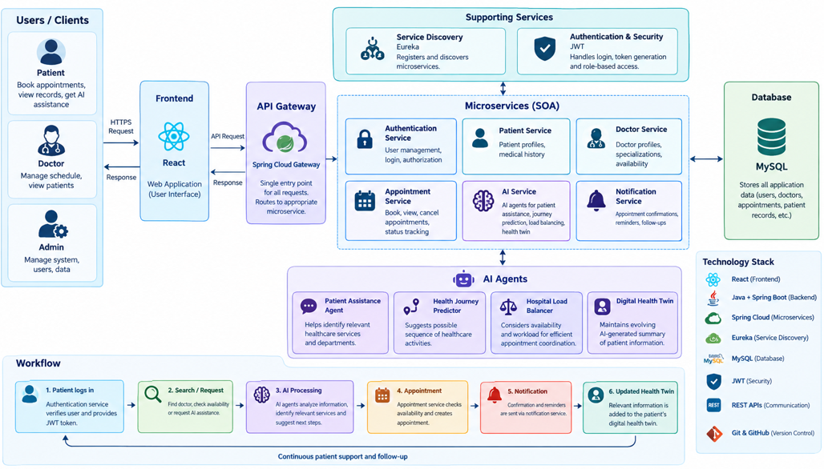
System Architecture
Notes:
“Our system follows a Service-Oriented Architecture.”
“The user interacts with our React frontend. The request then goes to the Spring Cloud API Gateway, which acts as the entry point and routes the request to the required microservice.”
“Our main microservices are Authentication, Patient, Doctor, Appointment, AI, and Notification.”
“Eureka provides service discovery between the microservices, while REST APIs are used for communication.”
“MySQL is used for storing the application data, and JWT is used for authentication and authorization.”
“The important part of our architecture is the AI Service, which connects our AI-based features with the healthcare workflow.”

Slide 6
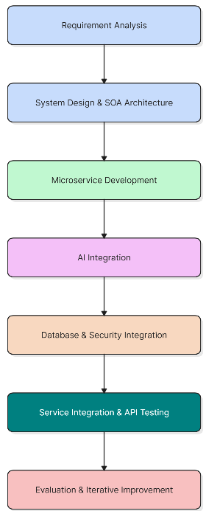
Methodology
Requirement Analysis – Identify healthcare workflow problems and system requirements.
System Design – Design the SOA-based architecture and define independent microservices.
Microservice Development – Develop Authentication, Patient, Doctor, Appointment, AI, and Notification Services.
AI Integration – Integrate AI agents for patient assistance, journey prediction, load balancing, and digital health twin.
Database & Security – Use MySQL for data management and JWT for authentication and authorization.
Integration & Testing – Connect services using REST APIs and test APIs using Postman.
Evaluation & Improvement – Evaluate functionality, security, usability, response time, and appointment workflow efficiency.
Notes:
Our methodology follows an iterative development approach along with Service-Oriented Architecture.”
“First, we perform requirement analysis to identify the healthcare workflow problems and system requirements.”
“Then we design the SOA architecture and define the microservices.”
“Next, we develop the individual services and integrate the AI functionality.”
“We then integrate MySQL for data management and JWT for security.”
“After that, we connect the services using REST APIs and test the APIs using Postman.”
“Finally, we evaluate the system and improve the implementation based on the results.”

Slide 7
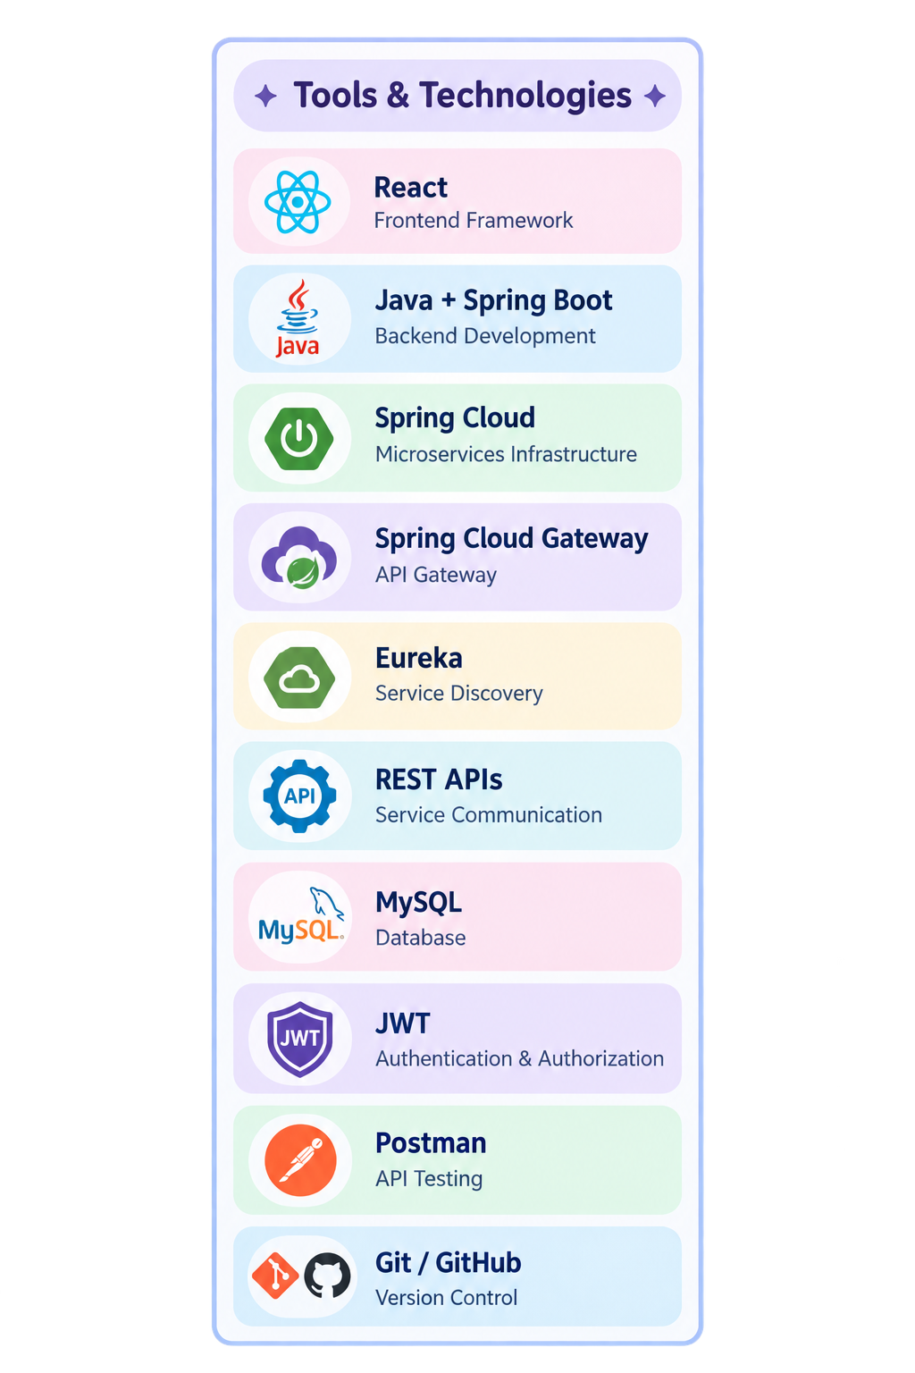
Technical Soundness
Frontend: React-based web interface for patients, doctors, and administrators.
Backend: Java + Spring Boot for developing independent microservices.
SOA: Authentication, Patient, Doctor, Appointment, AI, and Notification Services.
API Gateway: Spring Cloud Gateway routes client requests to the appropriate service.
Service Discovery: Eureka enables dynamic registration and discovery of microservices.
Communication: REST APIs are used for communication between frontend and backend services.
Database: MySQL stores user, doctor, patient, and appointment-related data.
Security: JWT-based authentication and role-based authorization protect system resources.
AI Integration: AI Service provides intelligent patient assistance and AI-based healthcare workflow support.
Testing & Version Control: Postman is used for API testing, while Git/GitHub is used for version control and project management.
Notes:
“For the frontend, we use React to provide the user interface.”
“For the backend, we use Java and Spring Boot to develop the microservices.”
“Spring Cloud provides the microservice infrastructure. Spring Cloud Gateway handles request routing, while Eureka provides service discovery.”
“REST APIs are used for communication between the components.”
“MySQL is used for storing application data.”
“For security, we use JWT-based authentication and role-based authorization.”
“Postman is used for API testing, and Git and GitHub are used for version control and project management.”

Slide 8
Problem Gap Identification
Existing Healthcare Appointment Systems
Mainly focus on appointment booking and cancellation.
Provide basic doctor and department search.
Maintain mostly static patient information.
Have limited personalization.
Usually do not coordinate multiple intelligent healthcare workflows.
Identified Research Gap
There is a need for an integrated platform that combines:
Agentic AI
Intelligent appointment coordination
Personalized healthcare journeys
AI-assisted hospital resource management
AI-generated patient health profiles
SOA-based microservices
Proposed Gap Addressed
MediMind AI bridges this gap by integrating multiple AI agents with independently managed SOA microservices into a unified healthcare appointment and patient-care platform.
Notes:
he patient interacts with our React frontend. The request first reaches the API Gateway, which acts as the entry point and routes the request to the required microservice.”
“Our main services are Authentication, Patient, Doctor, Appointment, AI, and Notification.”
“The services communicate using REST APIs, while Eureka provides service discovery between the microservices.”

Slide 9
Literature Survey
Authors | Title of the Paper | Methodology | Inferences | Limitation/Future work
Ali Ala, Feng Chen | Appointment Scheduling Problem in Complexity Systems of the Healthcare Services | Review of 150+ healthcare scheduling studies covering patient flow, preferences, waiting time, uncertainty, simulation, mathematical optimization, and AI-based approaches. | AI and optimization can reduce waiting time and improve resource utilization | Scheduling remains complex due to uncertainty and patient preferences
Knight et al. (2023) | Artificial Intelligence for Patient Scheduling in the Real-World Health Care Setting | Metanarrative review of 11 real-world AI scheduling studies | AI can improve scheduling efficiency, workload, and patient-directed care | Evidence is heterogeneous; further validation and bias assessment needed
Drummond & Gonsard (2024) | Definitions and Characteristics of Patient Digital Twins Being Developed for Clinical Use | Scoping review of 86 papers / 80 claimed Digital Twins | Digital Twins can integrate multiple types of patient data | Lack of consensus and limited clinical maturity

Slide 10
Innovation, Creativity, and Novelty
1. AI Health Journey Predictor
Generates a personalized healthcare pathway based on relevant patient information and helps the patient understand possible next steps in their healthcare process.
2. AI Hospital Load Balancer
Considers hospital or department availability and workload to assist in efficient appointment coordination and improve utilization of healthcare resources.
3. AI Digital Health Twin
Maintains an evolving AI-generated summary of relevant patient information, allowing important information to be presented in a consolidated form.
Notes:
“The first is the AI Health Journey Predictor, which generates a possible personalized sequence of healthcare activities.”
“The second is the AI Hospital Load Balancer, which considers factors such as availability and workload to assist with appointment coordination.”
“The third is the AI Digital Health Twin, which maintains an evolving AI-generated representation of relevant patient information.”

Slide 11
Feasibility and Project Plan
TIMELINE CHART FOR EACH PHASE OF YOUR PROJECT SHOULD BE THERE AFTER EXPLANATION
Literature Survey & Requirement Analysis → W1–W2
SOA Architecture & Microservice Design → W2–W3
Database & Authentication Service Development → W3–W4
Patient, Doctor & Appointment Services → W4–W5
AI Agent Integration & Novel Features → W5–W6
Frontend & Service Integration → W5–W7
System Testing, Security & Performance Evaluation → W6–W8
Documentation & Final Presentation → W7–W8

