Slide 1
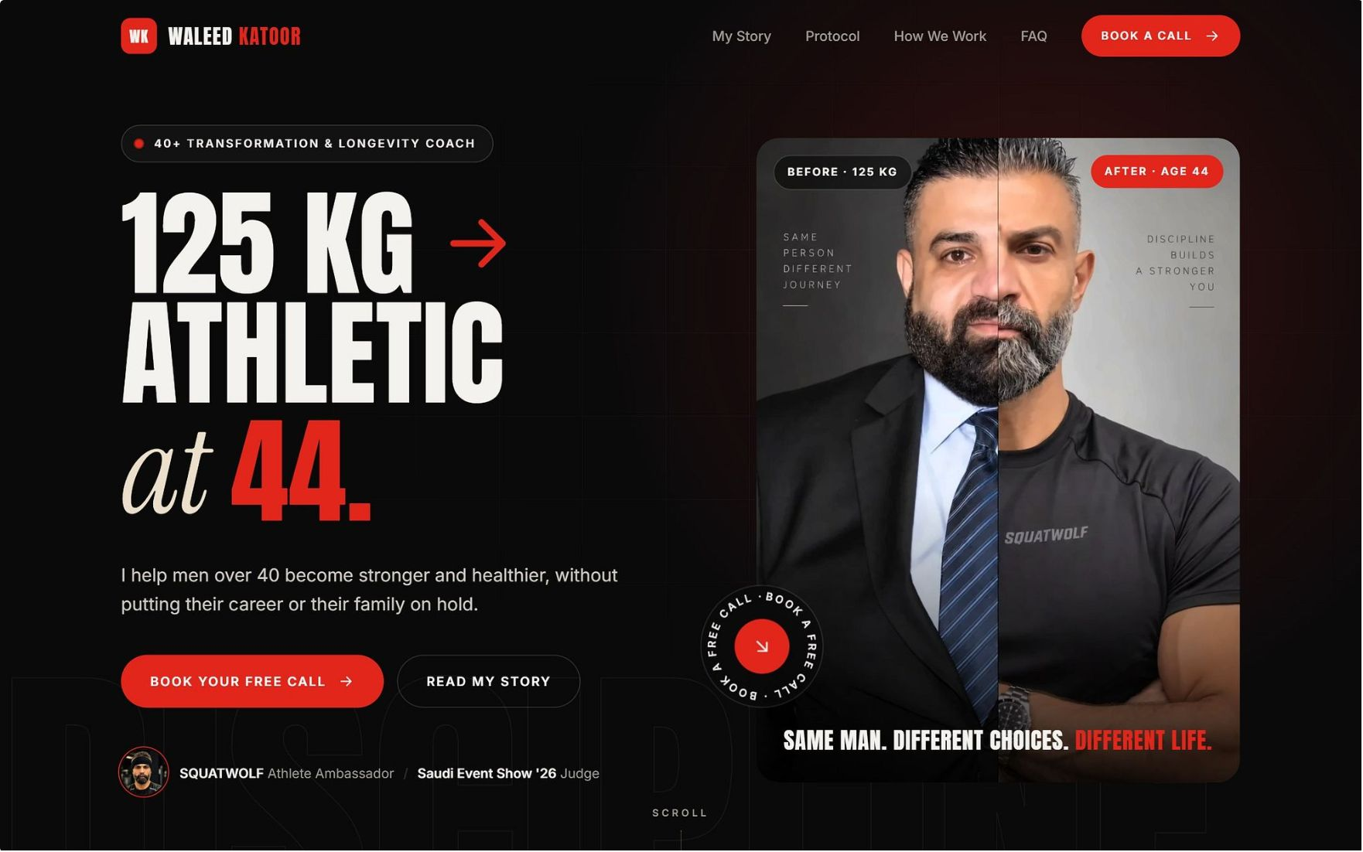
Waleed Katoor
Executive Longevity · Digital Growth Strategy
ما بتشتريها. بتكسبها.
"You cannot buy your health. You will earn it." — Waleed Katoor
One connected system that turns attention into booked calls, calls into clients, and clients into proof.
Prepared by Vida AI · Steven Ayman · Mario Wagyih Gomaa · Sameh Usama Shukry · September 2026

Slide 2
The plan on one page
Waleed went from roughly 125 kg to athletic at 44 while running a director-level job and raising three daughters. He isn't selling fitness. He is proof that a busy man can recover his health.
Today that story doesn't turn into business: 1,209 posts, 1,232 followers, no website, no booking path, no client system. But the account is moving: the last 30 days ran at 1,023 median views against 827 before. This is a build, not a rescue.
Social Media
Website
Creates demand: 4 Reels a week + a Saturday carousel, Arabic-first, him on camera
Converts: one page, eight sections, a calendar wired into automation
CRM
AI Automation
Runs the coaching: dashboard, client profiles, progress, payments, voice notes
Removes the admin: nine client automations + a leads engine

Slide 3
Five decisions that shape everything
1
Proof, not coach
He shares what worked on him and sends people to specialists for the details.
2
He speaks
Reels where he talks earn nearly twice the views (1,622 vs 822) and 3× the likes.
3
Arabic first
His growth audience thinks in Arabic. Captions burned into every video.
4
Client enters the data
Forms and WhatsApp do the typing — not Waleed.
5
Channels before automation
WhatsApp, Instagram and Facebook are set up properly first.
1,500
65%
Median views target
Talking-head Reels
Up from 859 in 30 days
Up from 13% of output
<10%
1.0
Zero-comment Reels
Following:follower ratio
Down from 34%
Down from 1.71

Slide 4


Where we start: the audit
Audit of 85 Reels, 22 Nov 2025 – 12 Sep 2026.
1,232
1,209
859
Followers
Posts
Median views
2,107 following — ratio 1.71
No website, no booking path
~0.70× his follower count
Creator account bio link points to one YouTube episode. Name field is English only — no one searching in Arabic can find him.
The finding that drives the content plan
 | He speaks on camera | Montage over a track | Someone else's audio
Share of output | 13% | 72% | 15%
Median views | 1,622 | 822 | 683
Median likes | 57 | 15 | 14
Zero-comment rate | 9% | 36% | 46%
87% of his production effort goes into the formats that perform worst.

Slide 5
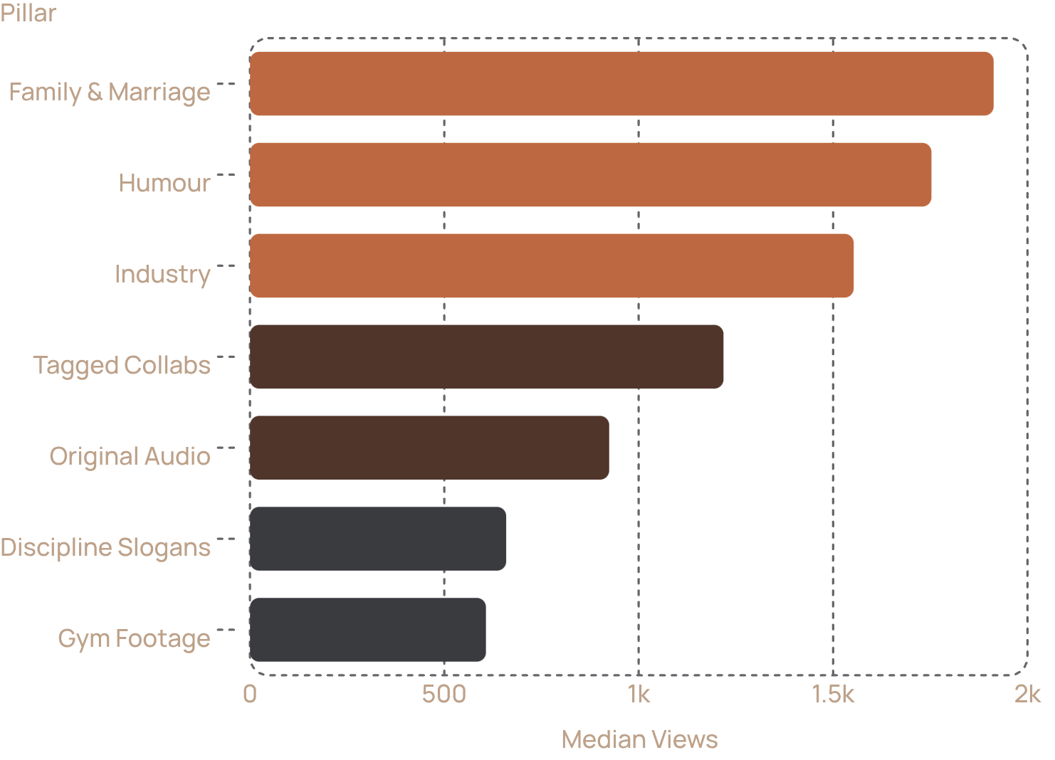


What the data says to do
Content Pillars
Key Tactical Decisions
Post at 20:00 KSA
60–120s length
19:00–21:00 performs best. After midnight is the worst slot (334 median views).
Best engagement at 3.8%. Teaching Reels run 45–90s, nothing under 10s.
Friday & Tuesday anchor
5 targeted hashtags
Used on only 2 of 85 Reels. Five targeted tags per post from now on.
Friday (1,163) and Tuesday (1,082) are anchors; Sunday (579) tested for 4 weeks.

Slide 6
Brand foundation: executive longevity
Positioning
Where he is now
Where he goes
For the Arab professional man past forty who has built everything except his health, Waleed Katoor is the proof that it is recoverable: a business director who went from 125 kg to athletic at 44 and explains exactly how, in the language his audience thinks in.
A fitness creator competing with 25-year-old coaches on looks and volume.
Executive longevity. Health as the asset that protects the career, the marriage and the years ahead.
The brand line, in his words
The enemy
His role
The belief that success costs you your body, and that this is a fair, temporary price.
Proof, not coach. "I am not a specialist. Go to a specialist for the details."
ما فيك تشتري صحتك. رح تكسبها. ولما تكسبها، بتصير ملك الدنيا.

Slide 7
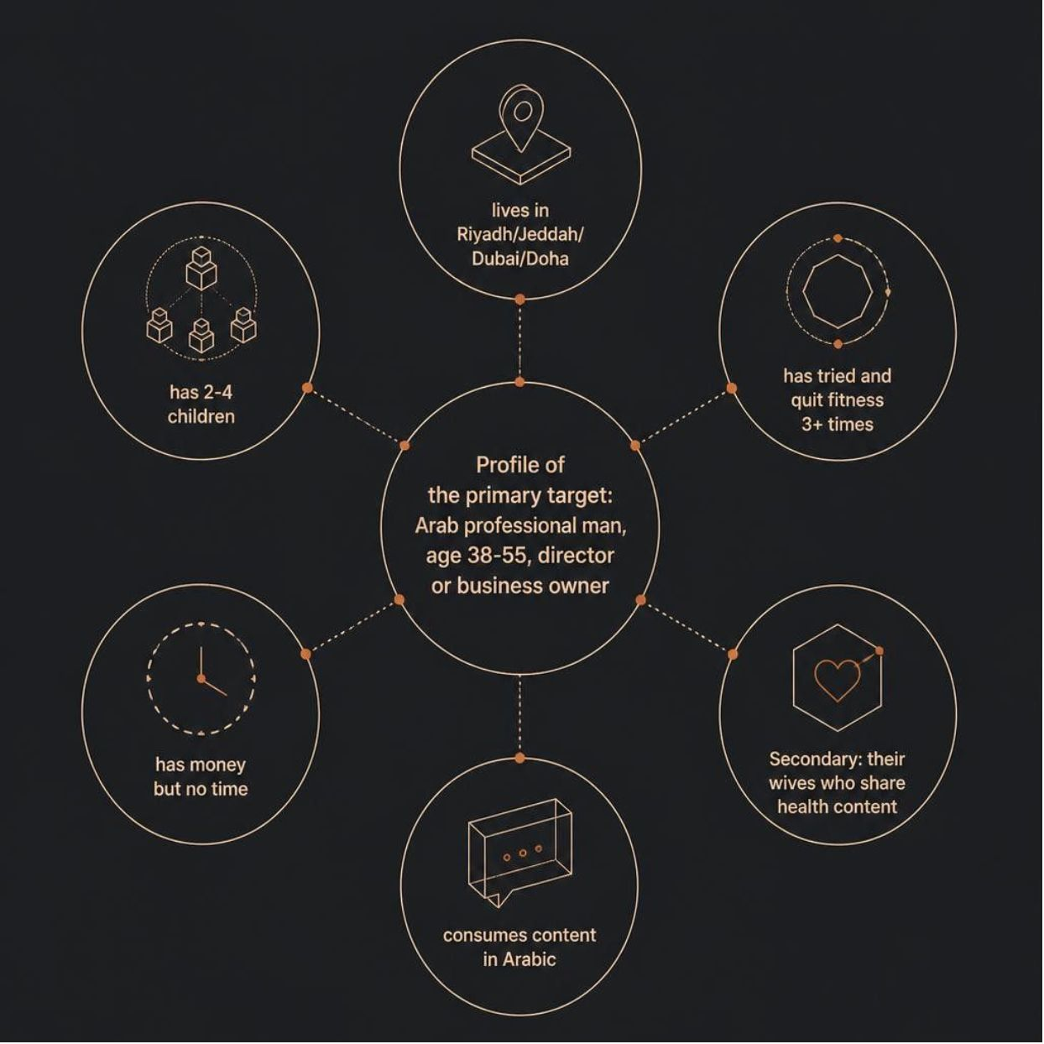

Who we talk to
PRIMARY AUDIENCE
"The 2AM email man"
Men 38–55 in Riyadh, Jeddah, Dubai, Doha
Director level or business owner, 90–130 kg
Has started and quit three or more times
Has money but no time, and stopped believing any plan fits his schedule
Two to four children; a recent photo made him uncomfortable
Consumes in Arabic
Aim at one man: 42, 110 kg, works too much, two kids, tried three times and quit.
SECONDARY AUDIENCE
Their wives
Family content has a 1,913 median against 859 overall. Women share health content about their husbands.
EXPLICITLY NOT
Young men chasing aesthetics, competitive lifters, anyone who wants a fast transformation.

Slide 8


Voice and visual identity
Four voice traits, all from his own transcripts
Visual Identity
Type: Oswald + Archivo (English) · Tajawal (Arabic) · JetBrains Mono (data). Reel covers are stills from the Reel, face visible. Never stock.
Brotherly, not authoritative
Specific over inspirational
First person, "this is what I did"
125 kg, 44, 6:45am, the 4th-day rule. No number, not finished.
Arabic first, English where it lands
Never shames
He talks about his 125 kg self with compassion
He code-switches naturally
Forge Black #100C09
Ember #D4552A
Brass #B8935A
Steel #5E6B72
Backgrounds
Hooks, key numbers
Credentials only
Secondary

Slide 9

The connected system
Each workstream matters because of what it hands to the next.
Engage
Content
Lead
Website
Week 1 channel build — before any automation
WhatsApp Business
Instagram
Facebook Page
Cloud API with Meta-approved templates
Professional account linked to Meta Business Suite, Arabic name field, new bio, website link
With cross-posting enabled
Telegram Bot
Domain & Tech
Private bot for Waleed
SSL, analytics and Meta Pixel

