Slide 1
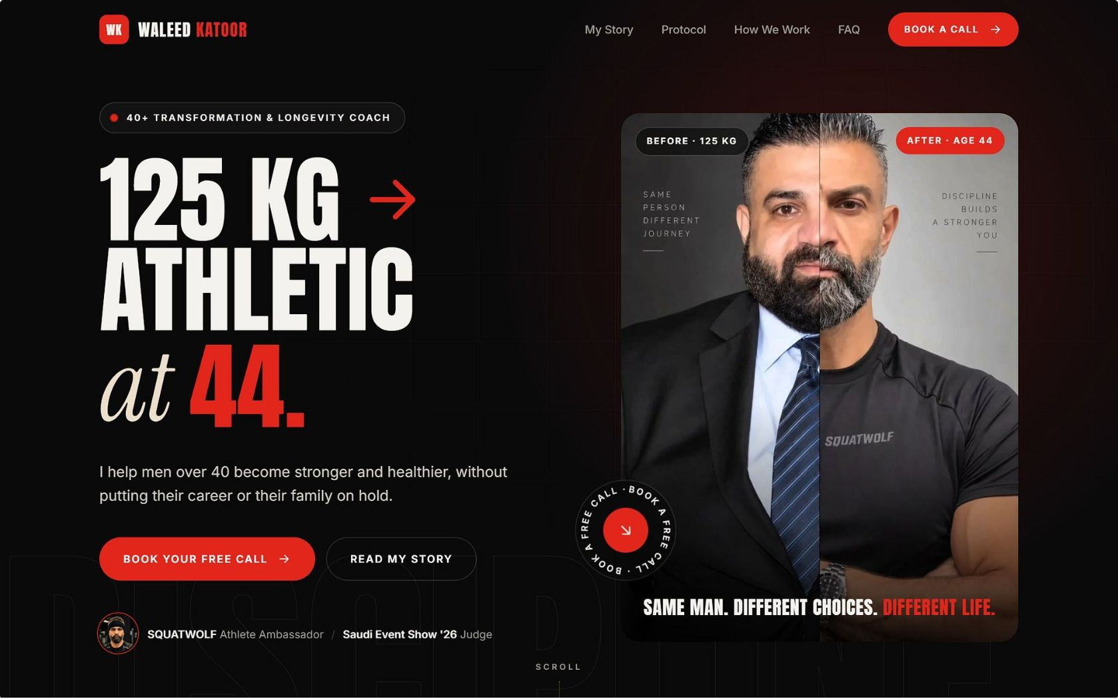
Website: one page, one job, book the call
Almost everyone arrives from the Instagram bio or a DM, on a phone, curious but not convinced. In about a minute the page has to prove the story is real, make him feel it was written for him, and put a calendar in front of him.
Format
One Action
Connected
Single scrolling page, Arabic-first with an English switch, mobile first
Every section leads to احجز مكالمة (book a call)
Calendar, forms and link tracking write into the CRM and trigger WhatsApp automation
The eight sections come straight from the strategy notes: Hero · Proof · My Story · This page is for… · Protocol · How We Work · FAQ · Calendar.

Slide 2
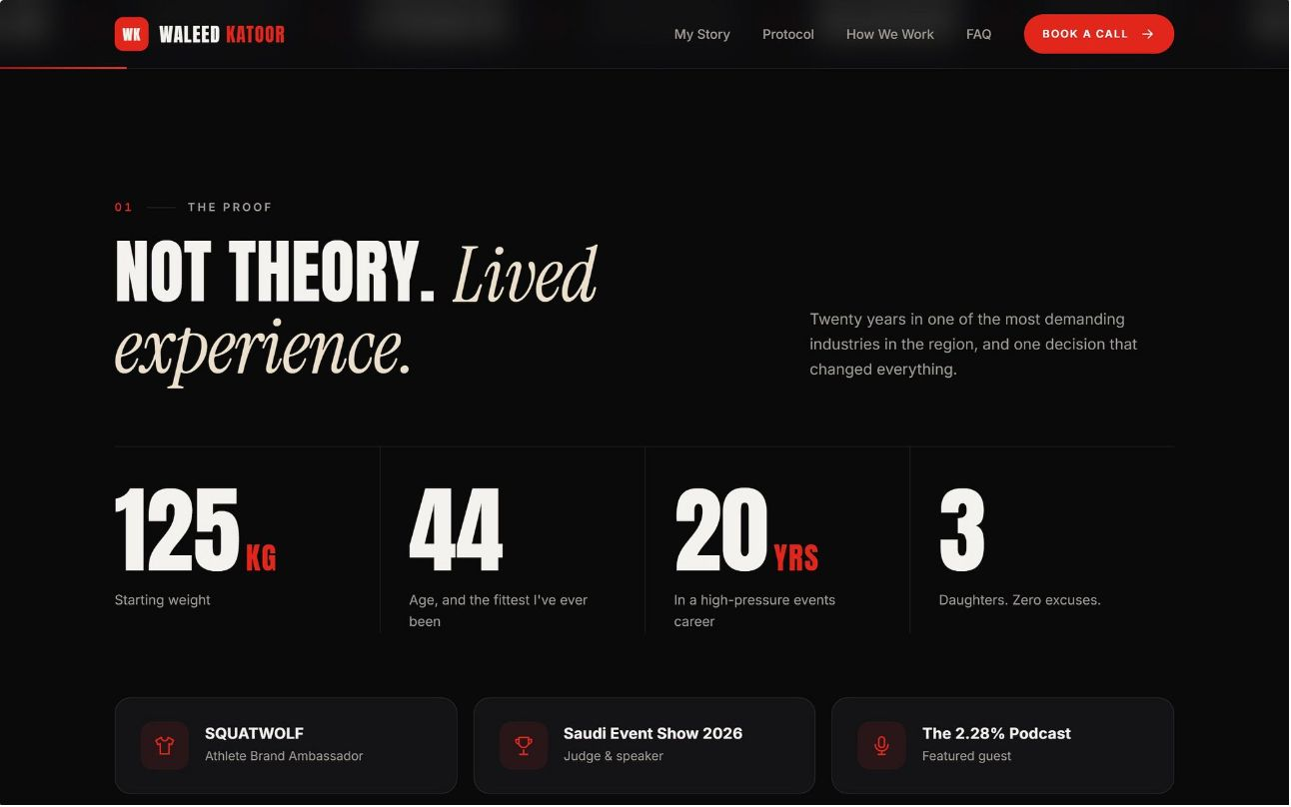
Sections 1–2: Hero and Proof
HERO · الفرق بين الاثنين
PROOF · حقائق عنه
Before and After, Side by Side
Credentials, Not Claims
The before and after side by side, 125 kg next to today. The proof goes first. One button, no second call to action. Captions carry numbers only: 125 kg, 44.
SQUATWOLF Athlete Ambassador
Saudi Event Show 2026 Judge
Years in the events industry
125 kg → athletic at 44
Father of three daughters
Podcast guest, soon host
125KG
44
Starting Weight
Age, Fittest Ever
20YRS
3
High-Pressure Career
Daughters. Zero Excuses.

Slide 3
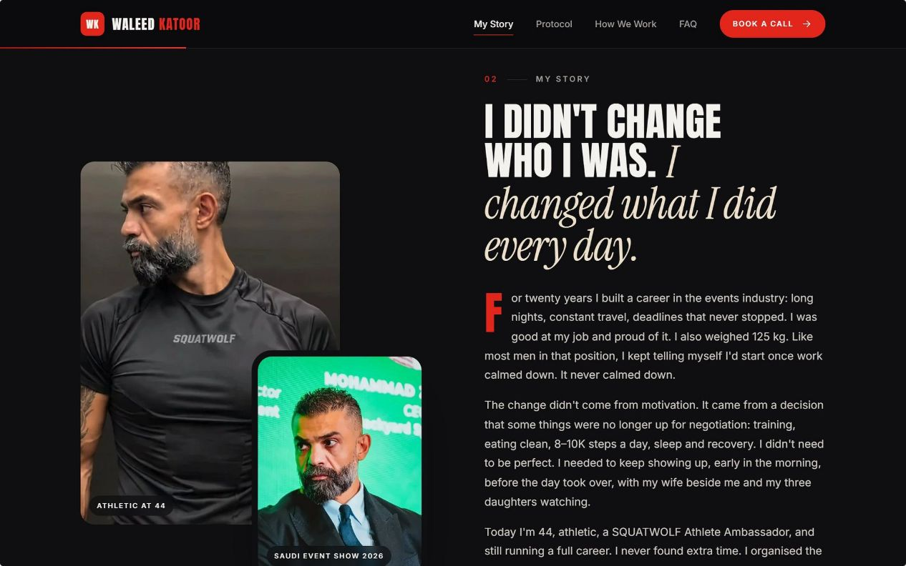
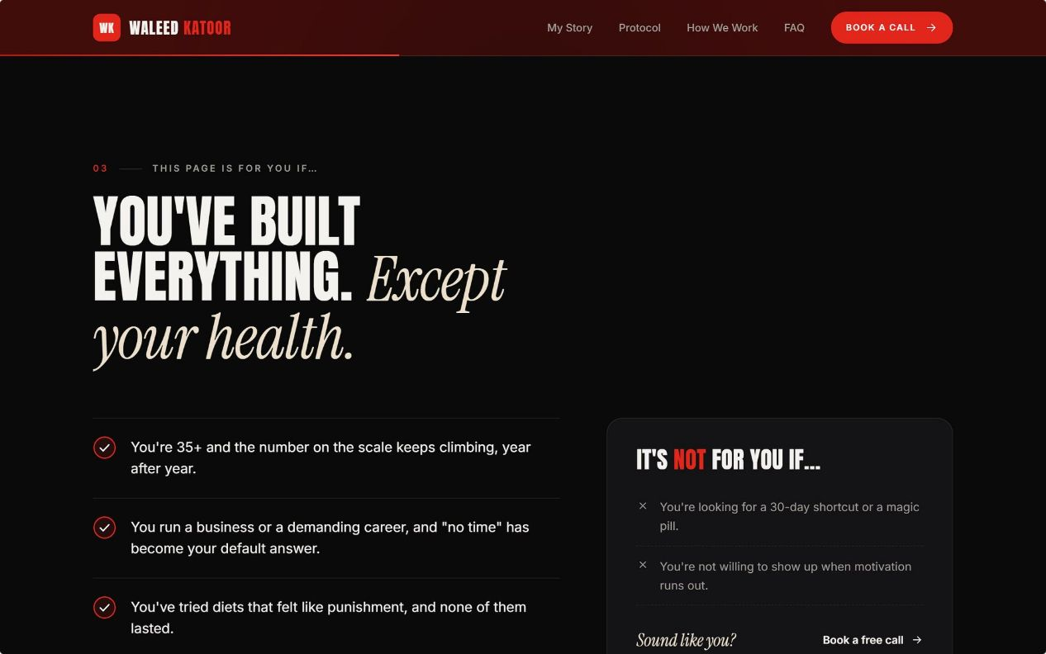
Sections 3–4: My Story and "This page is for…"
MY STORY · قصتي
Three Paragraphs, Three Numbers
The Before: The director at 125 kg — twenty years building a career in the events industry, long nights, constant travel, deadlines that never stopped. Good at the job and proud of it.
The Turning Point: The mirror, his daughter — a decision that some things were no longer up for negotiation: training, eating clean, 8–10K steps a day, sleep and recovery. No need to be perfect. Just keep showing up.
The System: Four days a week, the 4th-day rule, steps, protein, sleep. Early in the morning, before the day took over, with his wife beside him and his three daughters watching.
THIS PAGE IS FOR… · هاي الصفحة لمين؟
The Qualifier That Makes the Right Man Feel Seen
38 to 55 years old
90 to 130 kg, started and stopped more than once
"No time" has become your default answer
You've tried diets that felt like punishment
Not for you if…
You're looking for a six-week shred or a magic pill
You want to compete on stage
You need someone to shout at you

Slide 4
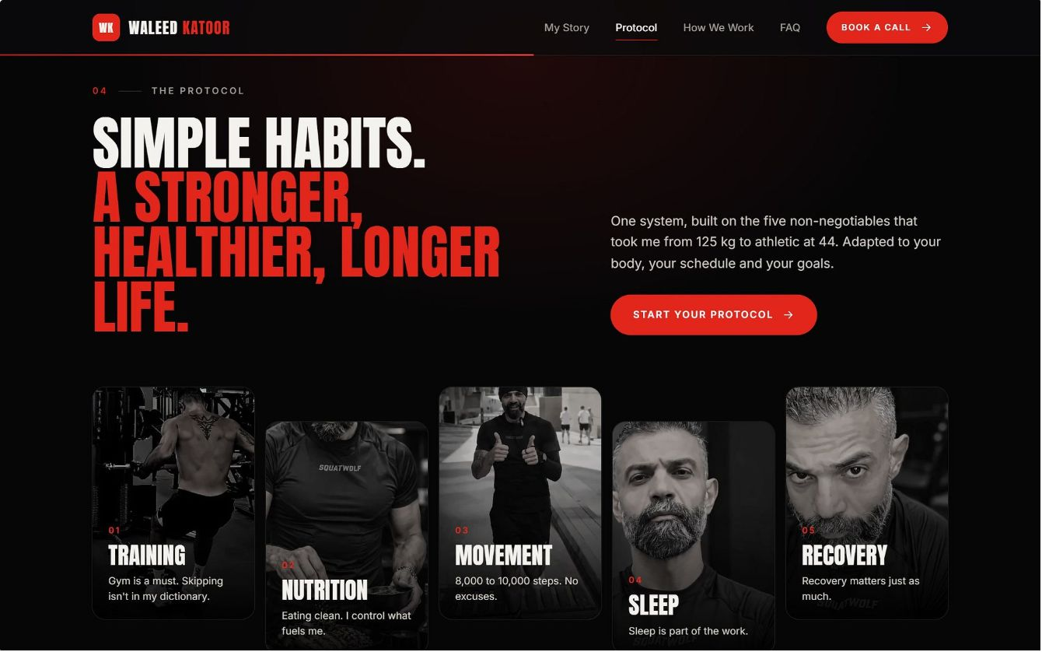






Section 5: The Protocol
One system, built on the five non-negotiables that took him from 125 kg to athletic at 44. Adapted to your body, your schedule and your goals. A slogan and five pillars — no details. The detail is what clients pay for; the page only shows that a system exists and fits a busy week.
Training
Nutrition
Movement
Gym is a must. Skipping isn't in my dictionary.
Eating clean. I control what fuels me.
8,000–10,000 steps. No excuses.
Sleep
Recovery
Sleep is part of the work.
Recovery matters just as much.
The offer: one-to-one and small-group coaching on health, nutrition habits and daily discipline for working men. A life-and-health system that fits around a real job.

Slide 5
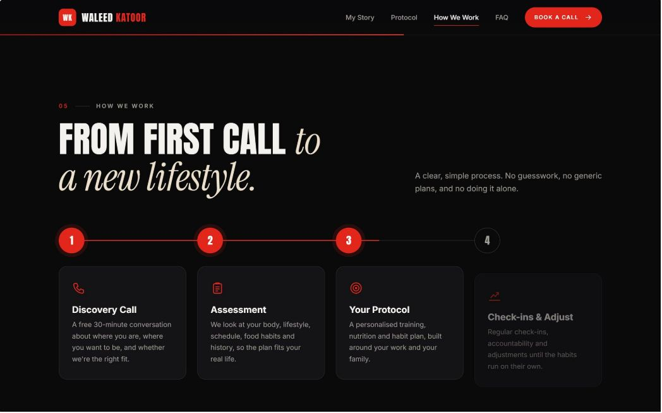
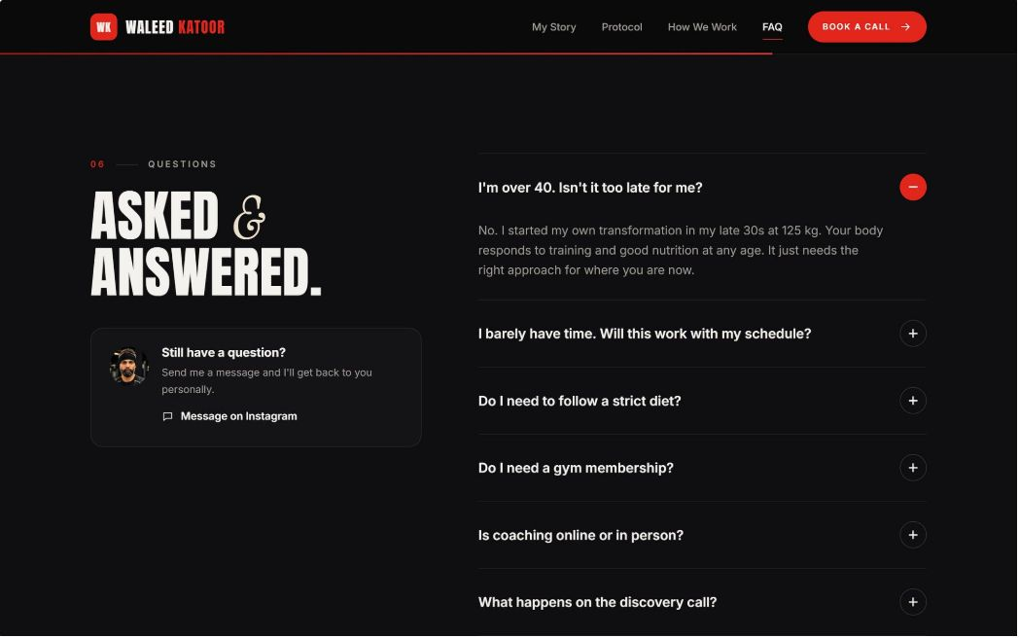


Sections 6–7: How We Work and FAQ
HOW WE WORK · كيف بنشتغل
01
Free Call on the Calendar
A free 30-minute conversation about where you are, where you want to be, and whether we're the right fit.
02
Registration Form on WhatsApp
A short form and a plan built around his schedule — food habits, history, lifestyle.
03
Weekly Check-In on WhatsApp
Weight, photo, training days, sleep, notes. Each step matches a real automated step.
04
Check-Ins and Adjust
Regular accountability and adjustments until the habits run on their own.
QUESTIONS · أسئلة
Five Questions, In His Voice
Do I need a gym?
Yes. The gym is non-negotiable — but the plan fits around your schedule, not the other way around.
How long does it take?
Real change takes months, not weeks. We build habits that last, not a 30-day sprint.
I travel a lot.
So do I. The protocol is built for travel — hotel gyms, airport meals, time zones.
Is any food banned?
No banned foods. Clean eating, not punishment. You'll learn to eat anywhere.
What does it cost?
We talk about it on the call. No "contact us for price" — that reads as expensive and evasive.

Slide 6
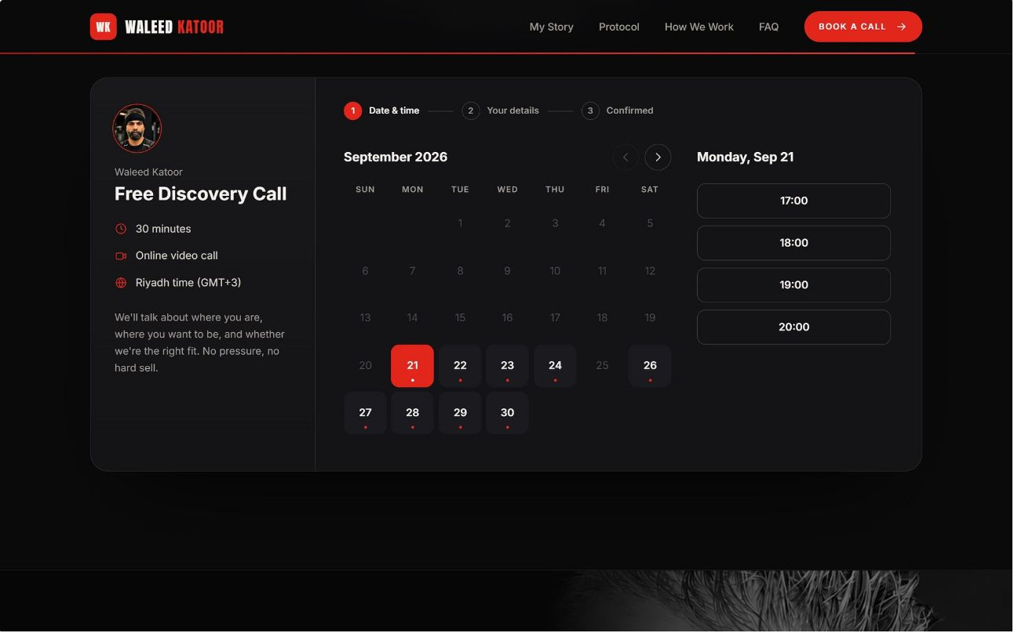
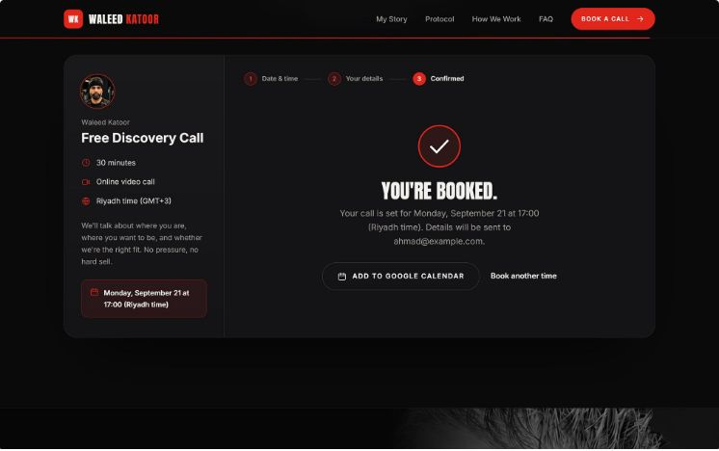

Section 8: The Calendar That Starts the Automation
An embedded booking calendar with only Waleed's available slots, in KSA time. Booking starts everything — no manual follow-up required.
Lead Created in CRM
The lead record is created with the source post attached automatically.
WhatsApp Confirmation
A confirmation goes out instantly in Arabic.
Reminders Sent
24 hours and 1 hour before the call, automatically.
Pre-Call Form
A short form arrives on WhatsApp so the call starts informed.
No-Show Recovery
No-shows get one polite rebooking message.
Post-Call Tap
After the call, Waleed taps "Client" or "Not now" and the next automation starts.

Slide 7
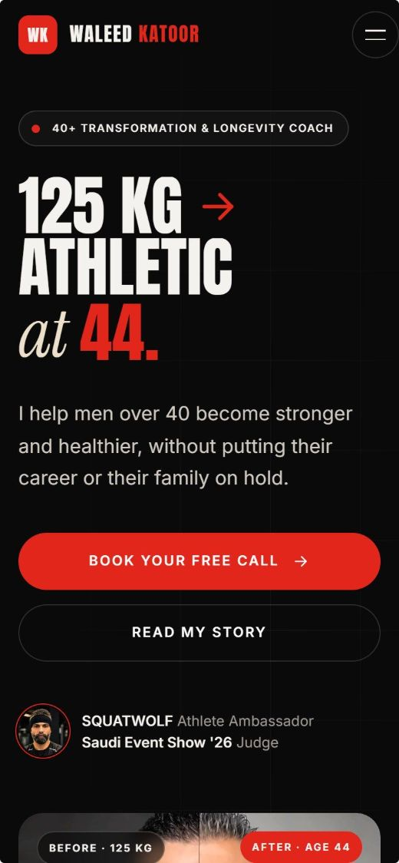

Built Mobile First
THREE RULES FOR THE WEBSITE
Technical Stack
Arabic (RTL) and English language toggle
Cal.com booking with webhooks into the CRM and WhatsApp
Analytics, Meta Pixel and a tracked link per post
Indexed under وليد كتور
Podcast embedded
Privacy policy and a "not medical advice" note
No Testimonials Section, Yet
Show the Price or Book the Call
Mobile First, Genuinely
A thin results block damages trust faster than none. His own transformation is the case study until the two client cases are ready.
Never "contact us for price." To this man it reads as expensive and evasive.
Tested on a mid-range phone over mobile data: thumb-reachable buttons, Arabic text readable without zooming, a sticky booking button.

Slide 8

CRM: Coaching from a Phone, Without Typing
DESIGN PRINCIPLES
The client enters the data · one screen a day · voice over typing.
DASHBOARD · الرئيسية
REGISTRATION FORM
Subscriptions: active, ending within 14 days, expired, upgrade candidates
Follow-up: needs follow-up today, no check-in this week, new InBody to review, AI drafts waiting
Clients: search, new leads, booked calls
Headline numbers: active clients, renewals, revenue, new leads
Allergies, diseases, medications, injuries, history and separate consents. Any declared condition raises a medical flag: no AI meal plan, doctor clearance first.
PAYMENTS AND RENEWALS · الدفعات والتجديد
Paid / due / overdue, full history, a renewal pipeline starting 14 days out.
CUSTOMER PROFILE · ملف العميل
Today's weight against starting weight at the top
Photo, plan, status · WhatsApp, email, Instagram
Start and renewal dates · weight chart, height, InBody history
Weekly photo timeline · meal PDF · check-in log
Transcribed voice notes · payments
NOTES REGISTER AND TELEGRAM
Voice notes auto-transcribed to the right client. A private Telegram bot answers questions and sends a morning digest. Health data handled under Saudi PDPL.
Client Input
Transcribe Note
Waleed Review
Automated Next Step

