Slide 1
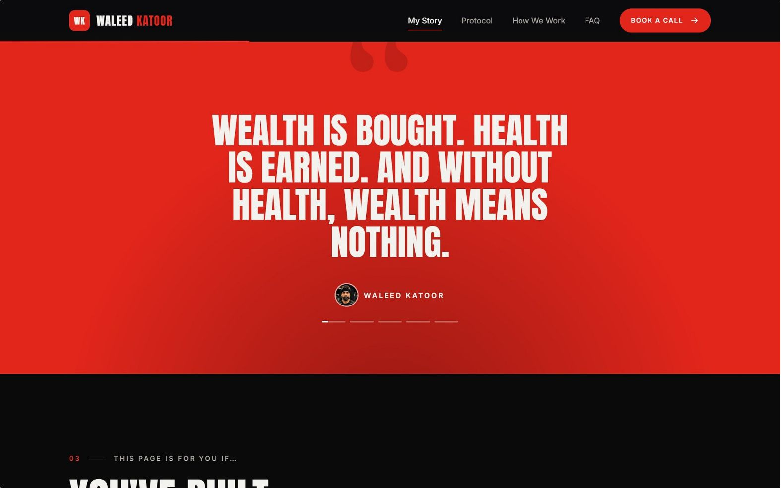
AI Automation: Nine Client Automations
A complete system for Waleed — Arabic-first, human in the loop for health and money, clean handover, within Meta's platform rules, and everything logged.
PRINCIPLES
Arabic-First
Human in the Loop
Every message, every touchpoint in the client's language
Health and money decisions always go through Waleed
Clean Handover
Platform Rules
Every action logged and handed off clearly
Within Meta's guidelines at every step

Slide 2
The Nine Automations
# | Automation | What Happens
1 | Meal PDF Delivery | Approved PDF sent to the client on WhatsApp
2 | InBody Tracking | AI reads the photo, saves weight, muscle, body fat, updates the graph
3 | Monthly Report | A report per client sent to Waleed on the 1st
4 | Weekly Reminder | «لا تنسى التشيك-إن تبعك اليوم»
5 | Weekly Form Link | The check-in link each week, answers land in the profile
6 | AI Plan Builder | Drafts meal and plan ideas; Waleed approves every one
7 | Renewals | Renew or upgrade message 7 days before, one follow-up
8 | Waleed's Assistant | Voice notes to the right client's CRM record; answers questions
9 | Weekly Progress Photo | Added to the before/now timeline

Slide 3


The Leads Engine
How It Works
Post + CTA: e.g. اكتب «بروتوكول» بالكومنت وببعتلك القاعدة كاملة
Auto DM: the promised resource + a website link unique to that person
Click = lead: the CRM registers his handle, the source post and the date
Assistant: answers repeat questions, qualifies, offers the calendar
Booked or follow-up: call booked, or queued for a human
Because every link is unique, we know which post produced which client, not only views.
Post + CTA
Click = Lead
Auto DM
Follow-up within the rules: Meta limits business messages to a window after the person's last message, and WhatsApp needs opt-in. So follow-up moves to WhatsApp with consent, happens personally from the "Not now" list, or comes back through new content. No mass cold DMs.
Stack
n8n (self-hosted) · WhatsApp Cloud API · Meta Graph API · an Arabic-strong LLM · vision for InBody · Whisper-class transcription · Cal.com · Telegram Bot API · branded PDFs.
Rollout
Month 1 catch every lead · Month 2 run the clients · Month 3 the intelligence layer.

Slide 4

Social Media: The Weekly Rhythm
Every post at 20:00 KSA, on Instagram and Facebook
Friday Reel (anchor) · Saturday carousel · Sunday Reel (test slot) · Tuesday Reel · Wednesday Reel · Monday and Thursday Stories only (+ Q&A box on Thursday)
4 Reels + 1 carousel a week · about 16 + 4 a month · 2+ raw Stories a day
Five Content Pillars
The Road · الطريق
1
The 125 kg story in unglamorous specifics
3/month
The Busy Man's Protocol · بروتوكول المشغول
2
The actual system, 60–90s teaching
5/month
Myths · خرافات
3
Myths taken apart, told as his stories
3/month
Why?! · ليش؟!
4
Family as the reason, the pillar wives share
3/month
The Difference · الفرق
5
Vlogs, events, work, SQUATWOLF
2/month
Gym footage is not a pillar. It is background texture.

Slide 5
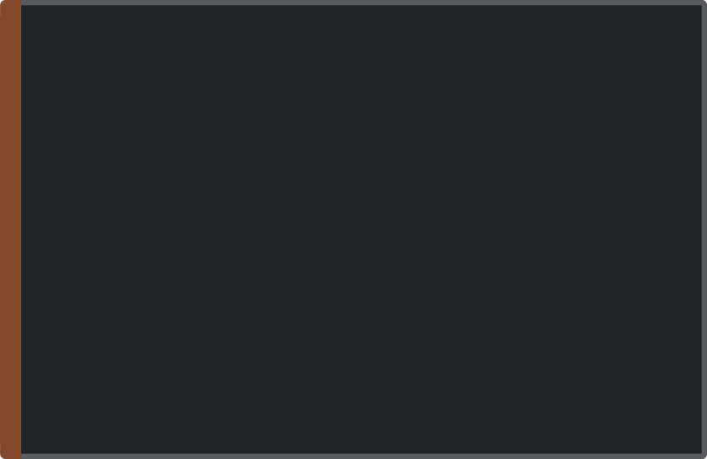


The Content Engine
25 Reel Ideas from the Strategy Notes
Production System
الصورة اللي خلتني أبلش (the photo that made me start) · قاعدة اليوم الرابع (the 4th-day rule) · the cheat meal · لما بنتي طلبت تلعب معي وما قدرت · لما يصير عمري 65 بدي كون متل عمرو دياب · يوم بحياتي.
Batch Filming
Better Editing
One 90-minute weekly session, change T-shirts between takes → 6 Reels (4 published, 2 banked)
Burned-in Arabic captions, punch-in zooms, numbers in Ember
Stories — Daily and Raw
Food and weight
The 6:45am gym
Old Reel with a new comment
Events and runs
Podcast behind the scenes
Q&A box
Training while travelling
Hashtags
Caption Formula
Exactly five per post, matched to the pillar
Hook · the specific thing with a number · CTA keyword · one real question · five hashtags
Stop immediately: reposted voiceovers · silent gym montages · clips under 10 seconds · follow-for-follow.

Slide 6
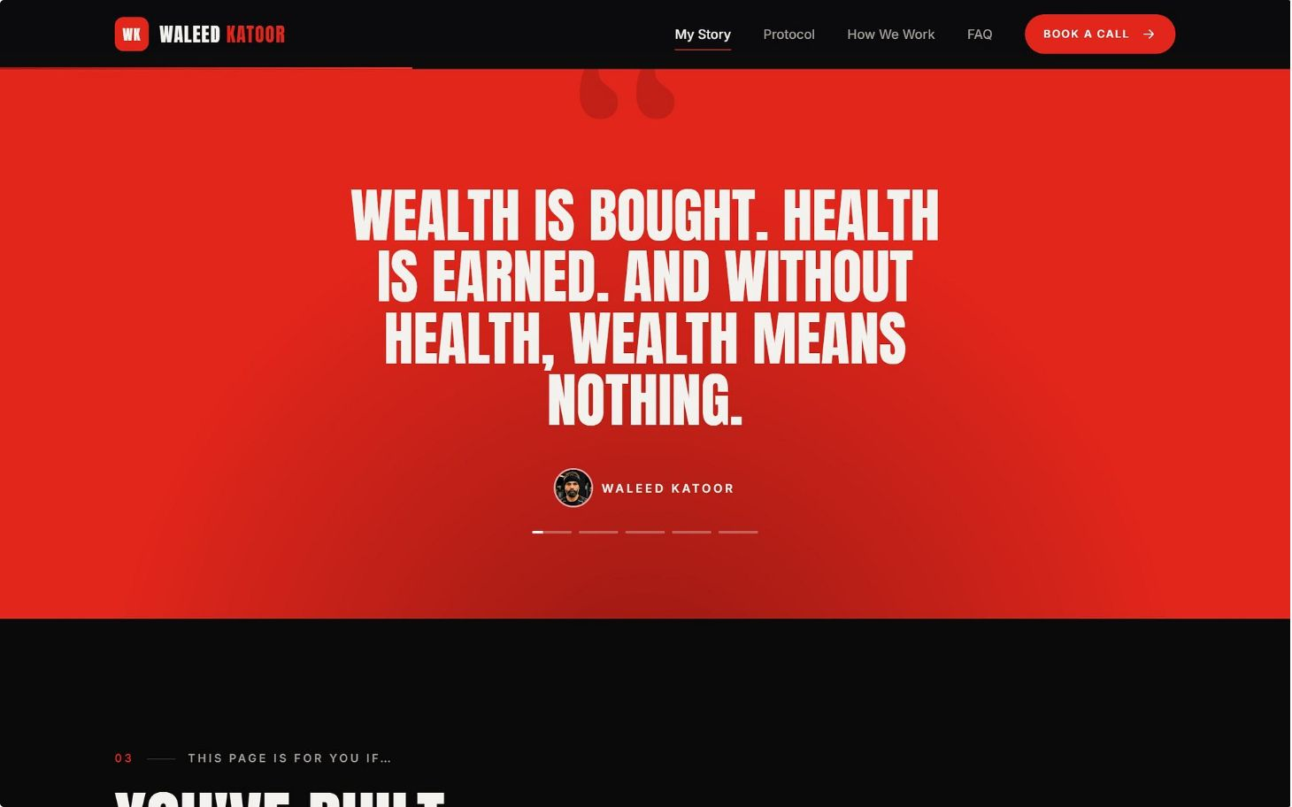





Growth Plays
Two Client Cases
Podcast Host with Well-Known Guests
The Serialised Transformation · المسلسل
Hint → build evidence in the CRM → written consent → reveal. Timing is driven by real results, not a date. Then the website's نتائج section goes live.
Successful people and the price their bodies paid. One episode a month; each yields 4–6 spoken Reels and a collab post.
The Road pillar as a 12-episode weekly series. "تابعني تشوف الحلقة الجاية" becomes an honest reason to follow.
Borrowed Audiences
Fix the Profile
A SQUATWOLF feature or takeover · six podcast guest spots in six months · collabs with Riyadh gyms · joint content with his wife.
Arabic name field وليد كتور | من 125 كيلو · new Arabic bio · website link · face-forward photo · pinned Reels · Highlights: قصتي · قبل وبعد · البروتوكول · خرافات · عائلتي

Slide 7
Roadmap: 90 Days, Then 12 Months
When | Social Media | Website + CRM | Automation
Week 1 | Profile fixes, Insights baseline | Discovery, pricing decision, design | Channel build
Weeks 2–4 | Full schedule live, series ep. 1 | Website and CRM build, forms drafted | Comment-to-DM, tracked links, DM assistant
Month 2 | First collab, podcast ep. 1 | Launch, bio link switched, calendar live | WhatsApp assistant, booking flow, reminders, PDFs, renewals
Month 3 | Review slots and pillars against data | Improvements; results section prepared | InBody reading, monthly report, AI plan builder
The 12-Month Ladder (a target, not a guarantee)
M1
Format fixed, 1,500 median views
M3
3,000–5,000 followers
M6
10,000–15,000 followers
M12
30,000+ and inbound brand deals
Months 1–2 will feel like nothing is happening. That is when most people quit, and it's the stretch that decides the outcome.

Slide 8


Measurement, Guardrails & Next Steps
Funnel We Report Monthly
Decisions to Confirm Before Launch
Years in the events industry: 10 or 20?
His age on his first day back at the gym
Show the price on the website, or book a call?
The two client cases: who, and will they consent?
Can he film one 90-minute session every week?
Keep the Sunday slot for four weeks?
Weekly link: check-in form (recommended) or full registration?
His assistant on Telegram, WhatsApp, or both?
Do clients have access to InBody scans?
Myth M2: «الكرش وراثة»?
Podcast name, first guests, recording location
Access: Instagram Insights, Meta Business Suite, calendar
Leads
Clients Closed
Calls Booked
Monthly report + 30-minute review: keep, change, stop.
Guardrails
The Medical Line
His Dialect, Not Ours
Consent
Next step: answer these in week 1, grant access, and book the first filming session.
No medical claims, no supplement protocols, no calorie prescriptions. The back story is told as story only.
Waleed reads every Arabic line aloud before it goes public.
Client photos published only with separate written permission, withdrawable.
ولما تكسبها، بتصير ملك الدنيا.
Client Data
Platform Rules
Honest Numbers
Saudi PDPL, encrypted, access-limited.
Meta-approved templates, opt-in, no mass unsolicited DMs.
Every public claim is true and checkable.

