Slide 1
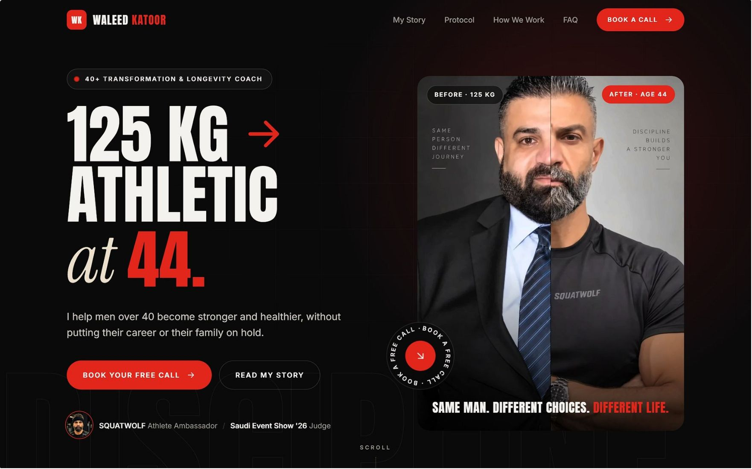
Waleed Katoor
Executive Longevity · Digital Growth Strategy
ما بتشتريها. بتكسبها.
"You cannot buy your health. You will earn it." — Waleed Katoor
One connected system that turns attention into booked calls, calls into clients, and clients into proof.
Prepared by Vida AI · Steven Ayman · Mario Wagyih Gomaa · Sameh Usama Shukry · September 2026

Slide 2
The plan on one page
Waleed went from roughly 125 kg to athletic at 44 while running a director-level job and raising three daughters. He isn't selling fitness. He is proof that a busy man can recover his health.
Today that story doesn't turn into business: 1,209 posts, 1,232 followers, no website, no booking path, no client system. But the account is moving: the last 30 days ran at 1,023 median views against 827 before. This is a build, not a rescue.
Social Media
Website
Creates demand: 4 Reels a week + a Saturday carousel, Arabic-first, him on camera
Converts: one page, eight sections, a calendar wired into automation
CRM
AI Automation
Runs the coaching: dashboard, client profiles, progress, payments, voice notes
Removes the admin: nine client automations + a leads engine

Slide 3
Five decisions that shape everything
1
Proof, not coach
He shares what worked on him and sends people to specialists for the details.
2
He speaks
Reels where he talks earn nearly twice the views (1,622 vs 822) and 3× the likes.
3
Arabic first
His growth audience thinks in Arabic. Captions burned into every video.
4
Client enters the data
Forms and WhatsApp do the typing — not Waleed.
5
Channels before automation
WhatsApp, Instagram and Facebook are set up properly first.
1,500
65%
Median views target
Talking-head Reels
Up from 859 in 30 days
Up from 13% of output
<10%
1.0
Zero-comment Reels
Following:follower ratio
Down from 34%
Down from 1.71

Slide 4


Where we start: the audit
Audit of 85 Reels, 22 Nov 2025 – 12 Sep 2026.
1,232
1,209
859
Followers
Posts
Median views
2,107 following — ratio 1.71
No website, no booking path
~0.70× his follower count
Creator account bio link points to one YouTube episode. Name field is English only — no one searching in Arabic can find him.
The finding that drives the content plan
 | He speaks on camera | Montage over a track | Someone else's audio
Share of output | 13% | 72% | 15%
Median views | 1,622 | 822 | 683
Median likes | 57 | 15 | 14
Zero-comment rate | 9% | 36% | 46%
87% of his production effort goes into the formats that perform worst.

Slide 5
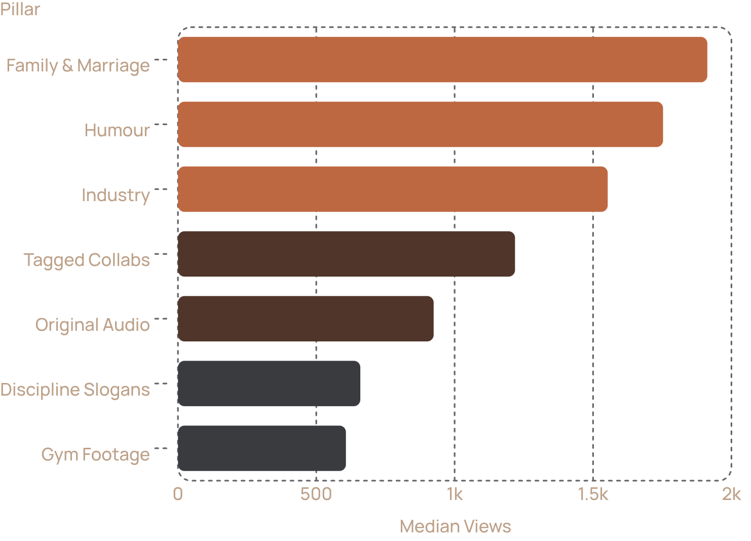
What the data says to do
Content Pillars
Key Tactical Decisions
Post at 20:00 KSA
60–120s length
19:00–21:00 performs best. After midnight is the worst slot (334 median views).
Best engagement at 3.8%. Teaching Reels run 45–90s, nothing under 10s.
Friday & Tuesday anchor
5 targeted hashtags
Used on only 2 of 85 Reels. Five targeted tags per post from now on.
Friday (1,163) and Tuesday (1,082) are anchors; Sunday (579) tested for 4 weeks.

Slide 6
Brand foundation: executive longevity
Positioning
Where he is now
Where he goes
For the Arab professional man past forty who has built everything except his health, Waleed Katoor is the proof that it is recoverable: a business director who went from 125 kg to athletic at 44 and explains exactly how, in the language his audience thinks in.
A fitness creator competing with 25-year-old coaches on looks and volume.
Executive longevity. Health as the asset that protects the career, the marriage and the years ahead.
The brand line, in his words
The enemy
His role
The belief that success costs you your body, and that this is a fair, temporary price.
Proof, not coach. "I am not a specialist. Go to a specialist for the details."
ما فيك تشتري صحتك. رح تكسبها. ولما تكسبها، بتصير ملك الدنيا.

Slide 7
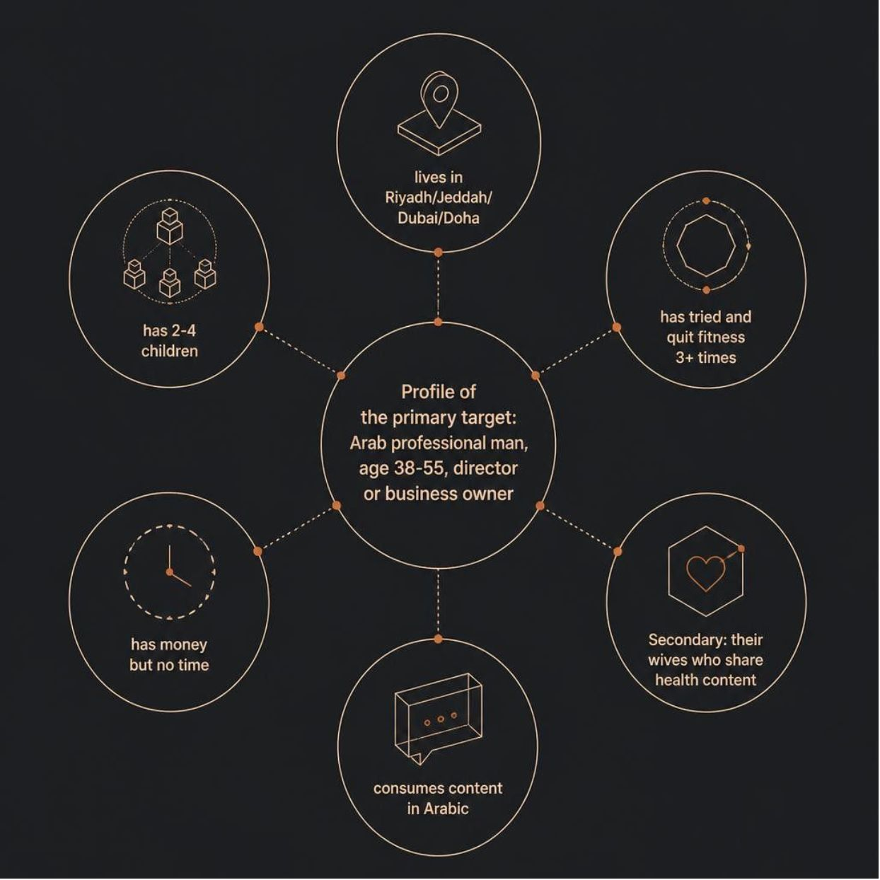

Who we talk to
PRIMARY AUDIENCE
"The 2AM email man"
Men 38–55 in Riyadh, Jeddah, Dubai, Doha
Director level or business owner, 90–130 kg
Has started and quit three or more times
Has money but no time, and stopped believing any plan fits his schedule
Two to four children; a recent photo made him uncomfortable
Consumes in Arabic
Aim at one man: 42, 110 kg, works too much, two kids, tried three times and quit.
SECONDARY AUDIENCE
Their wives
Family content has a 1,913 median against 859 overall. Women share health content about their husbands.
EXPLICITLY NOT
Young men chasing aesthetics, competitive lifters, anyone who wants a fast transformation.

Slide 8
Voice and visual identity
Four voice traits, all from his own transcripts
Visual Identity
Type: Oswald + Archivo (English) · Tajawal (Arabic) · JetBrains Mono (data). Reel covers are stills from the Reel, face visible. Never stock.
Brotherly, not authoritative
Specific over inspirational
First person, "this is what I did"
125 kg, 44, 6:45am, the 4th-day rule. No number, not finished.
Arabic first, English where it lands
Never shames
He talks about his 125 kg self with compassion
He code-switches naturally
Forge Black #100C09
Ember #D4552A
Brass #B8935A
Steel #5E6B72
Backgrounds
Hooks, key numbers
Credentials only
Secondary

Slide 9

The connected system
Each workstream matters because of what it hands to the next.
Engage
Content
Lead
Website
Week 1 channel build — before any automation
WhatsApp Business
Instagram
Facebook Page
Cloud API with Meta-approved templates
Professional account linked to Meta Business Suite, Arabic name field, new bio, website link
With cross-posting enabled
Telegram Bot
Domain & Tech
Private bot for Waleed
SSL, analytics and Meta Pixel

Slide 10

Website: one page, one job, book the call
Almost everyone arrives from the Instagram bio or a DM, on a phone, curious but not convinced. In about a minute the page has to prove the story is real, make him feel it was written for him, and put a calendar in front of him.
Format
One Action
Connected
Single scrolling page, Arabic-first with an English switch, mobile first
Every section leads to احجز مكالمة (book a call)
Calendar, forms and link tracking write into the CRM and trigger WhatsApp automation
The eight sections come straight from the strategy notes: Hero · Proof · My Story · This page is for… · Protocol · How We Work · FAQ · Calendar.

Slide 11
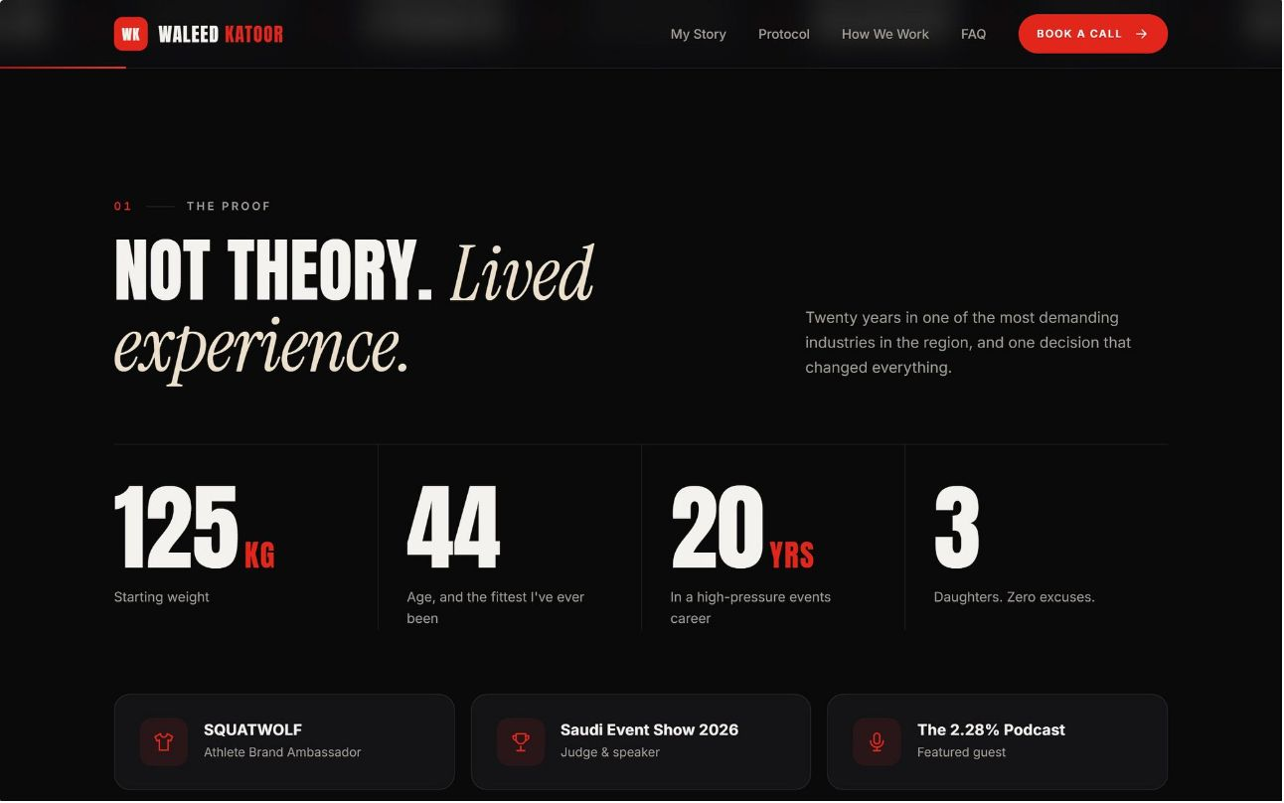
Sections 1–2: Hero and Proof
HERO · الفرق بين الاثنين
PROOF · حقائق عنه
Before and After, Side by Side
Credentials, Not Claims
The before and after side by side, 125 kg next to today. The proof goes first. One button, no second call to action. Captions carry numbers only: 125 kg, 44.
SQUATWOLF Athlete Ambassador
Saudi Event Show 2026 Judge
Years in the events industry
125 kg → athletic at 44
Father of three daughters
Podcast guest, soon host
125KG
44
Starting Weight
Age, Fittest Ever
20YRS
3
High-Pressure Career
Daughters. Zero Excuses.

Slide 12
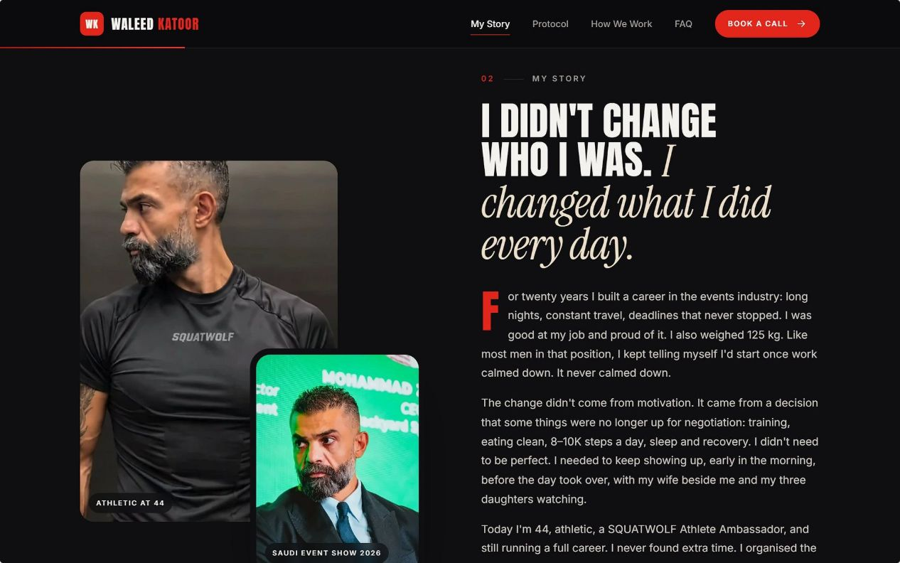
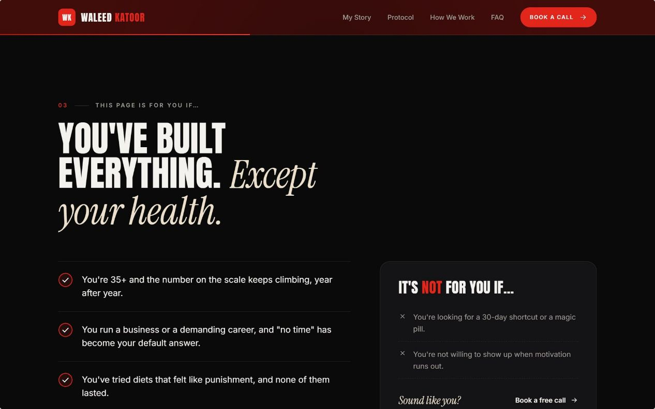
Sections 3–4: My Story and "This page is for…"
MY STORY · قصتي
Three Paragraphs, Three Numbers
The Before: The director at 125 kg — twenty years building a career in the events industry, long nights, constant travel, deadlines that never stopped. Good at the job and proud of it.
The Turning Point: The mirror, his daughter — a decision that some things were no longer up for negotiation: training, eating clean, 8–10K steps a day, sleep and recovery. No need to be perfect. Just keep showing up.
The System: Four days a week, the 4th-day rule, steps, protein, sleep. Early in the morning, before the day took over, with his wife beside him and his three daughters watching.
THIS PAGE IS FOR… · هاي الصفحة لمين؟
The Qualifier That Makes the Right Man Feel Seen
38 to 55 years old
90 to 130 kg, started and stopped more than once
"No time" has become your default answer
You've tried diets that felt like punishment
Not for you if…
You're looking for a six-week shred or a magic pill
You want to compete on stage
You need someone to shout at you

Slide 13
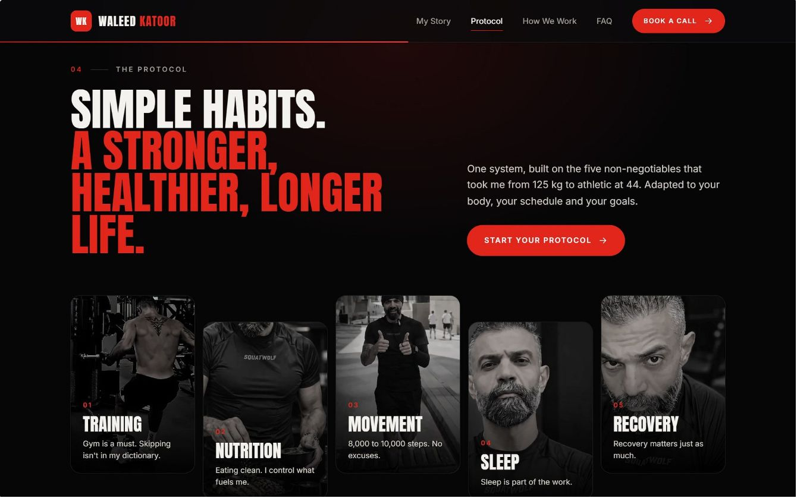

Section 5: The Protocol
One system, built on the five non-negotiables that took him from 125 kg to athletic at 44. Adapted to your body, your schedule and your goals. A slogan and five pillars — no details. The detail is what clients pay for; the page only shows that a system exists and fits a busy week.
Training
Nutrition
Movement
Gym is a must. Skipping isn't in my dictionary.
Eating clean. I control what fuels me.
8,000–10,000 steps. No excuses.
Sleep
Recovery
Sleep is part of the work.
Recovery matters just as much.
The offer: one-to-one and small-group coaching on health, nutrition habits and daily discipline for working men. A life-and-health system that fits around a real job.

Slide 14
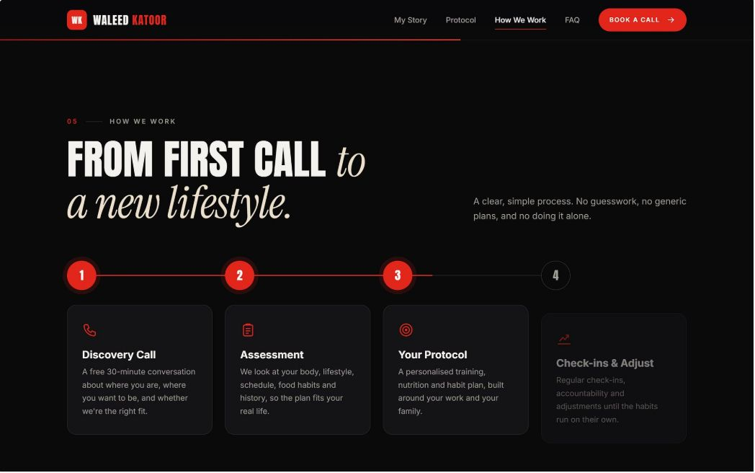
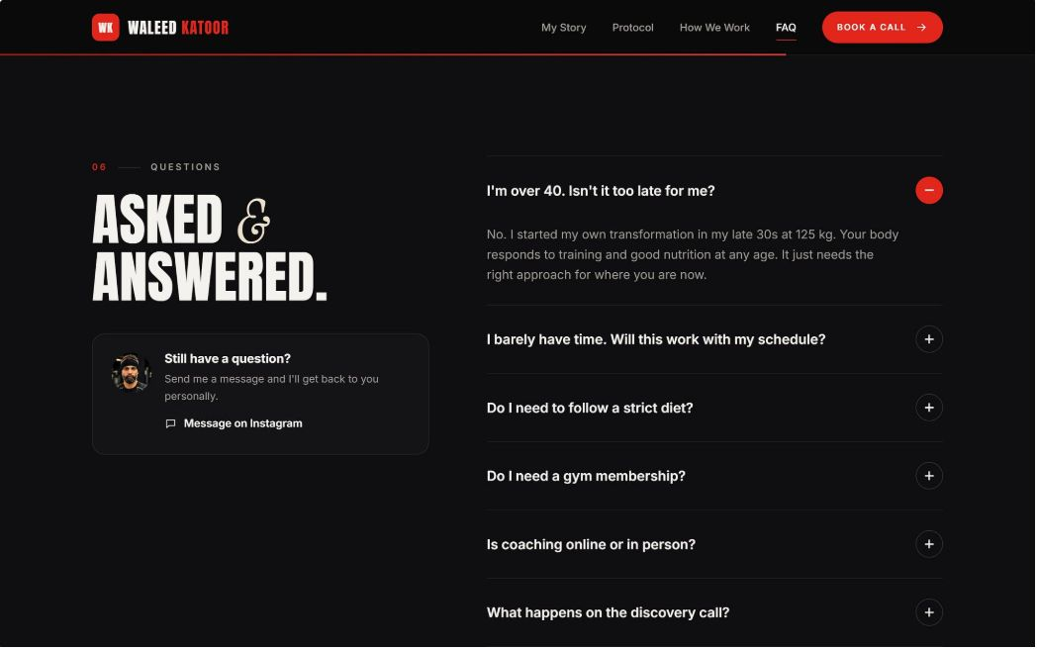
Sections 6–7: How We Work and FAQ
HOW WE WORK · كيف بنشتغل
01
Free Call on the Calendar
A free 30-minute conversation about where you are, where you want to be, and whether we're the right fit.
02
Registration Form on WhatsApp
A short form and a plan built around his schedule — food habits, history, lifestyle.
03
Weekly Check-In on WhatsApp
Weight, photo, training days, sleep, notes. Each step matches a real automated step.
04
Check-Ins and Adjust
Regular accountability and adjustments until the habits run on their own.
QUESTIONS · أسئلة
Five Questions, In His Voice
Do I need a gym?
Yes. The gym is non-negotiable — but the plan fits around your schedule, not the other way around.
How long does it take?
Real change takes months, not weeks. We build habits that last, not a 30-day sprint.
I travel a lot.
So do I. The protocol is built for travel — hotel gyms, airport meals, time zones.
Is any food banned?
No banned foods. Clean eating, not punishment. You'll learn to eat anywhere.
What does it cost?
We talk about it on the call. No "contact us for price" — that reads as expensive and evasive.

Slide 15
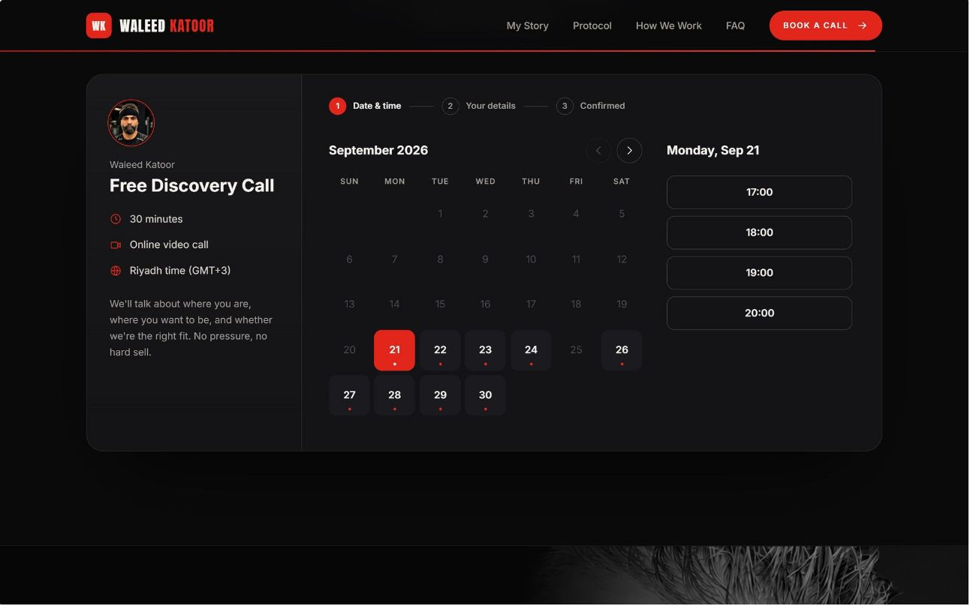
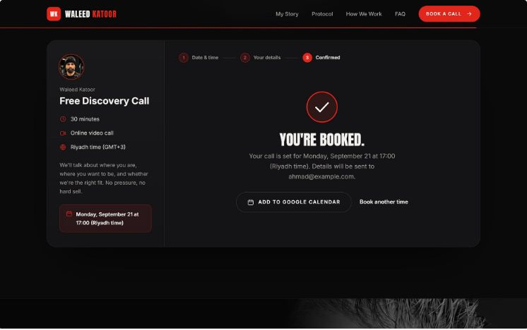
Section 8: The Calendar That Starts the Automation
An embedded booking calendar with only Waleed's available slots, in KSA time. Booking starts everything — no manual follow-up required.
Lead Created in CRM
The lead record is created with the source post attached automatically.
WhatsApp Confirmation
A confirmation goes out instantly in Arabic.
Reminders Sent
24 hours and 1 hour before the call, automatically.
Pre-Call Form
A short form arrives on WhatsApp so the call starts informed.
No-Show Recovery
No-shows get one polite rebooking message.
Post-Call Tap
After the call, Waleed taps "Client" or "Not now" and the next automation starts.

Slide 16
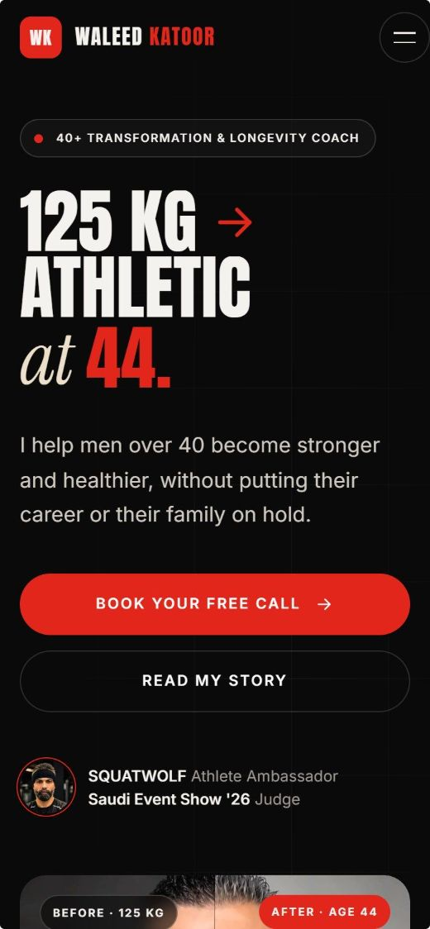
Built Mobile First
THREE RULES FOR THE WEBSITE
Technical Stack
Arabic (RTL) and English language toggle
Cal.com booking with webhooks into the CRM and WhatsApp
Analytics, Meta Pixel and a tracked link per post
Indexed under وليد كتور
Podcast embedded
Privacy policy and a "not medical advice" note
No Testimonials Section, Yet
Show the Price or Book the Call
Mobile First, Genuinely
A thin results block damages trust faster than none. His own transformation is the case study until the two client cases are ready.
Never "contact us for price." To this man it reads as expensive and evasive.
Tested on a mid-range phone over mobile data: thumb-reachable buttons, Arabic text readable without zooming, a sticky booking button.

Slide 17
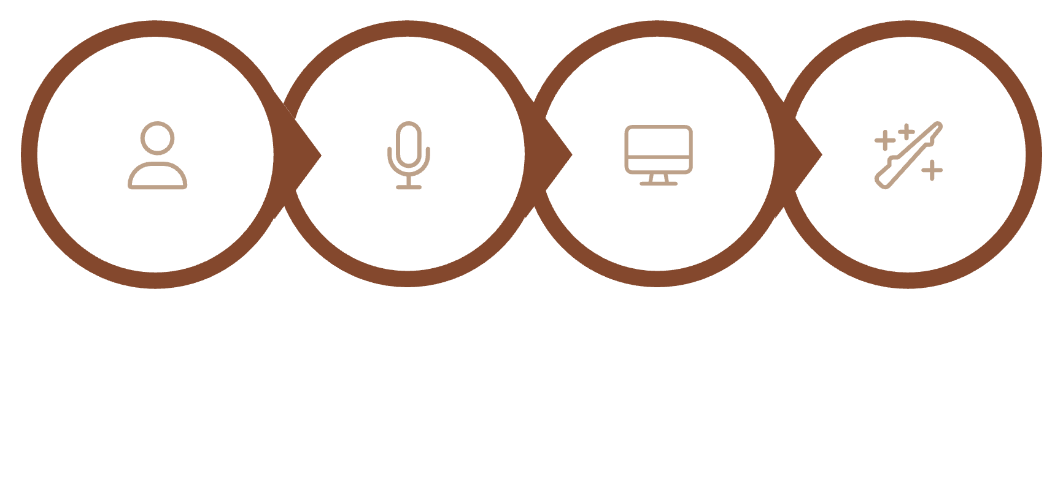
CRM: Coaching from a Phone, Without Typing
DESIGN PRINCIPLES
The client enters the data · one screen a day · voice over typing.
DASHBOARD · الرئيسية
REGISTRATION FORM
Subscriptions: active, ending within 14 days, expired, upgrade candidates
Follow-up: needs follow-up today, no check-in this week, new InBody to review, AI drafts waiting
Clients: search, new leads, booked calls
Headline numbers: active clients, renewals, revenue, new leads
Allergies, diseases, medications, injuries, history and separate consents. Any declared condition raises a medical flag: no AI meal plan, doctor clearance first.
PAYMENTS AND RENEWALS · الدفعات والتجديد
Paid / due / overdue, full history, a renewal pipeline starting 14 days out.
CUSTOMER PROFILE · ملف العميل
Today's weight against starting weight at the top
Photo, plan, status · WhatsApp, email, Instagram
Start and renewal dates · weight chart, height, InBody history
Weekly photo timeline · meal PDF · check-in log
Transcribed voice notes · payments
NOTES REGISTER AND TELEGRAM
Voice notes auto-transcribed to the right client. A private Telegram bot answers questions and sends a morning digest. Health data handled under Saudi PDPL.
Client Input
Transcribe Note
Waleed Review
Automated Next Step

Slide 18
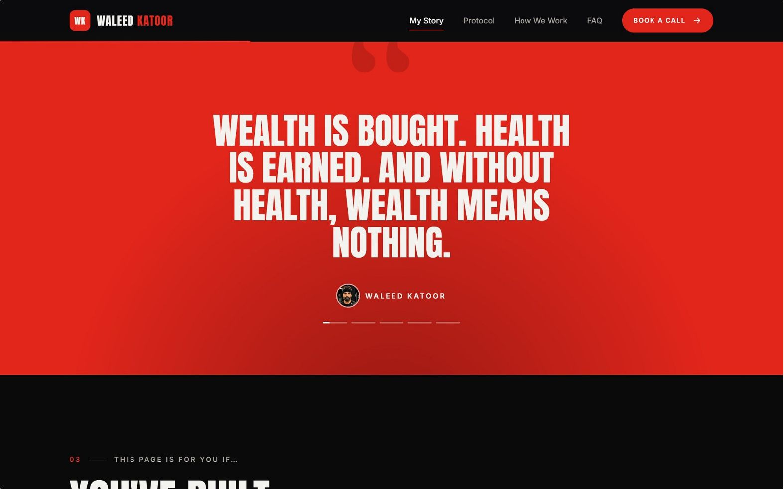
AI Automation: Nine Client Automations
A complete system for Waleed — Arabic-first, human in the loop for health and money, clean handover, within Meta's platform rules, and everything logged.
PRINCIPLES
Arabic-First
Human in the Loop
Every message, every touchpoint in the client's language
Health and money decisions always go through Waleed
Clean Handover
Platform Rules
Every action logged and handed off clearly
Within Meta's guidelines at every step

Slide 19
The Nine Automations
# | Automation | What Happens
1 | Meal PDF Delivery | Approved PDF sent to the client on WhatsApp
2 | InBody Tracking | AI reads the photo, saves weight, muscle, body fat, updates the graph
3 | Monthly Report | A report per client sent to Waleed on the 1st
4 | Weekly Reminder | «لا تنسى التشيك-إن تبعك اليوم»
5 | Weekly Form Link | The check-in link each week, answers land in the profile
6 | AI Plan Builder | Drafts meal and plan ideas; Waleed approves every one
7 | Renewals | Renew or upgrade message 7 days before, one follow-up
8 | Waleed's Assistant | Voice notes to the right client's CRM record; answers questions
9 | Weekly Progress Photo | Added to the before/now timeline

Slide 20


The Leads Engine
How It Works
Post + CTA: e.g. اكتب «بروتوكول» بالكومنت وببعتلك القاعدة كاملة
Auto DM: the promised resource + a website link unique to that person
Click = lead: the CRM registers his handle, the source post and the date
Assistant: answers repeat questions, qualifies, offers the calendar
Booked or follow-up: call booked, or queued for a human
Because every link is unique, we know which post produced which client, not only views.
Post + CTA
Click = Lead
Auto DM
Follow-up within the rules: Meta limits business messages to a window after the person's last message, and WhatsApp needs opt-in. So follow-up moves to WhatsApp with consent, happens personally from the "Not now" list, or comes back through new content. No mass cold DMs.
Stack
n8n (self-hosted) · WhatsApp Cloud API · Meta Graph API · an Arabic-strong LLM · vision for InBody · Whisper-class transcription · Cal.com · Telegram Bot API · branded PDFs.
Rollout
Month 1 catch every lead · Month 2 run the clients · Month 3 the intelligence layer.

Slide 21
Social Media: The Weekly Rhythm
Every post at 20:00 KSA, on Instagram and Facebook
Friday Reel (anchor) · Saturday carousel · Sunday Reel (test slot) · Tuesday Reel · Wednesday Reel · Monday and Thursday Stories only (+ Q&A box on Thursday)
4 Reels + 1 carousel a week · about 16 + 4 a month · 2+ raw Stories a day
Five Content Pillars
The Road · الطريق
1
The 125 kg story in unglamorous specifics
3/month
The Busy Man's Protocol · بروتوكول المشغول
2
The actual system, 60–90s teaching
5/month
Myths · خرافات
3
Myths taken apart, told as his stories
3/month
Why?! · ليش؟!
4
Family as the reason, the pillar wives share
3/month
The Difference · الفرق
5
Vlogs, events, work, SQUATWOLF
2/month
Gym footage is not a pillar. It is background texture.

Slide 22

The Content Engine
25 Reel Ideas from the Strategy Notes
Production System
الصورة اللي خلتني أبلش (the photo that made me start) · قاعدة اليوم الرابع (the 4th-day rule) · the cheat meal · لما بنتي طلبت تلعب معي وما قدرت · لما يصير عمري 65 بدي كون متل عمرو دياب · يوم بحياتي.
Batch Filming
Better Editing
One 90-minute weekly session, change T-shirts between takes → 6 Reels (4 published, 2 banked)
Burned-in Arabic captions, punch-in zooms, numbers in Ember
Stories — Daily and Raw
Food and weight
The 6:45am gym
Old Reel with a new comment
Events and runs
Podcast behind the scenes
Q&A box
Training while travelling
Hashtags
Caption Formula
Exactly five per post, matched to the pillar
Hook · the specific thing with a number · CTA keyword · one real question · five hashtags
Stop immediately: reposted voiceovers · silent gym montages · clips under 10 seconds · follow-for-follow.

Slide 23
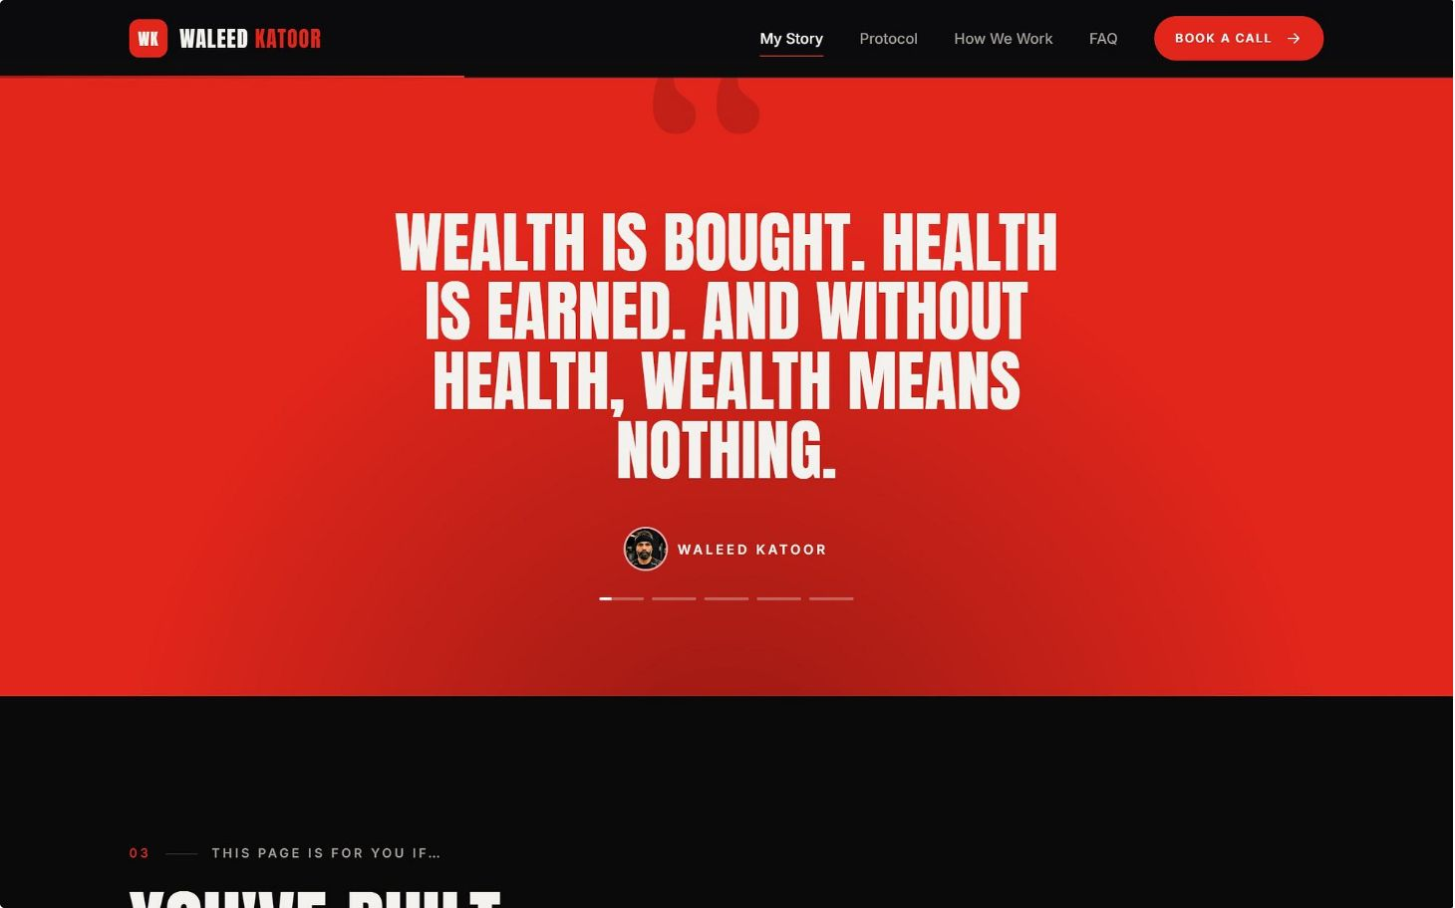
Growth Plays
Two Client Cases
Podcast Host with Well-Known Guests
The Serialised Transformation · المسلسل
Hint → build evidence in the CRM → written consent → reveal. Timing is driven by real results, not a date. Then the website's نتائج section goes live.
Successful people and the price their bodies paid. One episode a month; each yields 4–6 spoken Reels and a collab post.
The Road pillar as a 12-episode weekly series. "تابعني تشوف الحلقة الجاية" becomes an honest reason to follow.
Borrowed Audiences
Fix the Profile
A SQUATWOLF feature or takeover · six podcast guest spots in six months · collabs with Riyadh gyms · joint content with his wife.
Arabic name field وليد كتور | من 125 كيلو · new Arabic bio · website link · face-forward photo · pinned Reels · Highlights: قصتي · قبل وبعد · البروتوكول · خرافات · عائلتي

Slide 24
Roadmap: 90 Days, Then 12 Months
When | Social Media | Website + CRM | Automation
Week 1 | Profile fixes, Insights baseline | Discovery, pricing decision, design | Channel build
Weeks 2–4 | Full schedule live, series ep. 1 | Website and CRM build, forms drafted | Comment-to-DM, tracked links, DM assistant
Month 2 | First collab, podcast ep. 1 | Launch, bio link switched, calendar live | WhatsApp assistant, booking flow, reminders, PDFs, renewals
Month 3 | Review slots and pillars against data | Improvements; results section prepared | InBody reading, monthly report, AI plan builder
The 12-Month Ladder (a target, not a guarantee)
M1
Format fixed, 1,500 median views
M3
3,000–5,000 followers
M6
10,000–15,000 followers
M12
30,000+ and inbound brand deals
Months 1–2 will feel like nothing is happening. That is when most people quit, and it's the stretch that decides the outcome.

Slide 25
Measurement, Guardrails & Next Steps
Funnel We Report Monthly
Decisions to Confirm Before Launch
Years in the events industry: 10 or 20?
His age on his first day back at the gym
Show the price on the website, or book a call?
The two client cases: who, and will they consent?
Can he film one 90-minute session every week?
Keep the Sunday slot for four weeks?
Weekly link: check-in form (recommended) or full registration?
His assistant on Telegram, WhatsApp, or both?
Do clients have access to InBody scans?
Myth M2: «الكرش وراثة»?
Podcast name, first guests, recording location
Access: Instagram Insights, Meta Business Suite, calendar
Leads
Clients Closed
Calls Booked
Monthly report + 30-minute review: keep, change, stop.
Guardrails
The Medical Line
His Dialect, Not Ours
Consent
Next step: answer these in week 1, grant access, and book the first filming session.
No medical claims, no supplement protocols, no calorie prescriptions. The back story is told as story only.
Waleed reads every Arabic line aloud before it goes public.
Client photos published only with separate written permission, withdrawable.
ولما تكسبها، بتصير ملك الدنيا.
Client Data
Platform Rules
Honest Numbers
Saudi PDPL, encrypted, access-limited.
Meta-approved templates, opt-in, no mass unsolicited DMs.
Every public claim is true and checkable.

