Slide 1

Pricing pattern determination of Organic versus Conventional Produce (Fruits and vegetables)
Wholesale price pattern in Terminal markets
Organic pricing versus Conventional pricing
Geographical locations (SFO and ATL)

Slide 2
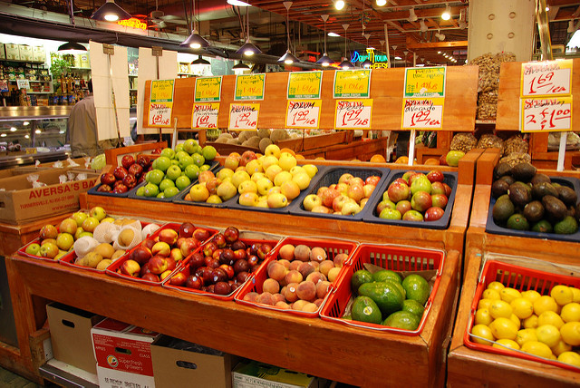
INTRODUCTION - A study on the market prices pattern of food produce in two different geographical locations in USA.
I want to solve following problems:
What are the price ranges of organic vegetables vs Conventional vegetables?
What is the probability of the increase in price using predictive Analysis?
Which market location has more price difference?
Which vegetable/fruit is costlier?

Slide 3

Perception of Organic Produce prices versus reality
My client will be Individual wholesale Consumers who are interested in buying Organic and conventional produce.
The List of Consumers are:
Restaurant/Hotel
Grocery Retailers
Individuals /Home
Culinary schools

Slide 4

Outcome of Statistical Analysis:
1)Pattern in produce pricing – A comparison of Organic and conventional Produce
2)Do the Geo-graphical locations differ in their pricing pattern? (San Francisco and Atlanta)
3)(consumers can be selective on the seasonal availability/Month=wise pricing) example: Restaurant owners can decide which produce to buy according to the Price increase-decrease and their operating cost.
4)Predictive analysis of prices will help the consumer on the produce prices that are probable to increase
5)Get perspectives on Organic produce. Is it really worth the while of buying organic versus conventional in the long run.

Slide 5
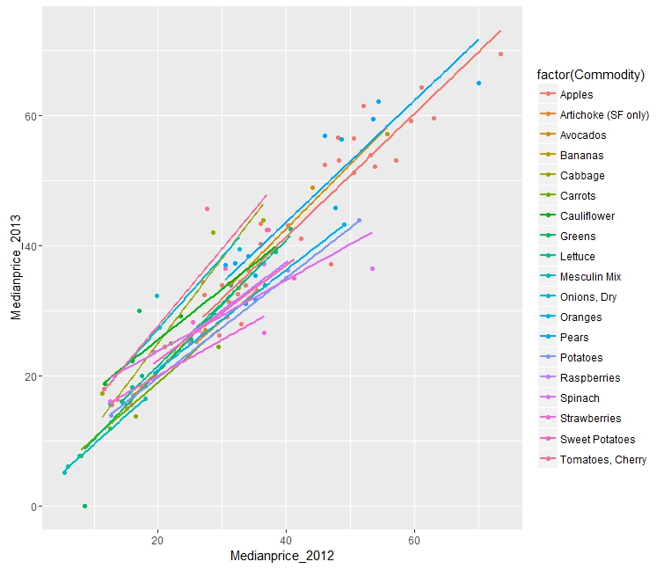
Types of Statistical Analysis
1)Descriptive Analysis
2)Exploratory Analysis
3)Predictive Analysis
I. Linear regression and Anova modeling
II. K mean clustering
III. Location analysis
IV. Organic and conventional price differentiation
V. Month-wise pricing analysis

Slide 6
Evaluation and Deployment
1)Pricing Pattern is comparatively the same and consistent, there is no significant price difference between organic and conventional.
2) The pricing pattern is similar relatively and correlate for both geographical locations.
3) Yes, Month-wise price pattern can determine on consumers being selective on purchase
4)Yes, Predictive analysis shows that both organic and conventional prices have linear positive upward pattern. Therefore, increase in prices is the trend.
Month | Expensive | moderate | Inexpensive
January | Apples | Raspberries | Greens
February | Apples | Strawberries | Cauliflower
March | Apples | Onions | Greens
April | Oranges | Spinach | Greens
May | Apples | Tomatoes | Lettuce
June | Apples | Potatoes | Greens
July | Apples | Strawberries | Greens
August | Apples | Cabbage | Lettuce
September | Apples | Onion | Greens
October | Apples | Carrots | Greens
November | Apples | Cauliflower | Greens
December | Apples | Strawberries | Greens
[vr1]ode
[vr2]

Slide 7
References:
1)https://www.carolinafarmstewards.org/wp-content/uploads/2015/05/Wholesale_Packing_Resource_Guide-1.pdf
2)http://www.consumerreports.org/cro/news/2015/03/cost-of-organic-food/index.htm
3)http://lib.dr.iastate.edu/cgi/viewcontent.cgi?article=2455&context=etd
4)http://www.choicesmagazine.org/2007-2/grabbag/2007-2-05.htm
5)https://datascientistinsights.com/2013/01/29/six-types-of-analyses-every-data-scientist-should-know/
6)http://www.fao.org/organicag/oa-faq/oa-faq5/en/
7)http://ageconsearch.umn.edu/bitstream/56659/2/jaae413a01.pdf
8)http://www.foxnews.com/leisure/2012/03/11/10-reasons-organic-food-is-so-expensive/
9)http://www.ecowatch.com/10-reasons-consumers-buy-organic-1881899943.html
10)http://www.terminalmarkets.com/markets.htm
11)http://www.sfproduce.org/merchants/merchname.html
12)http://terminalmarkets.com/atlantastate.htm
13)http://www.ers.usda.gov/media/255736/aib777c_1_.pdf
14) Data Science for Business – Foster Provost and Tom Fawcett

