Slide 1


Plant Disease Detection
and Explanation
Using Machine Learning and Large Language Models
COMP 4118 — Data Mining | University of Memphis
Vidal Calderon
U00825802 | vcldron1@memphis.edu
Oscar Barreto Lara
U00817669 | obarretlara@memphis.edu

Slide 2



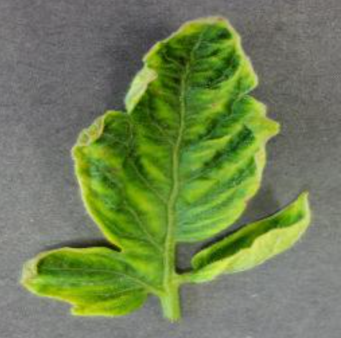
Why Does This Matter?
20–40%
The Problem
ML Helps — But Falls Short
Our Solution
of global crop
yield lost to
plant diseases
Traditional diagnosis requires manual inspection by agronomists — slow, expensive, and inaccessible in rural areas.
ML models predict a disease label, but give farmers NO guidance on what to do next.
Combine ML classification + Flan-T5 LLM to detect disease AND explain it in plain language.
Prediction alone is not enough — farmers need prediction + explanation to take action.

Slide 3
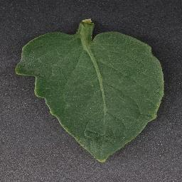
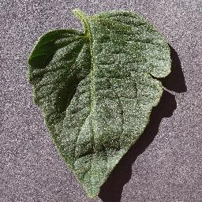
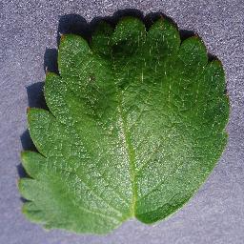
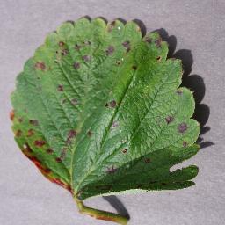
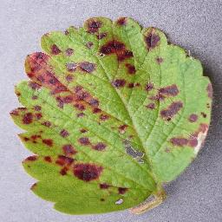
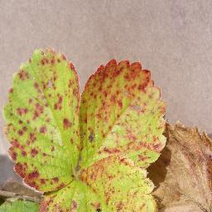
Dataset and Preprocessing
New Plant Diseases Dataset
80 / 20 Stratified Split
~87,000
Train: 1,520
Test: 380
total leaf images
Stratified → all 38 classes proportionally represented in both splits
38
disease classes
14
crop species
Feature Extraction — RGB Color Histogram
50
images/class used (cap)
1. Resize each image to 64 × 64 px
2. Compute 32-bin histogram per channel (R, G, B)
3. Normalize each histogram (sum = 1)
4. Concatenate → 96-dimensional feature vector
1,900
total samples loaded

Slide 4



Models
BASELINE
MAIN MODEL
LLM MODULE
Logistic Regression
Random Forest
Flan-T5-large
Linear decision boundary
L-BFGS solver
Max 1,000 iterations
Random seed: 42
Purpose: reference point
200 decision trees
Majority vote ensemble
Bootstrap aggregation
Parallel: n_jobs = -1
Captures non-linear patterns
780M parameter LLM
Instruction-tuned (Google)
HuggingFace Inference API
Zero-shot explanation
Input: disease label → Output: explanation
Image
Histogram
(96-dim)
Random
Forest
Disease
Label
Flan-T5
Explanation
for Farmer

Slide 5
Live Demo — iTiger Cluster
What You'll See
Results Preview
1
train_model.py — full pipeline code
Metric
LR Test
RF Test
Accuracy
0.3105
0.6053
2
SLURM job 59910 output log
Precision
0.2703
0.6288
Recall
0.3105
0.6053
3
Model comparison table
F1-Score
0.2567
0.5927
Random Forest: nearly 2× better than baseline
4
model_comparison.json results file
Sample explanation output:
5
explanations.txt — LLM outputs
"Tomato Yellow Leaf Curl Virus is transmitted by whiteflies, causing severe leaf curling and yield loss. Management: control whitefly vectors and plant resistant varieties."

Slide 6
Summary — Vidal's Section
01
Motivation
Plant diseases = 20–40% crop loss. Farmers need prediction + explanation.
02
Dataset
87K images, 38 classes. 1,520 train / 380 test via 80/20 stratified split.
03
Models
Logistic Regression (baseline) + Random Forest (200 trees) + Flan-T5 LLM.
04
Demo
Pipeline ran on iTiger job 59910. RF: 60.5% test accuracy, F1 = 0.59.
Now over to Oscar — Results, Discussion, and Takeaways →

Slide 7
Experiment Setup
Run iTiger GPU cluster
SlURM Job ID: 59910
Pyhton 3.10 (Scikit-learn, NumPy, PIL)
1,900 samples (1,520 train / 380 test)
Metrics: Accuracy, Precision, Recall F1-score
Random seed =42 (no tuning)

Slide 8
Model Performance Results
Logistic Regression: 31.05% accuracy
Percision: 27.03% | Recall: 31.05% | F1: 0.2567
Random Forest Forest: 60.53% accuracy
Precision: 62.88% | Recall: 60.53 | F1:0.5927
Random Forest = 2x better
NO OVERFITTING OBSERVED

Slide 9
LLM Explanation Outputs (Flan-T5)
Generates human readable explanations
Explains disease, cause, and treatment
Healthy —--> “ NO DIEASE DETECTED”
Example: Tomato Yellow Leaf Curl Virus
Outputs: explanations.json & .txt

Slide 10
Discussion and Limitations
Random Forest captures non-linear patterns
RGB histogram loses spatial info
Small dataset (1,900 vs 87k)
LLM depends on external API
Prediction + Explanation > Prediction alone

Slide 11
Takeaways and Future work
ML + LLM improves usability
Actionable insights for farmers
Future: CNNs for better accuracy
Use full dataset (87k images)
Deploy as web/mobile app

Slide 12
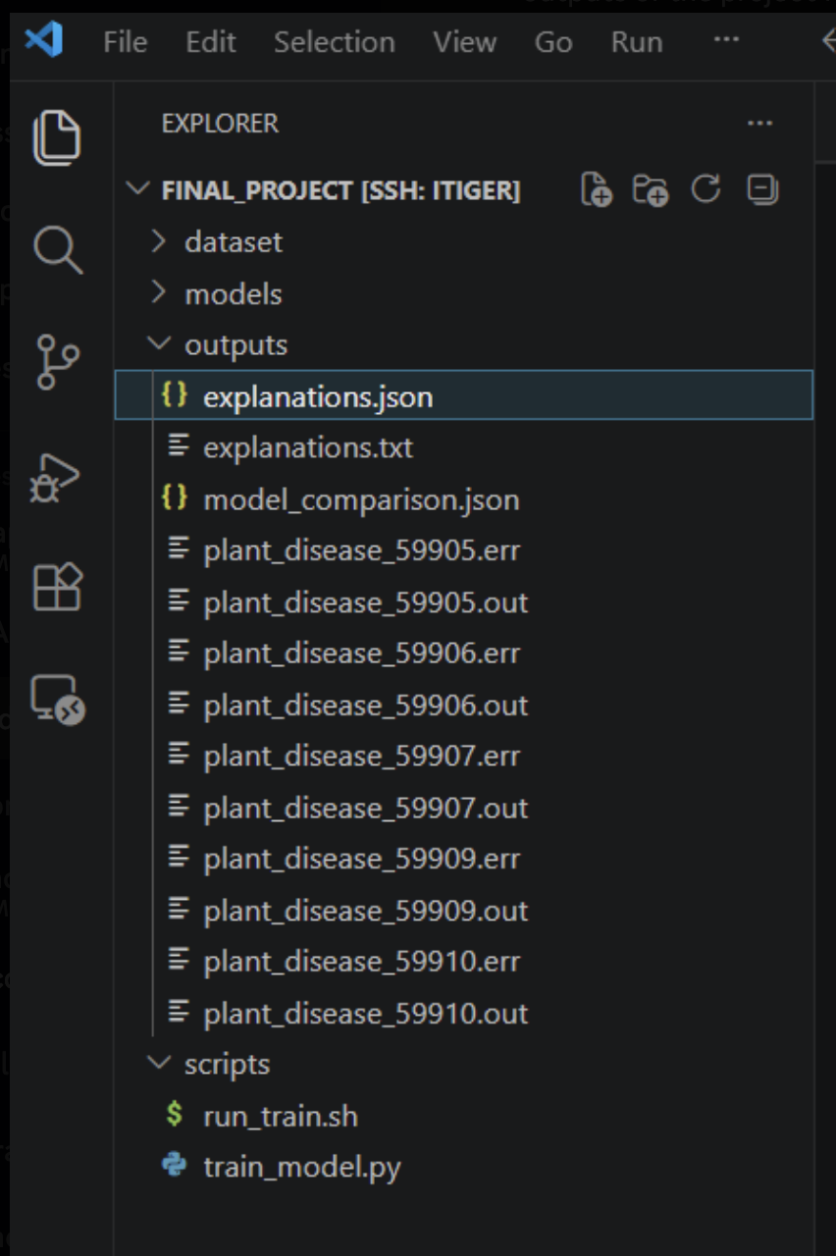
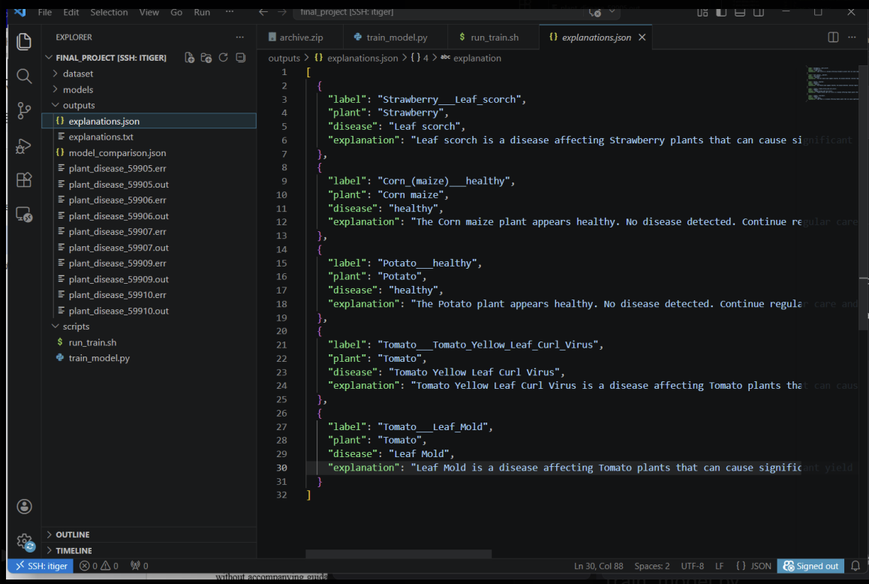
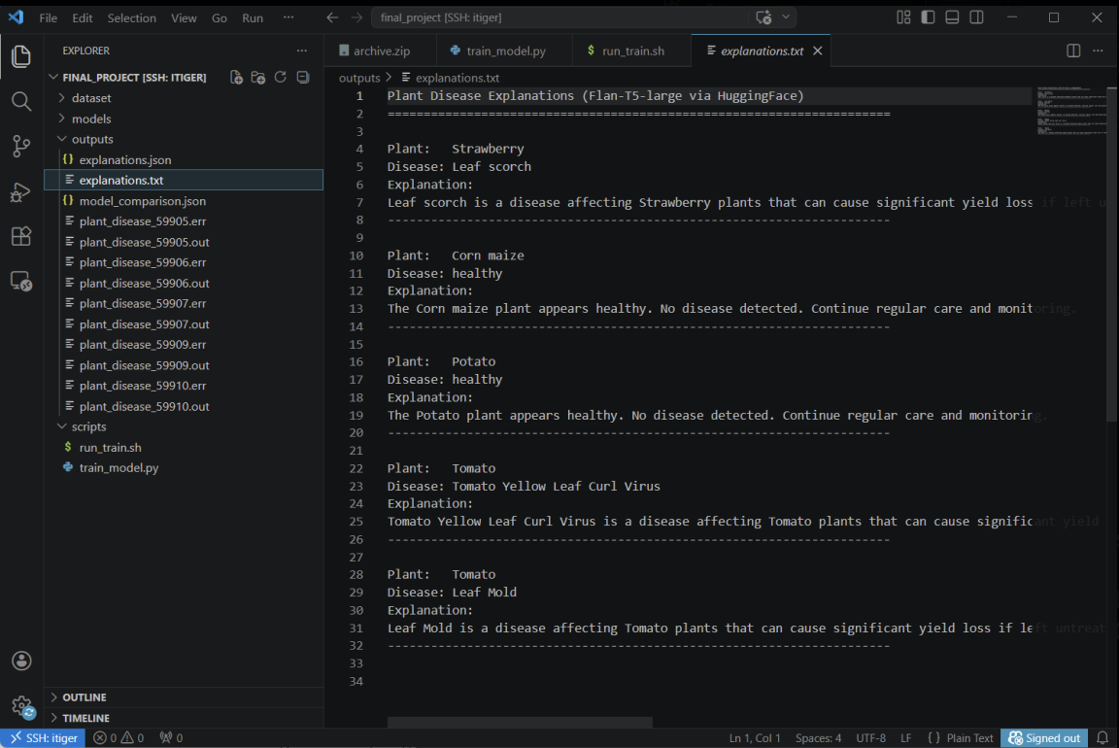
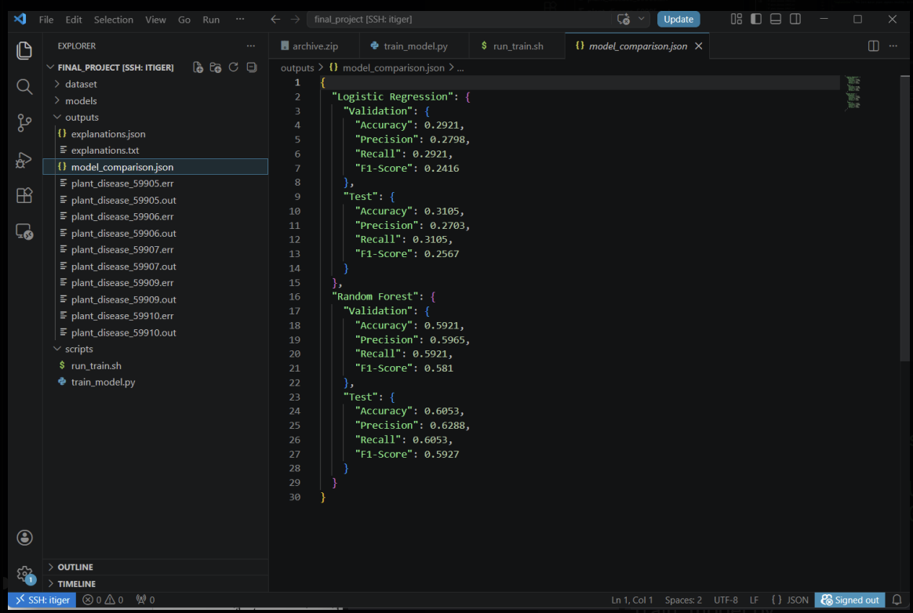
Output Pictures

Slide 13
Summary
THANK YOU
ANY QUESTIONS?

