Slide 1


Consistency of the Sleepy protocol of consensus with Markov chains
Matteo Vicari
Prof. Daniele Venturi
Prof. Giuseppe Di Luna
Department of Computer Science
Master degree in Cybersecurity

Slide 2
Roadmap
Blockchain Fundamentals
Sleepy Protocol
Consistency property
Convergence Opportunities
The new Markov Model
Sleepy Best Attack

Slide 3
Blockchain fundamentals

Slide 4
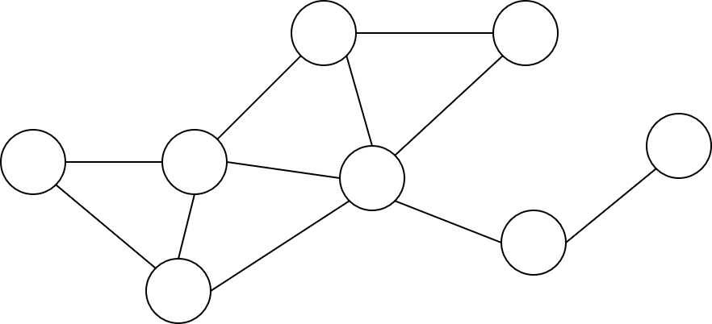
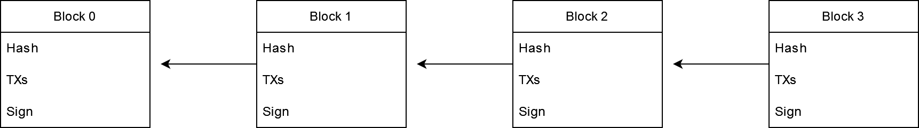
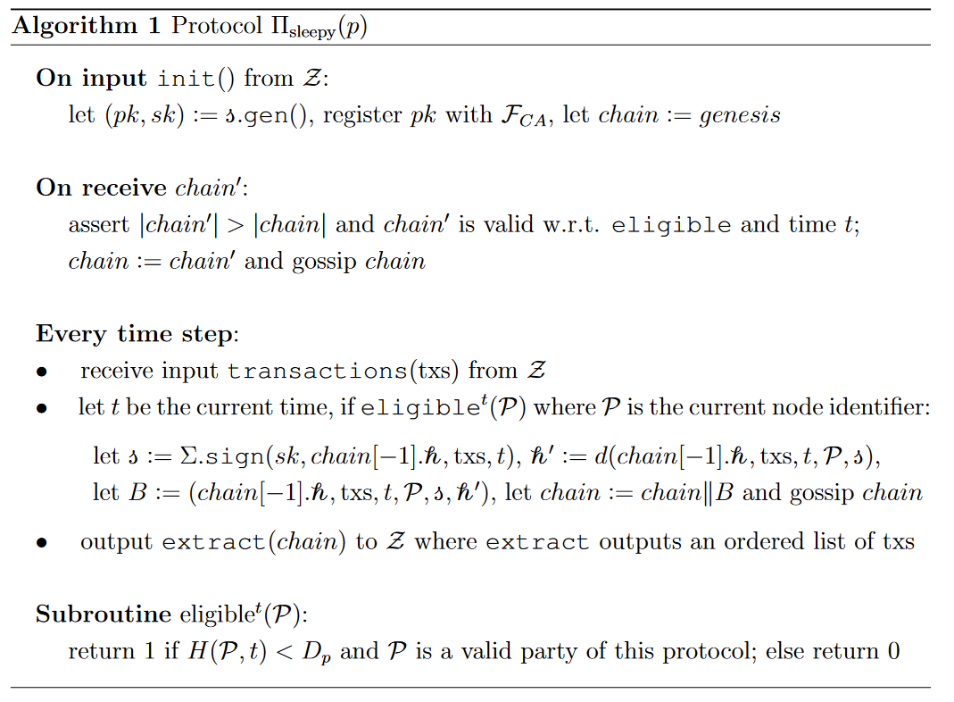
Peer to Peer network
Chain of blocks
Consensus protocol

Slide 5
Sleepy protocol

Slide 6
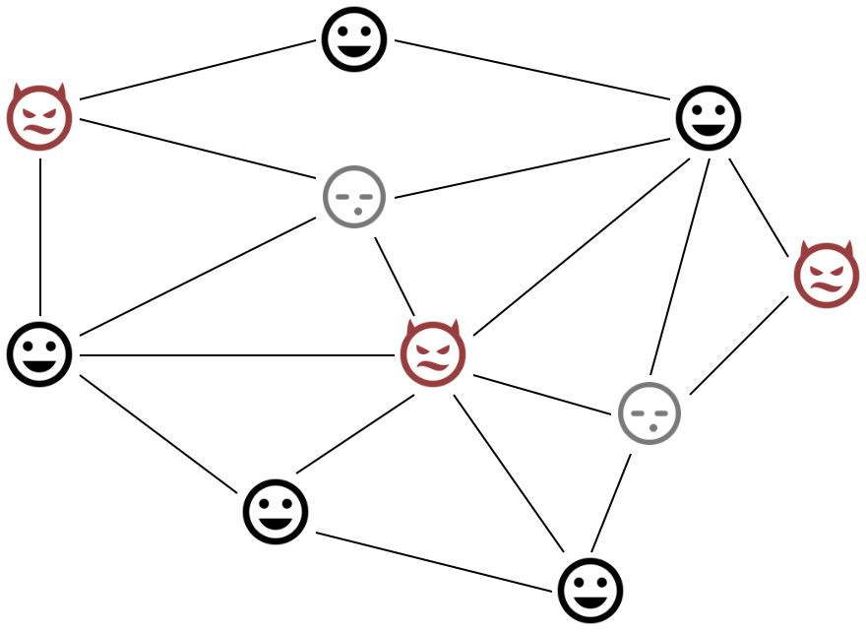
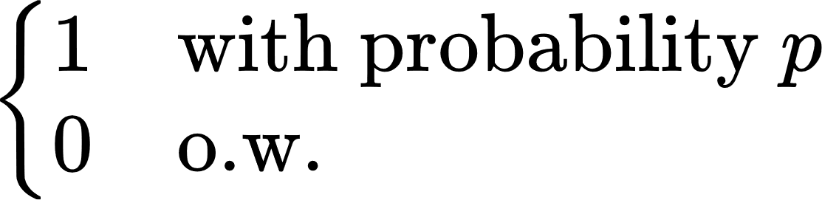
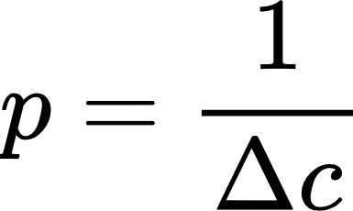
(Weakly) Synchronous network ⇒ Δ maximum network delay (order of 10¹³)
Static corruption ( 𝜇, 𝜎 and 𝜌 are fixed)
Am I the leader?
RO
Yes
Blocks are signed and hashed
Longest chain wins
c is the chain speed
𝜌 is the corrupt fraction of nodes
After Δ rounds …

Slide 7
Consistency property

Slide 8

Common prefix
Alice
Bob
For every honest node:
=
Common prefix
Trailing blocks
Future self consistency
At round r
At round r+T
After T rounds
A
B
C
A
B
C

Slide 9
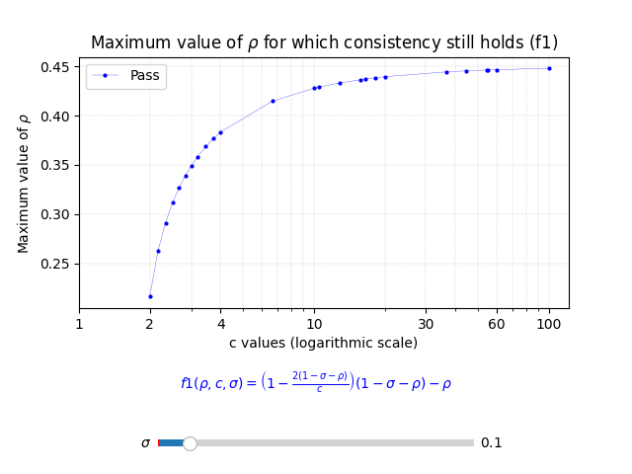
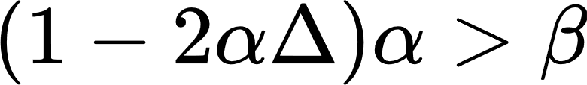
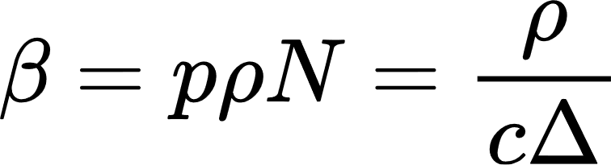
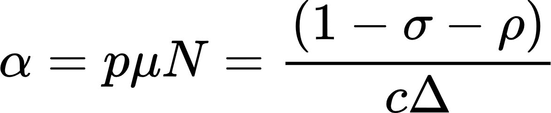
Previous Sleepy consistency conditions:
Consistency depends on c, 𝜌 and 𝜎

Slide 10
Convergence opportunity

Slide 11
3 steps event:
Bob gets lucky and becomes leader He builds and proposes to everyone block B
rounds
Δ rounds with no leader elected - Silent rounds Every node in the network received the missing blocks Everyone agrees on the last block A
Δ rounds with no leader elected - Silent rounds Every node in the network received block B The chain has increased by one and everyone agrees
A
B
B
What if Alice gets elected before reaching consensus and proposes block C?
rounds
B
A fork occurs Honest blocks cannot choose one of the two chains
Consensus is delayed
A
⇒ Adversarial tactic
C

Slide 12
= Δ silent rounds
The adversary must break all convergence opportunities to deny consensus
= honest leader
= corrupt leader
r
r+T
rounds
If we call adversarial slot, then we want to make sure that
Challenging estimate to compute Different techniques lead to values with different accuracy levels
Very easy to calculate It is just the expected number of leaders the adversary will have in the time interval
New framework to study consistency on PoW with Markov chains [Kiffer, Rajaraman and Shelat, 2022]
New estimate on convergence opportunities New consistency condition

Slide 13
The new Markov model

Slide 14
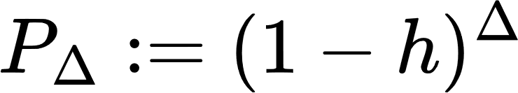
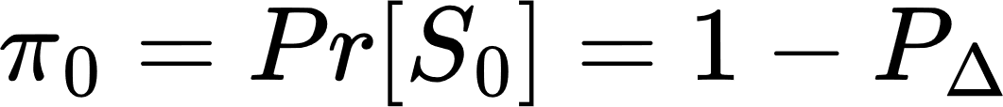
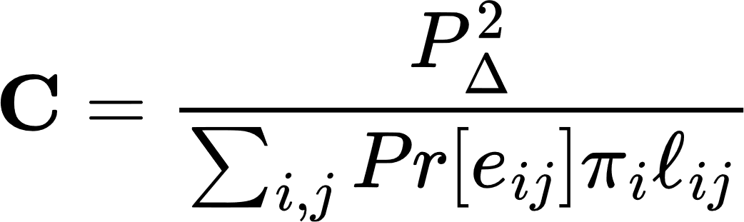
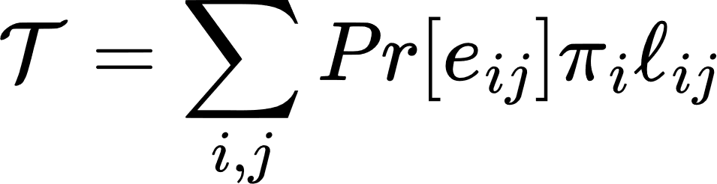
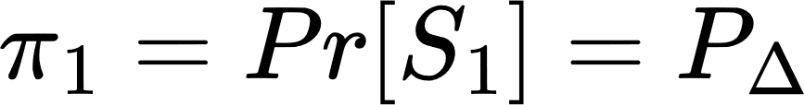
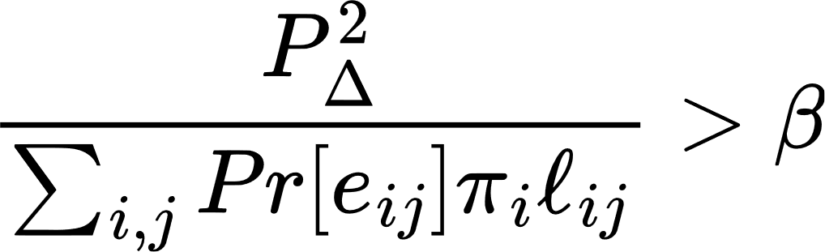
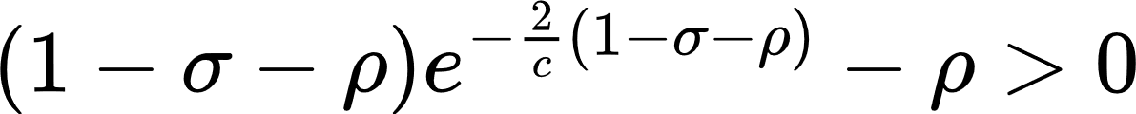
Leader ≤ Δ
Δ silent rounds
Leader + Δ silent rounds
S₀ = messy state
S₀
S₁
S₁ = ordered state
Convergence opportunity
Leader + Leader ≤ Δ
Events of interest
Stationary distribution
New C.O. estimate
New consistency condition
Final analytical condition

Slide 15
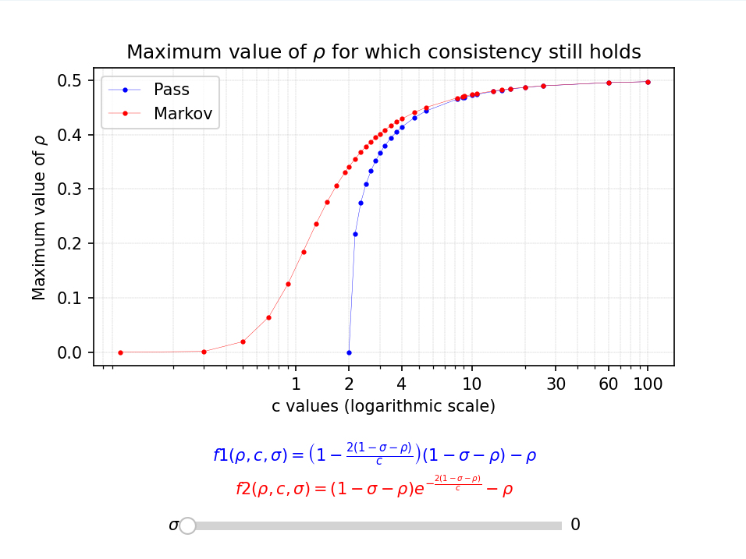
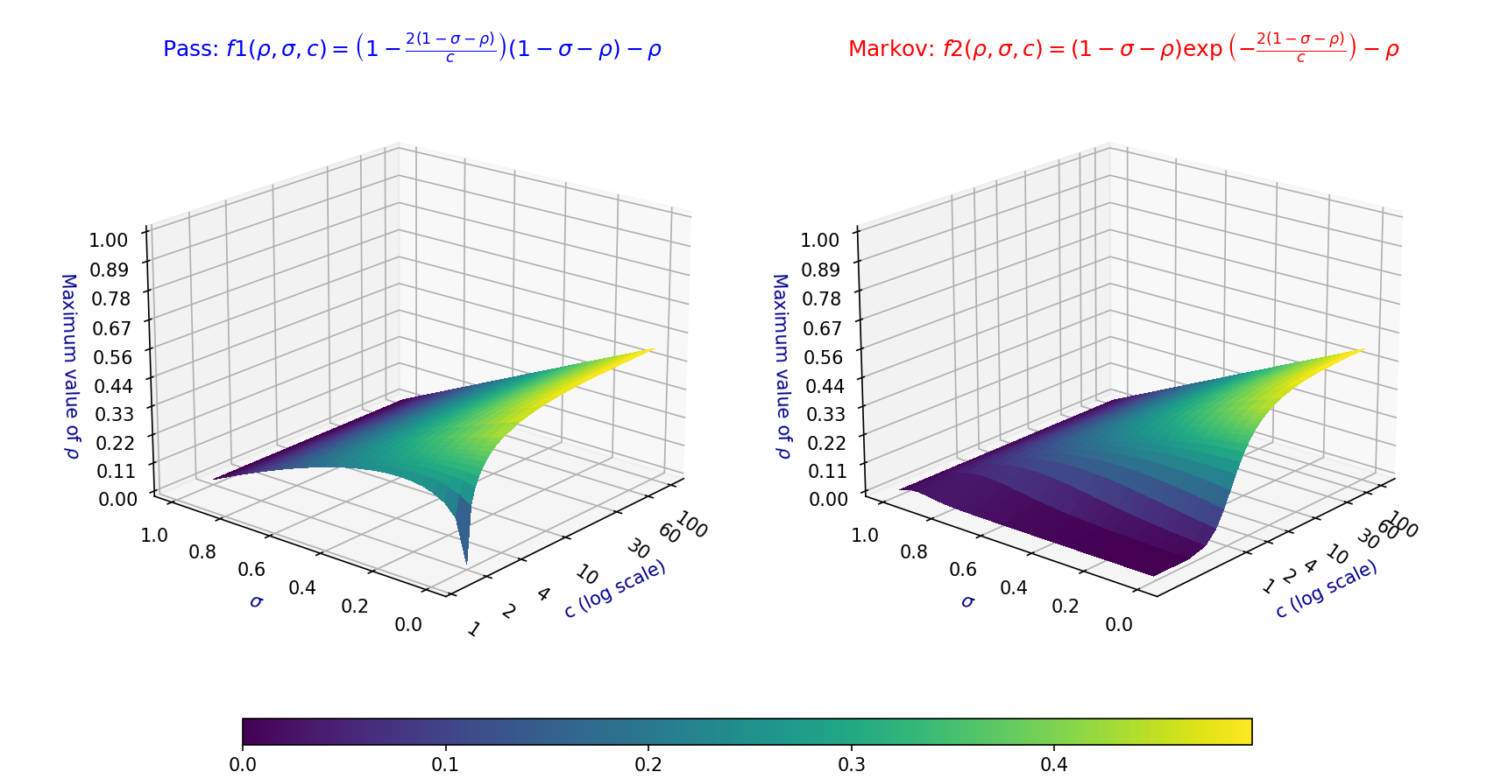
Pass and Seeman condition VS New Markov condition
Extended domain for c values
Increased resistance to adversarial elective power 𝜌

Slide 16
Sleepy best attack

Slide 17
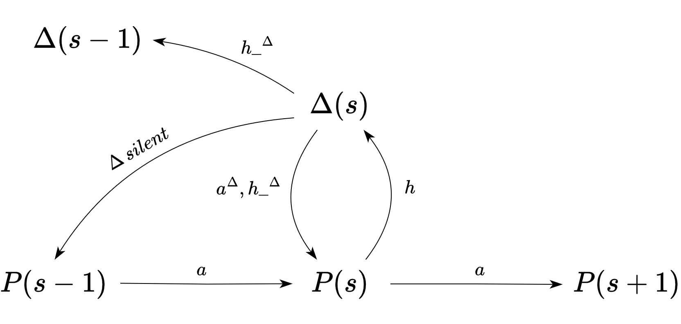
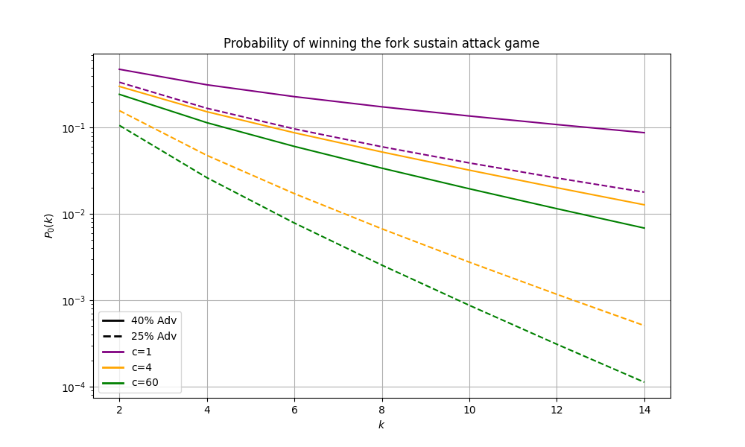
Fork sustain attack
Within Δ rounds
|left| = |right|
Left chain
Right chain
As long as the two chains have equal lengths, honest nodes cannot choose between the two
As soon as one of the two chains is ahead for more than Δ rounds, the adversary loses
Even if consistency holds, the adversary is able to sustain a fork for k block with non negligible probability (in k)

Slide 18

Consult the paper here
Thank you for your attention!

