Slide 1


Information and
Communication Theory
By
Dr. Hem Dutt Joshi
Associate Professor, ECED,
TIET, Patiala

Slide 2
Lecture-1
Module-2 : Information Theory

Slide 3
Course Content
Module-1 : Probability Theory
      Random Variable, Distribution function, Characteristic function and central limit theorem
Module-2 : Information Theory
      Information Measure, Entropy, Source coding, Mutual Information, channel capacity, Shannon’s Theorems.
Module-3 : Stochastic Processes
      Systems with Stochastic Inputs, Markov Chains, and Random-Walk Model
Module-4 : Estimation & Hypothesis Testing
      Hypothesis, Neyman Pearson Tests, Bayes’ Criteria, Z-Score, and p-Value Test
Module-5 : Statistical Modeling of Noise

Slide 4
Content of Lecture-1
Communication System
Importance of Information Theory
Historical Origin of Information Theory
Information and Uncertainty
Information measure (Mathematical definition of Information)

Slide 5
Communication System
Information
Source
Transmitter
Channel
Receiver
Destination
Message
Processed
Signal
Noisy
Signal
Estimate of Message
Goal of Communication System is to transmit information from source to destination.
Information Source
  generates random messages for the transmission .
  Types of Messages are: Audio signal , Video signal, Image and Text
  Types of Information Source
    The Memory less Source:
      Generates Independent random messages .
    The Markov Source (Source with Memory):
      Generate dependent random messages
      Each symbol depends on previous symbol or state of source
Notes:
Some signal processing is done both at Transmitter and Receiver so that information can be transfer at maximum data rate without distortion .
We can control signal processing but not channel characteristics, so the questions are

Slide 6
Communication System
Information
Source
Transmitter
Channel
Receiver
Destination
Message
Processed
Signal
Noisy
Signal
Estimate of Message
Transmitter
  Process the message generated by information source so that it can be transmitted efficiently through the channel.
Receiver
  Receive the Noisy signal from channel.
  Apply signal processing to correctly estimate the transmitted message.
  It performs the inverse function of transmitter to reconstruct the original signal
Notes:
Some signal processing is done both at Transmitter and Receiver so that information can be transfer at maximum data rate without distortion .
We can control signal processing but not channel characteristics, so the questions are

Slide 7
Communication System
Information
Source
Transmitter
Channel
Receiver
Destination
Message
Processed
Signal
Noisy
Signal
Estimate of Message
Channel
  act as a medium of transmission.
  Channel may be wired or wireless.
Wired communication System
  Telephone communication system (channel: Two wire transmission line)
  Cable TV transmission system (Coaxial cable as a channel)
  Local area network (LAN) (Ethernet cables as a channel)
Wireless communication system
  Free space as a medium of transmission (channel)
  Cellular network (Mobile communication system)
  Satellite communication system
  FM, AM and TV broadcast system
Notes:
Some signal processing is done both at Transmitter and Receiver so that information can be transfer at maximum data rate without distortion .
We can control signal processing but not channel characteristics, so the questions are

Slide 8
Communication System
Information
Source
Transmitter
Channel
Receiver
Destination
Message
Processed
Signal
Noisy
Signal
Estimate of Message
The major objective of any communication system is to transmit information with
  Maximum data rate
  Minimum probability of symbol error
  Minimum transmitted power
Now the questions are:
  how much maximum data rate can be supported by any communication system for reliable communication?
  What is the measure of information?
Notes:
Some signal processing is done both at Transmitter and Receiver so that information can be transfer at maximum data rate without distortion .
We can control signal processing but not channel characteristics, so the questions are

Slide 9
Information Theory
In particular, Information theory answers two fundamental questions:
  What is the irreducible complexity, below which a signal cannot be compressed?
    (Entropy of a source)
  What is the maximum transmission rate for reliable communication over a noisy channel?
    (Capacity of a channel)
In general, Information theory deals
  with the mathematical modeling and analysis of a communication system rather than with physical sources and physical channels.
  with the amount of information content in any random signal (Information Measure)
  Relationship between
    Signal to Noise Ratio and Channel Capacity
    Channel bandwidth and Capacity.

Slide 10
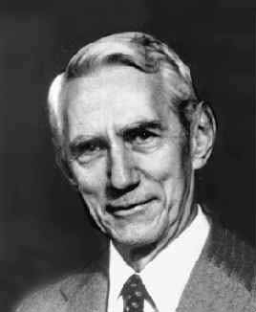
Historical origins of Information Theory
The main concepts and principles of information theory were developed by Claude E. Shannon in late 1940s
  (C. E. Shannon, “ A Mathematical Theory of Communication “, Published in The Bell System Technical Journal, Vol. 27, pp. 379–423, 623–656, July, October, 1948)
  He did mathematical modeling and analysis of a communication system and postulates many theorems related to information theory.
The major contributions are -
  Source coding theorem,
  Channel coding theorem,
  Established relationship between signal to noise ratio and channel capacity, channel bandwidth and capacity.
Notes:
prior to the publication of Shannon’s 1948 classic paper, it was
believed that increasing the rate of transmission over a channel would increase the
probability of error; the communication theory community was taken by surprise when
Shannon proved that this was not true, provided the transmission rate was below the
channel capacity.

Slide 11
INFORMATION AND UNCERTAINTY
Consider following sentences:
The Sun rise in the east and set in the west
  ( Highly probable event , Probability is 1 )
Dog bites a man
  (It happen but not frequently-- associated with some probability or uncertainty )
There will be less rain in Patiala in this rainy season
  (It may also happen hence it is also associated with some probability)
Man bites a dog
  (Rarest event -- Highly uncertain)
The Thar desert will receive heavy rainfall in this rainy season
  (Rarest event -- Highly uncertain)

Slide 12
INFORMATION AND UNCERTAINTY
Intuitive Feel:
  Information contained in an event is closely related to its uncertainty or probability
  Messages with low probability (i.e., highly unexpected messages) contains a large amount of information.
  Messages with high probability deliver very low amount of information.
  Before the event occurs,
    there is some amount of uncertainty.
  After the occurrence of the event,
    there is no uncertainty anymore, but there is gain in the amount of information.
    The amount of information should be inversely proportional to the probability of the message.

Slide 13
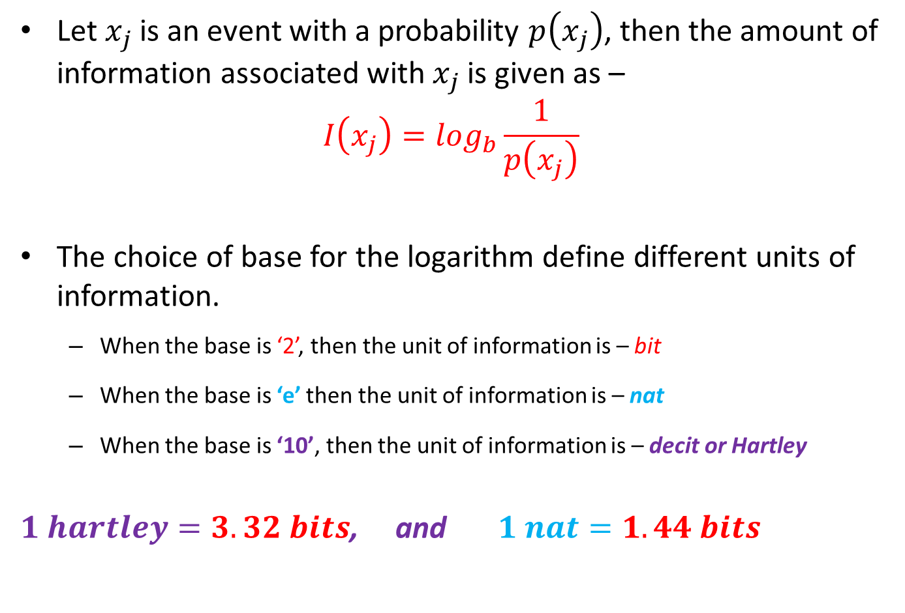
Amount of Information
(Mathematical Definition)
Let $x_{j}$is an event with a probability $p\left(x_{j}\right)$, then the amount of information associated with $x_{j}$ is given as –
$$I\left(x_{j}\right)=\log_{b}{\frac{1}{p\left(x_{j}\right)}}$$
The choice of base for the logarithm define different units of information.
  When the base is ‘2’, then the unit of information is – bit
  When the base is ‘e’ then the unit of information is – nat
  When the base is ‘10’, then the unit of information is – decit or Hartley
$1 hartley=3.32 bits$, and $1 nat=1.44 bits$
Self Information

Slide 14
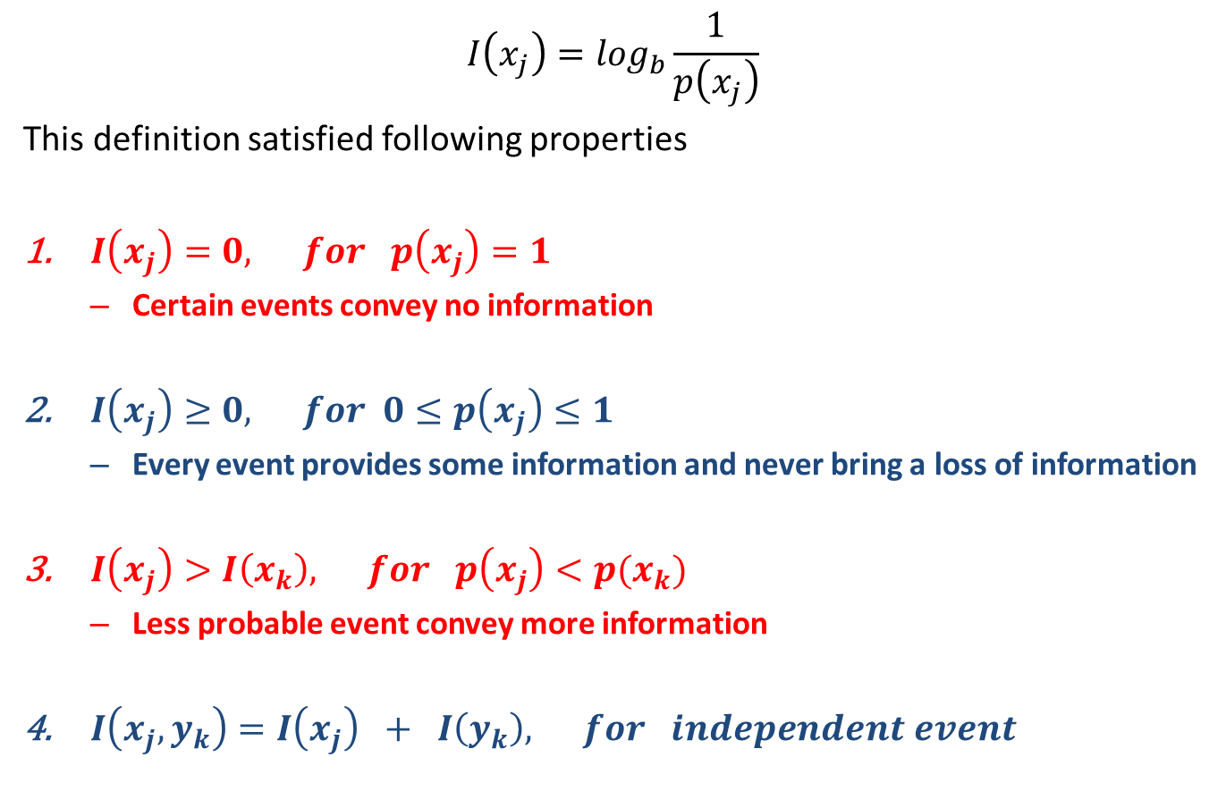
Amount of Information
(Mathematical Definition)
$$I\left(x_{j}\right)=\log_{b}{\frac{1}{p\left(x_{j}\right)}}$$
This definition satisfied following properties
$I\left(x_{j}\right)=0, for p\left(x_{j}\right)=1$
  Certain events convey no information
$I\left(x_{j}\right)≥0, for 0≤p\left(x_{j}\right)≤1$
  Every event provides some information and never bring a loss of information
$I\left(x_{j}\right)>I\left(x_{k}\right), for p\left(x_{j}\right)<p(x_{k})$
  Less probable event convey more information
$I\left(x_{j}, y_{k}\right)=I\left(x_{j}\right) + I\left(y_{k}\right), for independent event$
Self Information

Slide 15
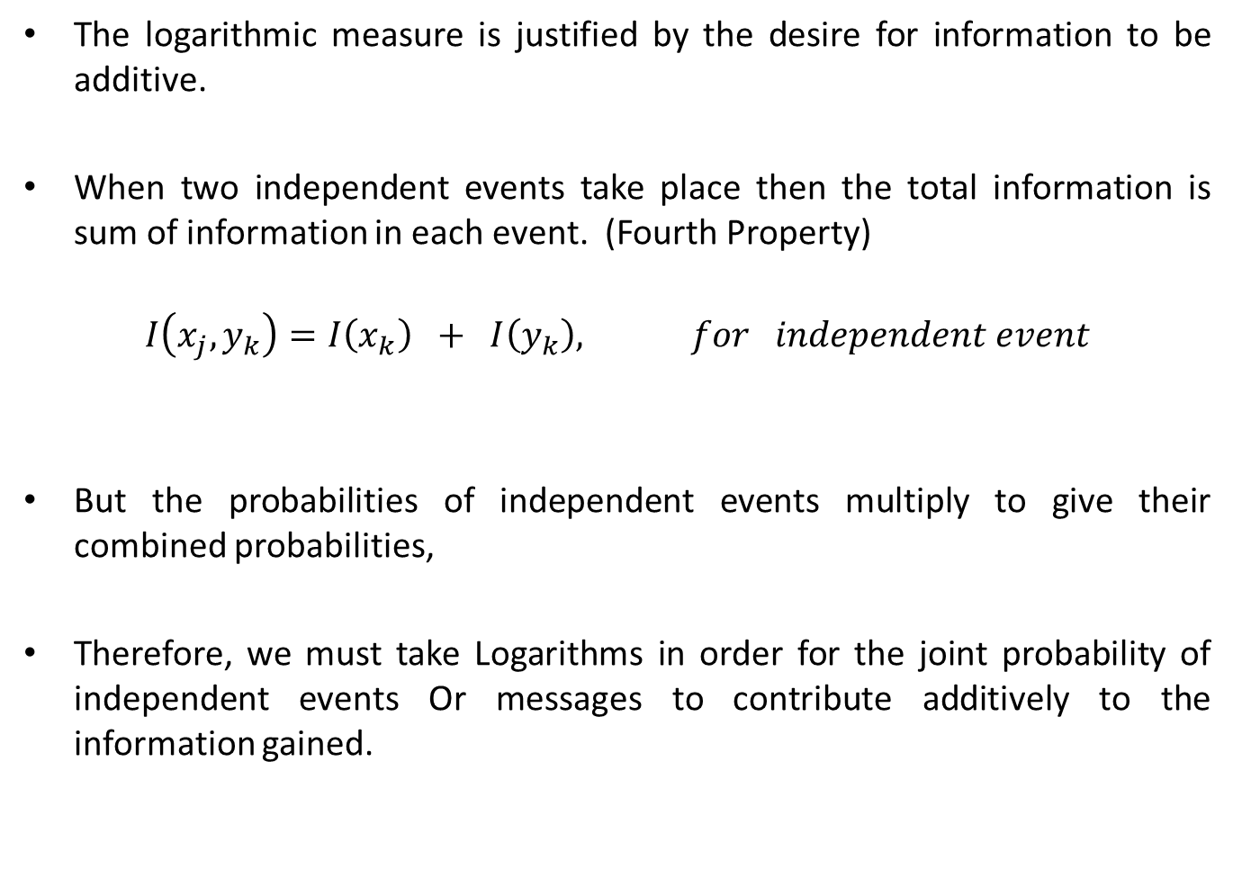
Why Logarithm
The logarithmic measure is justified by the desire for information to be additive.
When two independent events take place then the total information is sum of information in each event. (Fourth Property)
$$I\left(x_{j}, y_{k}\right)=I\left(x_{k}\right) + I\left(y_{k}\right), for independent event$$
But the probabilities of independent events multiply to give their combined probabilities,
Therefore, we must take Logarithms in order for the joint probability of independent events Or messages to contribute additively to the information gained.

Slide 16
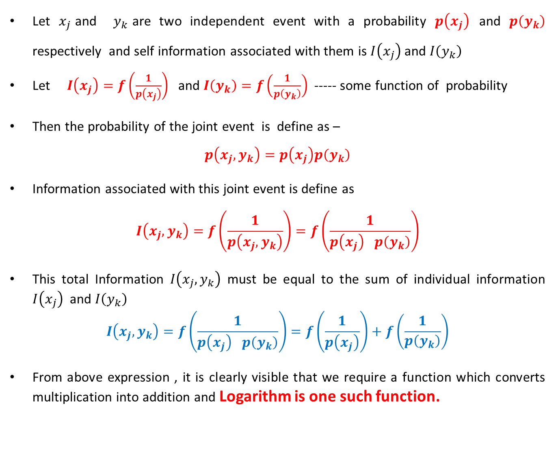
Why Logarithm
Let $x_{j}$and $y_{k}$are two independent event with a probability $p\left(x_{j}\right)$ and $p\left(y_{k}\right)$ respectively and self information associated with them is $I\left(x_{j}\right)$ and $I\left(y_{k}\right)$
Let $I\left(x_{j}\right)=f\left(\frac{1}{p\left(x_{j}\right)}\right)$ and $I\left(y_{k}\right)=f\left(\frac{1}{p\left(y_{k}\right)}\right)$ ----- some function of probability
Then the probability of the joint event is define as –
$$p\left(x_{j},y_{k}\right)=p\left(x_{j}\right)p\left(y_{k}\right)$$
Information associated with this joint event is define as
$$I\left(x_{j},y_{k}\right)=f\left(\frac{1}{p\left(x_{j},y_{k}\right)}\right)=f\left(\frac{1}{p\left(x_{j}\right) p\left(y_{k}\right)}\right)$$
This total Information $I\left(x_{j},y_{k}\right)$ must be equal to the sum of individual information $I\left(x_{j}\right)$ and $I\left(y_{k}\right)$
$$I\left(x_{j},y_{k}\right)=f\left(\frac{1}{p\left(x_{j}\right) p\left(y_{k}\right)}\right)=f\left(\frac{1}{p\left(x_{j}\right)}\right)+f\left(\frac{1}{p\left(y_{k}\right)}\right)$$
From above expression , it is clearly visible that we require a function which converts multiplication into addition and Logarithm is one such function.
$$I\left(x_{j},y_{k}\right)=log\left(\frac{1}{p\left(x_{j}\right) p\left(y_{k}\right)}\right)=log\left(\frac{1}{p\left(x_{j}\right)}\right)+log\left(\frac{1}{p\left(y_{k}\right)}\right)=I\left(x_{j}\right)+I\left(y_{k}\right)$$

Slide 17
Reference Book
S. Haykin, Digital Communication Systems, John Wiley & Sons, NY, 2014.
R. Bose, Information theory, coding and cryptography, Publisher: Tata McGraw-Hill, 3rd Edition 2016.
R P Singh and S D Sapre, Communication System (Analog and Digital), Tata McGraw-Hill, 3rd Edition 2012.

Slide 18
Thank you

