Slide 1


Information and
Communication Theory
By
Dr. Hem Dutt Joshi
Associate Professor, ECED,
TIET, Patiala

Slide 2
Module-2: Information Theory
Lecture-2

Slide 3
Topics covered in Lecture-1
Communication System
Importance of Information Theory
Historical Origin of Information Theory
Information and Uncertainty
Information measure (Mathematical definition of Information)

Slide 4
Contents of Lecture-2
Entropy
Properties of Entropy

Slide 5
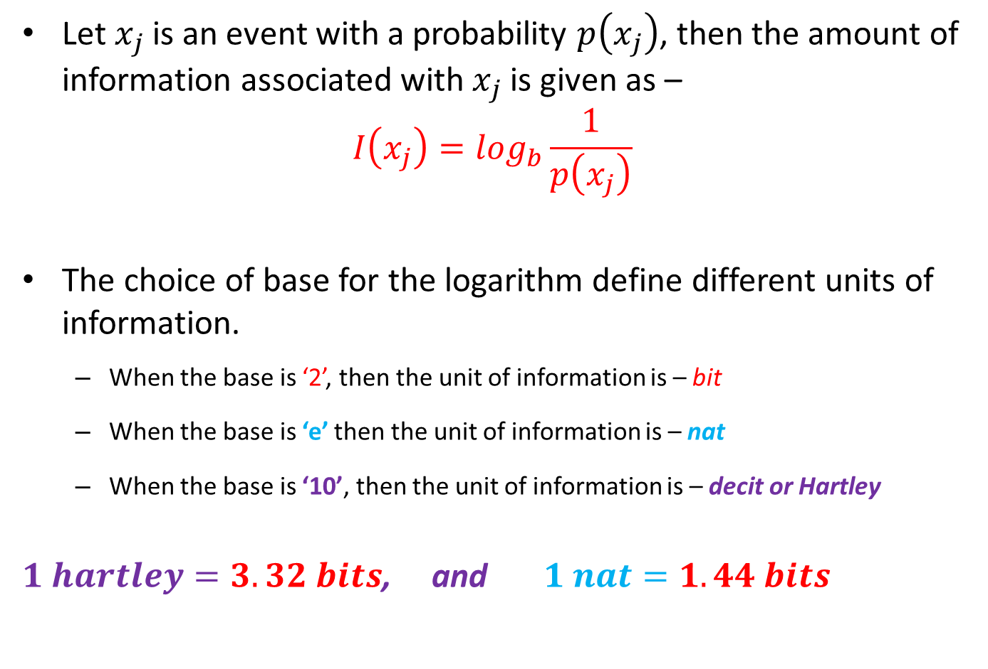
Amount of Information
(Mathematical Definition)
Let $x_{j}$is an event with a probability $p\left(x_{j}\right)$, then the amount of information associated with $x_{j}$ is given as –
$$I\left(x_{j}\right)=\log_{b}{\frac{1}{p\left(x_{j}\right)}}$$
The choice of base for the logarithm define different units of information.
  When the base is ‘2’, then the unit of information is – bit
  When the base is ‘e’ then the unit of information is – nat
  When the base is ‘10’, then the unit of information is – decit or Hartley
$1 hartley=3.32 bits$, and $1 nat=1.44 bits$
Self Information

Slide 6
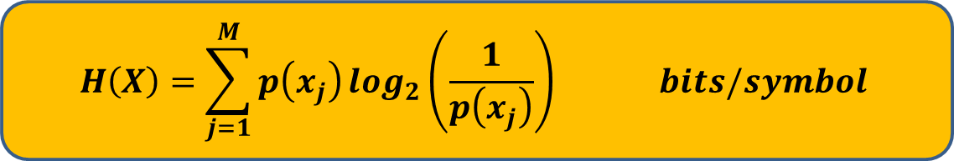
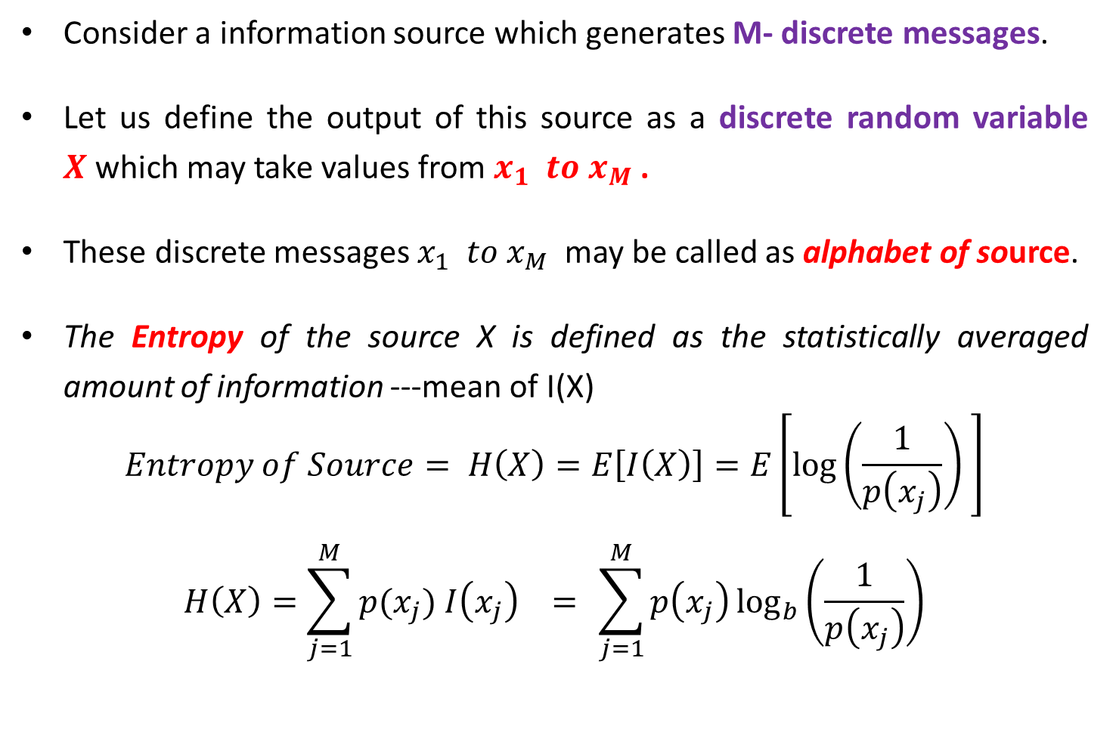
Entropy
Consider a information source which generates M- discrete messages.
Let us define the output of this source as a discrete random variable $X$which may take values from $x_{1} to x_{M}$ .
These discrete messages $x_{1} to x_{M}$ may be called as alphabet of source.
The Entropy of the source X is defined as the statistically averaged amount of information ---mean of I(X)
$$Entropy of Source= H\left(X\right)=E\left[I\left(X\right)\right]=E\left[\log\left(\frac{1}{p\left(x_{j}\right)}\right) \right]$$
$$H\left(X\right)=\sum_{j=1}^{M}{p(x_{j}) I\left(x_{j}\right) = }\sum_{j=1}^{M}{p\left(x_{j}\right)\log_{b}\left(\frac{1}{p\left(x_{j}\right)}\right)}$$
$$H\left(X\right)=\sum_{j=1}^{M}{p\left(x_{j}\right)\log_{2}\left(\frac{1}{p\left(x_{j}\right)}\right) bits/symbol}$$
If base = 2, then entropy is given as -

Slide 7
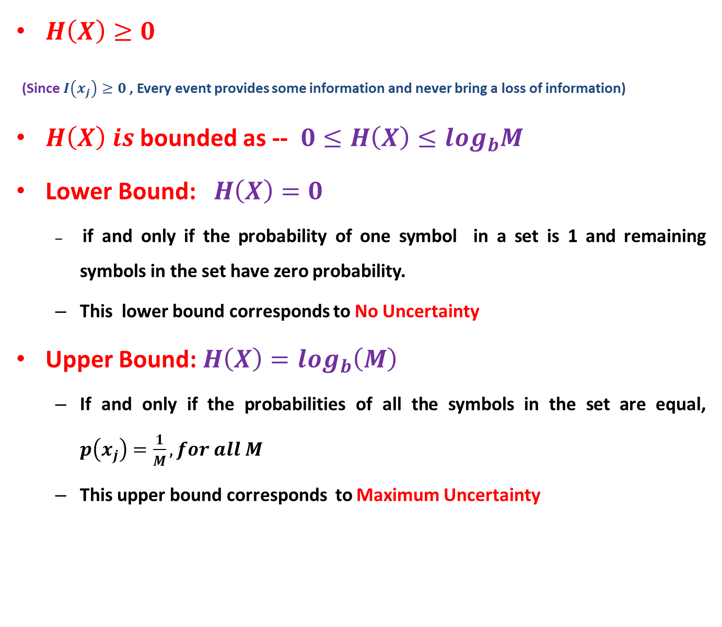
Properties of Entropy
$H\left(X\right)≥0$
(Since $I\left(x_{j}\right)≥0$, Every event provides some information and never bring a loss of information)
$H\left(X\right) is$bounded as -- $0≤H\left(X\right)≤log_{b}M$
Lower Bound: $H\left(X\right)=0$
  if and only if the probability of one symbol in a set is 1 and remaining symbols in the set have zero probability.
  This lower bound corresponds to No Uncertainty
Upper Bound: $H\left(X\right)=log_{b}\left(M\right)$
  If and only if the probabilities of all the symbols in the set are equal, $p\left(x_{j}\right)=\frac{1}{M}, for all M$
  This upper bound corresponds to Maximum Uncertainty

Slide 8
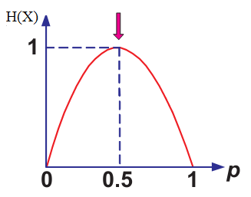
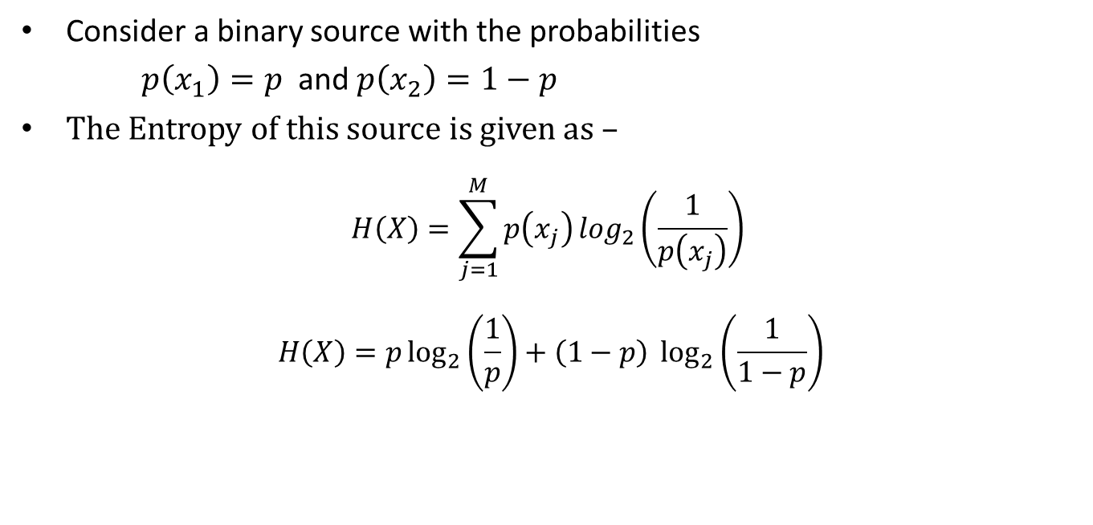
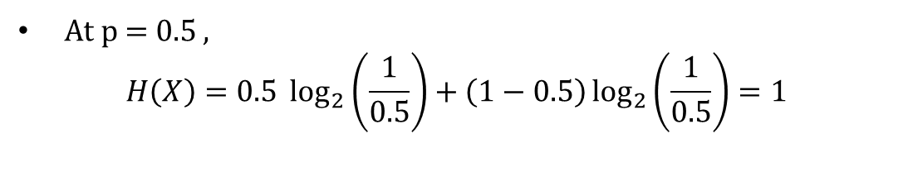
Example-1
Consider a binary source with the probabilities
$p\left(x_{1}\right)=p$and $p\left(x_{2}\right)=1−p$
The Entropy of this source is given as –
$$H\left(X\right)=\sum_{j=1}^{M}{p\left(x_{j}\right)\log_{2}\left(\frac{1}{p\left(x_{j}\right)}\right) }$$
$$H\left(X\right)=p\log_{2}\left(\frac{1}{p}\right)+\left(1−p\right) \log_{2}\left(\frac{1}{1−p}\right)$$
At p = 0.5 ,
$$H\left(X\right)=0.5 \log_{2}\left(\frac{1}{0.5}\right)+\left(1−0.5\right)\log_{2}\left(\frac{1}{0.5}\right)=1$$

Slide 9
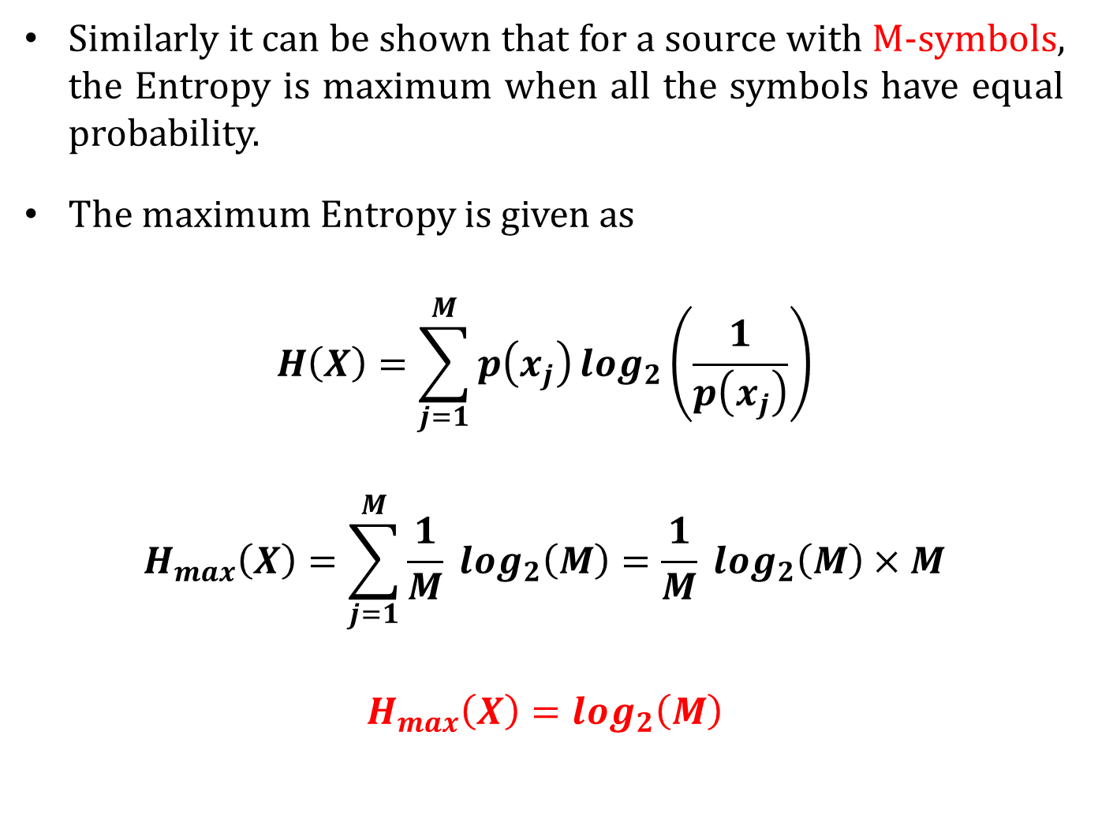
Similarly it can be shown that for a source with M-symbols, the Entropy is maximum when all the symbols have equal probability.
The maximum Entropy is given as
$$H\left(X\right)=\sum_{j=1}^{M}{p\left(x_{j}\right)\log_{2}\left(\frac{1}{p\left(x_{j}\right)}\right)}$$
$$H_{max}\left(X\right)=\sum_{j=1}^{M}{\frac{1}{M} log_{2}\left(M\right)}=\frac{1}{M} log_{2}\left(M\right)×M$$
$$H_{max}\left(X\right)=log_{2}\left(M\right)$$

Slide 10
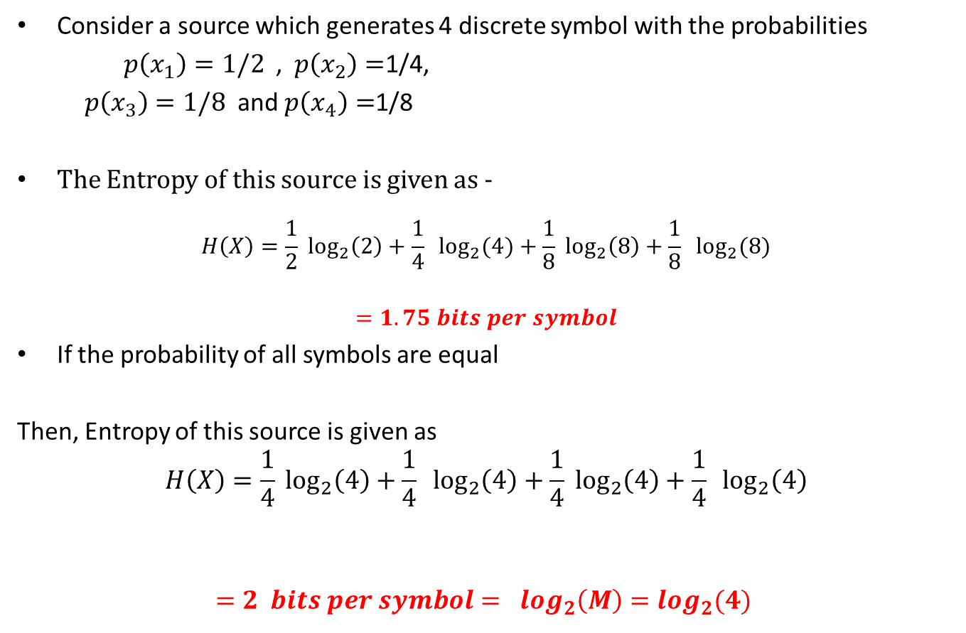
Example-2
Consider a source which generates 4 discrete symbol with the probabilities
$p\left(x_{1}\right)=1/2$,$p\left(x_{2}\right)=$1/4,
$p\left(x_{3}\right)=1/8$and $p\left(x_{4}\right)=$1/8
The Entropy of this source is given as -
$$H\left(X\right)=\frac{1}{2} \log_{2}\left(2\right)+\frac{1}{4} \log_{2}{(4)}+\frac{1}{8} \log_{2}\left(8\right)+\frac{1}{8} \log_{2}{(8)}$$
$$=1.75 bits per symbol$$
If the probability of all symbols are equal
Then, Entropy of this source is given as
$$H\left(X\right)=\frac{1}{4} \log_{2}\left(4\right)+\frac{1}{4} \log_{2}\left(4\right)+\frac{1}{4} \log_{2}\left(4\right)+\frac{1}{4} \log_{2}\left(4\right)$$
$$=2 bits per symbol= log_{2}\left(M\right)=log_{2}(4)$$

Slide 11
Reference Book
S. Haykin, Digital Communication Systems, John Wiley & Sons, NY, 2014.
R. Bose, Information theory, coding and cryptography, Publisher: Tata McGraw-Hill, 3rd Edition 2016.
R P Singh and S D Sapre, Communication System (Analog and Digital), Tata McGraw-Hill, 3rd Edition 2012.

Slide 12
Thank you

