Slide 1


Information and
Communication Theory
Module-2
Information Theory
By
Dr. Hem Dutt Joshi
Associate Professor, ECED,
TIET, Patiala

Slide 2
Lecture-4 (Module-2)
Mutual Information
Average Mutual Information
Properties of Mutual Information
Relationship between Information and Joint Entropy
Module-2: Information Theory

Slide 3

Different Entropies
$H\left(X\right)$ ---
$H\left(Y\right)$ ---
$H(X,Y)$ ---
$H\left(X/Y\right)$ ---
$H\left(Y/X\right)$ ---
Entropy of the transmitter (Average Information per symbols at Transmitter )
Probabilistic nature of Transmitter
Entropy of the receiver (Average Information per symbols at receiver)
Probabilistic nature of Receiver
Joint Entropy (Average information of whole communication system)
Average Information per pair of the transmitted and received symbols
Conditional Entropy at receiver
Average Information of transmitter when Y is received
It gives a measure of error or noise (how well receiver recover the transmitter symbol from the received symbols)
Conditional Entropy at transmitter
Average Information of receiver when it is known that X is transmitted
It gives a measure of error or noise (how well receiver recover the received symbol from the transmitted symbols)

Slide 4
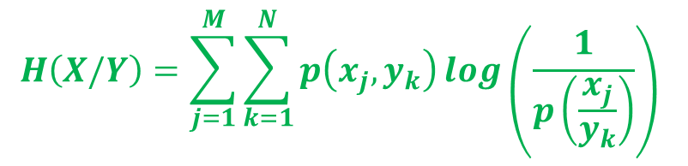
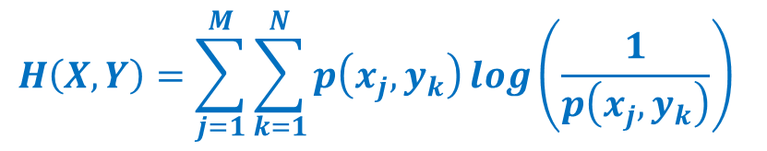
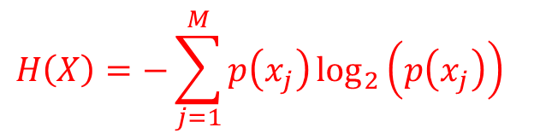
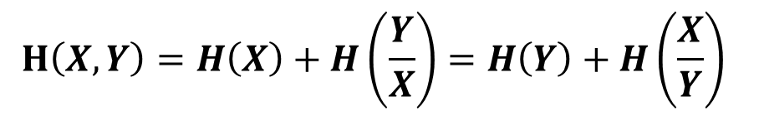
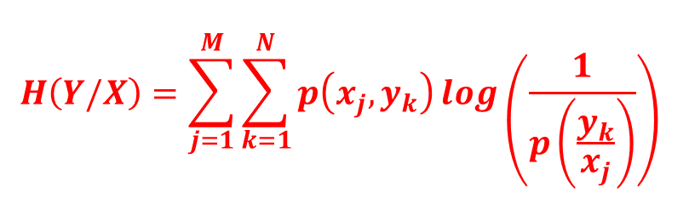
$$H\left(X\right)=−\sum_{j=1}^{M}{p\left(x_{j}\right)\log_{2}\left(p\left(x_{j}\right)\right)}$$
Entropy of the transmitter
$$H\left(X,Y\right)=\sum_{j=1}^{M}{\sum_{k=1}^{N}{p\left(x_{j},y_{k}\right)\log\left(\frac{1}{p\left(x_{j},y_{k}\right)}\right)}}$$
Joint Entropy
$$H\left(X/Y\right)=\sum_{j=1}^{M}{\sum_{k=1}^{N}{p\left(x_{j},y_{k}\right)\log\left(\frac{1}{p\left(\frac{x_{j}}{y_{k}}\right)}\right)}}$$
Conditional Entropy
$$H\left(Y/X\right)=\sum_{j=1}^{M}{\sum_{k=1}^{N}{p\left(x_{j},y_{k}\right)\log\left(\frac{1}{p\left(\frac{y_{k}}{x_{j}}\right)}\right)}}$$
Conditional Entropy
$$H\left(X,Y\right)=H\left(X\right)+H\left(\frac{Y}{X}\right)=H\left(Y\right)+H\left(\frac{X}{Y}\right)$$
Chain Rule

Slide 5
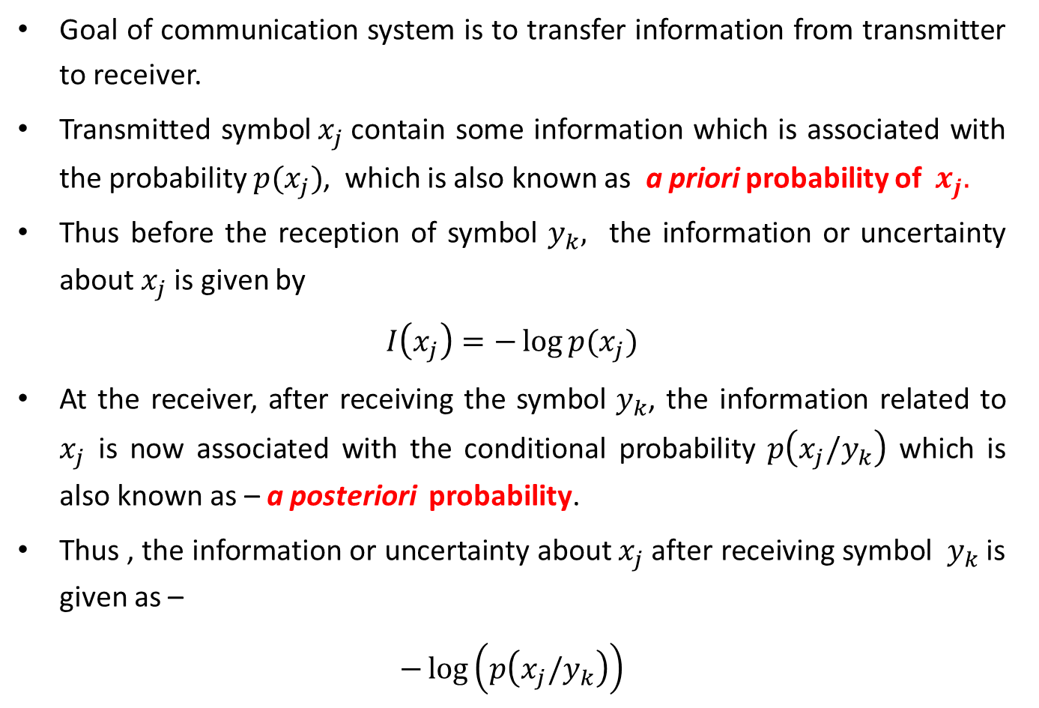
Mutual Information
Goal of communication system is to transfer information from transmitter to receiver.
Transmitted symbol${ x}_{j}$contain some information which is associated with the probability $p(x_{j})$, which is also known as a priori probability of${ x}_{j}.$
Thus before the reception of symbol $y_{k},$ the information or uncertainty about $x_{j}$is given by
$$I\left(x_{j}\right)=−\log{p(x_{j})}$$
At the receiver, after receiving the symbol $y_{k}$, the information related to $x_{j}$ is now associated with the conditional probability $p\left(x_{j}/y_{k}\right)$ which is also known as – a posteriori probability.
Thus , the information or uncertainty about $x_{j}$after receiving symbol $y_{k}$is given as –
$$−\log\left(p\left(x_{j}/y_{k}\right)\right)$$

Slide 6
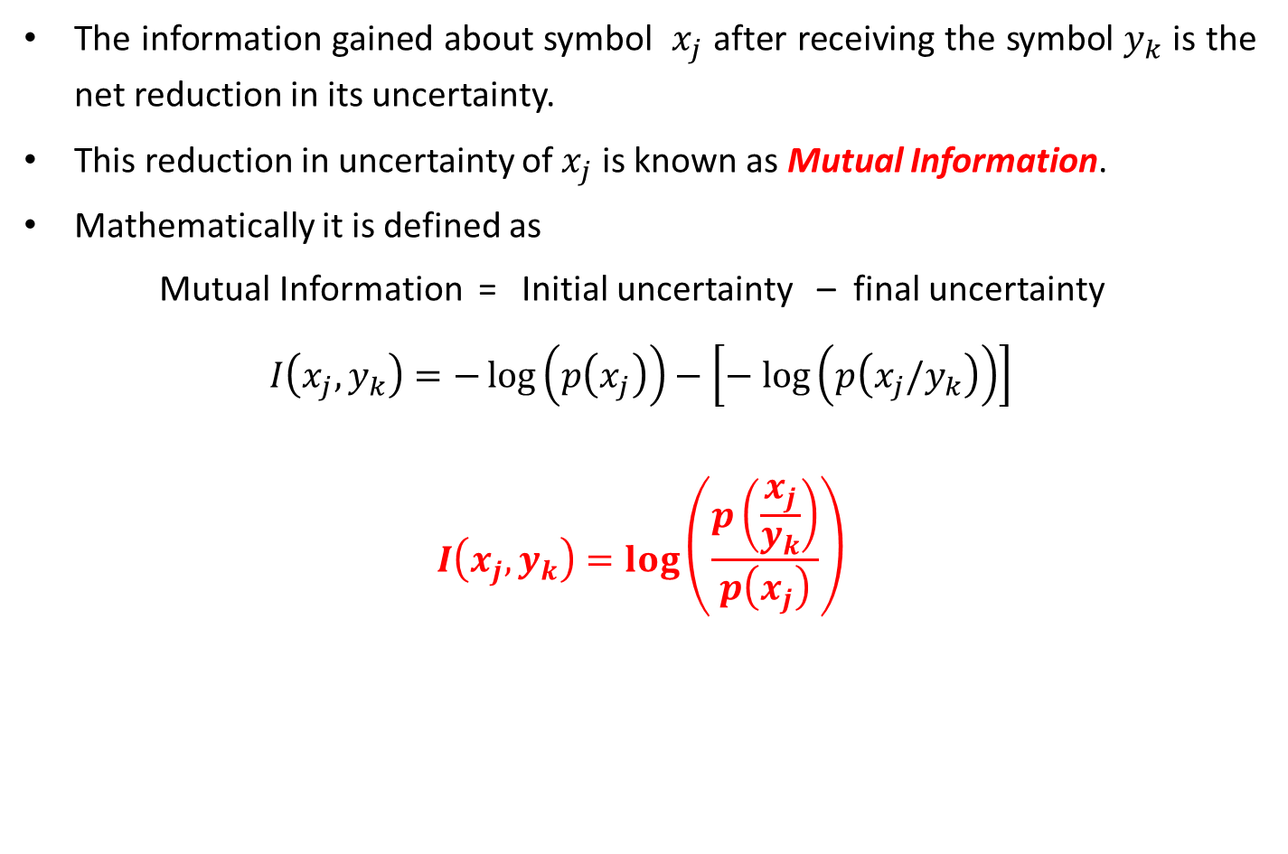
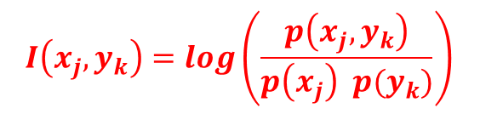
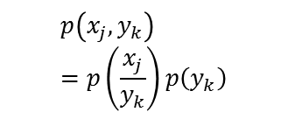
Mutual Information
The information gained about symbol $x_{j}$ after receiving the symbol $y_{k}$ is the net reduction in its uncertainty.
This reduction in uncertainty of $x_{j}$ is known as Mutual Information.
Mathematically it is defined as
Mutual Information = Initial uncertainty – final uncertainty
$$I\left(x_{j},y_{k}\right)=−\log\left(p\left(x_{j}\right)\right)−\left[− log\left(p\left(x_{j}/y_{k}\right)\right)\right]$$
$$I\left(x_{j},y_{k}\right)=\log\left(\frac{p\left(\frac{x_{j}}{y_{k}}\right)}{p\left(x_{j}\right)}\right)$$
Using Bayes rule
$$p\left(x_{j},y_{k}\right)=p\left(\frac{x_{j}}{y_{k}}\right)p\left(y_{k}\right)$$
$$I\left(x_{j},y_{k}\right)=log\left(\frac{p\left(x_{j},y_{k}\right)}{p\left(x_{j}\right) p(y_{k})}\right)$$

Slide 7
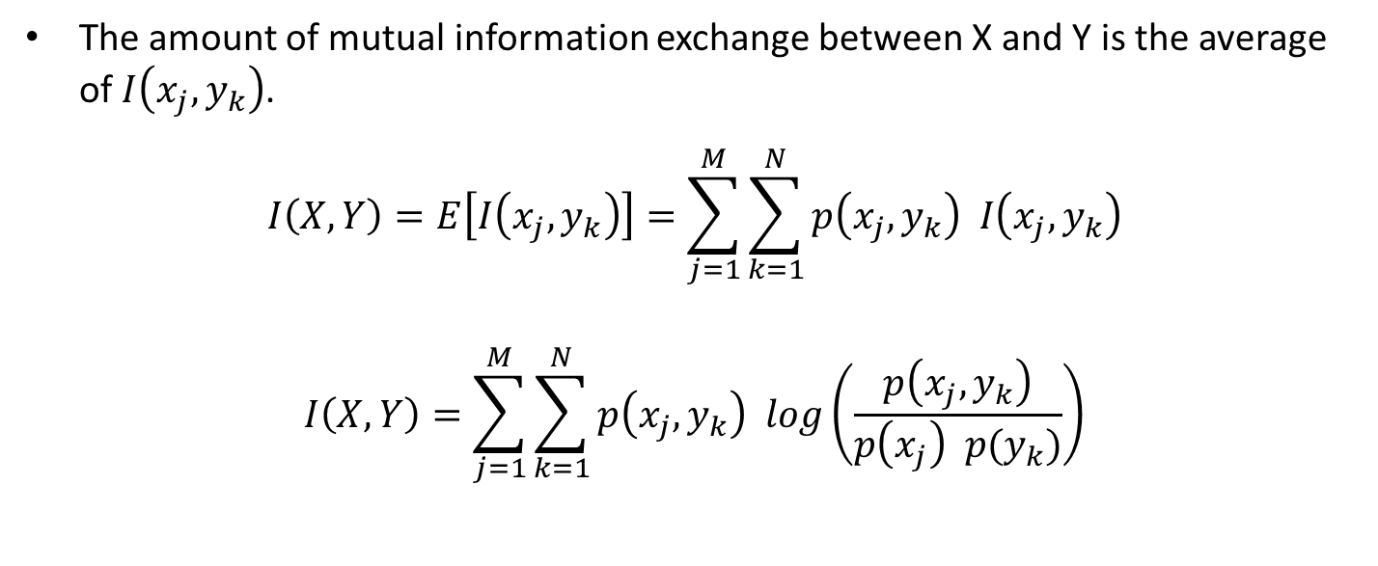
Average Mutual Information
The amount of mutual information exchange between X and Y is the average of $I\left(x_{j},y_{k}\right)$.
$$I\left(X,Y\right)=E\left[I\left(x_{j},y_{k}\right)\right]=\sum_{j=1}^{M}{\sum_{k=1}^{N}{p\left(x_{j},y_{k}\right) I\left(x_{j},y_{k}\right)}}$$
$$I\left(X,Y\right)=\sum_{j=1}^{M}{\sum_{k=1}^{N}{p\left(x_{j},y_{k}\right) log\left(\frac{p\left(x_{j},y_{k}\right)}{p\left(x_{j}\right) p(y_{k})}\right)}}$$

Slide 8
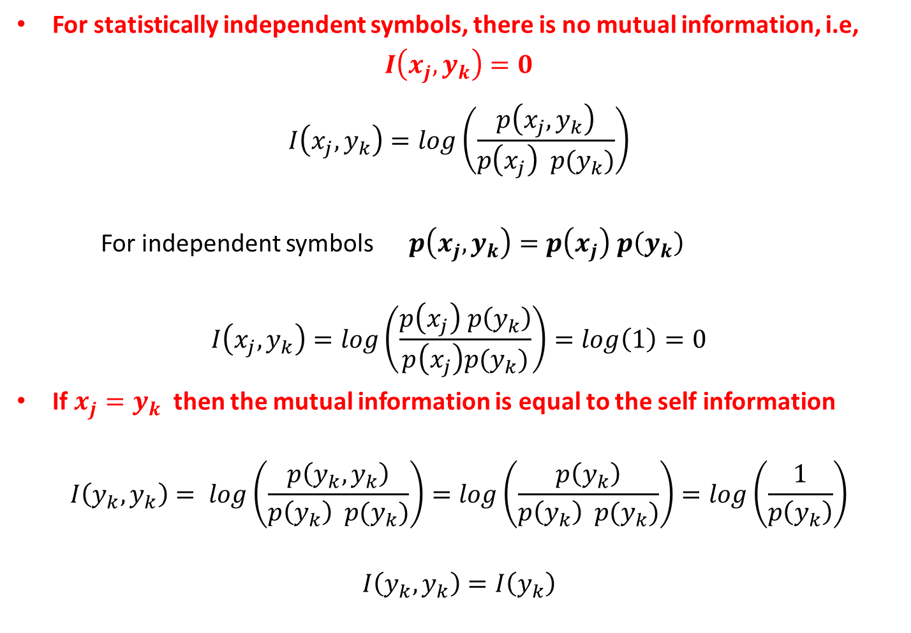
Properties of Mutual Information
For statistically independent symbols, there is no mutual information, i.e,
$$I\left(x_{j},y_{k}\right)=0$$
$$I\left(x_{j},y_{k}\right)=log\left(\frac{p\left(x_{j},y_{k}\right)}{p\left(x_{j}\right) p(y_{k})}\right)$$
For independent symbols $p\left(x_{j},y_{k}\right)=p\left(x_{j}\right) p\left(y_{k}\right)$
$$I\left(x_{j},y_{k}\right)=log\left(\frac{p\left(x_{j}\right) p\left(y_{k}\right)}{p\left(x_{j}\right)p(y_{k})}\right)=log\left(1\right)=0$$
If $x_{j}=y_{k}$ then the mutual information is equal to the self information
$$I\left(y_{k},y_{k}\right)= log\left(\frac{p\left(y_{k},y_{k}\right)}{p\left(y_{k}\right) p(y_{k})}\right)=log\left(\frac{p\left(y_{k}\right)}{p\left(y_{k}\right) p(y_{k})}\right)=log\left(\frac{1}{p\left(y_{k}\right)}\right)$$
$$I\left(y_{k}, y_{k}\right)=I\left(y_{k}\right)$$

Slide 9
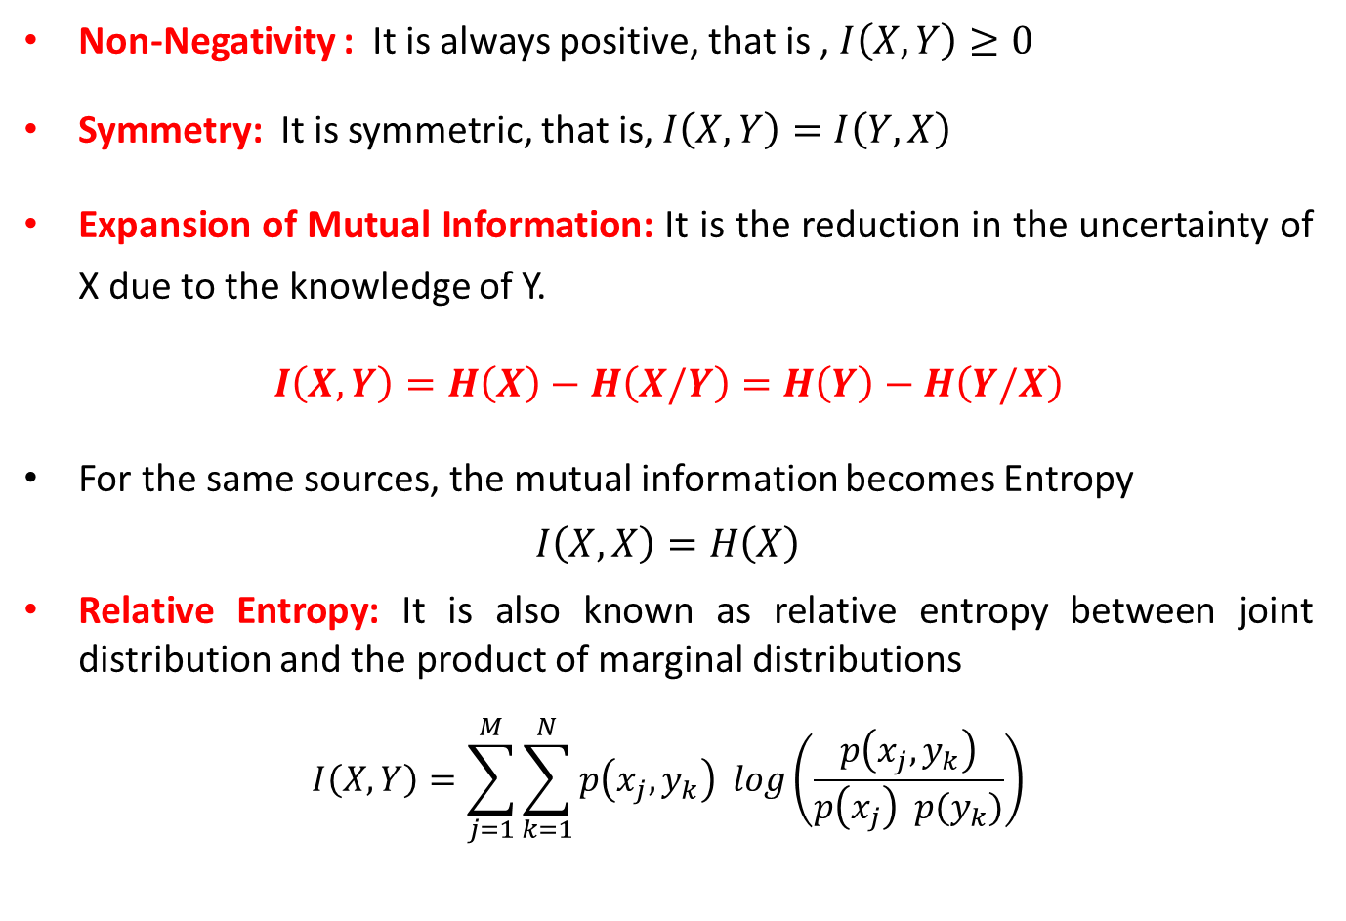
Properties of Mutual Information
Non-Negativity : It is always positive, that is , $I\left(X,Y\right)≥0$
Symmetry: It is symmetric, that is, $I\left(X,Y\right)=I\left(Y,X\right)$
Expansion of Mutual Information: It is the reduction in the uncertainty of X due to the knowledge of Y.
$$I\left(X,Y\right)=H\left(X\right)−H\left(X/Y\right)=H\left(Y\right)−H\left(Y/X\right)$$
For the same sources, the mutual information becomes Entropy
$$I\left(X,X\right)=H\left(X\right)$$
Relative Entropy: It is also known as relative entropy between joint distribution and the product of marginal distributions
$$I\left(X,Y\right)=\sum_{j=1}^{M}{\sum_{k=1}^{N}{p\left(x_{j},y_{k}\right) log\left(\frac{p\left(x_{j},y_{k}\right)}{p\left(x_{j}\right) p(y_{k})}\right)}}$$

Slide 10


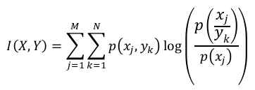


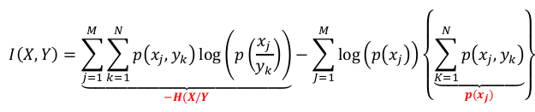
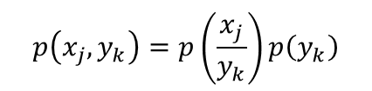
Relationship Between Mutual Information and Joint Entropy
Using Bayes rule
$$p\left(x_{j},y_{k}\right)=p\left(\frac{x_{j}}{y_{k}}\right)p\left(y_{k}\right)$$

Slide 11
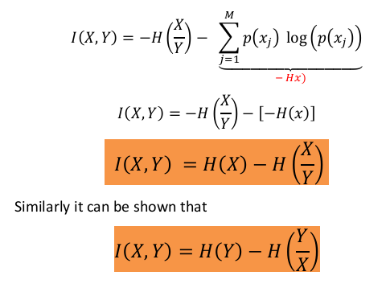
Relationship Between Mutual Information and Joint Entropy

Slide 12
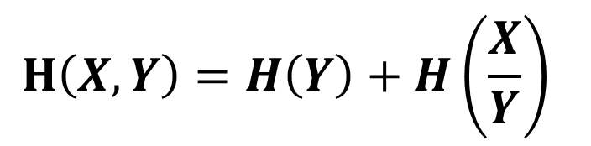
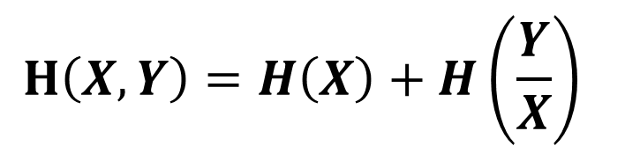
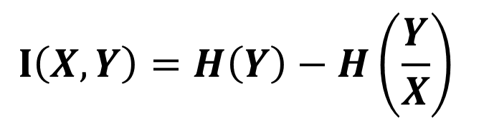
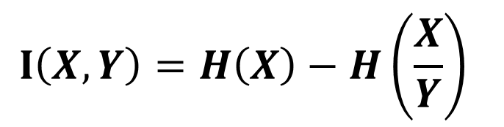
Summary
$$H\left(X,Y\right)=H\left(X\right)+H\left(\frac{Y}{X}\right)$$
$$H\left(X,Y\right)=H\left(Y\right)+H\left(\frac{X}{Y}\right)$$
$$I\left(X,Y\right)=H\left(X\right)−H\left(\frac{X}{Y}\right)$$
$$I\left(X,Y\right)=H\left(Y\right)−H\left(\frac{Y}{X}\right)$$

Slide 13
Reference Book
S. Haykin, Digital Communication Systems, John Wiley & Sons, NY, 2014.
R. Bose, Information theory, coding and cryptography, Publisher: Tata McGraw-Hill, 3rd Edition 2016.
R P Singh and S D Sapre, Communication System (Analog and Digital), Tata McGraw-Hill, 3rd Edition 2012.

