Slide 1
Lecture-2 Module-3
Stationary Process

Slide 2
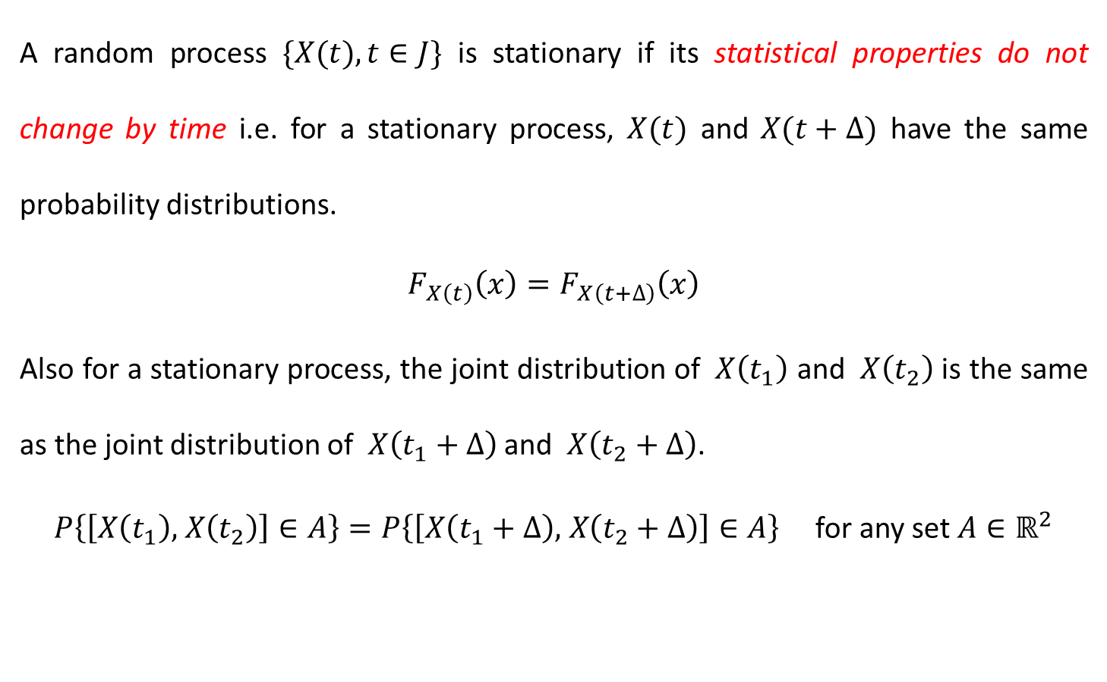
Stationary Processes
A random process $\{X(t),t∈J\}$ is stationary if its statistical properties do not change by time i.e. for a stationary process, $X(t)$ and $X(t+∆)$ have the same probability distributions.
$$F_{X\left(t\right)}\left(x\right)=F_{X\left(t+∆\right)}\left(x\right)$$
Also for a stationary process, the joint distribution of $X\left(t_{1}\right)$ and $X\left(t_{2}\right)$is the same as the joint distribution of $X\left(t_{1}+∆\right)$ and $X\left(t_{2}+∆\right)$.
$P\left\{\left[X\left(t_{1}\right)\text{,} X\left(t_{2}\right)\right]∈A\right\}=P\left\{\left[X\left(t_{1}+∆\right)\text{,} X\left(t_{2}+∆\right)\right]∈A\right\}$ for any set $A∈ℝ^{2}$

Slide 3
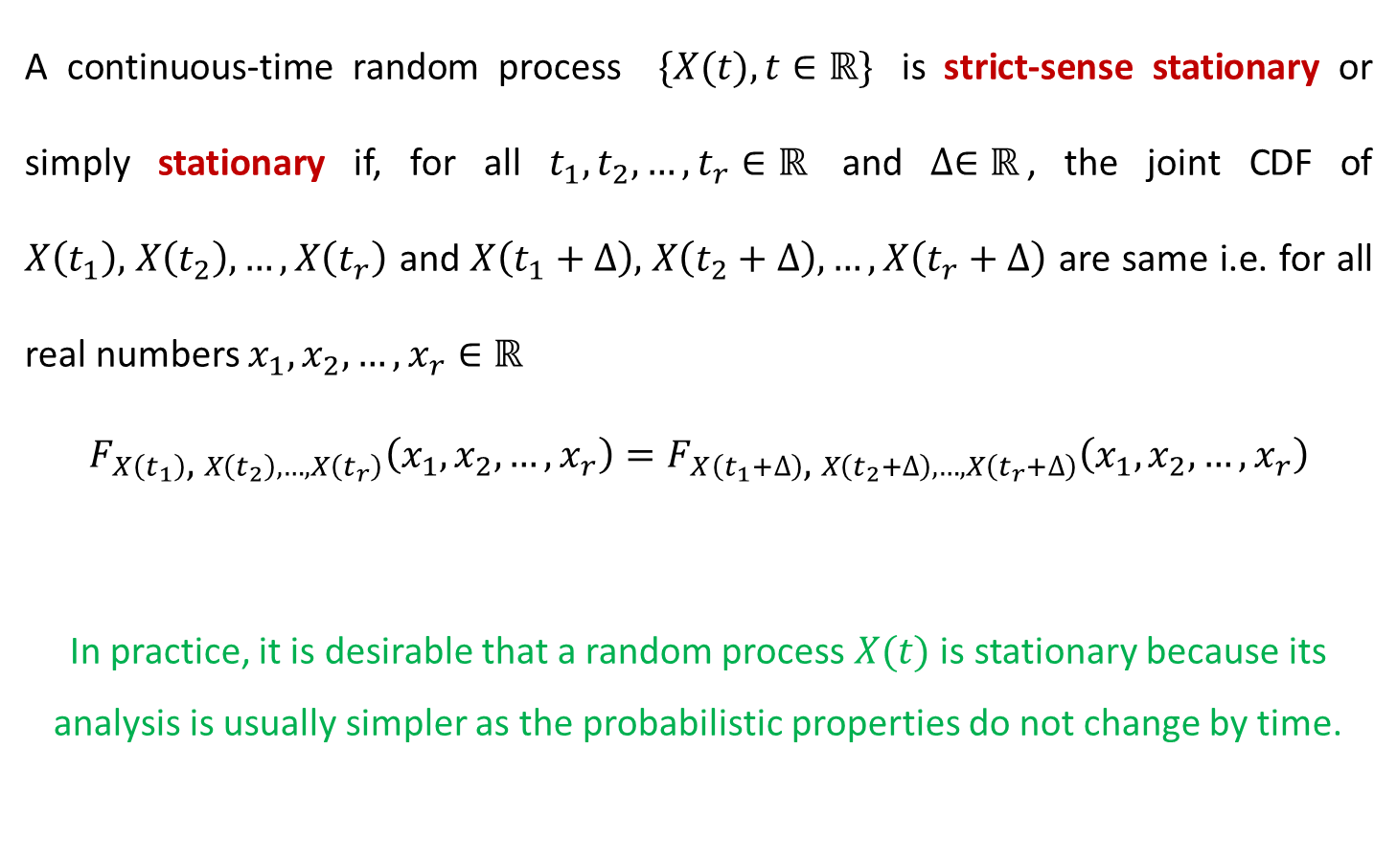
Stationary Processes_Definition
A continuous-time random process $\{X(t),t∈ℝ\}$ is strict-sense stationary or simply stationary if, for all $t_{1},t_{2},…,t_{r}∈ℝ$ and $∆∈ℝ$, the joint CDF of $X\left(t_{1}\right)\text{,} X\left(t_{2}\right),…,X\left(t_{r}\right)$ and $X\left(t_{1}+∆\right)\text{,} X\left(t_{2}+∆\right),…,X\left(t_{r}+∆\right)$ are same i.e. for all real numbers $x_{1},x_{2},…,x_{r}∈ℝ$
$$F_{X\left(t_{1}\right)\text{,} X\left(t_{2}\right),…,X\left(t_{r}\right)}\left(x_{1},x_{2},…,x_{r}\right)=F_{X\left(t_{1}+∆\right)\text{,} X\left(t_{2}+∆\right),…,X\left(t_{r}+∆\right)}\left(x_{1},x_{2},…,x_{r}\right)$$
In practice, it is desirable that a random process $X(t)$ is stationary because its analysis is usually simpler as the probabilistic properties do not change by time.

Slide 4
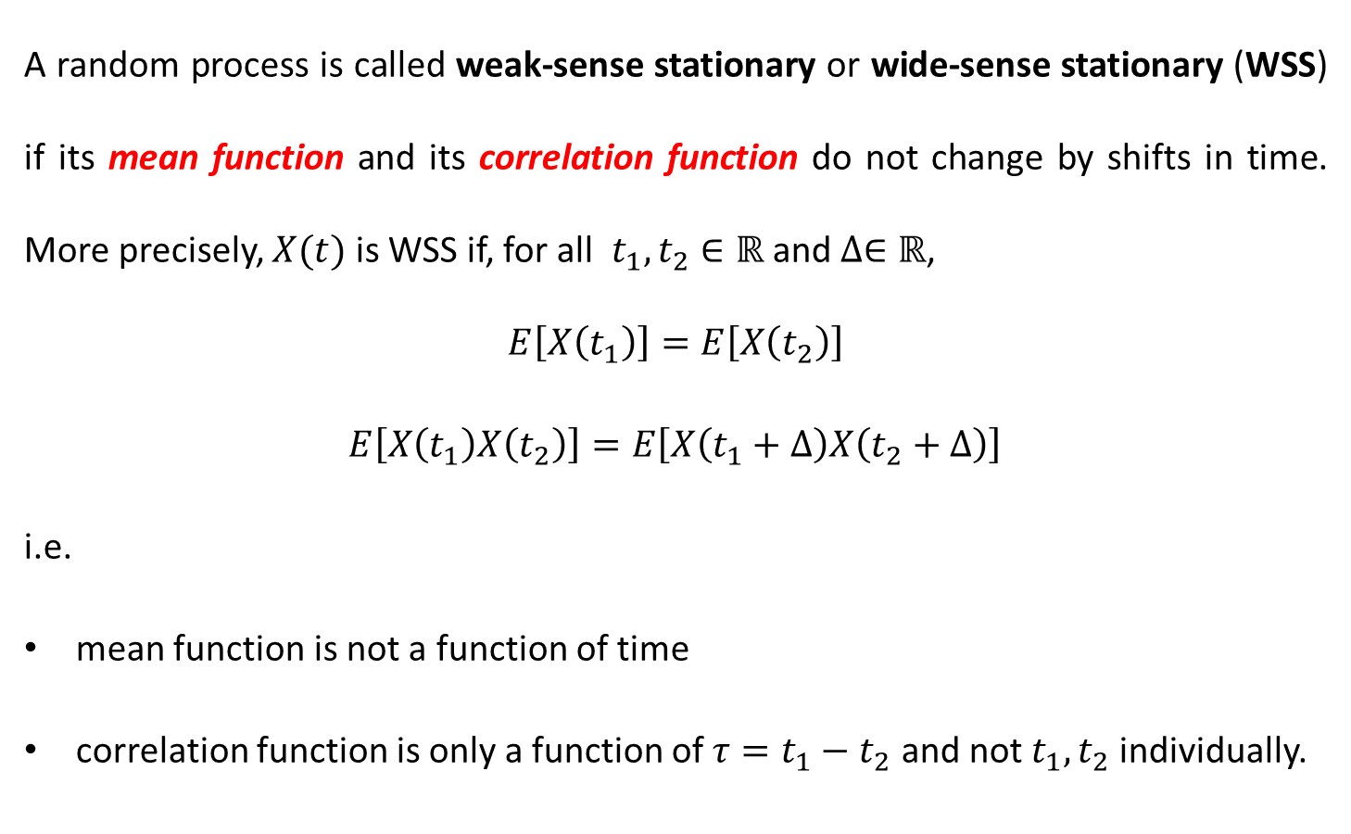
Weak-Sense Stationary Processes
A random process is called weak-sense stationary or wide-sense stationary (WSS) if its mean function and its correlation function do not change by shifts in time. More precisely, $X(t)$ is WSS if, for all $t_{1},t_{2}∈ℝ$ and $∆∈ℝ$,
$$E\left[X\left(t_{1}\right)\right]=E\left[X\left(t_{2}\right)\right]$$
$E\left[X\left(t_{1}\right)X\left(t_{2}\right)\right]=E\left[X\left(t_{1}+∆\right)X\left(t_{2}+∆\right)\right]$
i.e.
mean function is not a function of time
correlation function is only a function of $τ=t_{1}−t_{2}$ and not $t_{1},t_{2}$ individually.

Slide 5
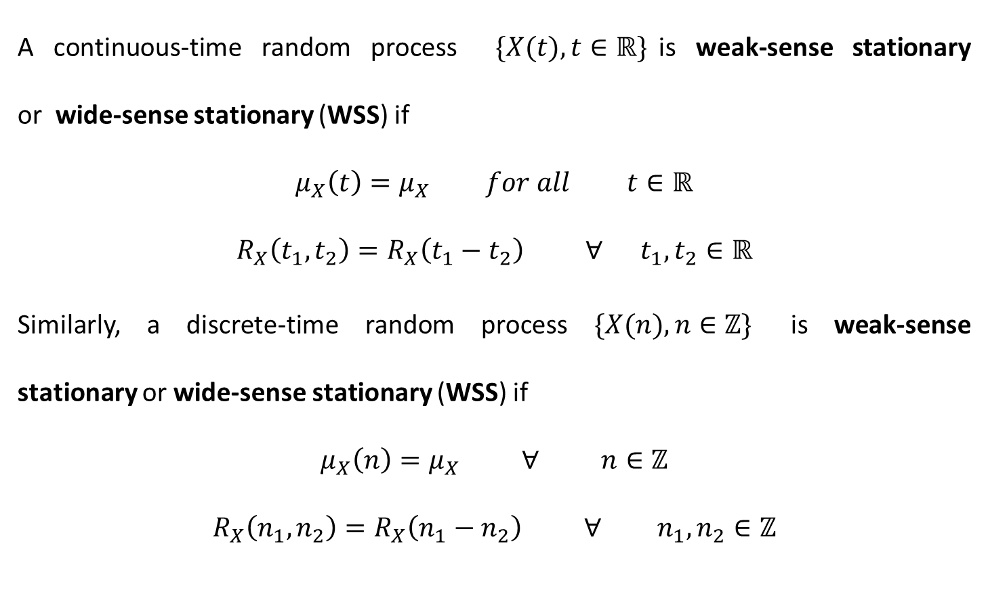
Weak-Sense Stationary Processes
A continuous-time random process $\{X(t),t∈ℝ\}$is weak-sense stationary or wide-sense stationary (WSS) if
$$μ_{X}\left(t\right)=μ_{X} for all t∈ℝ$$
$$R_{X}\left(t_{1},t_{2}\right)=R_{X}\left(t_{1}−t_{2}\right) ∀ t_{1},t_{2}∈ℝ$$
Similarly, a discrete-time random process $\{X(n),n∈ℤ\}$ is weak-sense stationary or wide-sense stationary (WSS) if
$$μ_{X}\left(n\right)=μ_{X} ∀ n∈ℤ$$
$$R_{X}\left(n_{1},n_{2}\right)=R_{X}\left(n_{1}−n_{2}\right) ∀ n_{1},n_{2}∈ℤ$$

Slide 6
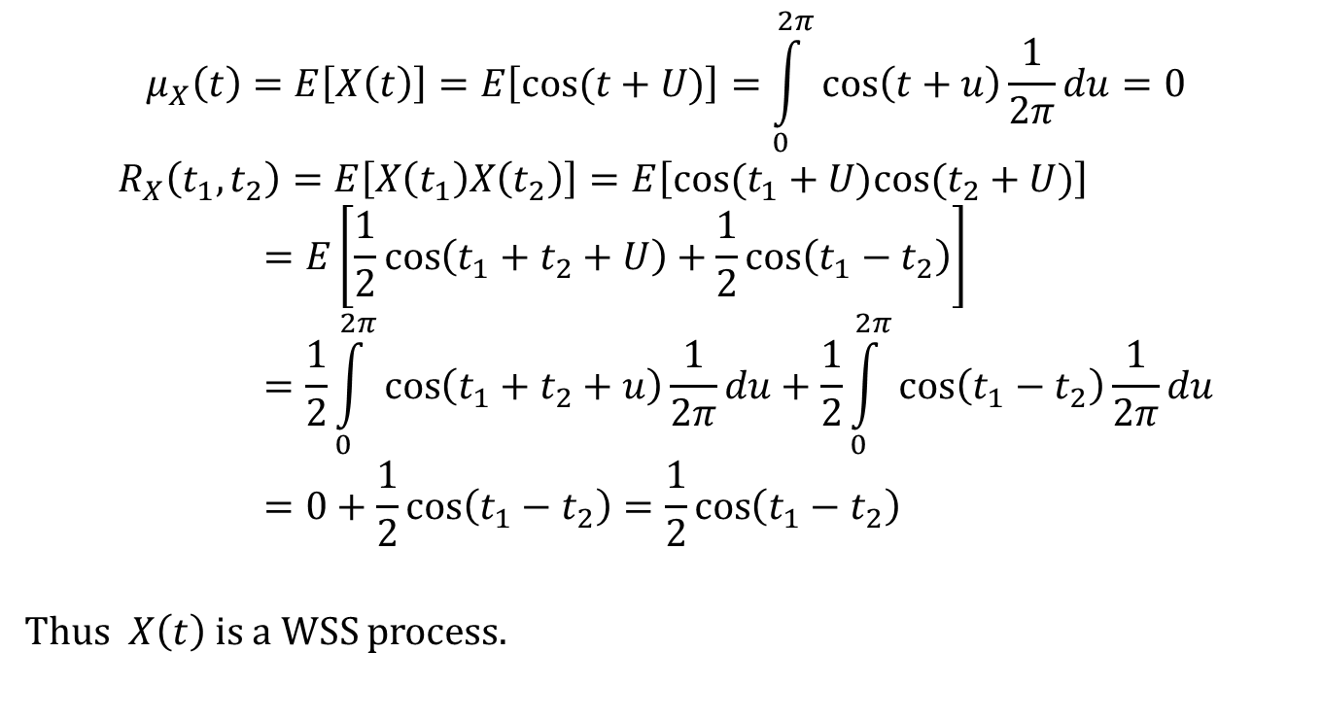
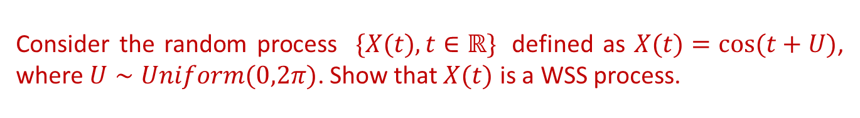
Consider the random process $\{X(t),t∈ℝ\}$ defined as $X(t)=cos⁡(t+U)$, where $U∼Uniform(0,2π)$. Show that $X(t)$ is a WSS process.
$$μ_{X}\left(t\right)=E\left[X\left(t\right)\right]=E\left[cos⁡(t+U)\right]=\int_{0}^{2π}{\cos\left(t+u\right)\frac{1}{2π}du}=0$$
$$R_{X}\left(t_{1},t_{2}\right)=E\left[X\left(t_{1}\right)X\left(t_{2}\right)\right]=E\left[cos⁡(t_{1}+U)cos⁡(t_{2}+U)\right]=E\left[\frac{1}{2}\cos\left(t_{1}+t_{2}+U\right)+\frac{1}{2}\cos\left(t_{1}−t_{2}\right)\right]=\frac{1}{2}\int_{0}^{2π}{\cos\left(t_{1}+t_{2}+u\right)\frac{1}{2π}du}+\frac{1}{2}\int_{0}^{2π}{\cos\left(t_{1}−t_{2}\right)\frac{1}{2π}du}=0+\frac{1}{2}\cos\left(t_{1}−t_{2}\right)=\frac{1}{2}\cos\left(t_{1}−t_{2}\right)$$
Thus $X\left(t\right)$ is a WSS process.

Slide 7
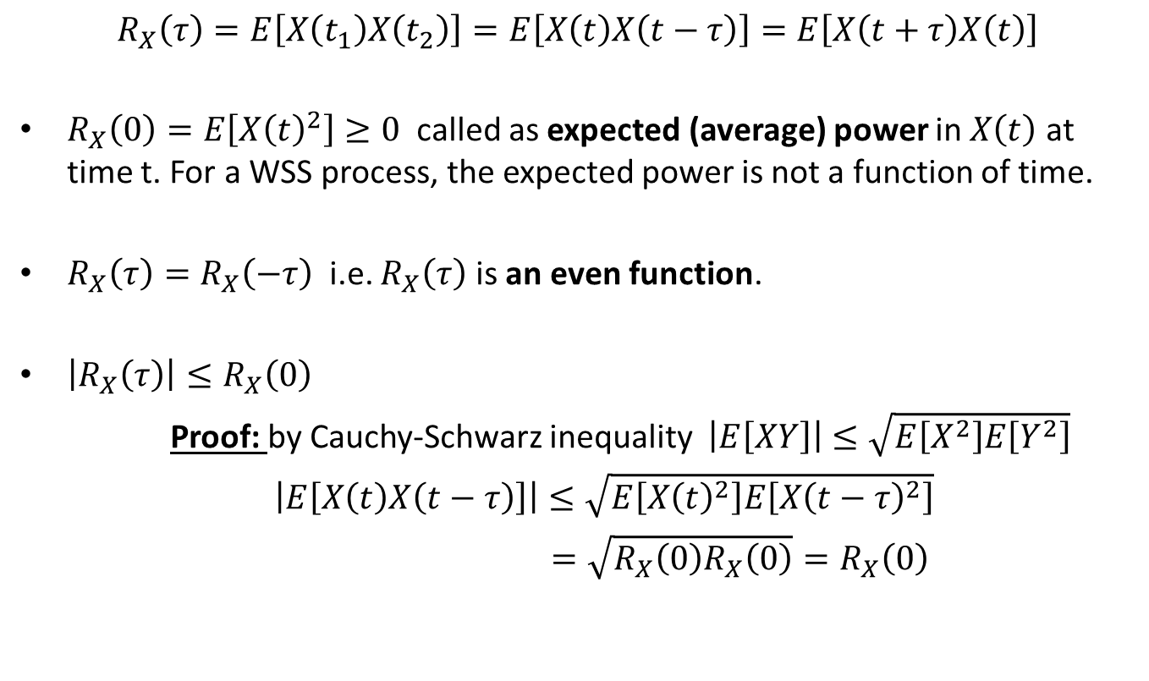
Properties of $R_{X}\left(t_{1},t_{2}\right)=R_{X}\left(t_{1}−t_{2}\right)=R_{X}\left(τ\right)$ of a WSS process
$$R_{X}\left(τ\right)=E\left[X\left(t_{1}\right)X\left(t_{2}\right)\right]=E\left[X\left(t\right)X\left(t−τ\right)\right]=E\left[X\left(t+τ\right)X\left(t\right)\right]$$
$R_{X}\left(0\right)=E\left[{X\left(t\right)}^{2}\right]≥0$ called as expected (average) power in $X\left(t\right)$ at time t. For a WSS process, the expected power is not a function of time.
$R_{X}\left(τ\right)=R_{X}\left(−τ\right)$ i.e. $R_{X}\left(τ\right)$ is an even function.
$\left|R_{X}\left(τ\right)\right|≤R_{X}\left(0\right)$
Proof: by Cauchy-Schwarz inequality $\left|E\left[XY\right]\right|≤\sqrt{E\left[X^{2}\right]E\left[Y^{2}\right]}$
$\left|E\left[X\left(t\right)X\left(t−τ\right)\right]\right|≤\sqrt{E\left[{X\left(t\right)}^{2}\right]E\left[{X\left(t−τ\right)}^{2}\right]}$
$=\sqrt{R_{X}\left(0\right)R_{X}\left(0\right)}=R_{X}\left(0\right)$

Slide 8
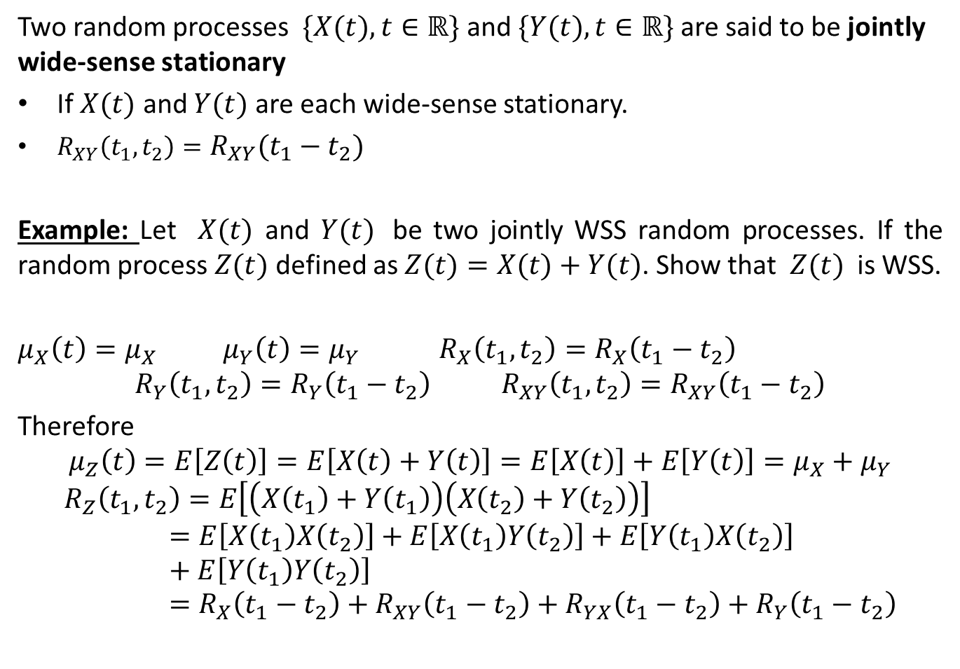
Jointly Wide-Sense Stationary Processes
Two random processes $\{X(t),t∈ℝ\}$ and $\{Y(t),t∈ℝ\}$are said to be jointly wide-sense stationary
If $X(t)$ and $Y(t)$ are each wide-sense stationary.
$R_{XY}\left(t_{1},t_{2}\right)=R_{XY}\left(t_{1}−t_{2}\right)$
Example: Let $X(t)$ and $Y(t)$ be two jointly WSS random processes. If the random process $Z(t)$ defined as $Z(t)=X(t)+Y(t)$. Show that $Z(t)$ is WSS.
$μ_{X}\left(t\right)=μ_{X}$ $μ_{Y}\left(t\right)=μ_{Y}$ $R_{X}\left(t_{1},t_{2}\right)=R_{X}\left(t_{1}−t_{2}\right)$
$$R_{Y}\left(t_{1},t_{2}\right)=R_{Y}\left(t_{1}−t_{2}\right) R_{XY}\left(t_{1},t_{2}\right)=R_{XY}\left(t_{1}−t_{2}\right)$$
Therefore
$$μ_{Z}\left(t\right)=E\left[Z\left(t\right)\right]=E\left[X\left(t\right)+Y\left(t\right)\right]=E\left[X\left(t\right)\right]+E\left[Y\left(t\right)\right]=μ_{X}+μ_{Y}$$
$$R_{Z}\left(t_{1},t_{2}\right)=E\left[\left(X\left(t_{1}\right)+Y\left(t_{1}\right)\right)\left(X\left(t_{2}\right)+Y\left(t_{2}\right)\right)\right]=E\left[X\left(t_{1}\right)X\left(t_{2}\right)\right]+E\left[X\left(t_{1}\right)Y\left(t_{2}\right)\right]+E\left[Y\left(t_{1}\right)X\left(t_{2}\right)\right]+E\left[Y\left(t_{1}\right)Y\left(t_{2}\right)\right]=R_{X}\left(t_{1}−t_{2}\right)+R_{XY}\left(t_{1}−t_{2}\right)+R_{YX}\left(t_{1}−t_{2}\right)+R_{Y}\left(t_{1}−t_{2}\right)$$

Slide 9
Reference
Athanasios Papoulis, “Probability, Random Variables, and Stochastic Processes,” 3rd edition, McGraw Hill Publication.
https://www.probabilitycourse.com

