Slide 1
Lecture-3 (Module-3)
Cyclostationary Processes
Gaussian Random Processes
Power Spectral Density

Slide 2

Cyclostationary Processes
Some practical random processes have a periodic structure. That is, the statistical properties are repeated every $T$ units of time (e.g., every $T$ seconds). In other words, the random variables $X\left(t_{1}\right) ,X\left(t_{2}\right),…,X\left(t_{r}\right)$ have the same joint CDF as the random variables $X\left(t_{1}+T\right) ,X\left(t_{2}+T\right),…,X\left(t_{r}+T\right)$. Such random variables are called cyclostationary.
A continuous-time random process $\{X(t),t∈ℝ\}$ is weak-sense cyclostationary or wide-sense cyclostationary if there exists a positive real number $T$ such that
$μ_{X}\left(t+T\right)=μ_{X}\left(t\right) ∀ t∈ℝ$
$R_{X}\left(t_{1}+T,t_{2}+T\right)=R_{X}\left(t_{1},t_{2}\right) ∀ t_{1},t_{2}∈ℝ$
Example: $X(t)=a\cos\left(ωt\right)$. which is a periodic signal with period $T=2π/ω$. Therefore, $X(t)$ is a cyclostationary random process with period $T=2π/ω$.

Slide 3
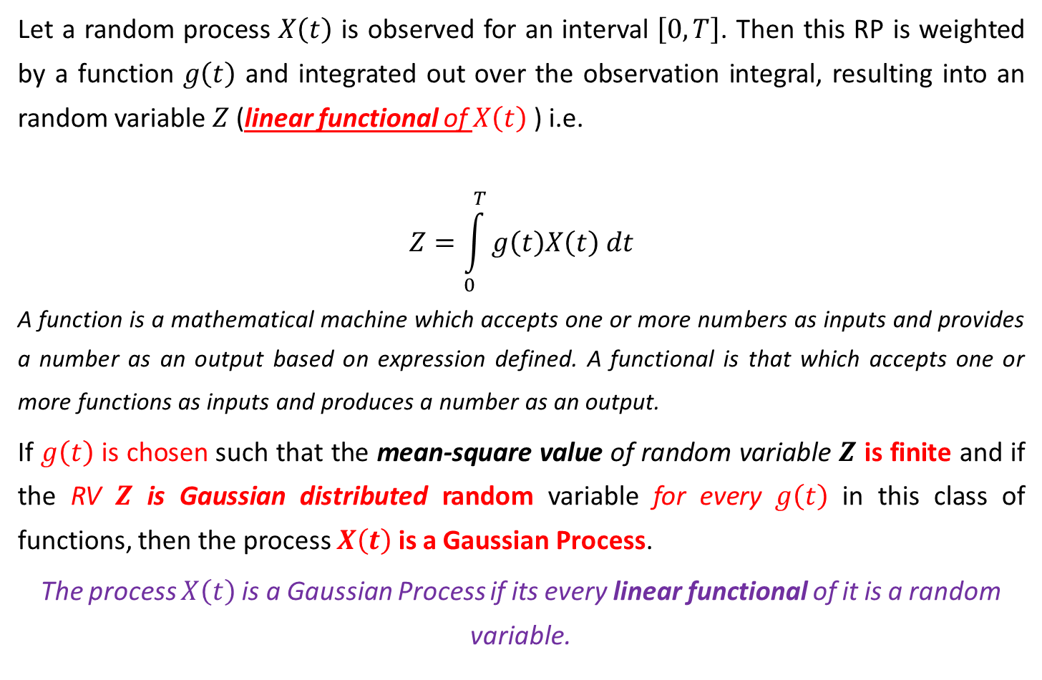
Gaussian Random Processes
Let a random process $X\left(t\right)$ is observed for an interval $\left[0,T\right]$. Then this RP is weighted by a function $g\left(t\right)$ and integrated out over the observation integral, resulting into an random variable $Z$ (linear functional of $X\left(t\right)$ ) i.e.
$$Z=\int_{0}^{T}{g\left(t\right)X\left(t\right) dt}$$
A function is a mathematical machine which accepts one or more numbers as inputs and provides a number as an output based on expression defined. A functional is that which accepts one or more functions as inputs and produces a number as an output.
If $g\left(t\right)$ is chosen such that the mean-square value of random variable $Z$ is finite and if the RV $Z$ is Gaussian distributed random variable for every $g\left(t\right)$ in this class of functions, then the process $X\left(t\right)$ is a Gaussian Process.
The process $X\left(t\right)$ is a Gaussian Process if its every linear functional of it is a random variable.

Slide 4
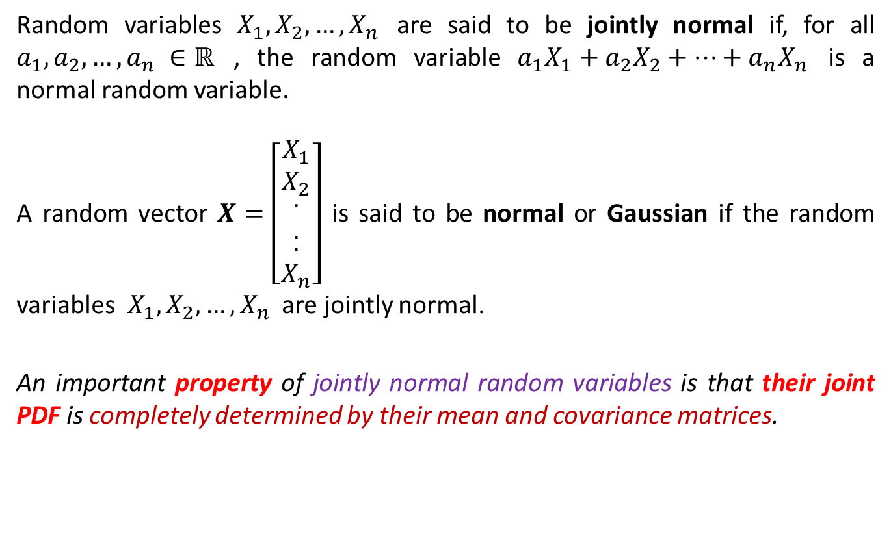
Gaussian Random Processes
Random variables $X_{1},X_{2},…,X_{n}$ are said to be jointly normal if, for all $a_{1},a_{2},…,a_{n} ∈ℝ$ , the random variable $a_{1}X_{1}+a_{2}X_{2}+…+a_{n}X_{n}$ is a normal random variable.
A random vector $X=\left[\begin{matrix}\begin{matrix}X_{1} \\ X_{2}\end{matrix} \\ \begin{matrix}. \\ .\end{matrix} \\ \begin{matrix}. \\ X_{n}\end{matrix}\end{matrix}\right]$ is said to be normal or Gaussian if the random variables $X_{1},X_{2},…,X_{n}$ are jointly normal.
An important property of jointly normal random variables is that their joint PDF is completely determined by their mean and covariance matrices.

Slide 5
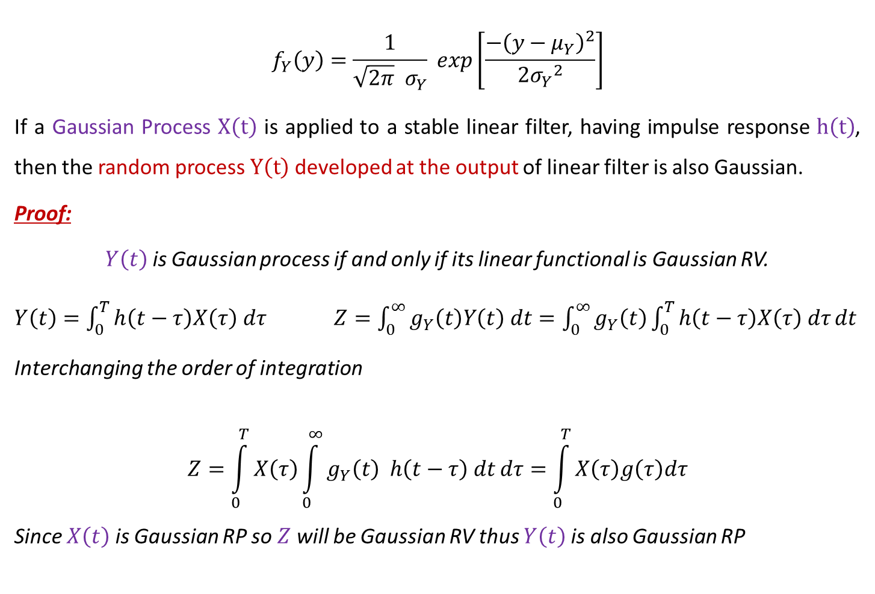
Properties of Gaussian Random Processes
$$f_{Y}\left(y\right)=\frac{1}{\sqrt{2π} σ_{Y}} exp\left[\frac{−{\left(y−μ_{Y}\right)}^{2}}{2{σ_{Y}}_{}^{2}}\right]$$
If a Gaussian Process $X\left(t\right)$ is applied to a stable linear filter, having impulse response $h\left(t\right)$, then the random process $Y\left(t\right)$ developed at the output of linear filter is also Gaussian.
Proof:
$Y\left(t\right)$ is Gaussian process if and only if its linear functional is Gaussian RV.
$Y\left(t\right)=\int_{0}^{T}{h\left(t−τ\right)X\left(τ\right) dτ}$ $Z=\int_{0}^{∞}{g_{Y}\left(t\right)Y\left(t\right) dt}=\int_{0}^{∞}{g_{Y}\left(t\right)\int_{0}^{T}{h\left(t−τ\right)X\left(τ\right) dτ}dt}$
Interchanging the order of integration
$$Z=\int_{0}^{T}{X\left(τ\right)\int_{0}^{∞}{g_{Y}\left(t\right) h\left(t−τ\right) dt}dτ}=\int_{0}^{T}{X\left(τ\right)g\left(τ\right)dτ}$$
Since $X\left(t\right)$ is Gaussian RP so $Z$ will be Gaussian RV thus $Y\left(t\right)$ is also Gaussian RP

Slide 6
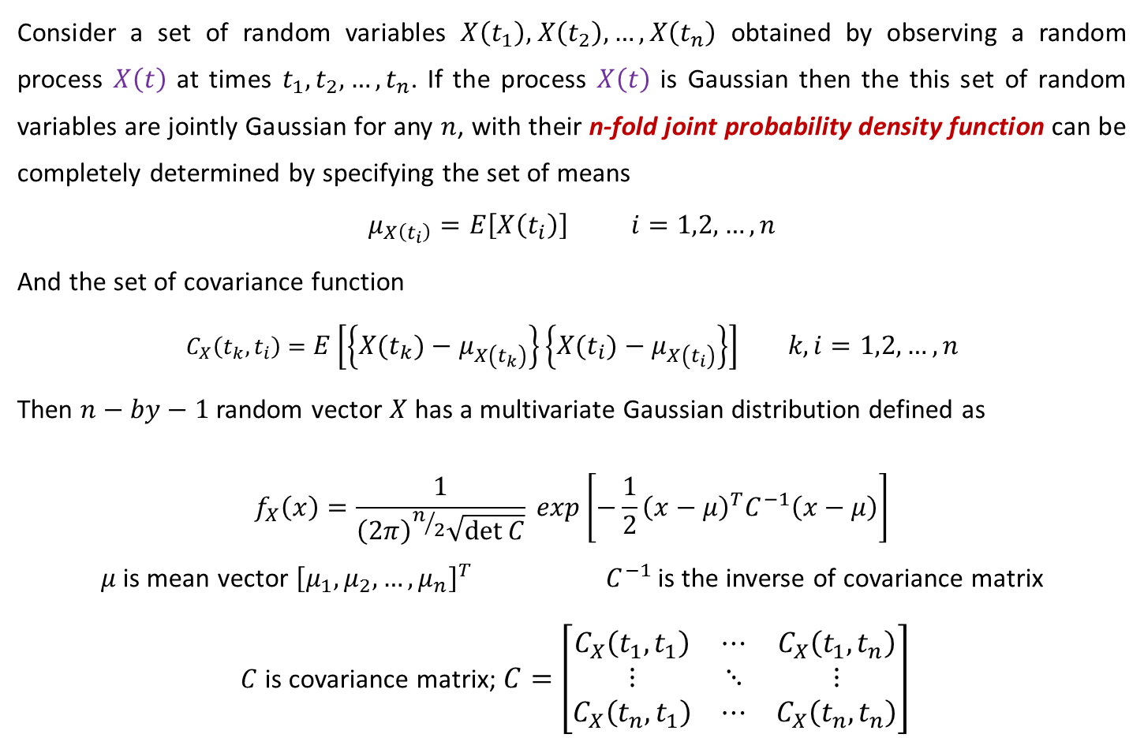
Properties of Gaussian Random Processes
Consider a set of random variables $X\left(t_{1}\right)\text{,} X\left(t_{2}\right),…,X\left(t_{n}\right)$ obtained by observing a random process $X\left(t\right)$ at times $t_{1},t_{2},…,t_{n}$. If the process $X\left(t\right)$ is Gaussian then the this set of random variables are jointly Gaussian for any $n$, with their n-fold joint probability density function can be completely determined by specifying the set of means
$$μ_{X\left(t_{i}\right)}=E\left[X\left(t_{i}\right)\right] i=1,2,…,n$$
And the set of covariance function
$$C_{X}\left(t_{k},t_{i}\right)=E\left[\left\{X\left(t_{k}\right)−μ_{X\left(t_{k}\right)}\right\}\left\{X\left(t_{i}\right)−μ_{X\left(t_{i}\right)}\right\}\right] k,i=1,2,…,n$$
Then $n−by−1$ random vector $X$ has a multivariate Gaussian distribution defined as
$$f_{X}\left(x\right)=\frac{1}{{\left(2π\right)}^{n/2}\sqrt{\det{C}}} exp\left[−\frac{1}{2}{\left(x−μ\right)}^{T}C^{−1}\left(x−μ\right)\right]$$
$μ$ is mean vector ${\left[μ_{1},μ_{2},…,μ_{n}\right]}^{T}$ $C^{−1}$ is the inverse of covariance matrix
$C$ is covariance matrix; $C=\left[\begin{matrix}C_{X}\left(t_{1},t_{1}\right) & ⋯ & C_{X}\left(t_{1},t_{n}\right) \\ ⋮ & ⋱ & ⋮ \\ C_{X}\left(t_{n},t_{1}\right) & ⋯ & C_{X}\left(t_{n},t_{n}\right)\end{matrix}\right]$

Slide 7

Properties of Gaussian Random Processes
If $X\left(t_{1}\right)\text{,} X\left(t_{2}\right),…,X\left(t_{n}\right)$ obtained by sampling a Gaussian process $X\left(t\right)$ at times $t_{1},t_{2},…,t_{n}$ are uncorrelated i.e. $E\left[\left\{X\left(t_{k}\right)−μ_{X\left(t_{k}\right)}\right\}\left\{X\left(t_{i}\right)−μ_{X\left(t_{i}\right)}\right\}\right]=0$ then these random variables are statistically independent.
Uncorrelatedness means $C$ is a diagonal matrix with diagonal elements ${σ_{i}^{}}^{2}$.
If Gaussian RV $X\left(t_{1}\right)\text{,} X\left(t_{2}\right),…,X\left(t_{n}\right)$ are uncorrelated then they are statistically independent, therefore, the joint PDF of this set of RVs are product of PDF of individual RVs.
Under this condition, the multivariate Gaussian distribution simplifies to
$$f_{X}\left(X\right)=\prod_{i=1}^{n}{f_{x_{i}}\left(x_{i}\right)}$$
Where $X_{i}=X\left(t_{i}\right)$and
$$f_{X_{i}}\left(x_{i}\right)=\frac{1}{\sqrt{2π} σ_{X_{i}}}exp\left[\frac{−{\left(x_{i}−μ_{X_{i}}\right)}^{2}}{2{σ_{X_{i}}}_{}^{2}}\right]$$

Slide 8

Power Spectral Density
Consider a WSS random process $X(t)$ with autocorrelation function $R_{X}\left(τ\right)$. Then the Power Spectral Density (PSD) of $X(t)$can be defined as the Fourier transform of $R_{X}\left(τ\right)$.
$$S_{X}\left(f\right)=Ϝ\left\{R_{X}\left(τ\right)\right\}=\int_{−∞}^{∞}{R_{X}\left(τ\right)e^{−j2πfτ} dτ}$$
Thus
$$R_{X}\left(τ\right)=\int_{−∞}^{∞}{S_{X}\left(f\right)e^{j2πfτ} df}$$
If $X(t)$ is a real-valued random process, then $R_{X}\left(τ\right)$ is an even, real-valued function of $τ$. From the properties of the Fourier transform, it can be concluded that $S_{X}\left(f\right)$ is also real-valued and an even function of $f$.
$S_{X}\left(−f\right)=S_{X}\left(f\right) ∀f$ and $S_{X}\left(f\right)≥0 ∀f$

Slide 9
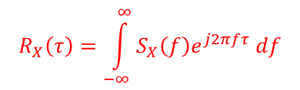

Power Spectral Density
$$R_{X}\left(τ\right)=\int_{−∞}^{∞}{S_{X}\left(f\right)e^{j2πfτ} df}$$
For $τ=0$, the expected (or average power) in $X(t)$
$$E\left[{X\left(t\right)}^{2}\right]=R_{X}\left(0\right)=\int_{−∞}^{∞}{S_{X}\left(f\right) df}$$
i.e. the expected power in $X(t)$ can be obtained by integrating the PSD of $X(t)$.
Cross Spectral Density:
For two jointly WSS random processes $X(t)$ and $Y(t)$, the cross spectral density $S_{XY}\left(f\right)$ can be defined as the Fourier transform of the cross-correlation function $R_{XY}\left(τ\right)$
$$S_{XY}\left(f\right)=Ϝ\left\{R_{XY}\left(τ\right)\right\}=\int_{−∞}^{∞}{R_{XY}\left(τ\right)e^{−j2πfτ} dτ}$$

Slide 10


Consider a WSS random process $X(t)$ with $R_{X}\left(τ\right)=e^{−a\left|τ\right|}$, where $a$ is a positive real number. Find the PSD of $X(t)$.
$$S_{X}\left(f\right)=Ϝ\left\{R_{X}\left(τ\right)\right\}=\int_{−∞}^{∞}{e^{−a\left|τ\right|}e^{−j2πfτ} dτ}$$
$$S_{X}\left(f\right)=\int_{−∞}^{0}{e^{aτ}e^{−j2πfτ} dτ}+\int_{0}^{∞}{e^{−aτ}e^{−j2πfτ} dτ}=\frac{1}{a−j2πf}+\frac{1}{a+j2πf}=\frac{2a}{a^{2}+4a^{2}f^{2}}$$

Slide 11
Reference
Athanasios Papoulis, “Probability, Random Variables, and Stochastic Processes,” 3rd edition, McGraw Hill Publication.
https://www.probabilitycourse.com

