Slide 1
Lecture-4 Module-3
LTI Systems with Random Inputs

Slide 2
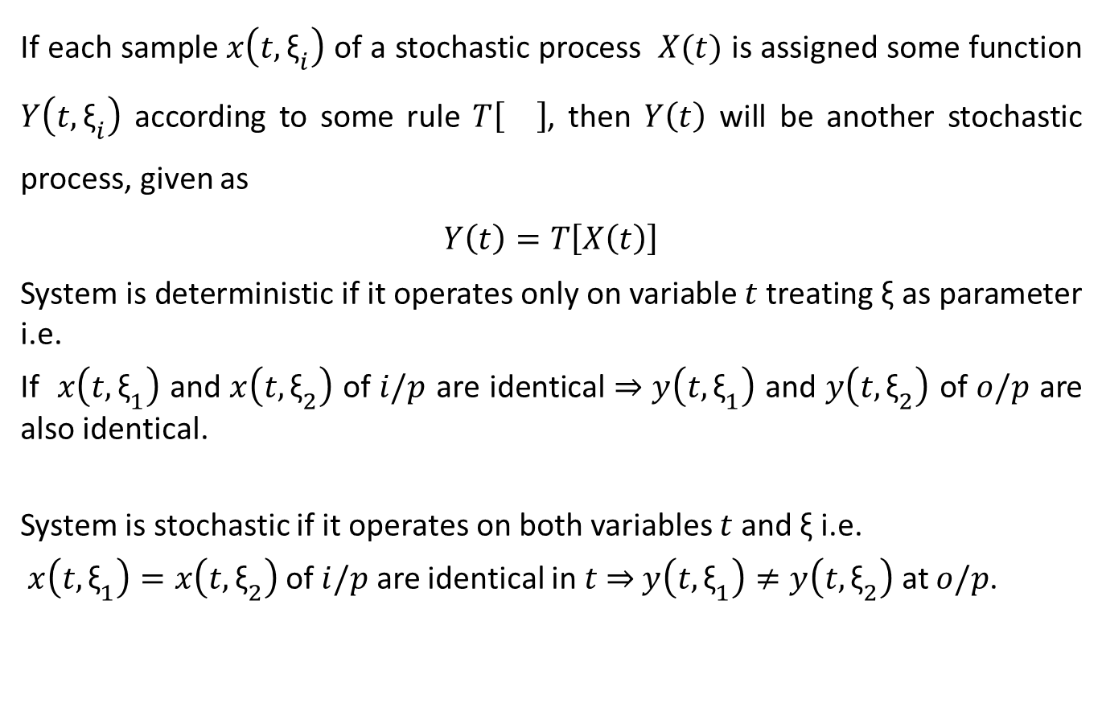
Systems with Stochastic Inputs
If each sample $x\left(t,{\text{ξ}}_{i}\right)$ of a stochastic process $X(t)$ is assigned some function $Y\left(t,{\text{ξ}}_{i}\right)$ according to some rule $T\left[\right]$, then $Y\left(t\right)$ will be another stochastic process, given as
$$Y\left(t\right)=T\left[X\left(t\right)\right]$$
System is deterministic if it operates only on variable $t$ treating $\text{ξ}$ as parameter i.e.
If $x\left(t,{\text{ξ}}_{1}\right)$ and $x\left(t,{\text{ξ}}_{2}\right)$ of $i/p$ are identical $⇒$ $y\left(t,{\text{ξ}}_{1}\right)$ and $y\left(t,{\text{ξ}}_{2}\right)$ of $o/p$ are also identical.
System is stochastic if it operates on both variables $t$ and $\text{ξ}$ i.e.
$x\left(t,{\text{ξ}}_{1}\right)=x\left(t,{\text{ξ}}_{2}\right)$ of $i/p$ are identical in $t$ $⇒$ $y\left(t,{\text{ξ}}_{1}\right)≠y\left(t,{\text{ξ}}_{2}\right)$ at $o/p$.

Slide 3
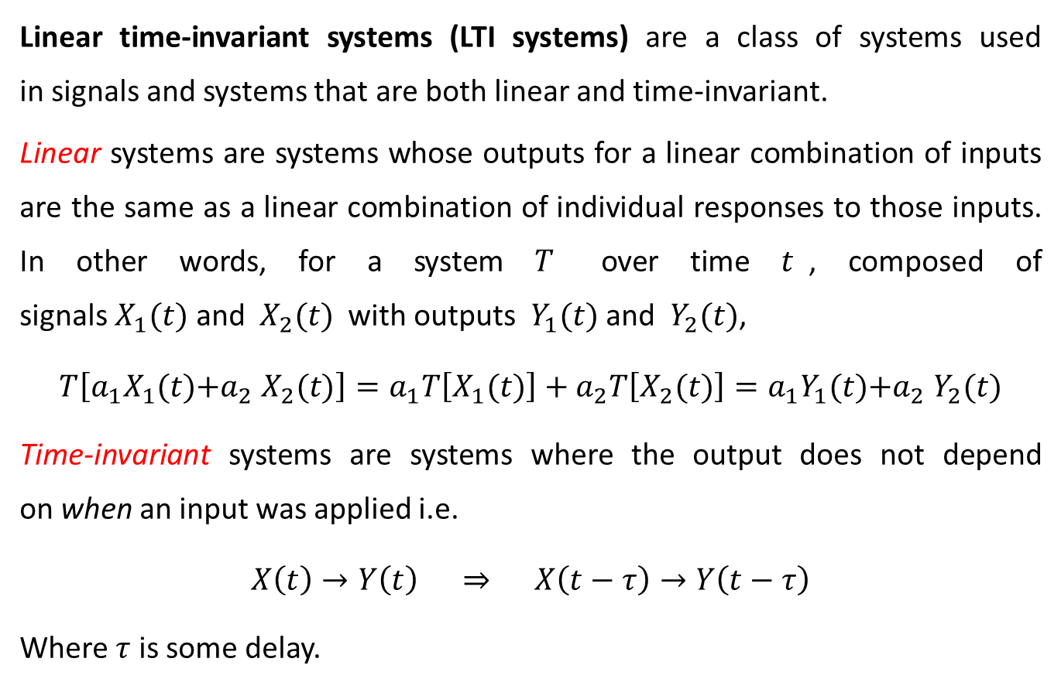
Linear Time-Invariant (LTI) Systems
Linear time-invariant systems (LTI systems) are a class of systems used in signals and systems that are both linear and time-invariant.
Linear systems are systems whose outputs for a linear combination of inputs are the same as a linear combination of individual responses to those inputs. In other words, for a system $T$ over time $t$, composed of signals $X_{1}(t)$ and $X_{2}(t)$ with outputs $Y_{1}(t)$ and $Y_{2}(t)$,
$$T\left[a_{1}X_{1}(t)\text{+}a_{2} X_{2}(t)\right]=a_{1}T\left[X_{1}(t)\right]+a_{2}T\left[X_{2}(t)\right]=a_{1}Y_{1}(t)\text{+}a_{2} Y_{2}(t)$$
Time-invariant systems are systems where the output does not depend on when an input was applied i.e.
$$X\left(t\right)→Y\left(t\right) ⇒ X\left(t−τ\right)→Y\left(t−τ\right)$$
Where $τ$ is some delay.

Slide 4
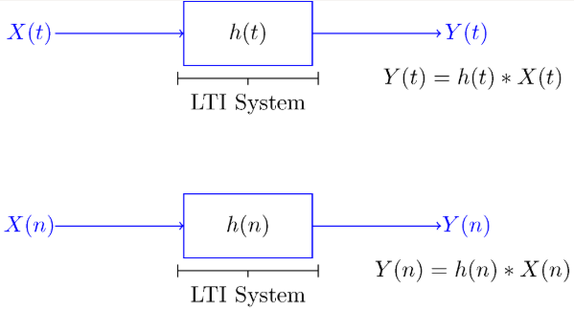

Linear Time-Invariant (LTI) Systems
$Y(t)=\int_{−∞}^{∞}{h(α)X(t−α)dα}=\int_{−∞}^{∞}{X(α)h(t−α)dα}$.
$$Y\left(n\right)=h\left(n\right)∗X\left(n\right)=X\left(n\right)∗h\left(n\right)=\sum_{k=−∞}^{∞}{h\left(k\right)X\left(n−k\right)}=\sum_{k=−∞}^{∞}{X\left(k\right)h\left(n−k\right)}$$

Slide 5
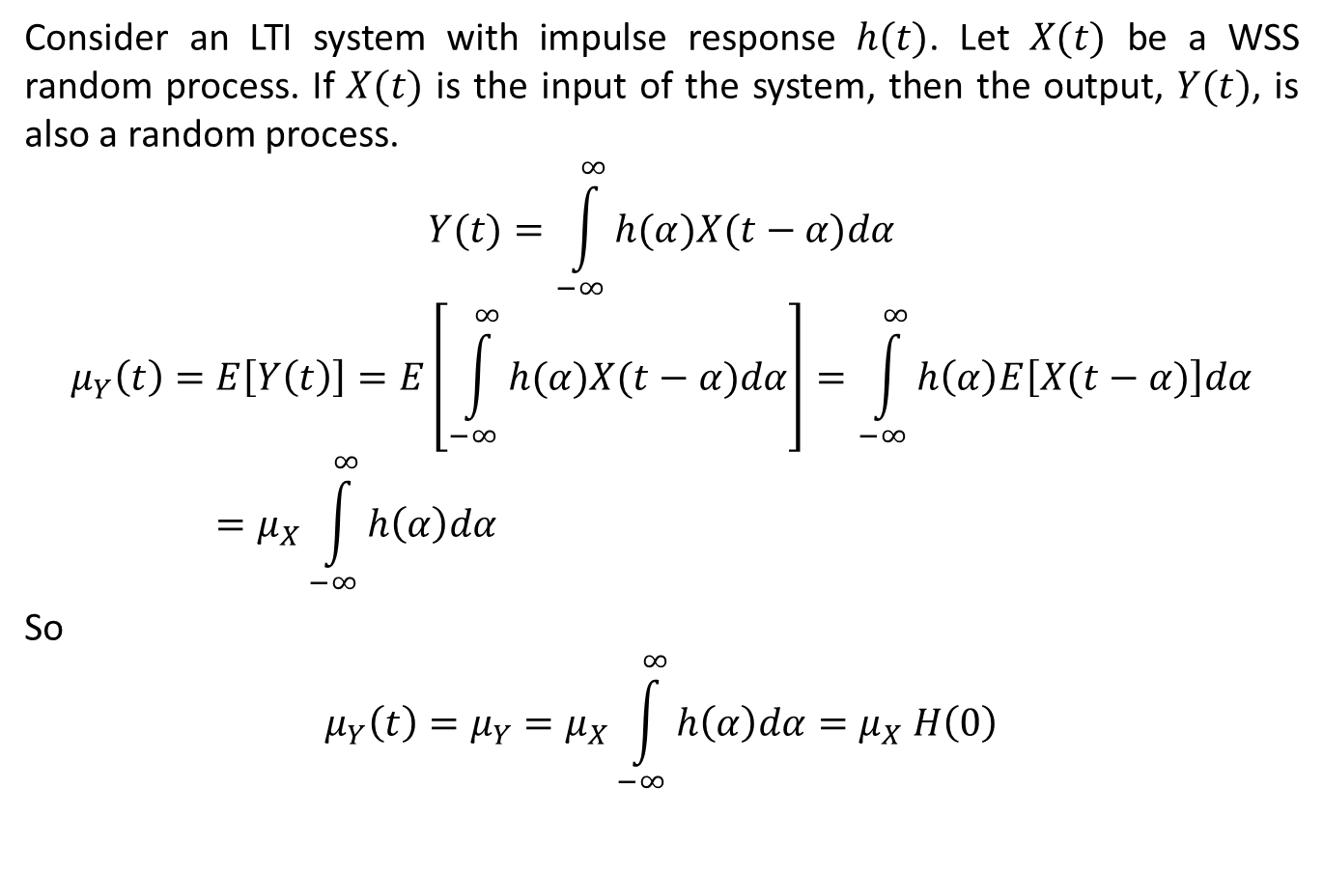
Mean of output of LTI Systems
Consider an LTI system with impulse response $h(t)$. Let $X(t)$ be a WSS random process. If $X(t)$ is the input of the system, then the output, $Y(t)$, is also a random process.
$$Y(t)=\int_{−∞}^{∞}{h(α)X(t−α)dα}$$
$$μ_{Y}\left(t\right)=E\left[Y\left(t\right)\right]=E\left[\int_{−∞}^{∞}{h(α)X(t−α)dα}\right]=\int_{−∞}^{∞}{h\left(α\right)E\left[X(t−α)\right]dα}=μ_{X}\int_{−∞}^{∞}{h\left(α\right)dα}$$
So
$$μ_{Y}\left(t\right)=μ_{Y}=μ_{X}\int_{−∞}^{∞}{h\left(α\right)dα}=μ_{X} H\left(0\right)$$

Slide 6
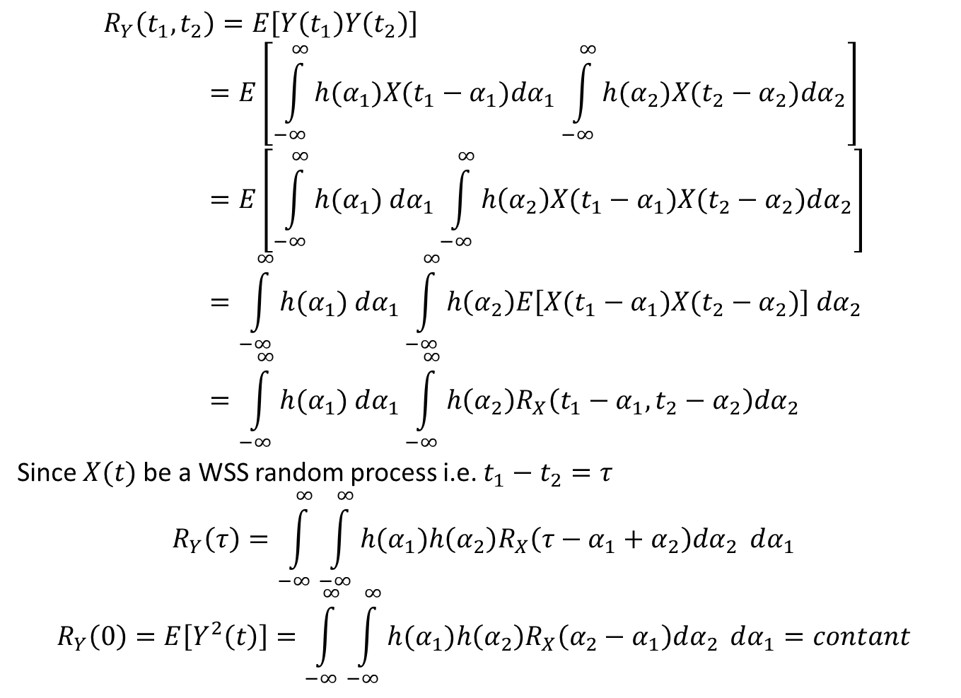
Cross-correlation Function of output of LTI Systems
$$R_{Y}\left(t_{1},t_{2}\right)=E\left[Y\left(t_{1}\right)Y\left(t_{2}\right)\right]=E\left[\int_{−∞}^{∞}{h(α_{1})X(t_{1}−α_{1})dα_{1}}\int_{−∞}^{∞}{h(α_{2})X(t_{2}−α_{2})dα_{2}}\right]=E\left[\int_{−∞}^{∞}{h(α_{1}) dα_{1}}\int_{−∞}^{∞}{h\left(α_{2}\right)X(t_{1}−α_{1})X(t_{2}−α_{2})dα_{2}}\right]=\int_{−∞}^{∞}{h(α_{1}) dα_{1}}\int_{−∞}^{∞}{h\left(α_{2}\right)E\left[X(t_{1}−α_{1})X(t_{2}−α_{2})\right] dα_{2}}=\int_{−∞}^{∞}{h(α_{1}) dα_{1}}\int_{−∞}^{∞}{h\left(α_{2}\right)R_{X}\left(t_{1}−α_{1},t_{2}−α_{2}\right)dα_{2}}$$
Since $X(t)$ be a WSS random process i.e. $t_{1}−t_{2}=τ$
$$R_{Y}\left(τ\right)=\int_{−∞}^{∞}{\int_{−∞}^{∞}{h(α_{1})h\left(α_{2}\right)R_{X}\left(τ−α_{1}+α_{2}\right)dα_{2}} dα_{1}}$$
$$R_{Y}\left(0\right)=E\left[Y^{2}\left(t\right)\right]=\int_{−∞}^{∞}{\int_{−∞}^{∞}{h(α_{1})h\left(α_{2}\right)R_{X}\left(α_{2}−α_{1}\right)dα_{2}} dα_{1}}=contant$$

Slide 7
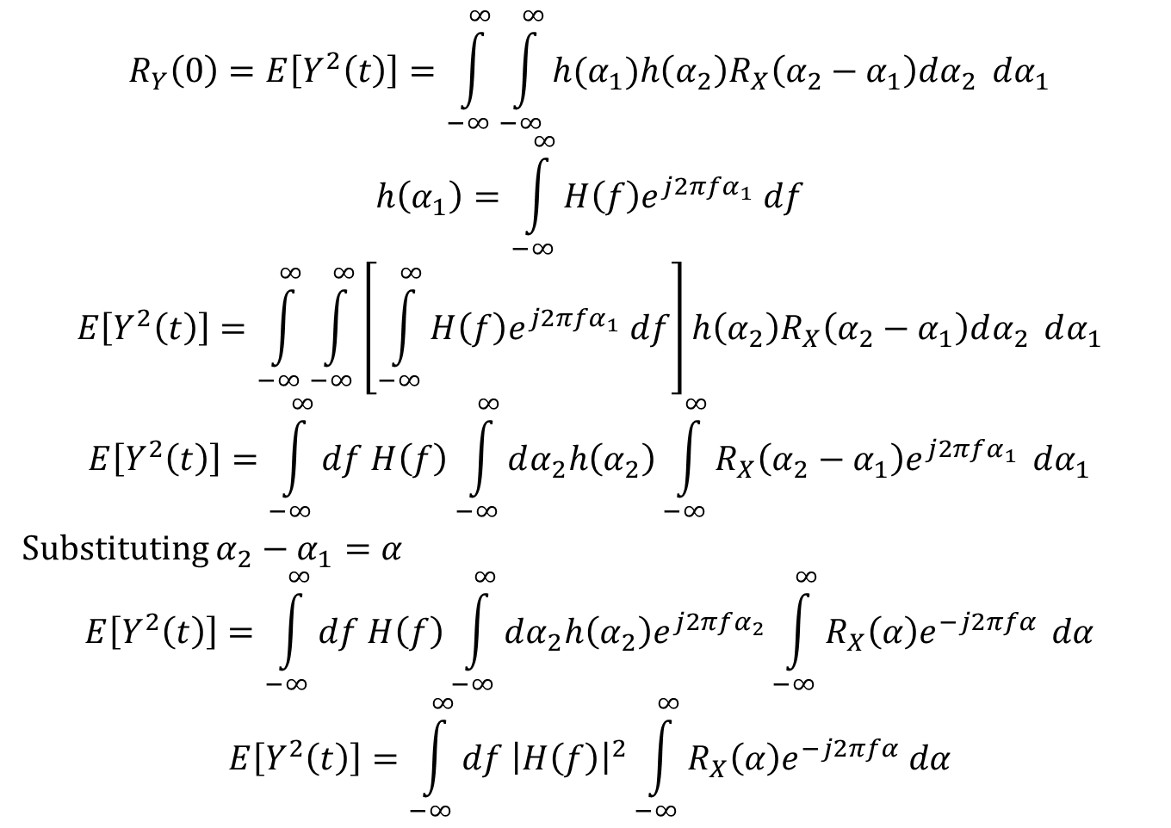
Power Spectral Density
$$R_{Y}\left(0\right)=E\left[Y^{2}\left(t\right)\right]=\int_{−∞}^{∞}{\int_{−∞}^{∞}{h(α_{1})h\left(α_{2}\right)R_{X}\left(α_{2}−α_{1}\right)dα_{2}} dα_{1}}$$
$$h\left(α_{1}\right)=\int_{−∞}^{∞}{H\left(f\right)e^{j2πfα_{1}} df}$$
$$E\left[Y^{2}\left(t\right)\right]=\int_{−∞}^{∞}{\int_{−∞}^{∞}{\left[\int_{−∞}^{∞}{H\left(f\right)e^{j2πfα_{1}} df}\right]h\left(α_{2}\right)R_{X}\left(α_{2}−α_{1}\right)dα_{2}} dα_{1}}$$
$$E\left[Y^{2}\left(t\right)\right]=\int_{−∞}^{∞}{df H\left(f\right)\int_{−∞}^{∞}{dα_{2}h\left(α_{2}\right)\int_{−∞}^{∞}{R_{X}\left(α_{2}−α_{1}\right)e^{j2πfα_{1}}}} dα_{1}}$$
Substituting $α_{2}−α_{1}=α$
$$E\left[Y^{2}\left(t\right)\right]=\int_{−∞}^{∞}{df H\left(f\right)\int_{−∞}^{∞}{dα_{2}h\left(α_{2}\right)e^{j2πfα_{2}}\int_{−∞}^{∞}{R_{X}\left(α\right)e^{−j2πfα}}} dα}$$
$$E\left[Y^{2}\left(t\right)\right]=\int_{−∞}^{∞}{df {\left|H\left(f\right)\right|}^{2}\int_{−∞}^{∞}{R_{X}\left(α\right)e^{−j2πfα} dα}}$$

Slide 8

Power Spectral Density
$$E\left[Y^{2}\left(t\right)\right]=\int_{−∞}^{∞}{df {\left|H\left(f\right)\right|}^{2}\int_{−∞}^{∞}{R_{X}\left(α\right)e^{−j2πfα} dα}}$$
Let
$$S_{X}\left(f\right)=\int_{−∞}^{∞}{R_{X}\left(α\right)e^{−j2πfα} dα}$$
$$E\left[Y^{2}\left(t\right)\right]=\int_{−∞}^{∞}{S_{X}\left(f\right){\left|H\left(f\right)\right|}^{2} df}=\int_{−∞}^{∞}{S_{Y}\left(f\right) df}$$
$$S_{Y}\left(f\right)=S_{X}\left(f\right){\left|H\left(f\right)\right|}^{2}$$
Einstein-Wiener-Khintchine relation
$$S_{X}\left(f\right)=\int_{−∞}^{∞}{R_{X}\left(τ\right)e^{−j2πfτ} dτ}$$
$$R_{X}\left(τ\right)=\int_{−∞}^{∞}{S_{X}\left(f\right) e^{j2πfτ} df}$$

Slide 9
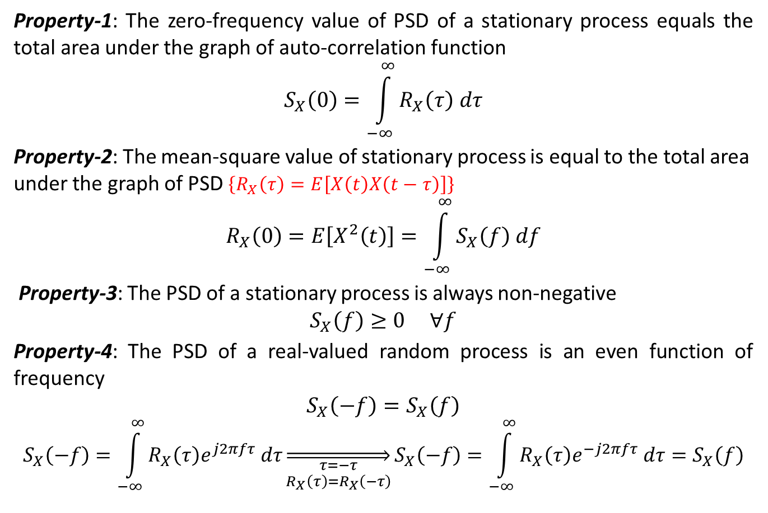
Properties of Power Spectral Density
Property-1: The zero-frequency value of PSD of a stationary process equals the total area under the graph of auto-correlation function
$$S_{X}\left(0\right)=\int_{−∞}^{∞}{R_{X}\left(τ\right) dτ}$$
Property-2: The mean-square value of stationary process is equal to the total area under the graph of PSD $\left\{R_{X}\left(τ\right)=E\left[X\left(t\right)X\left(t−τ\right)\right]\right\}$
$$R_{X}\left(0\right)=E\left[X^{2}\left(t\right)\right]=\int_{−∞}^{∞}{S_{X}\left(f\right) df}$$
Property-3: The PSD of a stationary process is always non-negative
$$S_{X}\left(f\right)≥0 ∀f$$
Property-4: The PSD of a real-valued random process is an even function of frequency
$$S_{X}\left(−f\right)=S_{X}\left(f\right)$$
$$S_{X}\left(−f\right)=\int_{−∞}^{∞}{R_{X}\left(τ\right)e^{j2πfτ} dτ}\overset{⇒}{\begin{aligned}τ=−τ \\ R_{X}\left(τ\right)=R_{X}\left(−τ\right)\end{aligned}}S_{X}\left(−f\right)=\int_{−∞}^{∞}{R_{X}\left(τ\right)e^{−j2πfτ} dτ}=S_{X}\left(f\right)$$

Slide 10
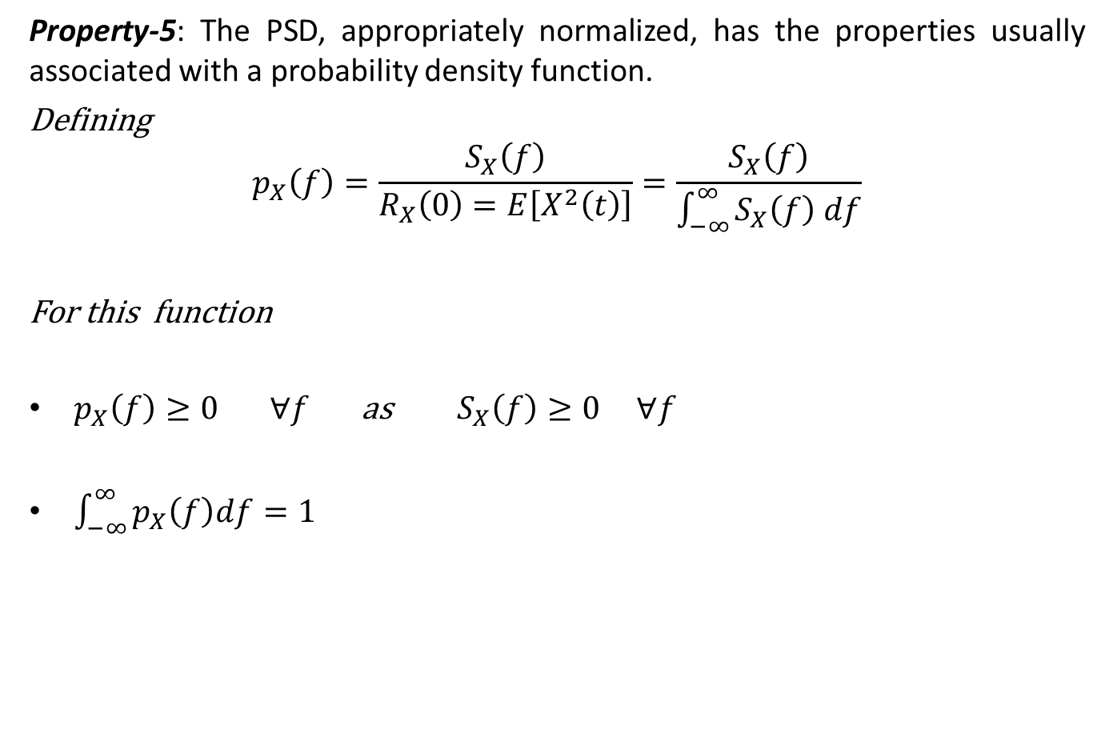
Properties of Power Spectral Density
Property-5: The PSD, appropriately normalized, has the properties usually associated with a probability density function.
Defining
$$p_{X}\left(f\right)=\frac{S_{X}\left(f\right)}{R_{X}\left(0\right)=E\left[X^{2}\left(t\right)\right]}=\frac{S_{X}\left(f\right)}{\int_{−∞}^{∞}{S_{X}\left(f\right) df}}$$
For this function
$p_{X}\left(f\right)≥0 ∀f$ as $S_{X}\left(f\right)≥0 ∀f$
$\int_{−∞}^{∞}{p_{X}\left(f\right)df}=1$

Slide 11
Reference
Athanasios Papoulis, “Probability, Random Variables, and Stochastic Processes,” 3rd edition, McGraw Hill Publication.
https://www.probabilitycourse.com

