Slide 1


Information and
Communication Theory
By
Dr. Hem Dutt Joshi
Associate Professor, ECED,
TIET, Patiala

Slide 2
Module – 4
Estimation & Hypothesis Testing

Slide 3
Course Content
Module-1 : Probability Theory
      Random Variable, Distribution function, Characteristic function and central limit theorem
Module-2 : Information Theory
      Information Measure, Entropy, Source coding, Mutual Information, channel capacity, Shannon’s Theorems.
Module-3 : Stochastic Processes
      Systems with Stochastic Inputs, Markov Chains, and Random-Walk Model
Module-4 : Estimation & Hypothesis Testing
      Hypothesis, Neyman Pearson Tests, Bayes’ Criteria, Z-Score, and p-Value Test
Module-5 : Statistical Modeling of Noise

Slide 4
Content of Module – 4
Estimation & Hypothesis Testing
Following are the main topics of this module:
Concept of Estimation (Estimation of parameters of random variables)
Estimation methods for obtaining point estimates as well as confidence intervals for parameters of interest.
Hypothesis testing and methods
  Simple Binary Hypothesis Tests, Decision Criteria,
  Neyman Pearson Tests, Bayes’ Criteria
  z-Score, and p-Value Test

Slide 5
Motivation
The concept of Probability theory is used to model the situations of real world scenarios that exhibit some randomness.
These models used random experiments involving sample spaces, events, and probability distributions.
The field of statistics plays an important role in bridging these probability models to the real world.
Statistics is concerned with the gathering and analysis of data and with the drawing of conclusions or inferences from the data.

Slide 6
Example
An LED bulb manufacturer claims that the average power rating of the bulb is 15 Watt
  How does quality manager test this claim?
Two groups of Football players trained by two different methods (method A and B).
  Whether method B is better than A on an average.
  What statistical procedure should be adopted?

Slide 7
Motivation
The statistical methods answer the following questions.
  What are the values of parameters of a random variable of interest? (Example: mean and variance)
  Are the observed data consistent with an assumed distribution?
  Are the observed data consistent with a given parameter value of a random variable?

Slide 8
What is Estimation
Approximate Calculation
  Judgment based on available evidences
    Judgment refer to either of these: Detection, prediction, classification, or computation
    Available evidence involve randomness or unknown/uncertain elements
In terms of communication system
Estimation theory deals
  with the ability of receiver to estimates the values of parameters or waveform of interest based on measured empirical data that has a random component.
  Estimation of signal or parameters of signal.

Slide 9
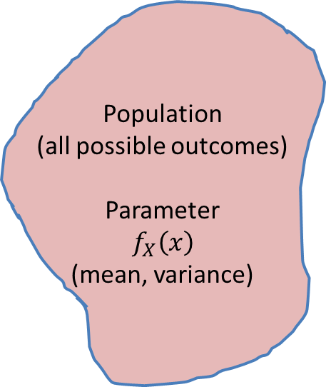
Sample Space/Population
The term population refers to the collection of all objects or elements under study in a given situation.
Since it is very difficult to observe the data of whole population, the data of some items or objects is taken. This is called sampling of data.
In order for inferences about the population to be valid, it is important that the individuals in the sample be representative of the entire population.
Population
(all possible outcomes)
Parameter
$$f_{X}\left(x\right)$$
(mean, variance)
Sampled Data
Sample Space
Apply Statistic on sample space data
Inference

Slide 10
Sample Space/Population
Example of Sample Space
Suppose we want to make inference on the average education standard of people in a north state of India.
First we will define one random variable which represent education standard like if a person educated up to class 5th then random variable will take value -1 and up to class 8th it will take value -2 and so on.
After that we will collect data of eligible person for this survey.
We will not collect data for whole population of that state, instead we will take survey of fixed number of peoples.
The number of peoples who takes part in this survey is our random sample space . The size of this sample space is represented by variable – n.
With the help of this survey, we can estimate the average education standard of whole population.

Slide 11
Sample Space/Population
In essence, we require that the n observations be made from random experiments conducted under the same conditions.
For this reason we define a random sample as consisting of n independent random variables with the same distribution as X.
Set of all possible outcomes of a random phenomenon, represented by “S”
If outcomes are discrete then it is discrete sample space
(Ex: Throw of dice (any one out of six number), flip of coin (head or Tail)
If outcomes are continuous then it is continuous sample space
(Ex: Ambient temperature, gas pressure etc.)

Slide 12
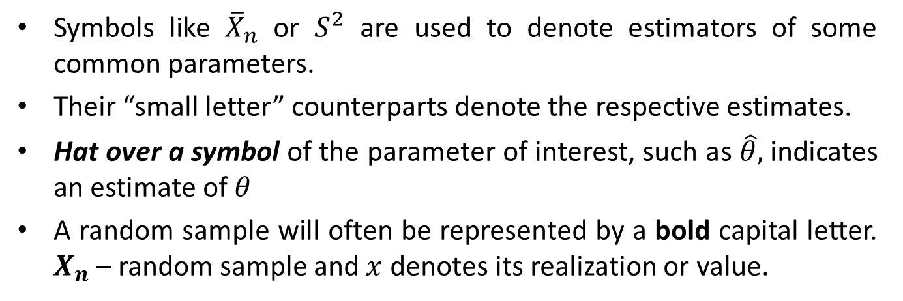
Notation Used
Symbols like ${\overline{X}}_{n}$ or $S^{2}$ are used to denote estimators of some common parameters.
Their “small letter” counterparts denote the respective estimates.
Hat over a symbol of the parameter of interest, such as $\hat{θ},$indicates an estimate of $θ$
A random sample will often be represented by a bold capital letter. $X_{n}$ – random sample and $x$ denotes its realization or value.

Slide 13
Reference Book
Alberto Leon-Garcia, Probability, Statistics, and Random Processes for Electrical Engineering, Third Edition, 2007, Pearson India,
Douglas C. Montgomery and George C. Runger (2010), Applied Statistics and Probability for Engineers. Fifth Edition. John Wiley & Sons.

