Slide 1


Information and
Communication Theory
By
Dr. Hem Dutt Joshi
Associate Professor, ECED,
TIET, Patiala

Slide 2
Lecture-2
Parameter Estimation
Module – 4
Estimation & Hypothesis Testing

Slide 3
Content of Lecture-2
Module – 4
Parameter Estimation
Properties of Good Estimator
Sample Mean Estimator

Slide 4
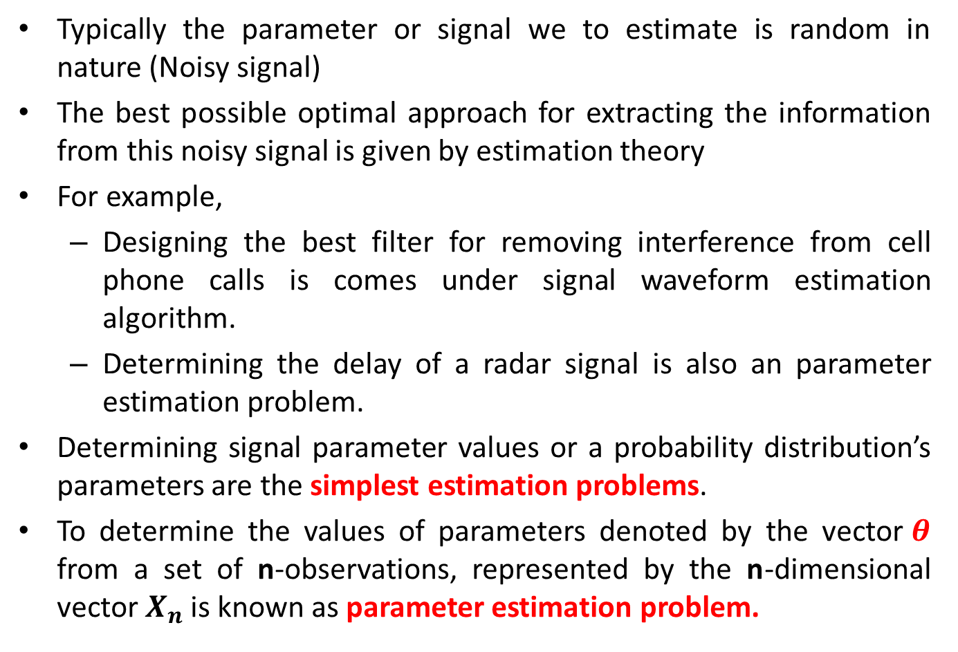
What is parameter estimation problem?
Typically the parameter or signal we to estimate is random in nature (Noisy signal)
The best possible optimal approach for extracting the information from this noisy signal is given by estimation theory
For example,
  Designing the best filter for removing interference from cell phone calls is comes under signal waveform estimation algorithm.
  Determining the delay of a radar signal is also an parameter estimation problem.
Determining signal parameter values or a probability distribution’s parameters are the simplest estimation problems.
To determine the values of parameters denoted by the vector$θ$ from a set of n-observations, represented by the n-dimensional vector $X_{n}$is known as parameter estimation problem.

Slide 5
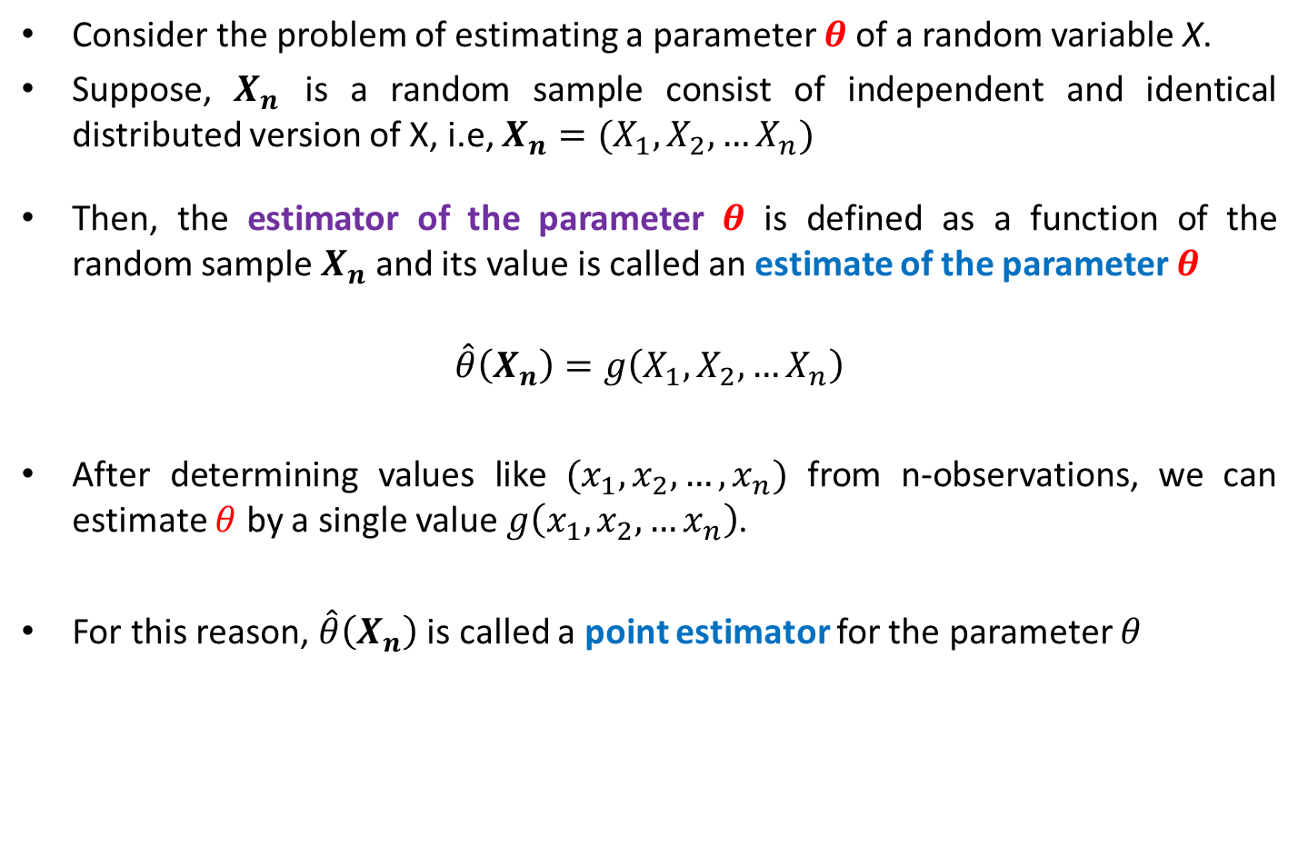
Parameter Estimation Problem
Consider the problem of estimating a parameter $θ$of a random variable X.
Suppose, $X_{n}$ is a random sample consist of independent and identical distributed version of X, i.e, $X_{n}=(X_{1},X_{2},…X_{n})$
Then, the estimator of the parameter $θ$ is defined as a function of the random sample $X_{n}$ and its value is called an estimate of the parameter $θ$
$$\hat{θ}\left(X_{n}\right)=g\left(X_{1},X_{2},…X_{n}\right)$$
After determining values like $(x_{1},x_{2},…, x_{n})$ from n-observations, we can estimate $θ$ by a single value $g\left(x_{1},x_{2},…x_{n}\right)$.
For this reason, $\hat{θ}\left(X_{n}\right)$ is called a point estimator for the parameter $θ$

Slide 6
Parameter Estimation Problem
Now the question is how to decide that an estimator is better than another?
What are the properties of a good estimator?
  Bias of Estimator
  Estimation Error (Mean square Estimation Error)
  Consistency

Slide 7
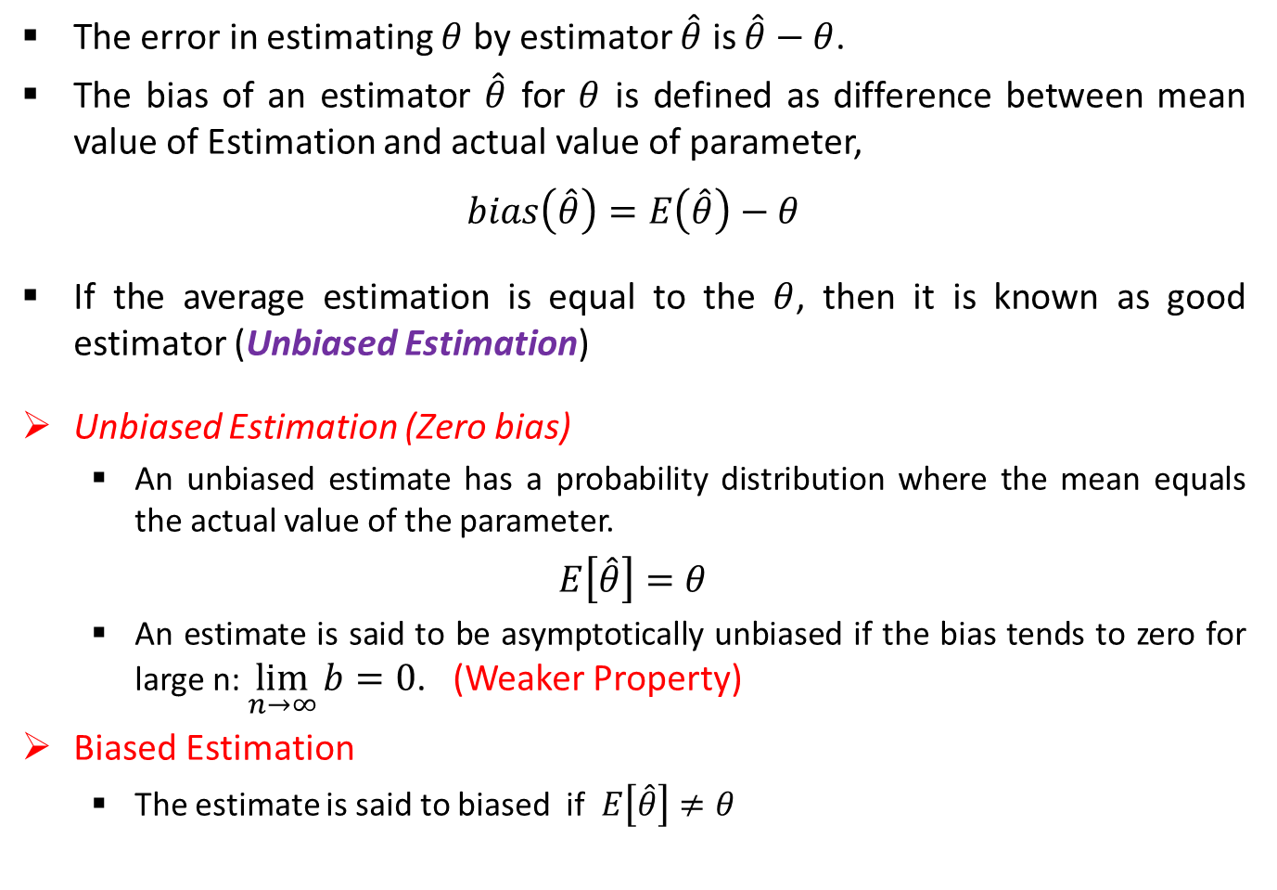
Bias of Estimator
The error in estimating $θ$ by estimator $\hat{θ}$ is $\hat{θ}−θ$.
The bias of an estimator $\hat{θ}$ for $θ$ is defined as difference between mean value of Estimation and actual value of parameter,
$$bias\left(\hat{θ}\right)=E\left(\hat{θ}\right)−θ$$
If the average estimation is equal to the $θ$, then it is known as good estimator (Unbiased Estimation)
Unbiased Estimation (Zero bias)
  An unbiased estimate has a probability distribution where the mean equals the actual value of the parameter.
$E\left[\hat{θ}\right]=θ$
  An estimate is said to be asymptotically unbiased if the bias tends to zero for large n: $\lim_{n→∞}{b=0}$. (Weaker Property)
Biased Estimation
  The estimate is said to biased if $E\left[\hat{θ}\right]≠θ$

Slide 8
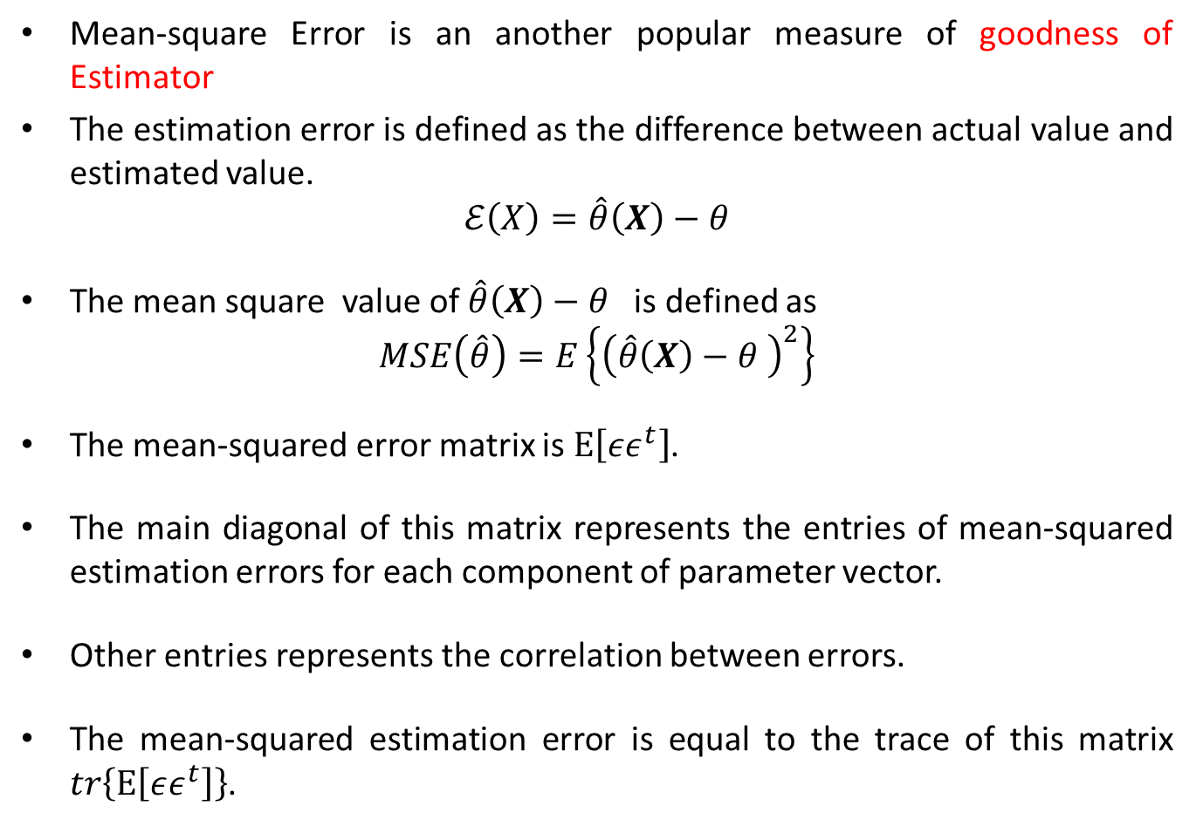
Estimation Error
Mean-square Error is an another popular measure of goodness of Estimator
The estimation error is defined as the difference between actual value and estimated value.
$$ℰ\left(X\right)=\hat{θ}\left(X\right)−θ$$
The mean square value of $\hat{θ}\left(X\right)−θ$ is defined as
$$MSE\left(\hat{θ}\right)=E\left\{{\left(\hat{θ}\left(X\right)−θ \right)}^{2}\right\}$$
The mean-squared error matrix is $E\left[εε^{t}\right]$.
The main diagonal of this matrix represents the entries of mean-squared estimation errors for each component of parameter vector.
Other entries represents the correlation between errors.
The mean-squared estimation error is equal to the trace of this matrix $tr\left\{E\left[εε^{t}\right]\right\}$.

Slide 9
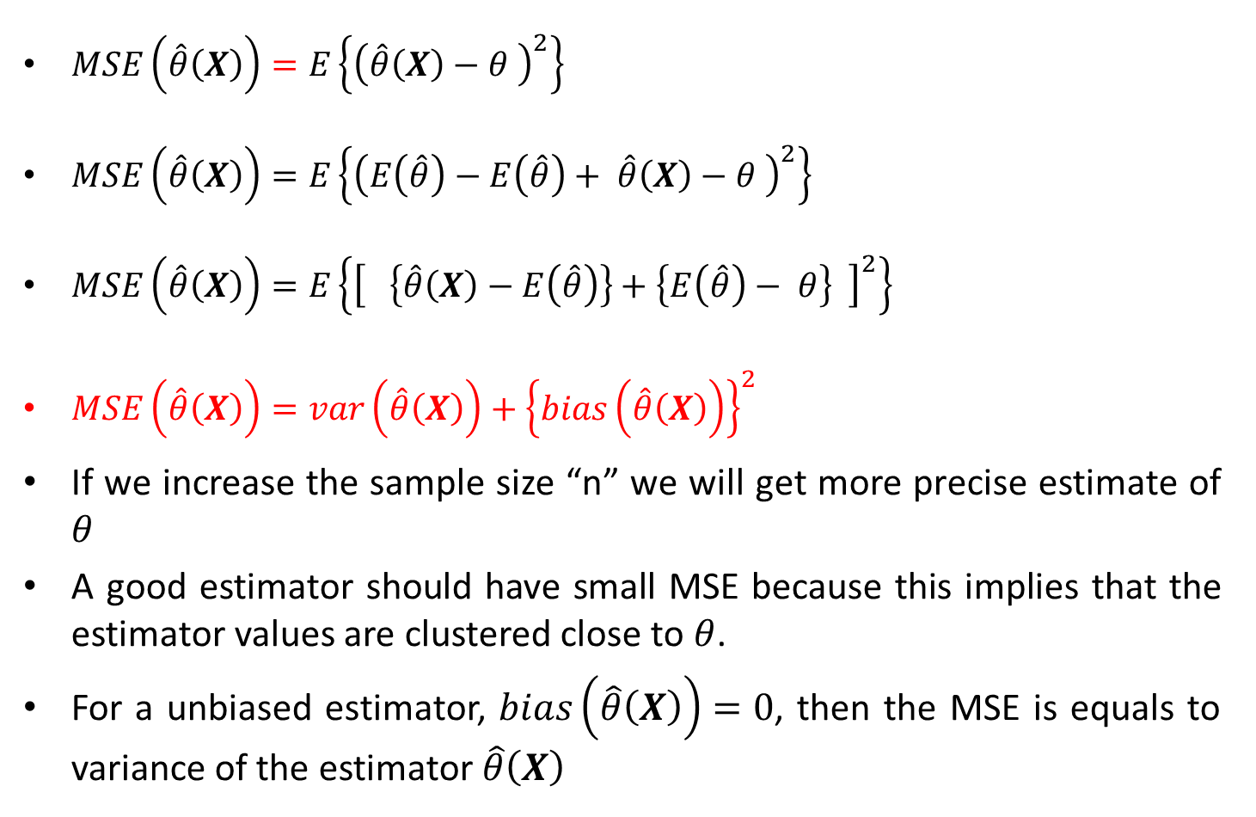
Estimation Error
$MSE\left(\hat{θ}\left(X\right)\right)=E\left\{{\left(\hat{θ}\left(X\right)−θ \right)}^{2}\right\}$
$MSE\left(\hat{θ}\left(X\right)\right)=E\left\{{\left(E\left(\hat{θ}\right)−E\left(\hat{θ}\right)+ \hat{θ}\left(X\right)−θ \right)}^{2}\right\}$
$MSE\left(\hat{θ}\left(X\right)\right)=E\left\{{\left[ \left\{\hat{θ}\left(X\right)−E\left(\hat{θ}\right)\right\}+\left\{E\left(\hat{θ}\right)− θ\right\} \right]}^{2}\right\}$
$MSE\left(\hat{θ}\left(X\right)\right)=var\left(\hat{θ}\left(X\right)\right)+{\left\{bias\left(\hat{θ}\left(X\right)\right)\right\}}^{2}$
If we increase the sample size “n” we will get more precise estimate of $θ$
A good estimator should have small MSE because this implies that the estimator values are clustered close to $θ$.
For a unbiased estimator, $bias\left(\hat{θ}\left(X\right)\right)=0$, then the MSE is equals to variance of the estimator $\hat{θ}\left(X\right)$

Slide 10
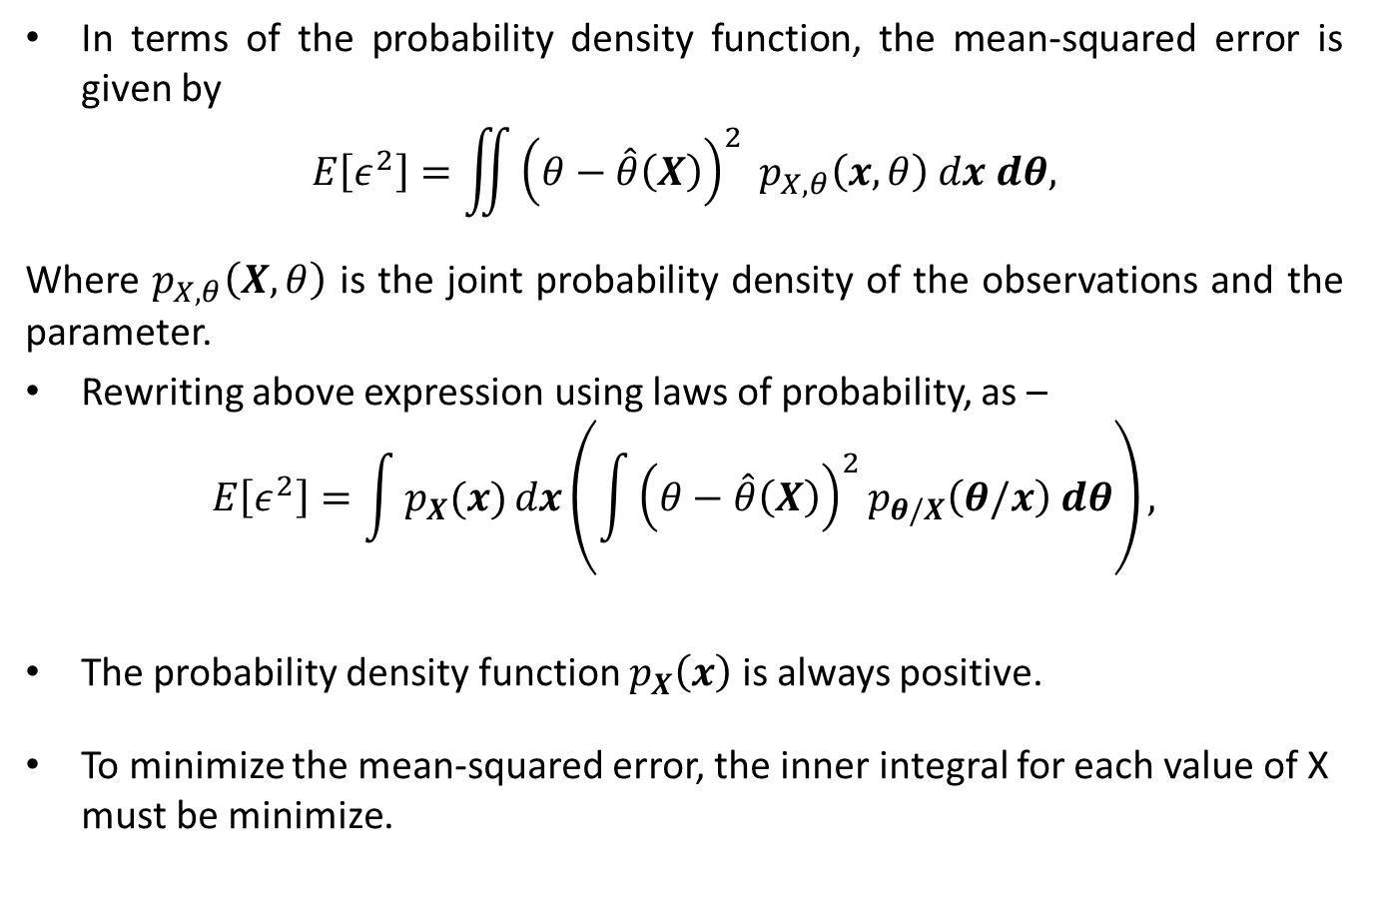
Minimum Mean-Squared Error Estimators
In terms of the probability density function, the mean-squared error is given by
$$E\left[ε^{2}\right]=\iint{{\left(θ−\hat{θ}\left(X\right)\right)}^{2}} p_{X,θ}\left(x,θ\right) dx dθ,$$
Where $p_{X,θ}\left(X,θ\right)$ is the joint probability density of the observations and the parameter.
Rewriting above expression using laws of probability, as –
$$E\left[ε^{2}\right]=\int{p_{X}(x)}dx\left(\int{{\left(θ−\hat{θ}\left(X\right)\right)}^{2}p_{θ/X}\left(θ/x\right) dθ}\right),$$
The probability density function $p_{X}\left(x\right)$ is always positive.
To minimize the mean-squared error, the inner integral for each value of X must be minimize.

Slide 11
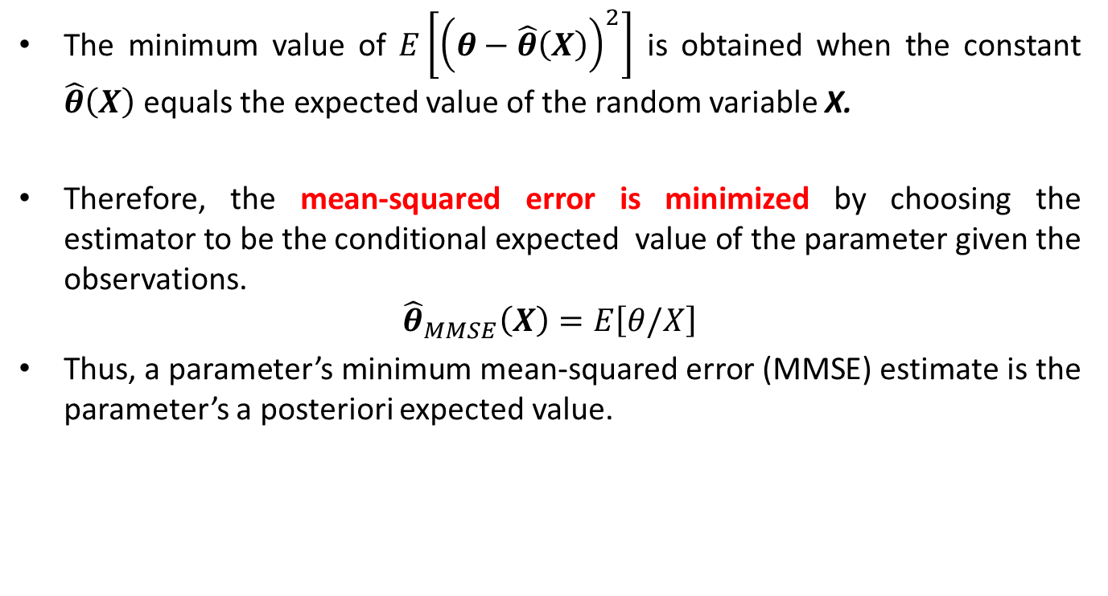
Minimum Mean-Squared Error Estimators
The minimum value of $E\left[{\left(θ−\hat{θ}\left(X\right)\right)}^{2}\right]$ is obtained when the constant $\hat{θ}\left(X\right)$ equals the expected value of the random variable X.
Therefore, the mean-squared error is minimized by choosing the estimator to be the conditional expected value of the parameter given the observations.
$${\hat{θ}}_{MMSE}\left(X\right)=E\left[θ/X\right]$$
Thus, a parameter’s minimum mean-squared error (MMSE) estimate is the parameter’s a posteriori expected value.

Slide 12
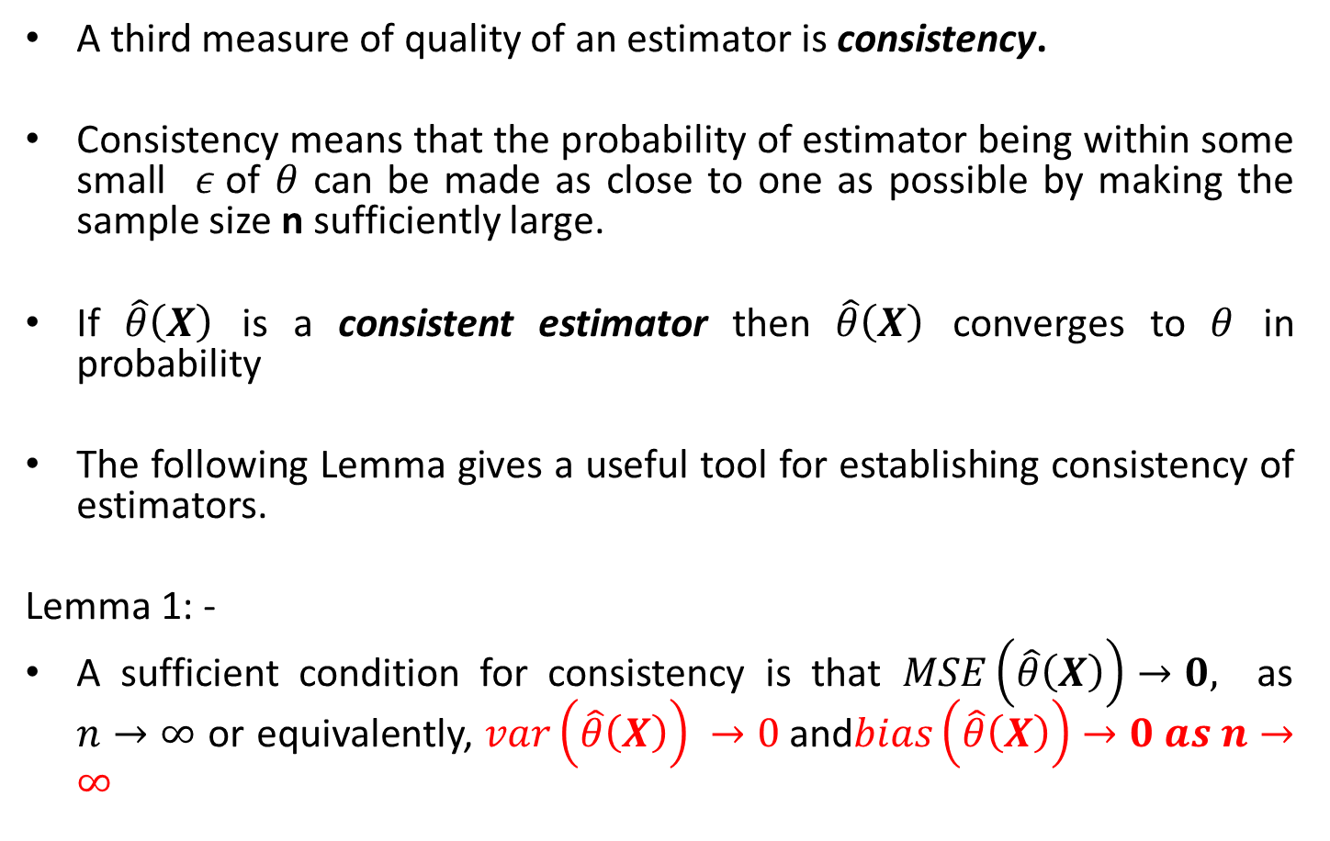
Consistency
A third measure of quality of an estimator is consistency.
Consistency means that the probability of estimator being within some small $ε$of $θ$ can be made as close to one as possible by making the sample size n sufficiently large.
If $\hat{θ}\left(X\right)$ is a consistent estimator then $\hat{θ}\left(X\right)$ converges to $θ$ in probability
The following Lemma gives a useful tool for establishing consistency of estimators.
Lemma 1: -
A sufficient condition for consistency is that $MSE\left(\hat{θ}\left(X\right)\right)→0,$ as $n→∞$ or equivalently, $var\left(\hat{θ}\left(X\right)\right) →0$and$bias\left(\hat{θ}\left(X\right)\right)→0 as n→∞$

Slide 13
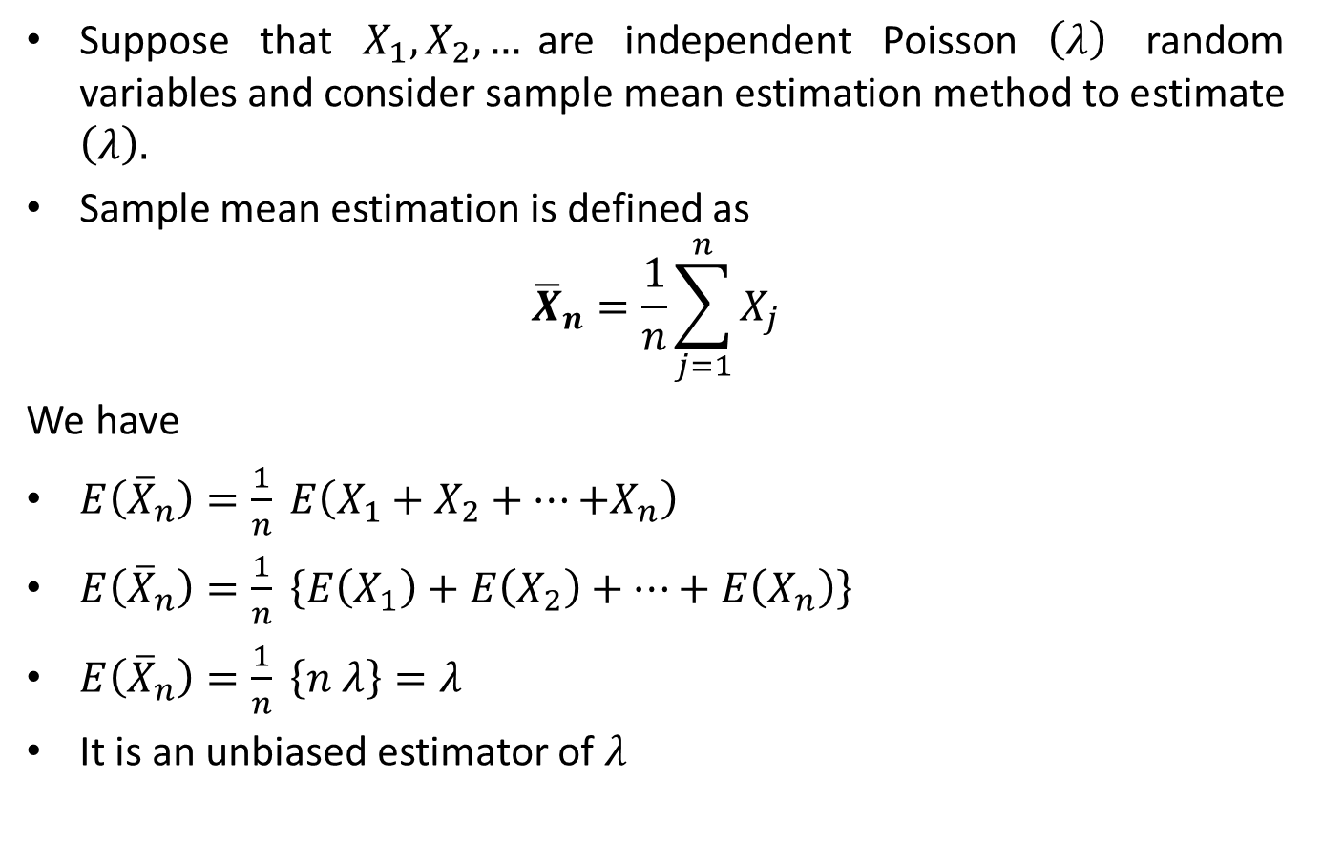
Example
Suppose that $X_{1}, X_{2},…$are independent Poisson $\left(λ\right)$ random variables and consider sample mean estimation method to estimate $\left(λ\right).$
Sample mean estimation is defined as
$${\overline{X}}_{n}=\frac{1}{n}\sum_{j=1}^{n}{X_{j}}$$
We have
$E\left({\overline{X}}_{n}\right)=\frac{1}{n} E\left(X_{1}+X_{2}+…{+X}_{n}\right)$
$E\left({\overline{X}}_{n}\right)=\frac{1}{n} \left\{E\left(X_{1}\right)+E\left(X_{2}\right)+…+E\left(X_{n}\right)\right\}$
$E\left({\overline{X}}_{n}\right)=\frac{1}{n} \left\{n λ\right\}=λ$
It is an unbiased estimator of $λ$

Slide 14
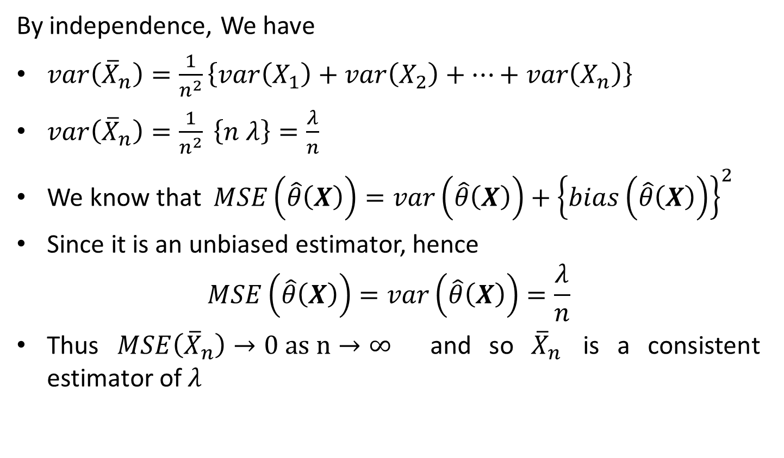
Example
By independence, We have
$var\left({\overline{X}}_{n}\right)=\frac{1}{n^{2}}\left\{var\left(X_{1}\right)+var\left(X_{2}\right)+…+var\left(X_{n}\right)\right\}$
$var\left({\overline{X}}_{n}\right)=\frac{1}{n^{2}} \left\{n λ\right\}=\frac{λ}{n}$
We know that $MSE\left(\hat{θ}\left(X\right)\right)=var\left(\hat{θ}\left(X\right)\right)+{\left\{bias\left(\hat{θ}\left(X\right)\right)\right\}}^{2}$
Since it is an unbiased estimator, hence
$$MSE\left(\hat{θ}\left(X\right)\right)=var\left(\hat{θ}\left(X\right)\right)=\frac{λ}{n}$$
Thus $MSE\left({\overline{X}}_{n}\right)→0 as n→∞$ and so ${\overline{X}}_{n}$ is a consistent estimator of $λ$

Slide 15
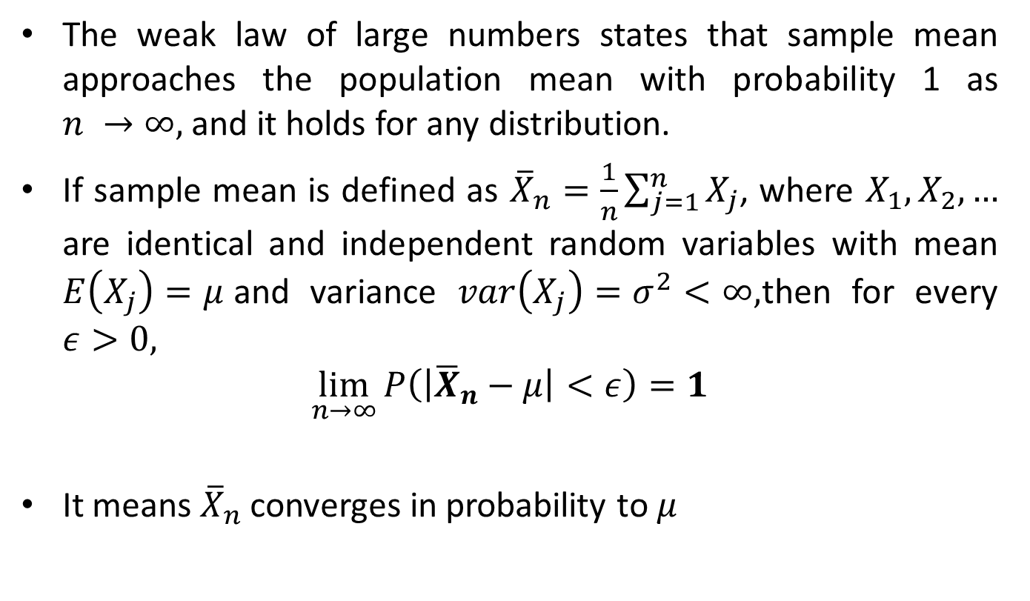
Weak Law of Large Numbers
The weak law of large numbers states that sample mean approaches the population mean with probability 1 as $n →∞,$and it holds for any distribution.
If sample mean is defined as ${\overline{X}}_{n}=\frac{1}{n}\sum_{j=1}^{n}{X_{j}}$, where $X_{1},X_{2},…$ are identical and independent random variables with mean $E\left(X_{j}\right)=μ$and variance $var\left(X_{j}\right)=σ^{2}<∞,$then for every $ε>0,$
$$\lim_{n→∞}{P\left(\left|{\overline{X}}_{n}−μ\right|<ε\right)=1}$$
It means ${\overline{X}}_{n}$ converges in probability to $μ$

Slide 16
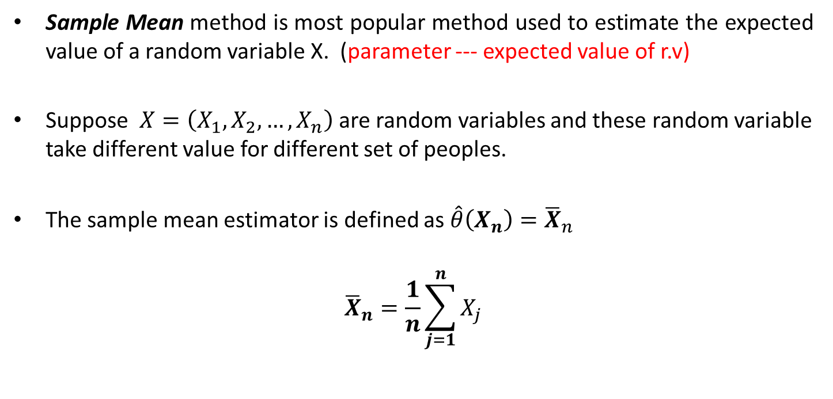
Sample Mean Estimator
Sample Mean method is most popular method used to estimate the expected value of a random variable X. (parameter --- expected value of r.v)
Suppose $X=\left(X_{1},X_{2},…,X_{n}\right)$ are random variables and these random variable take different value for different set of peoples.
The sample mean estimator is defined as $\hat{θ}\left(X_{n}\right)={\overline{X}}_{n}$
$${\overline{X}}_{n}=\frac{1}{n}\sum_{j=1}^{n}{X_{j}}$$

Slide 17
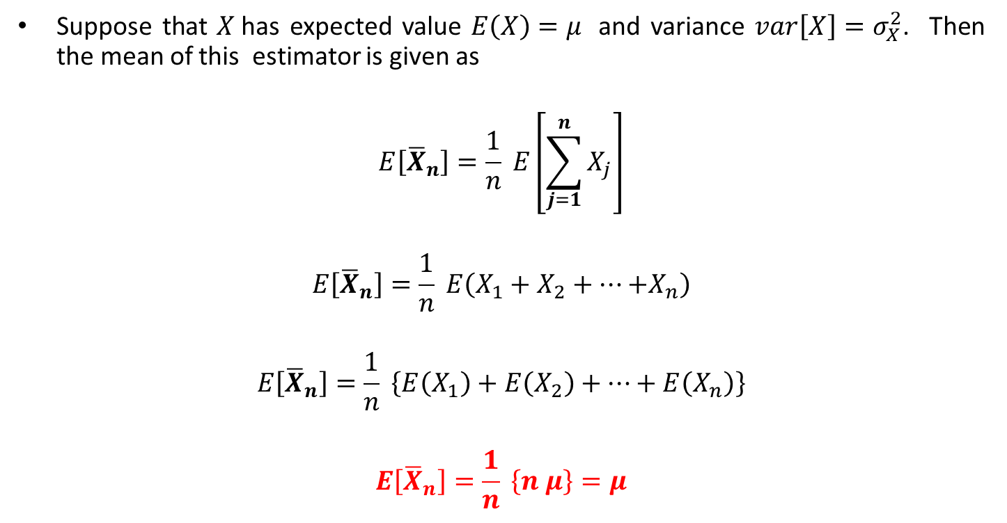
Expected Value of Sample Mean Estimator
Suppose that $X$has expected value $E\left(X\right)=μ$ and variance $var\left[X\right]=σ_{X}^{2}$. Then the mean of this estimator is given as
$$E\left[{\overline{X}}_{n}\right]=\frac{1}{n} E\left[\sum_{j=1}^{n}{X_{j}}\right]$$
$$E\left[{\overline{X}}_{n}\right]=\frac{1}{n} E\left(X_{1}+X_{2}+…{+X}_{n}\right)$$
$$E\left[{\overline{X}}_{n}\right]=\frac{1}{n} \left\{E\left(X_{1}\right)+E\left(X_{2}\right)+…+E\left(X_{n}\right)\right\}$$
$$E\left[{\overline{X}}_{n}\right]=\frac{1}{n} \left\{n μ\right\}=μ$$

Slide 18
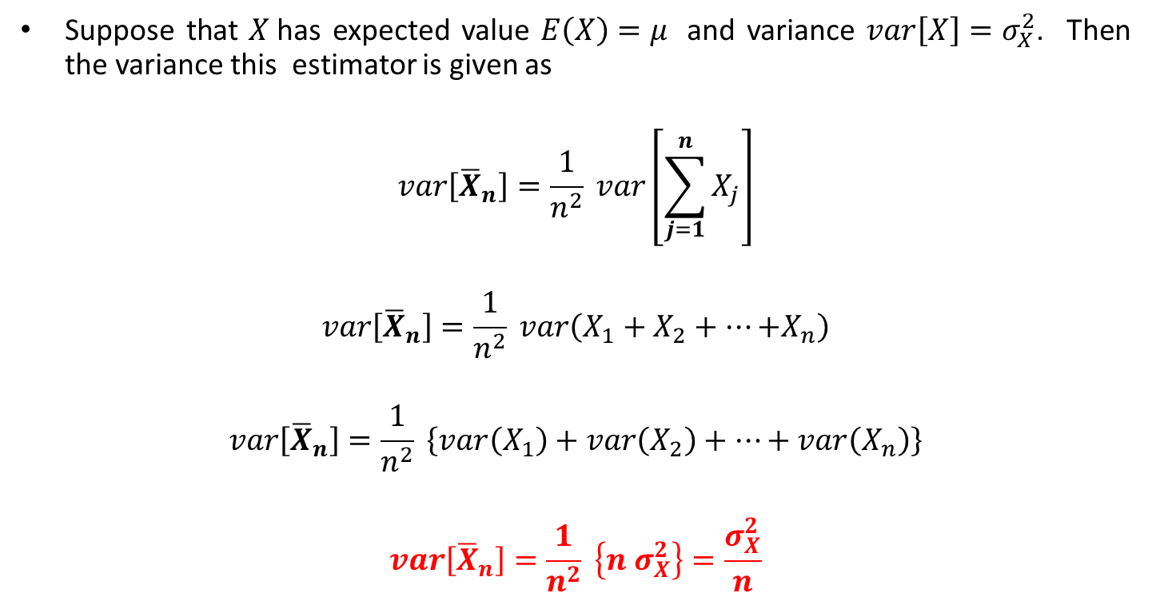
Variance of Sample Mean Estimator
Suppose that $X$has expected value $E\left(X\right)=μ$ and variance $var\left[X\right]=σ_{X}^{2}$. Then the variance this estimator is given as
$$var\left[{\overline{X}}_{n}\right]=\frac{1}{n^{2}} var\left[\sum_{j=1}^{n}{X_{j}}\right]$$
$$var\left[{\overline{X}}_{n}\right]=\frac{1}{n^{2}} var\left(X_{1}+X_{2}+…{+X}_{n}\right)$$
$$var\left[{\overline{X}}_{n}\right]=\frac{1}{n^{2}} \left\{var\left(X_{1}\right)+var\left(X_{2}\right)+…+var\left(X_{n}\right)\right\}$$
$$var\left[{\overline{X}}_{n}\right]=\frac{1}{n^{2}} \left\{n σ_{X}^{2}\right\}=\frac{σ_{X}^{2}}{n}$$

Slide 19
Reference Book
Alberto Leon-Garcia, Probability, Statistics, and Random Processes for Electrical Engineering, Third Edition, 2007, Pearson India,
Douglas C. Montgomery and George C. Runger (2010), Applied Statistics and Probability for Engineers. Fifth Edition. John Wiley & Sons.

Slide 20
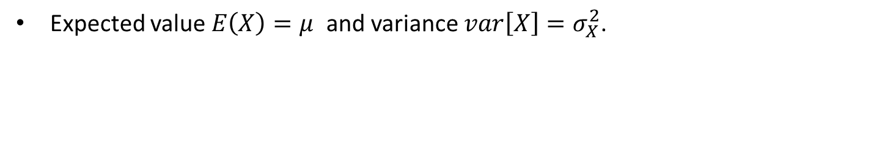
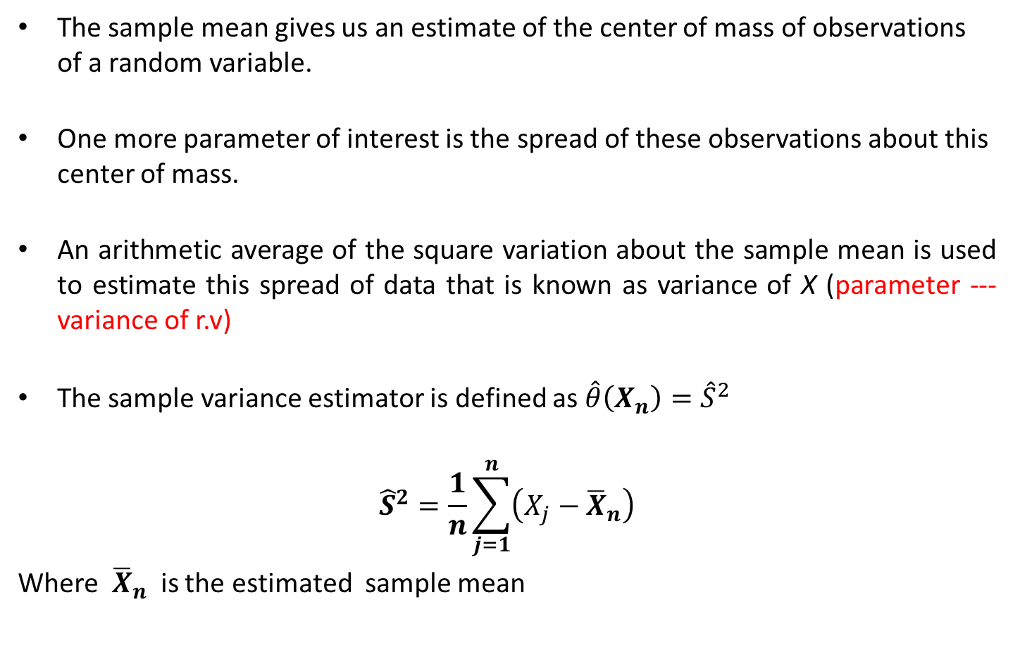
Sample Variance Estimator
The sample mean gives us an estimate of the center of mass of observations of a random variable.
One more parameter of interest is the spread of these observations about this center of mass.
An arithmetic average of the square variation about the sample mean is used to estimate this spread of data that is known as variance of X (parameter --- variance of r.v)
The sample variance estimator is defined as $\hat{θ}\left(X_{n}\right)={\hat{S}}^{2}$
$${\hat{S}}^{2}=\frac{1}{n}\sum_{j=1}^{n}{\left(X_{j}−{\overline{X}}_{n}\right)}$$
Where ${\overline{X}}_{n}$ is the estimated sample mean
Expected value $E\left(X\right)=μ$ and variance $var\left[X\right]=σ_{X}^{2}$.

Slide 21
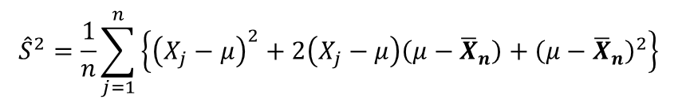
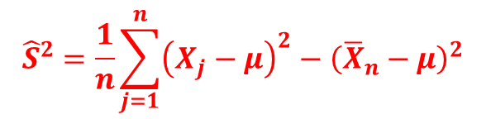
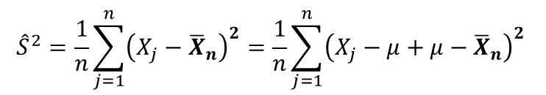
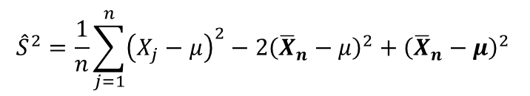
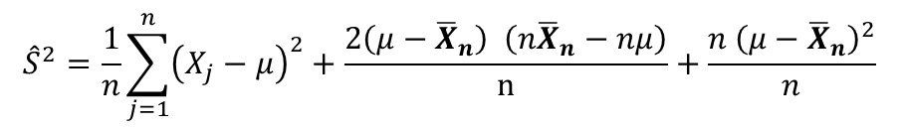
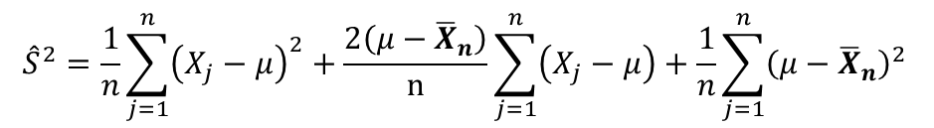
Expected Value of Sample Variance Estimator biased Estimator
$${\hat{S}}^{2}=\frac{1}{n}\sum_{j=1}^{n}{{\left(X_{j}−{\overline{X}}_{n}\right)}^{2}}=\frac{1}{n}\sum_{j=1}^{n}{{\left(X_{j}−μ+μ−{\overline{X}}_{n}\right)}^{2}}$$
$${\hat{S}}^{2}=\frac{1}{n}\sum_{j=1}^{n}{\left\{{\left(X_{j}−μ\right)}^{2}+2\left(X_{j}−μ\right)\left(μ−{\overline{X}}_{n}\right)+{\left(μ−{\overline{X}}_{n}\right)}^{2}\right\}}$$
$${\hat{S}}^{2}=\frac{1}{n}\sum_{j=1}^{n}{{\left(X_{j}−μ\right)}^{2}}+\frac{2\left(μ−{\overline{X}}_{n}\right)}{n}\sum_{j=1}^{n}{\left(X_{j}−μ\right)}+\frac{1}{n}\sum_{j=1}^{n}{{\left(μ−{\overline{X}}_{n}\right)}^{2}}$$
$${\hat{S}}^{2}=\frac{1}{n}\sum_{j=1}^{n}{{\left(X_{j}−μ\right)}^{2}}+\frac{2\left(μ−{\overline{X}}_{n}\right) \left(n{\overline{X}}_{n}−nμ\right)}{n}+\frac{n {\left(μ−{\overline{X}}_{n}\right)}^{2}}{n}$$
$${\hat{S}}^{2}=\frac{1}{n}\sum_{j=1}^{n}{{\left(X_{j}−μ\right)}^{2}}−2{\left({\overline{X}}_{n}−μ\right)}^{2}+{\left({\overline{X}}_{n}−μ\right)}^{2}$$
$${\hat{S}}^{2}=\frac{1}{n}\sum_{j=1}^{n}{{\left(X_{j}−μ\right)}^{2}}−{\left({\overline{X}}_{n}−μ\right)}^{2}$$

Slide 22
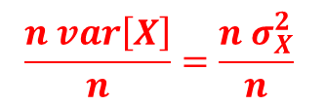
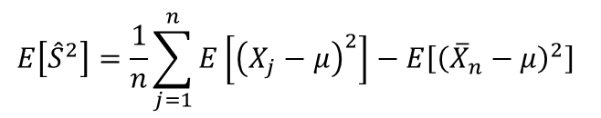
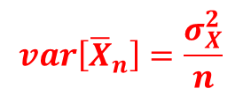
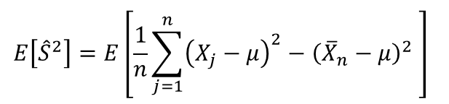
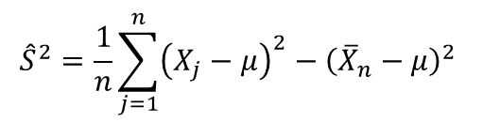
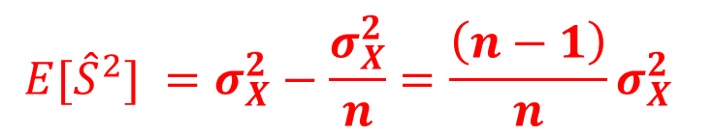
Expected Value of Sample Variance Estimator biased Estimator
Sample variance is defined as
$${\hat{S}}^{2}=\frac{1}{n}\sum_{j=1}^{n}{{\left(X_{j}−μ\right)}^{2}}−{\left({\overline{X}}_{n}−μ\right)}^{2}$$
The expected value of sample variance is given as:
$$E\left[{\hat{S}}^{2}\right]=E\left[\frac{1}{n}\sum_{j=1}^{n}{{\left(X_{j}−μ\right)}^{2}}−{\left({\overline{X}}_{n}−μ\right)}^{2} \right]$$
$$E\left[{\hat{S}}^{2}\right]=\frac{1}{n}\sum_{j=1}^{n}{E\left[{\left(X_{j}−μ\right)}^{2}\right]}−E\left[{\left({\overline{X}}_{n}−μ\right)}^{2}\right]$$
$$var\left[{\overline{X}}_{n}\right]=\frac{σ_{X}^{2}}{n}$$
$$\frac{n var\left[X\right]}{n}=\frac{{n σ}_{X}^{2}}{n}$$
$${E[\hat{S}}^{2}] =σ_{X}^{2}−\frac{σ_{X}^{2}}{n}=\frac{\left(n−1\right)}{n}σ_{X}^{2}$$

Slide 23
Sample Variance Estimator biased Estimator
Unbiased Sample variance is defined as
$${\hat{σ}}_{n}^{2}=\frac{1}{n−1}\sum_{j=1}^{n}{{\left(X_{j}−{\overline{X}}_{n}\right)}^{2}}$$

