Slide 1


Information and
Communication Theory
By
Dr. Hem Dutt Joshi
Associate Professor, ECED,
TIET, Patiala

Slide 2
Lecture-4
Introduction to Hypothesis
Module – 4
Estimation & Hypothesis Testing

Slide 3
Content of Lecture-4
Module – 4
Introduction to Hypothesis
Types of Hypothesis
  Null Hypothesis
  Alternate Hypothesis

Slide 4
Introduction
Scientific method is composed of the following key elements
An empirical approach,
Observations,
Questions,
Hypothesis,
Experiments,
Analyses,
Conclusion

Slide 5
Difference between Hypothesis and Theory
Hypothesis | Theory
A specific, testable prediction about what is expected to happen in a study | Well established principle which predicts events in general terms
Makes a specific prediction about a specified set of circumstances | Arises from repeated observation and testing
A speculative guess that has yet to be tested | Incorporates facts, laws, predictions, and tested hypothesis that are widely accepted
Is new and relatively untested | Extensively tested and is generally accepted

Slide 6
What is Hypothesis?
  Hypothesis is defined as a proposed explanation or a preliminary Postulate made on the basis of limited evidence as a starting point for further investigation.
  It can also be defined as an educated guess or a tentative point of view or a proposition which is not yet tested.
  Characteristics of a hypothesis
  Hypothesis should be
  clearly defined and precise or specific,
  capable of being tested,
  able to relate to a variable of sample space (i.e., mean, variance etc.)
  related to available techniques of research

Slide 7
Example of Hypothesis
Example of Hypothesis are:
  The mileage of Car- A is better than Car-B
  The performance of Class-A is better than B
  The new manufacturing process produce less defected peace than previous process.
  A given coin is fair.
  A new manufacturing process produces “new and improved” batteries that last longer.
  Two random noise signals have the same mean.
  The current bit received at receiver is correct one

Slide 8
Null and Alternate Hypothesis
Null Hypothesis
  The null hypothesis represent a theory that has been put forward either because it is believed to be true or because it is used as a basis for an argument and has not been proven.
  A null hypothesis H₀ is a statistical hypothesis that contains a statement of equality such as ≤, =, or ≥
Alternate Hypothesis
  The alternative hypothesis is a statement of what a statistical hypothesis test is set up to establish.
  A alternative hypothesis H₁ is the complement of the null hypothesis.
  It is a statement that must be true if H₀ is false and contains a statement of inequality such as >, ≠, or <.

Slide 9
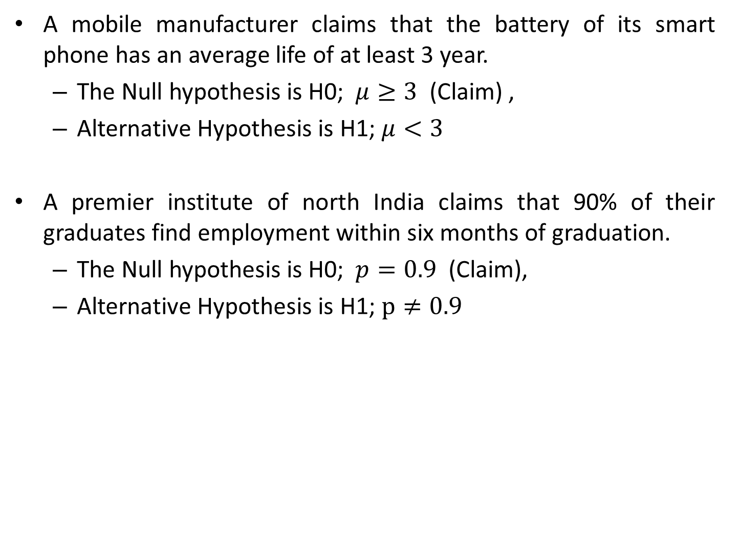
Example of Null and Alternate Hypothesis
A mobile manufacturer claims that the battery of its smart phone has an average life of at least 3 year.
  The Null hypothesis is H0; $μ≥3$ (Claim) ,
  Alternative Hypothesis is H1; $μ<3$
    A premier institute of north India claims that 90% of their graduates find employment within six months of graduation.
  The Null hypothesis is H0; $p=0.9$ (Claim),
  Alternative Hypothesis is H1; $p≠0.9$

Slide 10
Reference Book
Alberto Leon-Garcia, Probability, Statistics, and Random Processes for Electrical Engineering, Third Edition, 2007, Pearson India,
Douglas C. Montgomery and George C. Runger (2010), Applied Statistics and Probability for Engineers. Fifth Edition. John Wiley & Sons.

