Slide 1


Information and
Communication Theory
By
Dr. Hem Dutt Joshi
Associate Professor, ECED,
TIET, Patiala

Slide 2
Lecture-5
Hypothesis Testing
Module – 4
Estimation & Hypothesis Testing

Slide 3
Content of Lecture-5
Module – 4
Hypothesis Testing
Types of Error in Hypothesis Testing
Significance Testing

Slide 4
Hypothesis Testing
Hypothesis testing refers to
  Making an assumption about a population parameter (called as hypothesis)
  Collect sample data and calculate a sample statistics
  Use this sample statistic to evaluate the hypothesis (i.e., correct or wrong)

Slide 5
Steps of Hypothesis Testing
Steps of Hypothesis Testing
  Problem Definition
  Clearly state the null and alternate hypothesis
  Choose the relevant test and the appropriate probability density function
  Choose the critical vale
    Determine significance level
    Determine degree of freedom
    Decide if one or two tailed test
  Compare the test statistic and critical region
  Does the test statistic fall in the critical region?
    Yes – Reject null hypothesis
    No – Do not reject null hypothesis

Slide 6
Hypothesis Testing
Example
Hypothesis to test: A given coin is fair.
Experiment perform to test this hypothesis
  Flip or toss the coin 100 times and observe the number of heads N.
The value of N decides whether to accept or reject the hypothesis.
Divide the set of possible outcomes of the coin flips (0,1,…, 100) into two set
  Set of values for accept the hypothesis
  Set of values to reject the hypothesis.
If the coin is fair then the value of N should be equal to 50 or close to 50. (numbers close to 50 should be included in the set that accept the hypothesis)
But exactly at what values do we start rejecting the hypothesis?
There are many ways of partitioning the observation space into two regions, and clearly we need some criterion to guide us in making this choice.
Notes:
Suppose we want to test the hypothesis that a given coin is fair.

Slide 7

Error in Hypothesis Testing
Two kinds of errors can occur when executing this decision rule:
$$Type I error: Reject H_{0} when H_{0} is true.$$
$$Type II error: Accept H_{0} when H_{0} is false$$
Actual Truth of H₀
Decision of Test
H₀ is true
H₀ is false
Do not reject H₀
Correct Decision
Type II Error
Reject H₀
Type I Error
Correct Decision

Slide 8
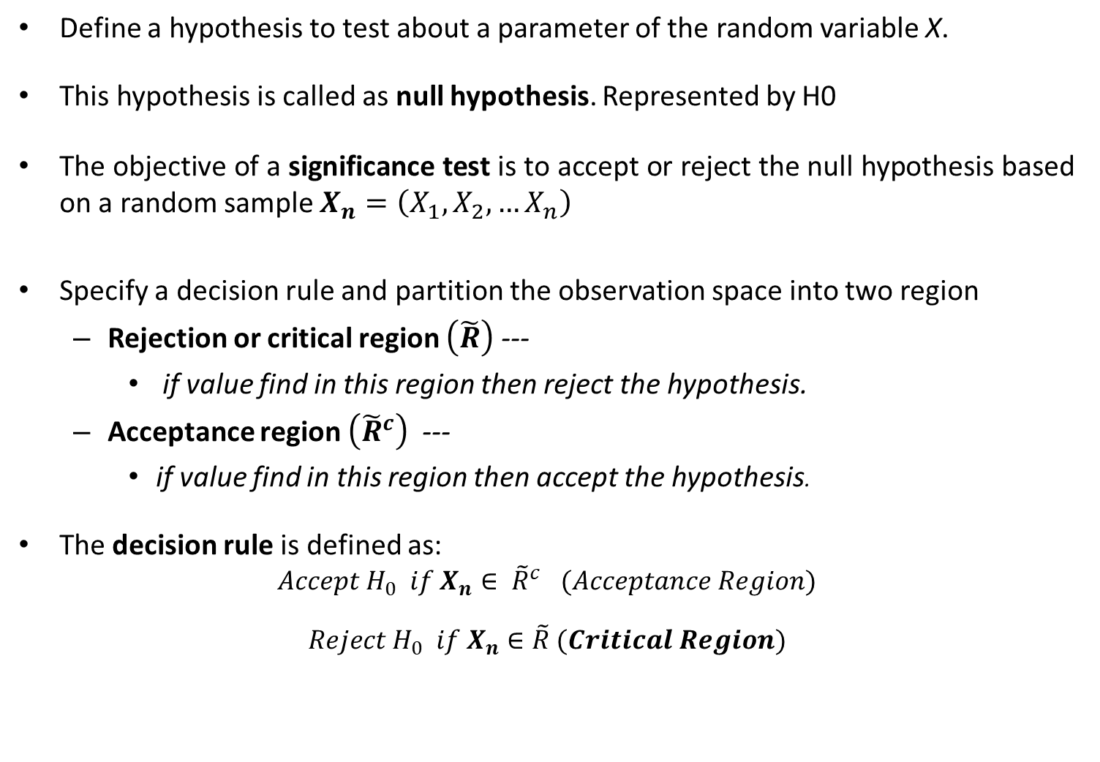
Significance Testing
Define a hypothesis to test about a parameter of the random variable X.
This hypothesis is called as null hypothesis. Represented by H0
The objective of a significance test is to accept or reject the null hypothesis based on a random sample $X_{n}=\left(X_{1},X_{2},…X_{n}\right)$
Specify a decision rule and partition the observation space into two region
  Rejection or critical region $\left(\tilde{R}\right)$ ---
    if value find in this region then reject the hypothesis.
  Acceptance region $\left({\tilde{R}}^{c}\right)$ ---
    if value find in this region then accept the hypothesis.
The decision rule is defined as:
$$Accept H_{0} if X_{n}∈ {\tilde{R}}^{c} (Acceptance Region)$$
$$Reject H_{0} if X_{n}∈\tilde{R} (Critical Region)$$

Slide 9
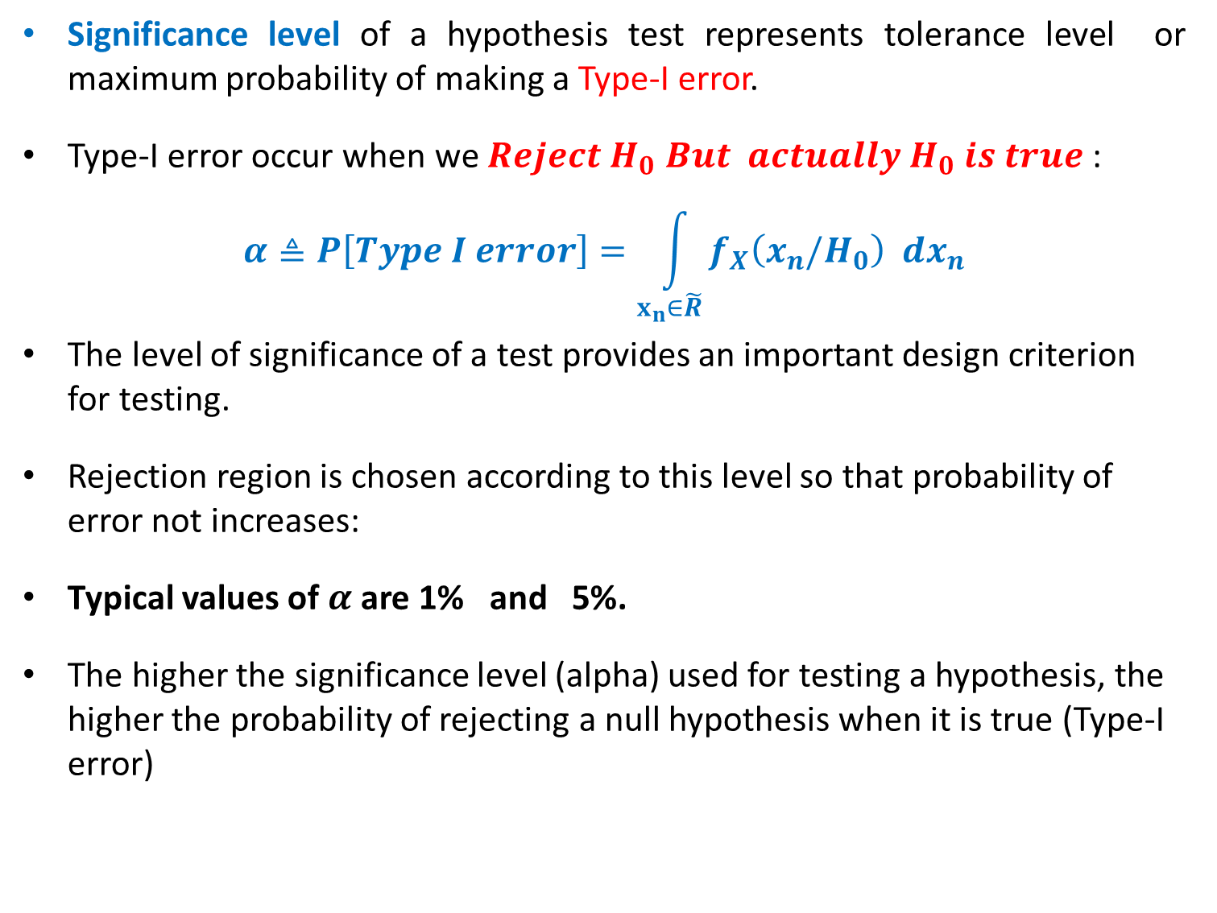
Significance Testing
Significance level of a hypothesis test represents tolerance level or maximum probability of making a Type-I error.
Type-I error occur when we $Reject H_{0} But actually H_{0} is true$:
$$α≜P\left[Type I error\right]=\int_{x_{n}∈\tilde{R}}{f_{X}\left(x_{n}/H_{0}\right) dx_{n}}$$
The level of significance of a test provides an important design criterion for testing.
Rejection region is chosen according to this level so that probability of error not increases:
Typical values of $α$are 1% and 5%.
The higher the significance level (alpha) used for testing a hypothesis, the higher the probability of rejecting a null hypothesis when it is true (Type-I error)

Slide 10
Test Statistic
After stating the null and alternative hypotheses and specifying the level of significance, a random sample is taken from the population and sample statistics are calculated.
The statistic that is compared with the parameter in the null hypothesis is called the test statistic.
Population parameter
Test statistic
Standardized test statistic
μ
z (n ≥ 30)
t (n < 30)
p
z
σ²
s²
X²

Slide 11
Reference Book
Alberto Leon-Garcia, Probability, Statistics, and Random Processes for Electrical Engineering, Third Edition, 2007, Pearson India,
Douglas C. Montgomery and George C. Runger (2010), Applied Statistics and Probability for Engineers. Fifth Edition. John Wiley & Sons.

