Slide 1


Information and
Communication Theory
By
Dr. Hem Dutt Joshi
Associate Professor, ECED,
TIET, Patiala

Slide 2
Lecture-6
One-Tailed and Two-Tailed Test
Module – 4
Estimation & Hypothesis Testing

Slide 3
Content of Lecture-6
Module – 4
P-value approach of Hypothesis Testing
One sided and Two sided test
Steps for Hypothesis Testing using significance level & p-value

Slide 4
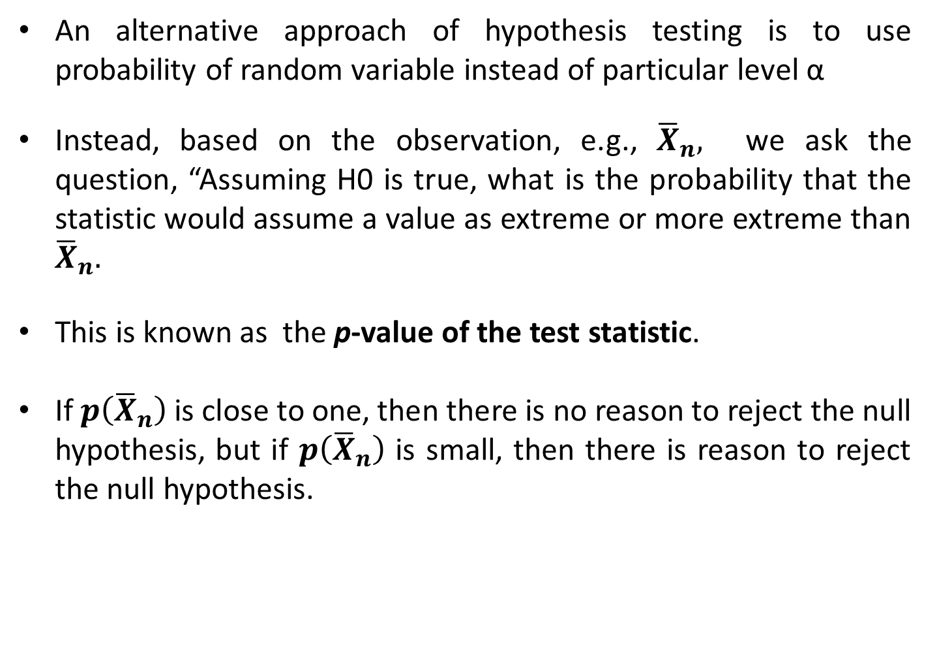
The Probability Values (p-values) Approach of hypothesis testing
An alternative approach of hypothesis testing is to use probability of random variable instead of particular level α
Instead, based on the observation, e.g., ${\overline{X}}_{n},$ we ask the question, “Assuming H0 is true, what is the probability that the statistic would assume a value as extreme or more extreme than ${\overline{X}}_{n}.$
This is known as the p-value of the test statistic.
If $p\left({\overline{X}}_{n}\right)$ is close to one, then there is no reason to reject the null hypothesis, but if $p\left({\overline{X}}_{n}\right)$ is small, then there is reason to reject the null hypothesis.

Slide 5
The Probability Values (p-values) Approach of hypothesis testing
p-value is used to determine “how unlikely is the result that has been observed?”
p-value is sensitive to sample size. A large sample should yield a low p-value
Decision Rule:
If p ≤ α, then reject H₀,
If p > α, then Accept H₀.

Slide 6
Types of Hypothesis Test
The type of test depends on the region of the sampling distribution that favors a rejection of H₀.
This region is indicated by the alternative hypothesis.
Therefore, on the basis of sampling distribution, two types of hypothesis tests can be defined:
  One-tailed or One-sided test
  Two-tailed or Two- sided test.

Slide 7
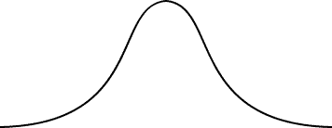
One-tailed or one-sided Test
A one sided test is a statistical hypothesis test in which the values for which we can reject the null hypothesis (Ho) are located entirely in one tail of the probability distribution function
The critical region for a one-sided test is the set of values which are either less or greater than the critical value of the test
The rejection region lies only in one tail.
z
3
2
1
0
1
2
3
z
3
2
1
0
1
2
3

Slide 8
Left-tailed Test
If the alternative hypothesis contains the less-than inequality symbol (<),
the hypothesis test is a left-tailed test. H0: μ ≥ k, H1: μ < k
Test statistic
P is the area to the left of the test statistic.
z
-3
-2
-1
0
1
2
3
Right-tailed Test
If the alternative hypothesis contains the greater-than symbol (>),
the hypothesis test is a right-tailed test. H0: μ ≤ k, H1: μ > k
Test statistic
P is the area to the right of the test statistic.
z
-3
-2
-1
0
1
2
3

Slide 9
Two-tailed or Two-sided Test
A two sided test is a statistical hypothesis test in which the values for which we can reject the null hypothesis (Ho) are located in both side or both tail of the probability distribution function
For two-sided test, acceptance region lies between two critical values.
If the alternative hypothesis contains the not-equal-to symbol (≠), the hypothesis test is a two-tailed test. In a two-tailed test, each tail has an area of p/2. H₀: μ = k, H₁: μ ≠ k
Test statistic
Test statistic
z
-3
-2
-1
0
1
2
3

Slide 10

Example of test
Right-tailed test
One private company survey claims that less than one-fourth of the Indian adult population are suffering from obesity but in realty it looks that this claim is wrong and more peoples are suffering from obesity.
H0: $μ≤0.25$ (Claim) --- Null Hypothesis
H1: $μ>0.25$ ---- Alternate Hypothesis
z
-3
-2
-1
0
1
2
3

Slide 11

Example of test
Left-tailed test
A mobile manufacturer claims that the battery of its smart phone has an average life of at least 3 year.
H0: $μ≥3$ (Claim) --- Null Hypothesis
H1: $μ<$3 ---- Alternate Hypothesis
z
3
2
1
0
1
2
3

Slide 12

Example of test
Two-tailed test
A local mobile company claims that the average data downloaded by a user is 1.5 Gb per day
H0: $μ=1.5$ (Claim) --- Null Hypothesis
H1: $μ≠$ 1.5 ---- Alternate Hypothesis
z
-3
-2
-1
0
1
2
3

Slide 13
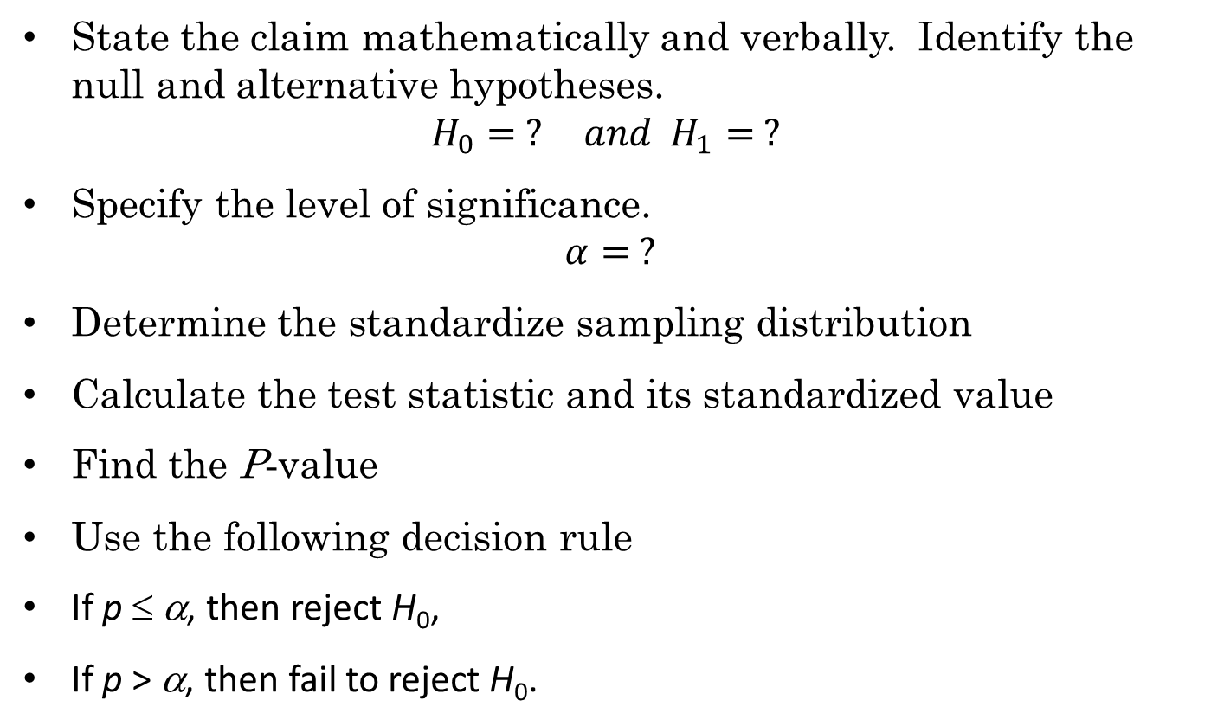
Steps for Hypothesis Testing using significance level & p-value
State the claim mathematically and verbally. Identify the null and alternative hypotheses.
$$H_{0}= ? and H_{1}= ?$$
Specify the level of significance.
$$α= ?$$
Determine the standardize sampling distribution
Calculate the test statistic and its standardized value
Find the P-value
Use the following decision rule
If p ≤ α, then reject H₀,
If p > α, then fail to reject H₀.
0
z
0
z
Test statistic

Slide 14
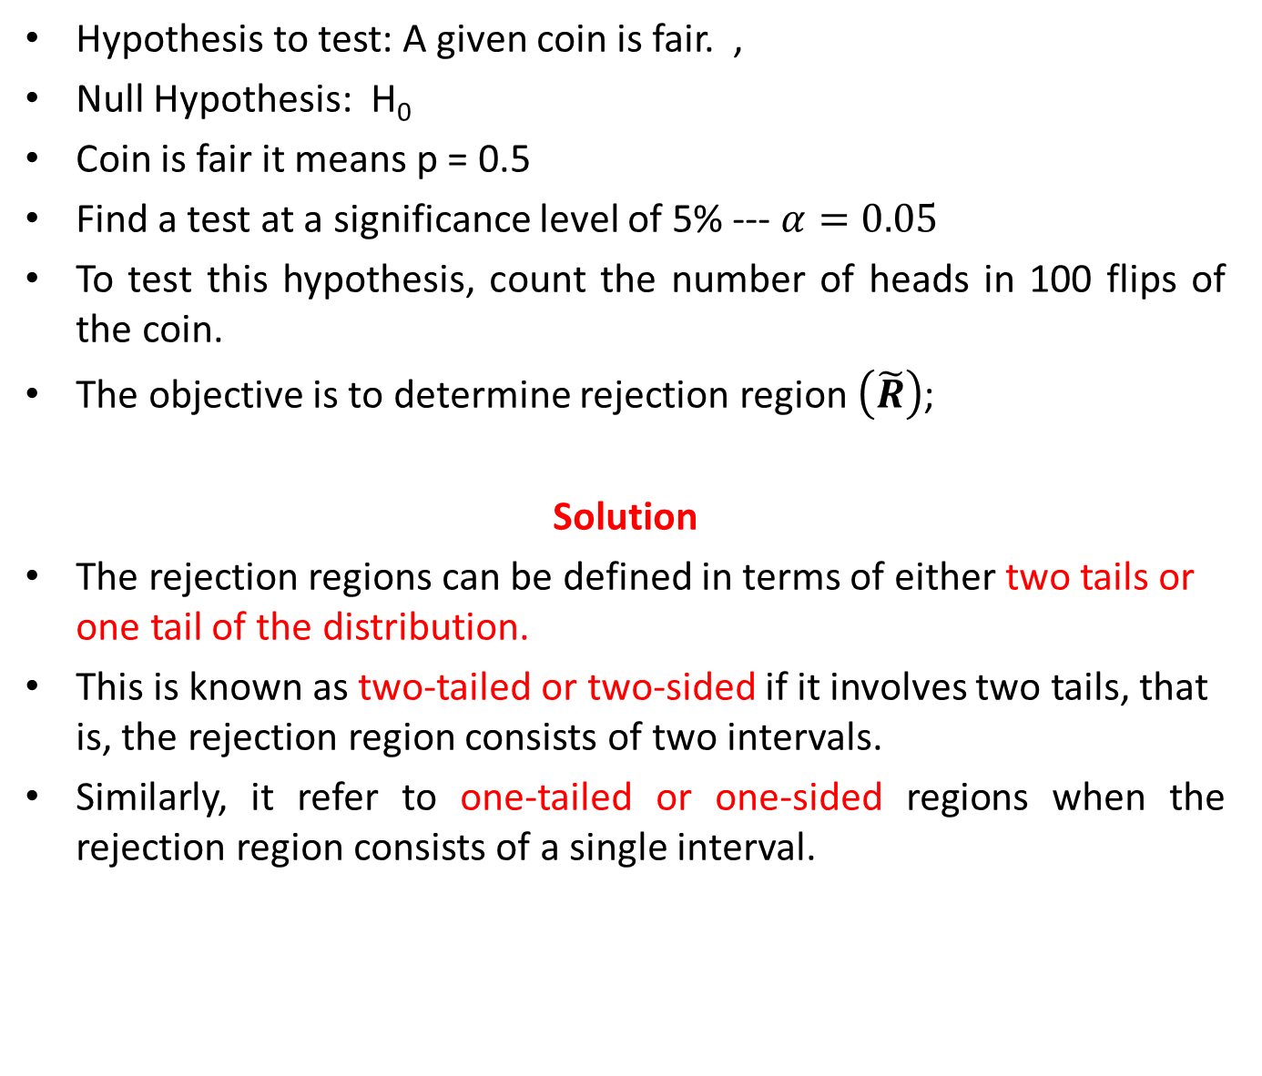
Example
Hypothesis to test: A given coin is fair. ,
Null Hypothesis: H₀
Coin is fair it means p = 0.5
Find a test at a significance level of 5% --- $α=0.05$
To test this hypothesis, count the number of heads in 100 flips of the coin.
The objective is to determine rejection region $\left(\tilde{R}\right)$;
Solution
The rejection regions can be defined in terms of either two tails or one tail of the distribution.
This is known as two-tailed or two-sided if it involves two tails, that is, the rejection region consists of two intervals.
Similarly, it refer to one-tailed or one-sided regions when the rejection region consists of a single interval.

Slide 15

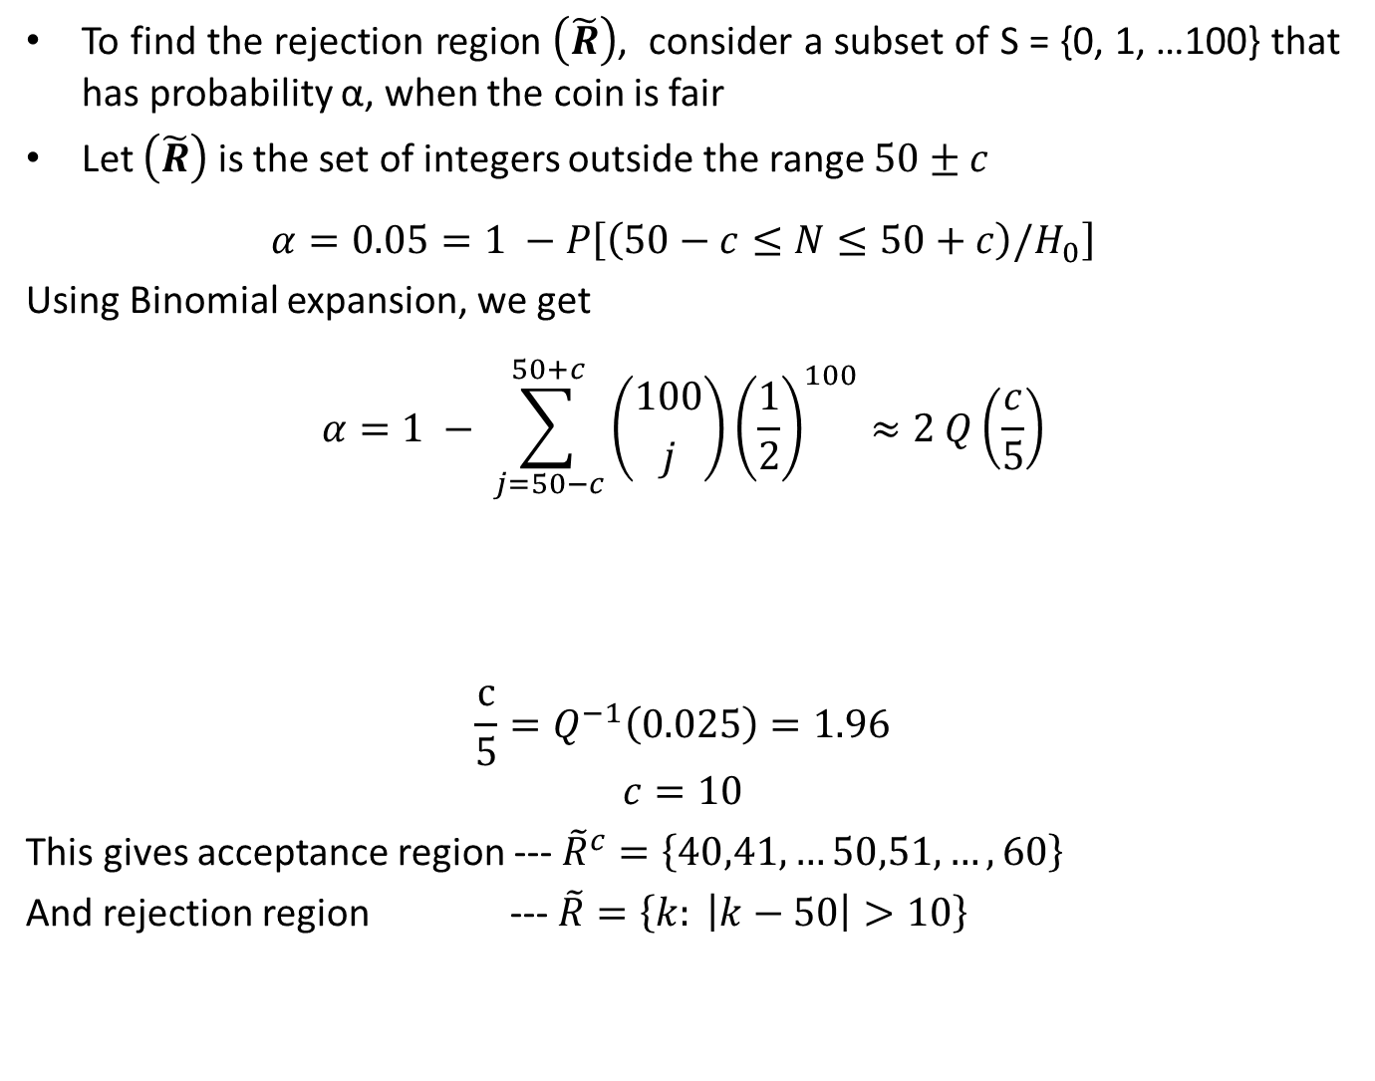
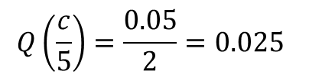

two-tailed or two-sided Test
To find the rejection region $\left(\tilde{R}\right)$, consider a subset of S = {0, 1, …100} that has probability α, when the coin is fair
Let $\left(\tilde{R}\right)$ is the set of integers outside the range $50±c$
$$α=0.05=1 −P\left[\left(50−c≤N≤50+c\right)/H_{0}\right]$$
Using Binomial expansion, we get
$$α=1 − \sum_{j=50−c}^{50+c}{\left({100 \atop j}\right){\left(\frac{1}{2}\right)}^{100}≈2 Q\left(\frac{c}{5}\right)}$$
$$\frac{c}{5}=Q^{−1}\left(0.025\right)=1.96$$
$$c=10$$
This gives acceptance region --- ${\tilde{R}}^{c}=\left\{40,41,…50,51,…,60\right\}$
And rejection region --- $\tilde{R}=\left\{k: \left|k−50\right|>10\right\}$
Substitute $α=0.05$
$$2 Q\left(\frac{c}{5}\right)=0.05$$
$$Q\left(\frac{c}{5}\right)=\frac{0.05}{2}=0.025$$

Slide 16
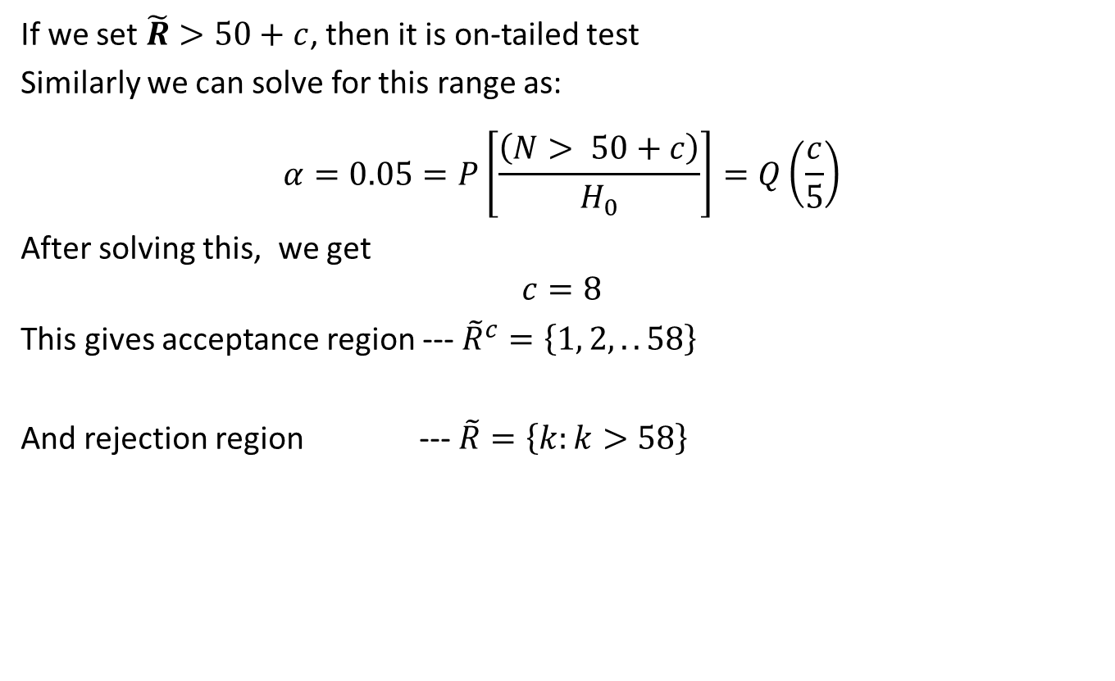
one-tailed or one-sided Test
If we set $\tilde{R}>50+c$, then it is on-tailed test
Similarly we can solve for this range as:
$$α=0.05=P\left[\frac{\left(N> 50+c\right)}{H_{0}}\right]=Q\left(\frac{c}{5}\right)$$
After solving this, we get
$$c=8$$
This gives acceptance region --- ${\tilde{R}}^{c}=\left\{1, 2,..58\right\}$
And rejection region --- $\tilde{R}=\left\{k:k>58\right\}$

Slide 17
Reference Book
Alberto Leon-Garcia, Probability, Statistics, and Random Processes for Electrical Engineering, Third Edition, 2007, Pearson India,
Douglas C. Montgomery and George C. Runger (2010), Applied Statistics and Probability for Engineers. Fifth Edition. John Wiley & Sons.

