Slide 1


Information and
Communication Theory
By
Dr. Hem Dutt Joshi
Associate Professor, ECED,
TIET, Patiala

Slide 2
Lecture-7 z and t-test
Module – 4
Estimation & Hypothesis Testing

Slide 3
Content of Lecture-7
Module – 4
Z- test
  One Sample
  Two sample
T-test
  One Sample
  Two Sample
Radar Detection Problem

Slide 4
Z-test
Z-test is a statistical procedure used to test an alternative hypothesis against a null hypothesis
Z-test is used to determine whether two samples means are different when
population variances (standard deviation) are known
Samples are independent
Samples are large in size (n>=30)

Slide 5
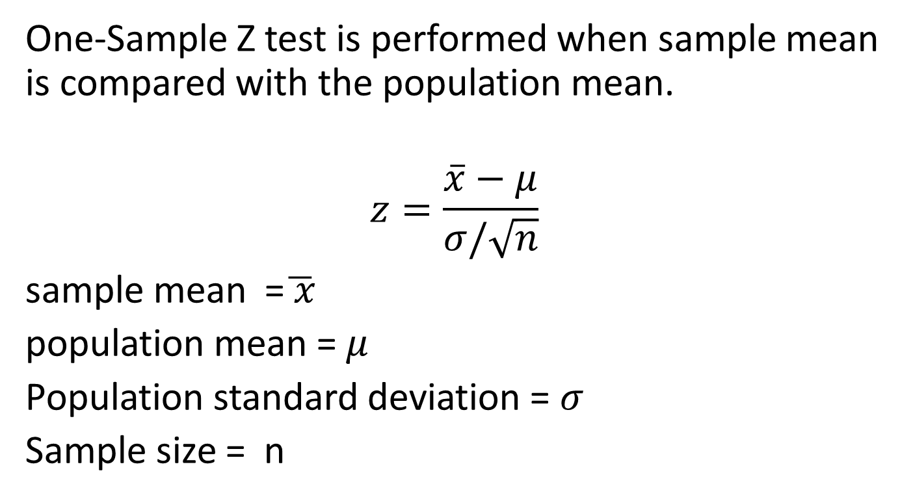
One-Sample
Z test
One-Sample Z test is performed when sample mean is compared with the population mean.
$$z=\frac{\overline{x}−μ}{σ/\sqrt{n}}$$
sample mean =$\overline{ x}$
population mean = $μ$
Population standard deviation = $σ$
Sample size = n

Slide 6
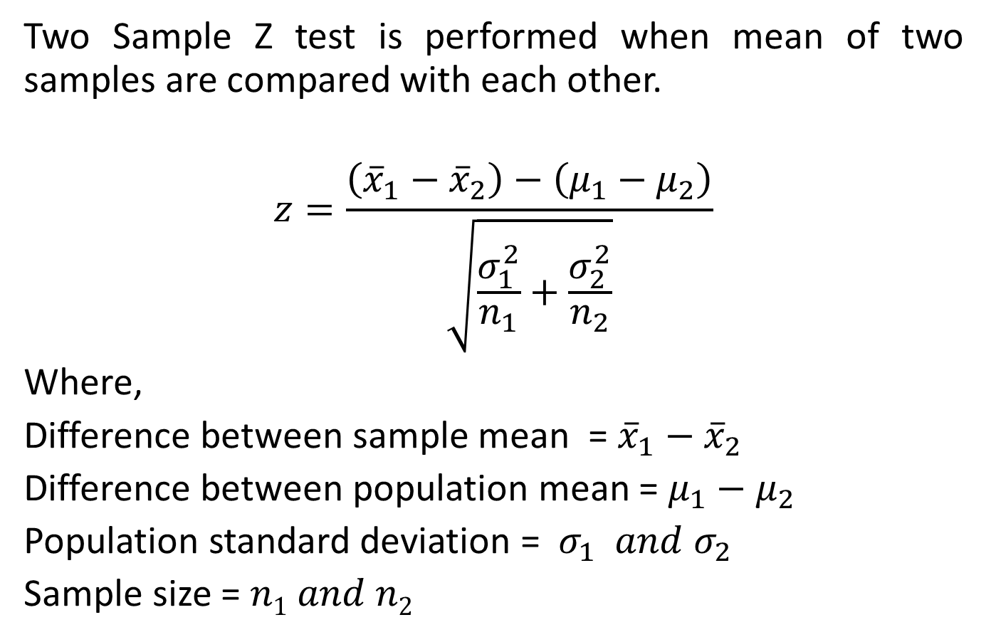
Two-Sample
Z test
Two Sample Z test is performed when mean of two samples are compared with each other.
$$z=\frac{\left({\overline{x}}_{1}−{\overline{x}}_{2}\right)−\left(μ_{1}−μ_{2}\right)}{\sqrt{\frac{σ_{1}^{2}}{n_{1}}+\frac{σ_{2}^{2}}{n_{2}}}}$$
Where,
Difference between sample mean = ${\overline{x}}_{1}−{\overline{x}}_{2}$
Difference between population mean = $μ_{1}−μ_{2}$
Population standard deviation = $σ_{1} and σ_{2}$
Sample size = $n1 and n2$

Slide 7
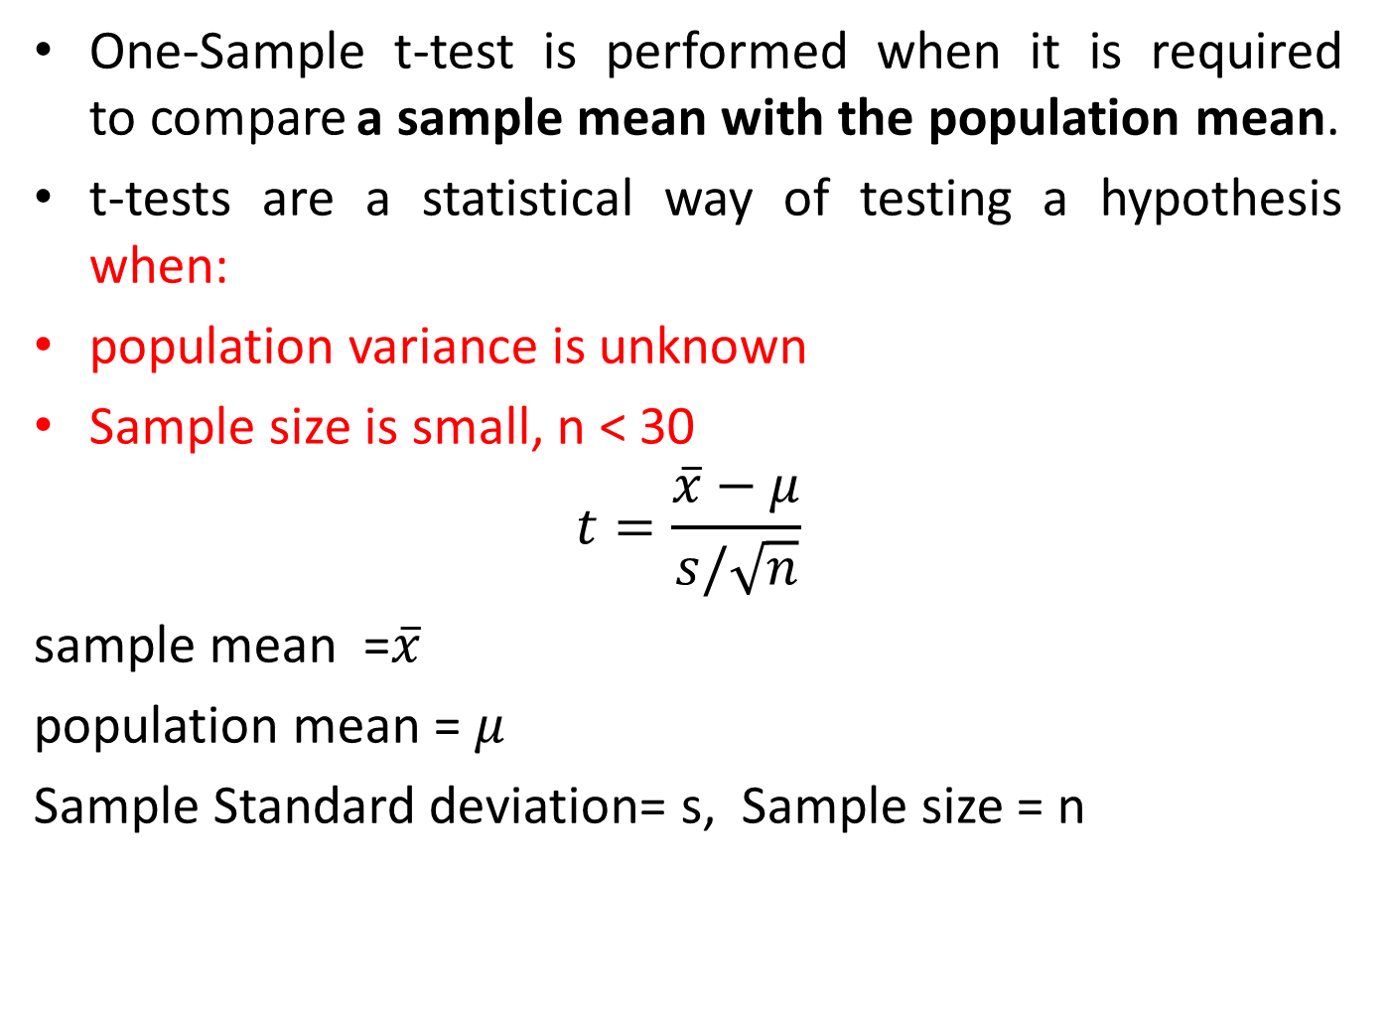
One Sample t-test
One-Sample t-test is performed when it is required to compare a sample mean with the population mean.
t-tests are a statistical way of testing a hypothesis when:
population variance is unknown
Sample size is small, n < 30
$$t=\frac{\overline{x}−μ}{s/\sqrt{n}}$$
sample mean =$\overline{x}$
population mean = $μ$
Sample Standard deviation= s, Sample size = n

Slide 8
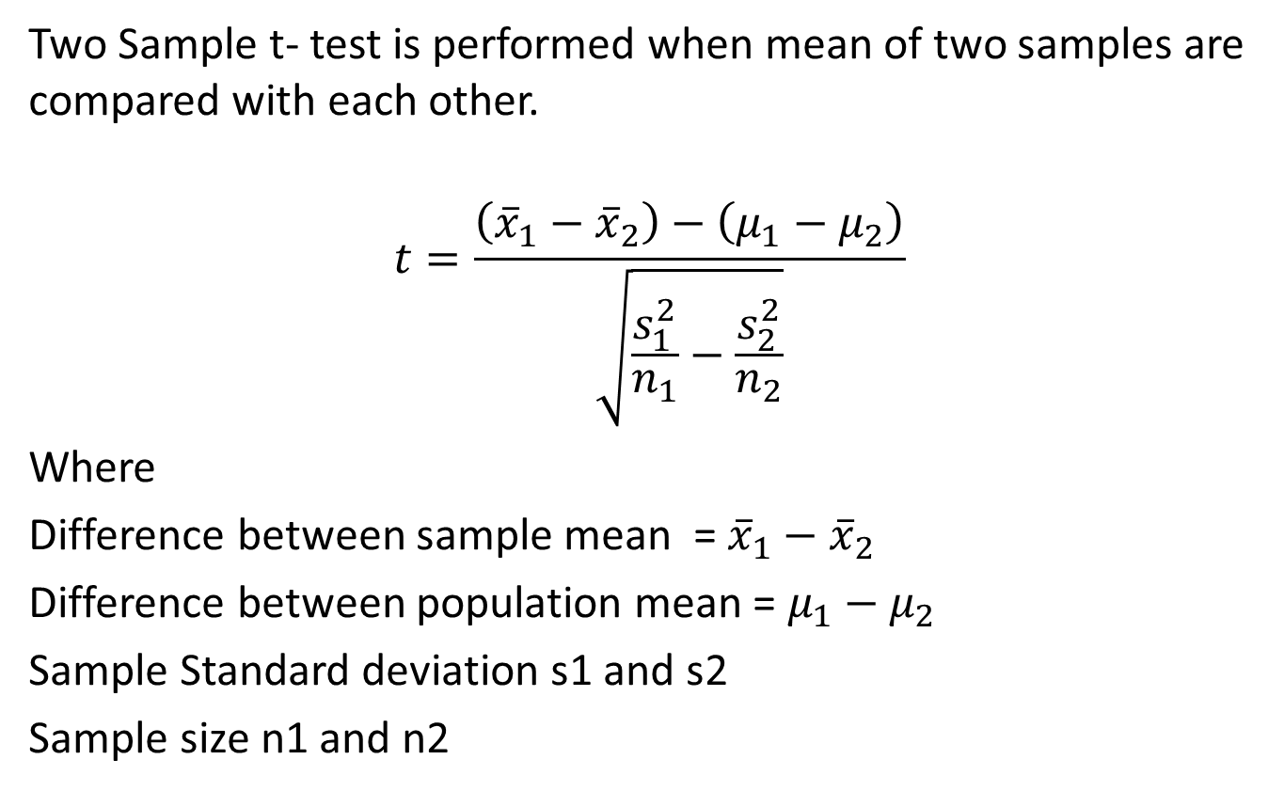
Two-Sample t-Test
Two Sample t- test is performed when mean of two samples are compared with each other.
$$t=\frac{\left({\overline{x}}_{1}−{\overline{x}}_{2}\right)−\left(μ_{1}−μ_{2}\right)}{\sqrt{\frac{s_{1}^{2}}{n_{1}}−\frac{s_{2}^{2}}{n_{2}}}}$$
Where
Difference between sample mean = ${\overline{x}}_{1}−{\overline{x}}_{2}$
Difference between population mean = $μ_{1}−μ_{2}$
Sample Standard deviation s1 and s2
Sample size n1 and n2

Slide 9
Comparison of z and t test
Sample Size > 30
Yes
No
z-test
or
t-test
Unknown
Population Variance
Known
t-test
z-test
If the sample size is large enough, then the z test and t-Test will conclude with the same results.
For a large sample size, Sample Variance will be a better estimate of Population variance so even if population variance is unknown, Z-test can be used using sample variance.

Slide 10

Testing Simple Hypothesis
In binary hypothesis case, a null hypothesis H0 is tested against an alternative hypothesis H1
The outcome of the test is: accept H0 or reject H0 and accept H1
A simple hypothesis specifies the associated distribution completely.
If the distribution is not specified completely, then we say that we have a composite hypothesis.
When the alternative hypothesis is simple, we can evaluate the probability of Type II errors, that is, of accepting H0 when H1 is true

Slide 11
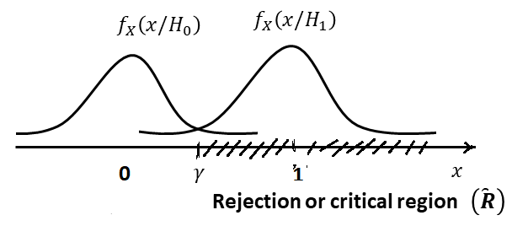
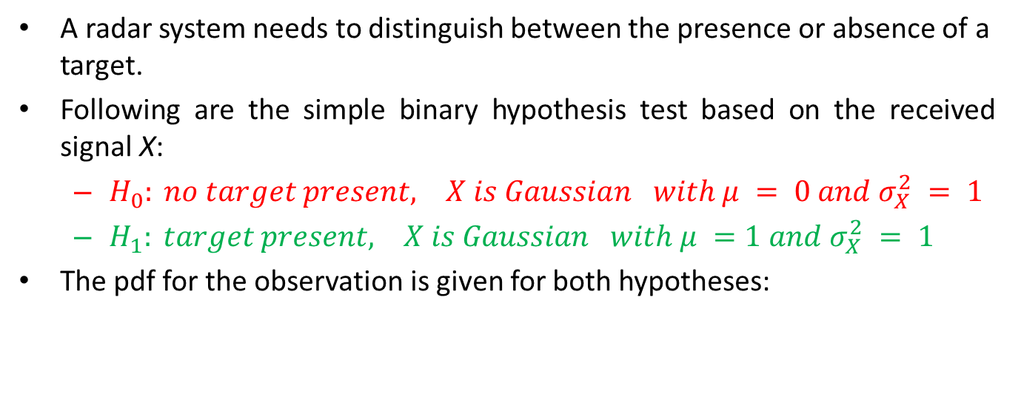
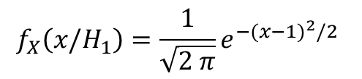
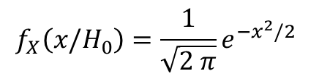
The Radar Detection Problem
A radar system needs to distinguish between the presence or absence of a target.
Following are the simple binary hypothesis test based on the received signal X:
  $H_{0}: no target present, X is Gaussian with μ = 0 and σ_{X}^{2} = 1$
  $H_{1}: target present, X is Gaussian with μ =1 and σ_{X}^{2} = 1$
The pdf for the observation is given for both hypotheses:
$$f_{X}\left(x/H_{0}\right)=\frac{1}{\sqrt{2 π}}e^{−x^{2}/2}$$
$$f_{X}\left(x/H_{1}\right)=\frac{1}{\sqrt{2 π}}e^{−{(x−1)}^{2}/2}$$

Slide 12
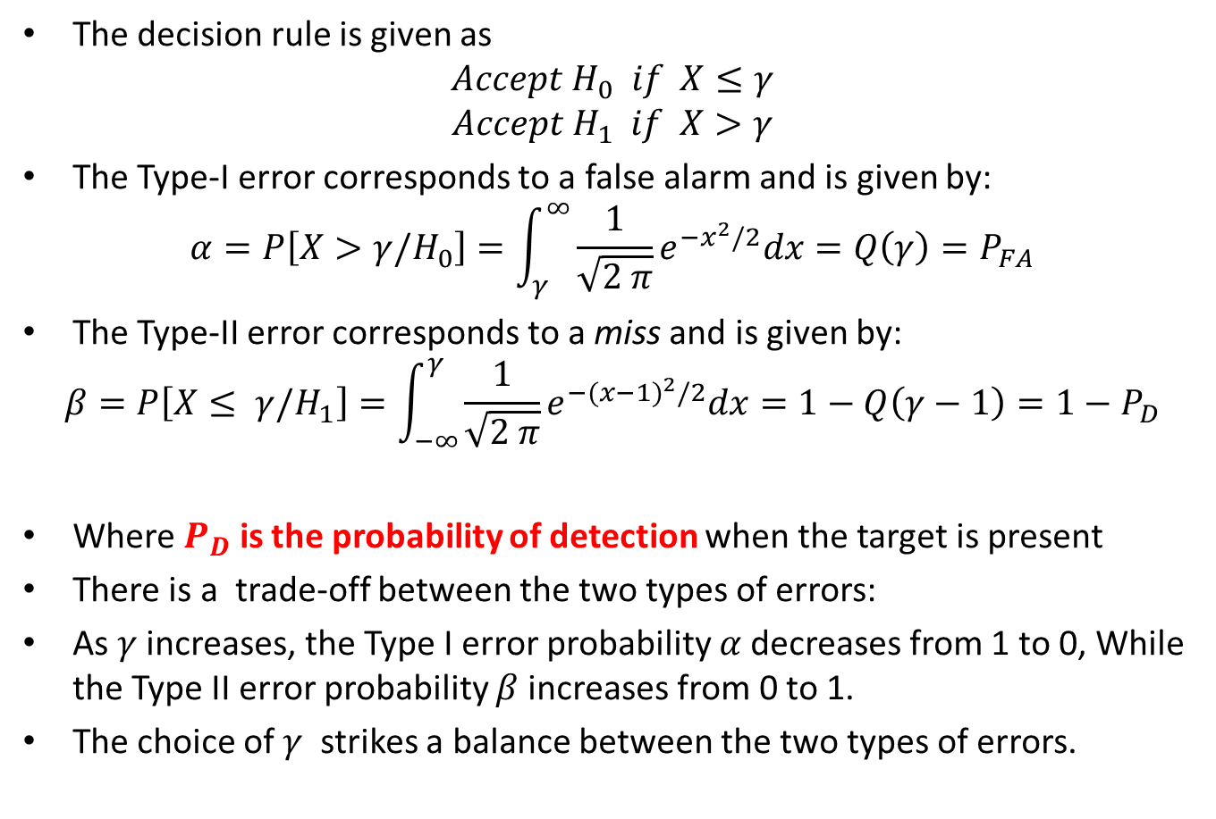
The Radar Detection Problem
The decision rule is given as
$$Accept H_{0} if X≤γ$$
$$Accept H_{1} if X>γ$$
The Type-I error corresponds to a false alarm and is given by:
$$α=P\left[X>γ/H_{0}\right]=\int_{γ}^{∞}{\frac{1}{\sqrt{2 π}}e^{−x^{2}/2}dx}=Q\left(γ\right)=P_{FA}$$
The Type-II error corresponds to a miss and is given by:
$$β=P\left[X≤ γ/H_{1}\right]=\int_{−∞}^{γ}{\frac{1}{\sqrt{2 π}}e^{−{(x−1)}^{2}/2}dx}=1−Q\left(γ−1\right)={1−P}_{D}$$
Where $P_{D}$ is the probability of detection when the target is present
There is a trade-off between the two types of errors:
As $γ$ increases, the Type I error probability $α$decreases from 1 to 0, While the Type II error probability $β$increases from 0 to 1.
The choice of $γ$ strikes a balance between the two types of errors.

Slide 13
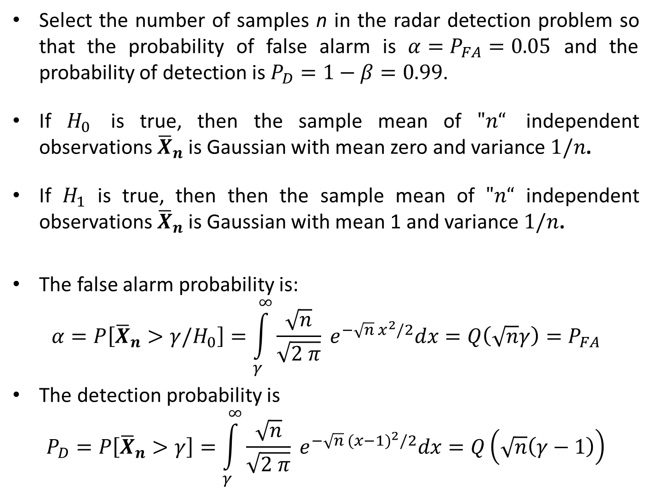
Example
Select the number of samples n in the radar detection problem so that the probability of false alarm is $α=P_{FA}=0.05$ and the probability of detection is $P_{D}=1−β=0.99$.
If $H_{0}$ is true, then the sample mean of $"n“$ independent observations ${\overline{X}}_{n}$ is Gaussian with mean zero and variance $1/n$.
If $H_{1}$ is true, then then the sample mean of $"n“$ independent observations ${\overline{X}}_{n}$ is Gaussian with mean 1 and variance $1/n$.
The false alarm probability is:
$$α=P\left[{\overline{X}}_{n}>γ/H_{0}\right]=\int_{γ}^{∞}{\frac{\sqrt{n}}{\sqrt{2 π}} e^{−\sqrt{n} x^{2}/2}dx=Q\left(\sqrt{n}γ\right)=P_{FA}}$$
The detection probability is
$$P_{D}=P\left[{\overline{X}}_{n}>γ\right]=\int_{γ}^{∞}{\frac{\sqrt{n}}{\sqrt{2 π}} e^{−\sqrt{n} {(x−1)}^{2}/2}dx=Q\left(\sqrt{n}\left(γ−1\right)\right)}$$

Slide 14

Example
Given $α= Q\left(\sqrt{n}γ\right)=P_{FA}=0.05$, this gives
$$\sqrt{n}γ=Q^{−1}\left(α\right)=Q^{−1}\left(0.05\right)=1.64$$
$$\sqrt{n}\left(γ−1\right)=Q^{−1}\left(0.99\right)=−2.33$$
This gives
$$γ=0.41 and n=16$$

Slide 15
Reference Book
Alberto Leon-Garcia, Probability, Statistics, and Random Processes for Electrical Engineering, Third Edition, 2007, Pearson India,
Douglas C. Montgomery and George C. Runger (2010), Applied Statistics and Probability for Engineers. Fifth Edition. John Wiley & Sons.

