Slide 1
Lecture-3 (Module-1)
Random Variable
RANDOM VARIABLE
DISTRIBUTION FUNCTION
PROBABILITY DENSITY FUNCTION
By
Dr. A K SINGH,
Dept. of ECE, TIET, Patiala

Slide 2
Random Variable
Random variable is a function X(ξ) assigned to every outcome ξ of an experiment.
Random variable is a function whose domain is the set Ω of experimental outcome.
Definition of Function: Given two sets of objects Ω_{α} and Ω_{β} consisting of elements α and β. Let β is a function of α if to every element of set Ω_{α} there exist an element β in the set Ω_{β}.
Ω_{α} - domain of the function
Ω_{β} - range of the function
For a given α there exist a single β(α) however, more than one element of set Ω_{α} might be paired with same β in the set Ω_{β}.

Slide 3
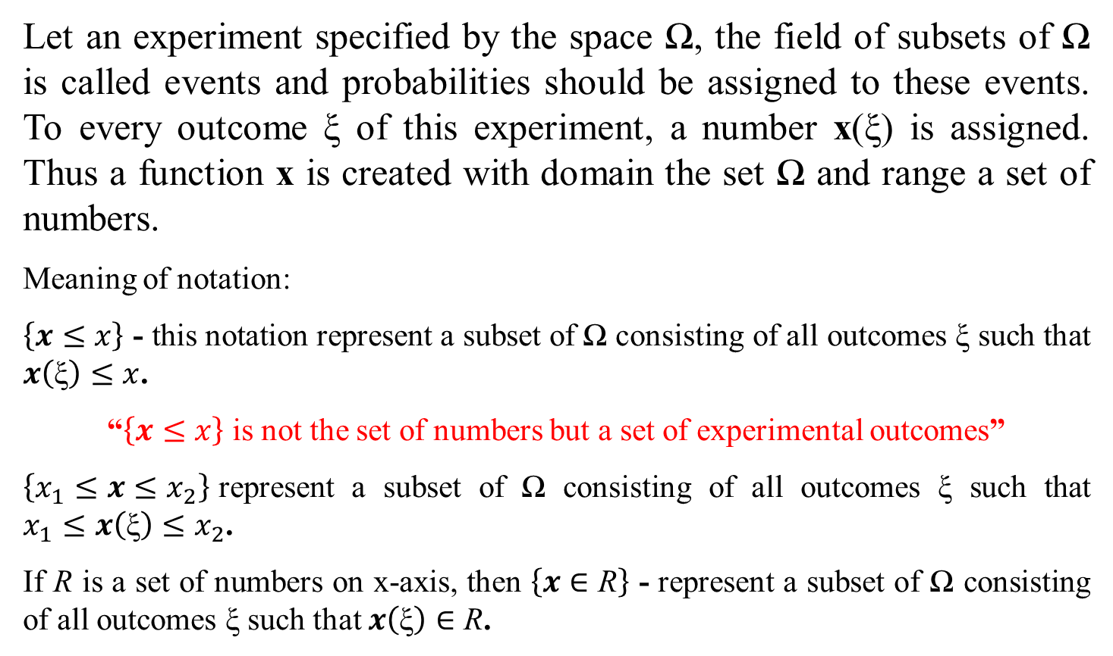
Random Variable
Let an experiment specified by the space Ω, the field of subsets of Ω is called events and probabilities should be assigned to these events. To every outcome ξ of this experiment, a number x(ξ) is assigned. Thus a function x is created with domain the set Ω and range a set of numbers.
Meaning of notation:
$\left\{x≤x\right\}$ - this notation represent a subset of Ω consisting of all outcomes ξ such that $x\left(\text{ξ}\right)≤x$.
“$\left\{x≤x\right\}$ is not the set of numbers but a set of experimental outcomes”
$\left\{x_{1}≤x≤x_{2}\right\}$represent a subset of Ω consisting of all outcomes ξ such that $x_{1}≤x\left(\text{ξ}\right)≤x_{2}$.
If R is a set of numbers on x-axis, then $\left\{x∈\text{R}\right\}$ - represent a subset of Ω consisting of all outcomes ξ such that $x\left(\text{ξ}\right)∈\text{R}$.

Slide 4
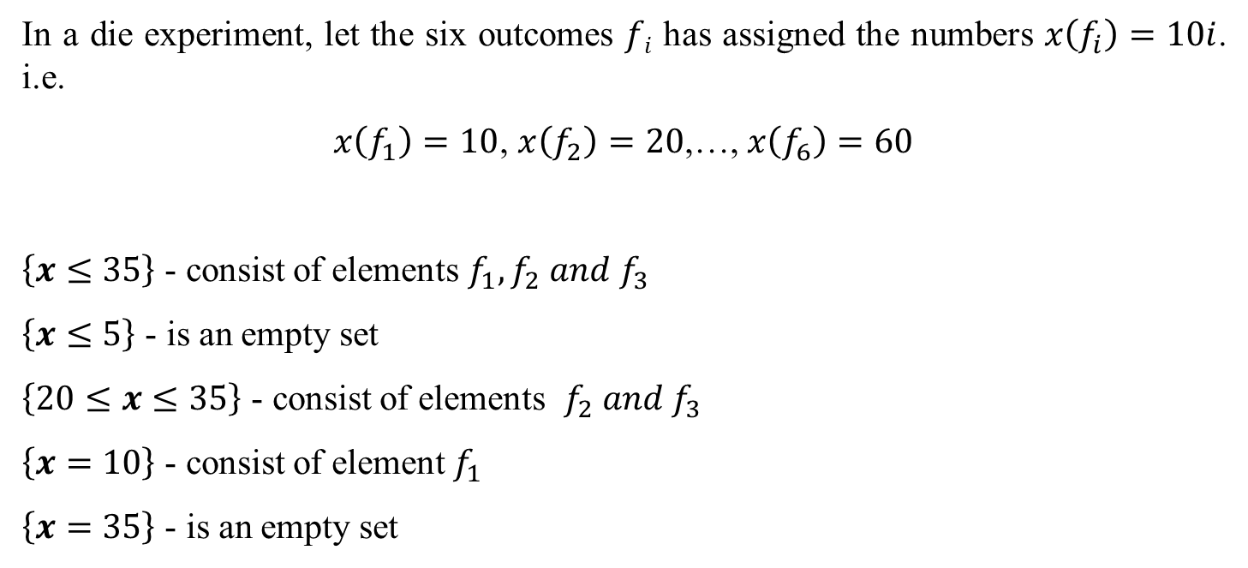
Die experiment
In a die experiment, let the six outcomes $fi$ has assigned the numbers $x\left(f_{i}\right)=10i$. i.e.
$x\left(f_{1}\right)=10$, $x\left(f_{2}\right)=20$,…, $x\left(f_{6}\right)=60$
$\left\{x≤35\right\}$ - consist of elements $f_{1}, f_{2} and f_{3}$
$\left\{x≤5\right\}$ - is an empty set
$\left\{20≤x≤35\right\}$ - consist of elements $f_{2} and f_{3}$
$\left\{x=10\right\}$ - consist of element $f_{1}$
$\left\{x=35\right\}$ - is an empty set

Slide 5
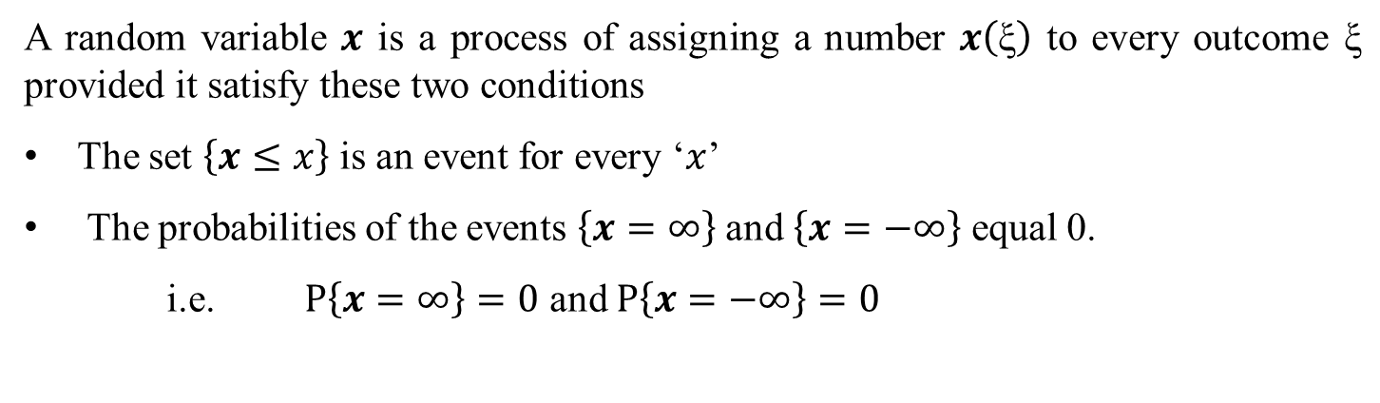
RANDOM VARIABLE_a Formal Definition
A random variable $x$ is a process of assigning a number $x\left(\text{ξ}\right)$ to every outcome $\text{ξ}$ $\text{provided} \text{it} \text{satisfy} \text{these} \text{two} \text{conditions}$
The set $\left\{x≤x\right\}$ is an event for every ‘$x$’
The probabilities of the events $\left\{x=∞\right\}$ and $\left\{x=−∞\right\}$ equal 0.
i.e. $P\left\{x=∞\right\}=0$ and $P\left\{x=−∞\right\}=0$

Slide 6
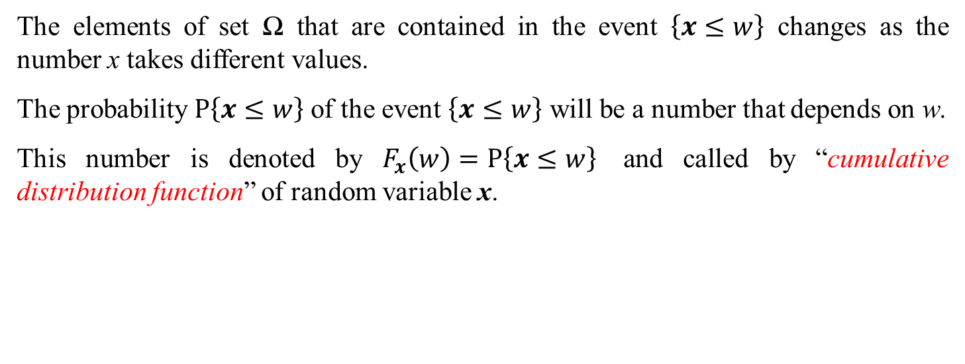
DISTRIBUTION FUNCTION
The elements of set Ω that are contained in the event $\left\{x≤w\right\}$ changes as the number x takes different values.
The probability $P\left\{x≤w\right\}$ of the event $\left\{x≤w\right\}$ will be a number that depends on w.
This number is denoted by $F_{x}\left(w\right)=P\left\{x≤w\right\}$ and called by “cumulative distribution function” of random variable x.

Slide 7
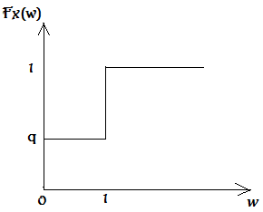
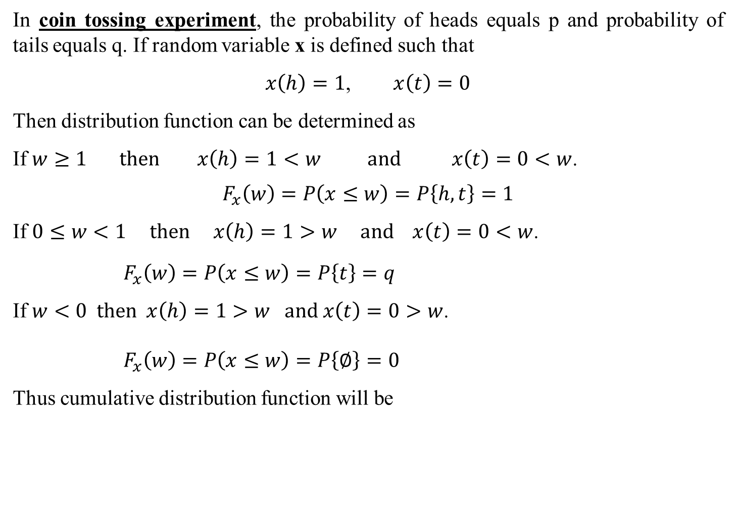
DISTRIBUTION FUNCTION - Example
In coin tossing experiment, the probability of heads equals p and probability of tails equals q. If random variable x is defined such that
$x\left(h\right)=1$, $x\left(t\right)=0$
Then distribution function can be determined as
If $w≥1 then x\left(h\right)=1<w and x\left(t\right)=0<w$.
$$F_{x}\left(w\right)=P\left(x≤w\right)=P\left\{h, t\right\}=1$$
If $0≤w<1 then x\left(h\right)=1>w and x\left(t\right)=0<w$.
$F_{x}\left(w\right)=P\left(x≤w\right)=P\left\{t\right\}=q$
If $w<0 then x\left(h\right)=1>w and x\left(t\right)=0>w$.
$F_{x}\left(w\right)=P\left(x≤w\right)=P\left\{∅\right\}=0$
Thus cumulative distribution function will be

Slide 8
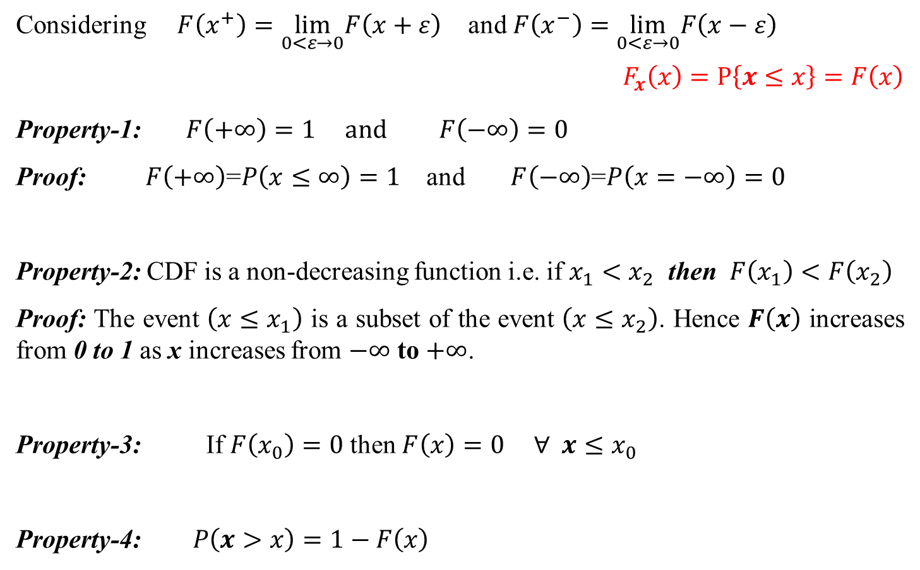
DISTRIBUTION FUNCTION - Properties
Considering $F\left(x^{+}\right)=\lim_{0<ε→0}F\left(x+ε\right)$ and $F\left(x^{−}\right)=\lim_{0<ε→0}F\left(x−ε\right)$
$$F_{x}\left(x\right)=P\left\{x≤x\right\}=F\left(x\right)$$
Property-1: $F\left(+∞\right)=1 and F\left(−∞\right)=0$
Proof: $F\left(+∞\right)$=$P\left(x≤∞\right)=1$ and $F\left(−∞\right)$=$P\left(x=−∞\right)=0$
Property-2: CDF is a non-decreasing function i.e. if $x_{1}<x_{2}$ then $F\left(x_{1}\right)<F\left(x_{2}\right)$
Proof: The event $\left(x≤x_{1}\right)$ is a subset of the event $\left(x≤x_{2}\right)$. Hence $F\left(x\right)$ increases from 0 to 1 as x increases from $−∞$ to $+∞$.
Property-3: If $F\left(x_{0}\right)=0$ then $F\left(x\right)=0 ∀ x≤x_{0}$
Property-4: $P\left(x>x\right)=1−F\left(x\right)$

Slide 9
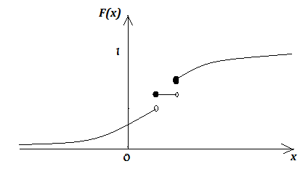
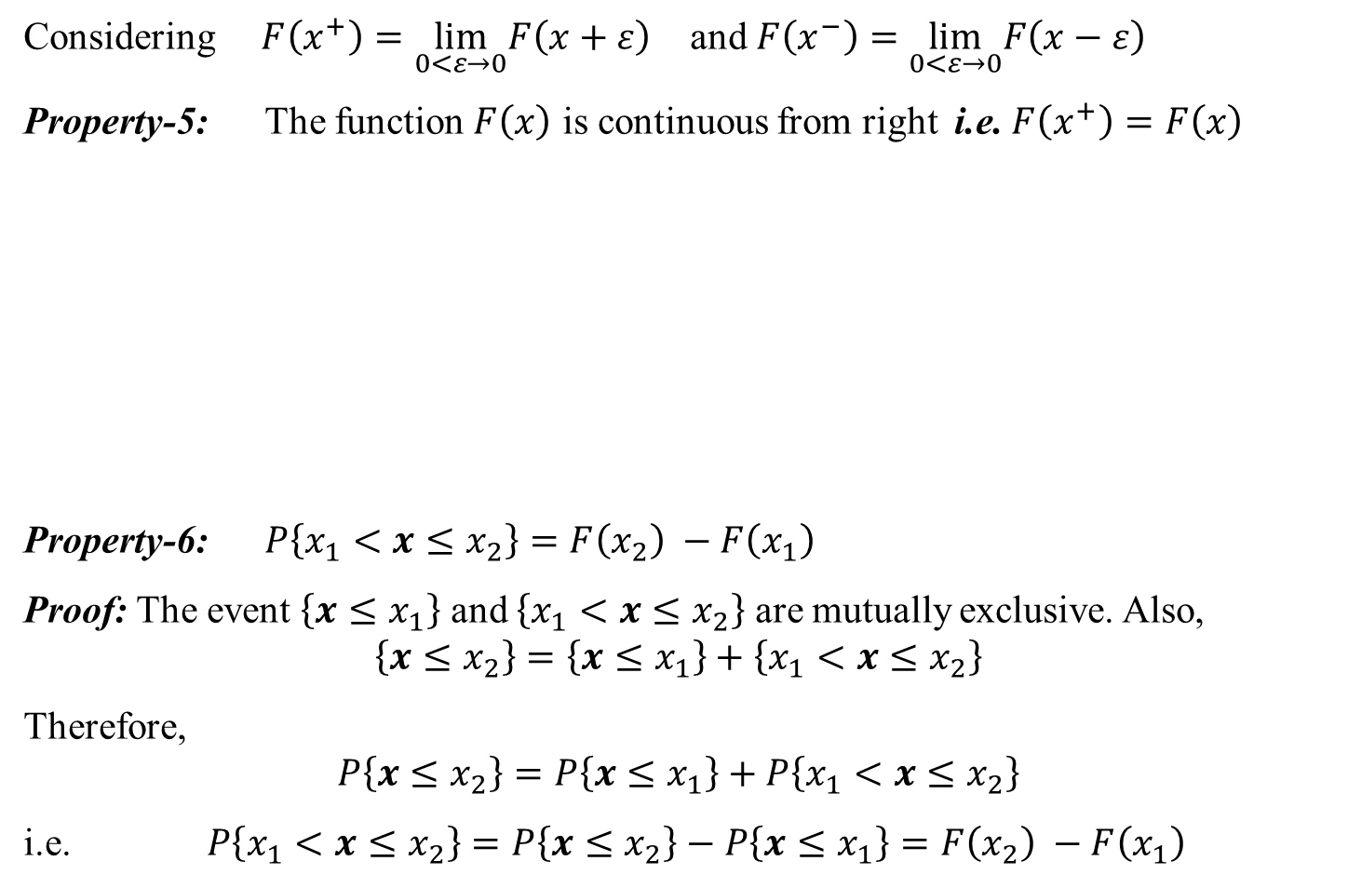
DISTRIBUTION FUNCTION - Properties
Considering $F\left(x^{+}\right)=\lim_{0<ε→0}F\left(x+ε\right)$ and $F\left(x^{−}\right)=\lim_{0<ε→0}F\left(x−ε\right)$
Property-5: The function $F\left(x\right)$ is continuous from right i.e. $F\left(x^{+}\right)=F\left(x\right)$
Property-6: $P\left\{x_{1}<x≤x_{2}\right\}=F\left(x_{2}\right) −F\left(x_{1}\right)$
Proof: The event $\left\{x≤x_{1}\right\}$ and $\left\{x_{1}<x≤x_{2}\right\}$ are mutually exclusive. Also,
$$\left\{x≤x_{2}\right\}=\left\{x≤x_{1}\right\}+\left\{x_{1}<x≤x_{2}\right\}$$
Therefore,
$$P\left\{x≤x_{2}\right\}=P\left\{x≤x_{1}\right\}+P\left\{x_{1}<x≤x_{2}\right\}$$
i.e. $P\left\{x_{1}<x≤x_{2}\right\}=P\left\{x≤x_{2}\right\}−P\left\{x≤x_{1}\right\}=F\left(x_{2}\right) −F\left(x_{1}\right)$

Slide 10
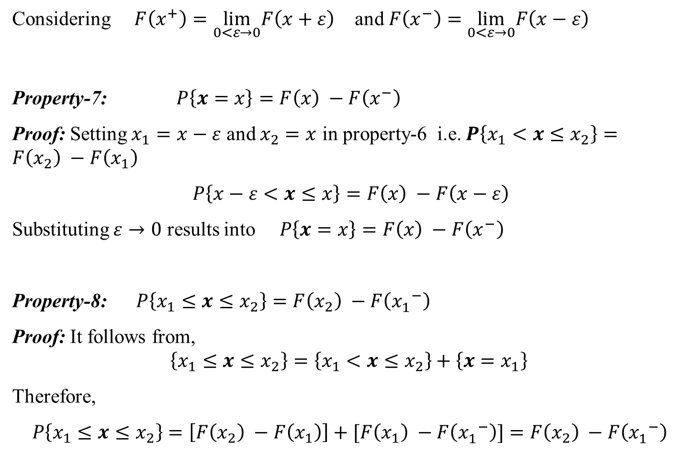
DISTRIBUTION FUNCTION - Properties
Considering $F\left(x^{+}\right)=\lim_{0<ε→0}F\left(x+ε\right)$ and $F\left(x^{−}\right)=\lim_{0<ε→0}F\left(x−ε\right)$
Property-7: $P\left\{x=x\right\}=F\left(x\right) −F\left(x^{−}\right)$
Proof: Setting $x_{1}=x−ε$ and $x_{2}=x$ in property-6 i.e. $P\left\{x_{1}<x≤x_{2}\right\}=F\left(x_{2}\right) −F\left(x_{1}\right)$
$P\left\{x−ε<x≤x\right\}=F\left(x\right) −F\left(x−ε\right)$
Substituting $ε→0$ results into $P\left\{x=x\right\}=F\left(x\right) −F\left(x^{−}\right)$
Property-8: $P\left\{x_{1}≤x≤x_{2}\right\}=F\left(x_{2}\right) −F\left({x_{1}^{}}^{−}\right)$
Proof: It follows from,
$$\left\{x_{1}≤x≤x_{2}\right\}=\left\{x_{1}<x≤x_{2}\right\}+\left\{x=x_{1}\right\}$$
Therefore,
$P\left\{x_{1}≤x≤x_{2}\right\}=\left[F\left(x_{2}\right) −F\left(x_{1}\right)\right]+[F\left(x_{1}\right) −F\left({x_{1}^{}}^{−}\right)]=F\left(x_{2}\right) −F\left({x_{1}^{}}^{−}\right)$

Slide 11
Example: A fair coin is tossed twice, and let the random variable X represent the number of heads. Find
Solution: In this case

Slide 12
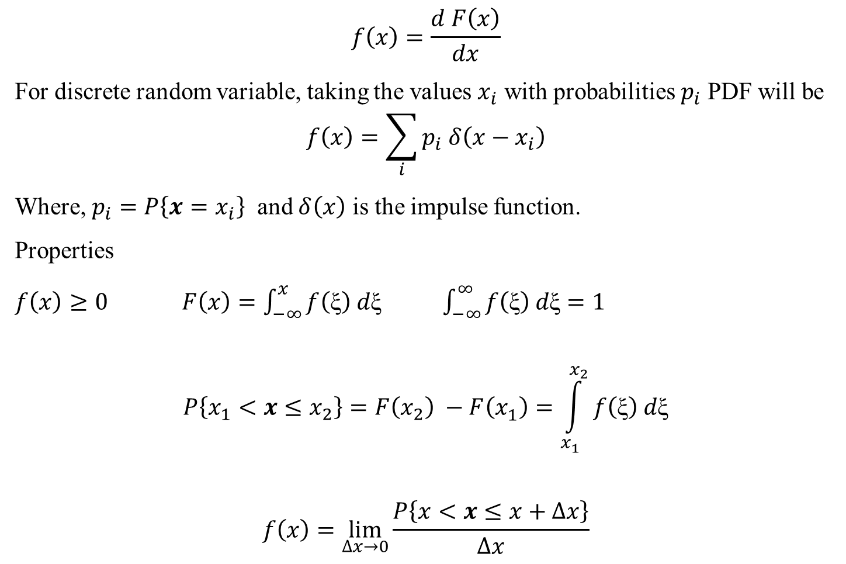
PROBABILITY DENSITY FUNCTION
$$f\left(x\right)=\frac{d F\left(x\right)}{dx}$$
For discrete random variable, taking the values $x_{i}$ with probabilities $p_{i}$ PDF will be
$$f\left(x\right)=\sum_{i}{p_{i} δ\left(x−x_{i}\right)}$$
Where, $p_{i}=P\left\{x=x_{i}\right\}$ and $δ\left(x\right)$ is the impulse function.
Properties
$f\left(x\right)≥0$ $F\left(x\right)=\int_{−∞}^{x}{f\left(\text{ξ}\right) d\text{ξ}}$ $\int_{−∞}^{∞}{f\left(\text{ξ}\right) d\text{ξ}}=1$
$$P\left\{x_{1}<x≤x_{2}\right\}=F\left(x_{2}\right) −F\left(x_{1}^{}\right)=\int_{x_{1}^{}}^{x_{2}}{f\left(\text{ξ}\right) d\text{ξ}}$$
$$f\left(x\right)=\lim_{∆x→0}{\frac{P\left\{x<x≤x+∆x\right\}}{∆x}}$$

Slide 13
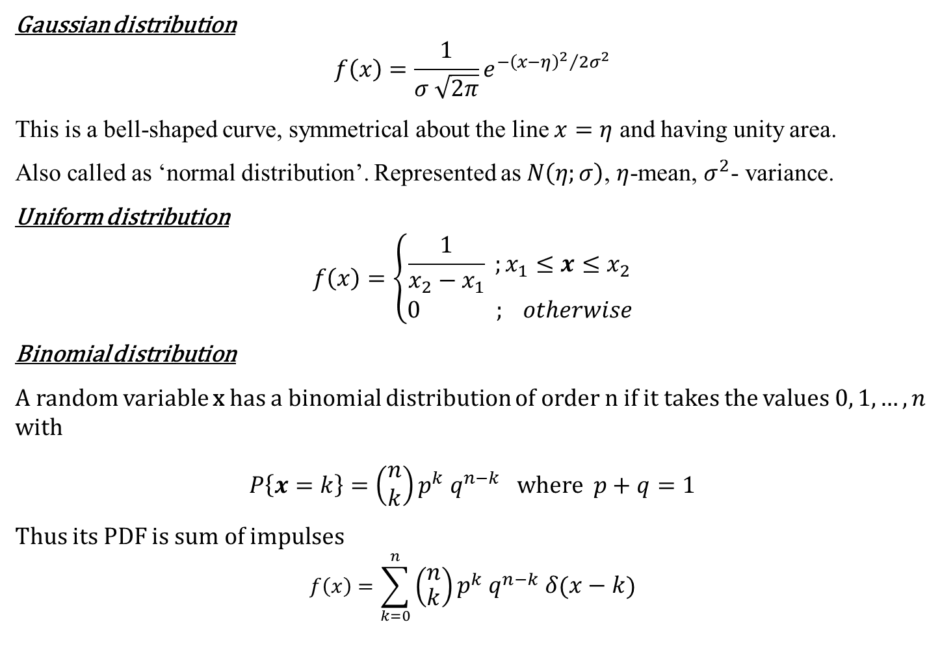
PROBABILITY DENSITY FUNCTIONS
Gaussian distribution
$$f\left(x\right)=\frac{1}{σ \sqrt{2π}}e^{−{{\left(x−η\right)}^{2}}/{2σ^{2}}}$$
This is a bell-shaped curve, symmetrical about the line $x=η$ and having unity area.
Also called as ‘normal distribution’. Represented as $N\left(η;σ\right)$, $η$-mean, $σ^{2}$- variance.
Uniform distribution
$$f\left(x\right)=\left\{\begin{matrix}\frac{1}{x_{2}−x_{1}} ;x_{1}≤x≤x_{2} \\ 0 ; otherwise\end{matrix}\right.$$
Binomial distribution
A random variable x has a binomial distribution of order n if it takes the values $0, 1, …, n$ with
$P\left\{x=k\right\}=\left(\begin{matrix}n \\ k\end{matrix}\right)p^{k} q^{n−k}$ where $p+q=1$
Thus its PDF is sum of impulses
$$f\left(x\right)=\sum_{k=0}^{n}{\left(\begin{matrix}n \\ k\end{matrix}\right)p^{k} q^{n−k} δ\left(x−k\right)}$$

Slide 14
Reference
Athanasios Papoulis, “Probability, Random Variables, and Stochastic Processes,” 4th edition, McGraw Hill Publication.

