Slide 1
Lecture-5 (Module-1)
FUNCTIONS OF ONE RANDOM VARIABLE

Slide 2
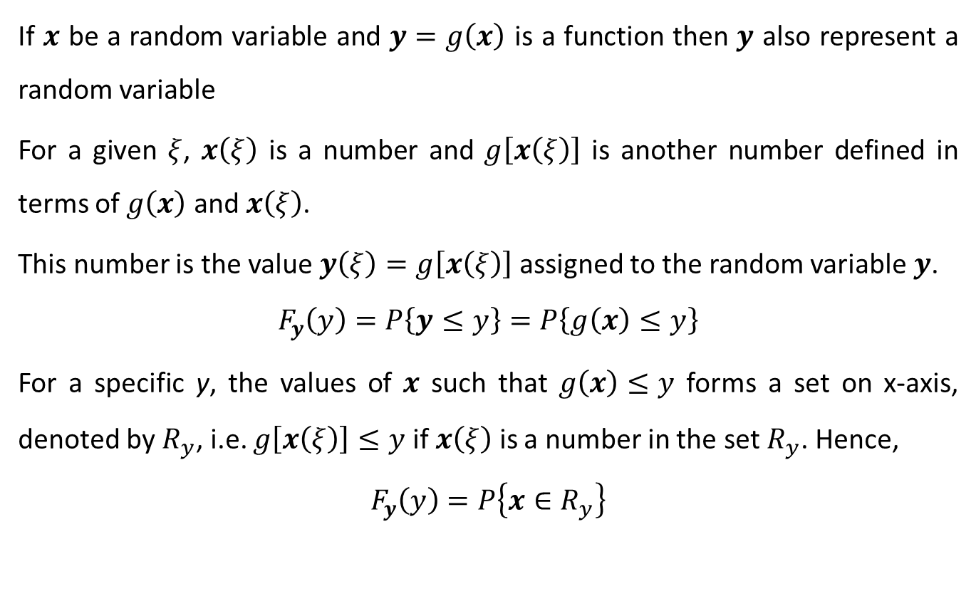
FUNCTION OF ONE RANDOM VARIABLE
If $x$ be a random variable and $y=g\left(x\right)$ is a function then $y$ also represent a random variable
For a given $ξ$, $x\left(ξ\right)$ is a number and $g\left[x\left(ξ\right)\right]$ is another number defined in terms of $g\left(x\right)$ and $x\left(ξ\right)$.
This number is the value $y\left(ξ\right)=g\left[x\left(ξ\right)\right]$ assigned to the random variable $y$.
$$F_{y}\left(y\right)=P\left\{y≤y\right\}=P\left\{g\left(x\right)≤y\right\}$$
For a specific y, the values of $x$ such that $g\left(x\right)≤y$ forms a set on x-axis, denoted by $R_{y}$, i.e. $g\left[x\left(ξ\right)\right]≤y$ if $x\left(ξ\right)$ is a number in the set $R_{y}$. Hence,
$$F_{y}\left(y\right)=P\left\{x∈R_{y}\right\}$$

Slide 3


Constraint on $g\left(x\right)$
For $g\left(x\right)$ to be a random variable, $g\left(x\right)$ must have following properties –
Its domain must include the range of random variable $x$
If $g\left(\right)$ is a Borel measurable function i.e. if $g\left(\right)$ is either a continuous function or piecewise continuous function
The event $\left\{g\left(x\right)=±∞\right\}$ must have zero probabilities

Slide 4

$$y=g\left(x\right)=a x+b$$
Solution:
If $a>0$
$$F_{y}\left(y\right)=P\left\{y≤y\right\}=P\left\{a x+b≤y\right\}=P\left\{ x≤\frac{y−b}{a}\right\}=F_{x}\left(\frac{y−b}{a}\right)$$
If $a<0$
$$F_{y}\left(y\right)=P\left\{y≤y\right\}=P\left\{a x+b≤y\right\}=P\left\{ x≥\frac{y−b}{a}\right\}=1−F_{x}\left(\frac{y−b}{a}\right)$$
Thus
$$F_{y}\left(y\right)=\left\{\begin{aligned}F_{x}\left(\frac{y−b}{a}\right); a>0 \\ 1−F_{x}\left(\frac{y−b}{a}\right); a<0\end{aligned}\right.$$

Slide 5


$$y=g\left(x\right)=\left\{\begin{matrix}x−c ; x>c \\ 0 ; −c<x≤c \\ x+c ; x≤−c\end{matrix}\right.$$
Solution:
In this case $F_{y}\left(y\right)$ is discontinuous at $y=0$ by
$$P\left\{y=0\right\}=P\left\{−c<x≤c\right\}=F_{x}\left(c\right)−F_{x}\left(−c\right)$$
For $y≥0$
$$F_{y}\left(y\right)=P\left\{y≤y\right\}=P\left\{ x≤y+c\right\}=F_{x}\left(y+c\right)$$
If $y<0$
$$F_{y}\left(y\right)=P\left\{y≤y\right\}=P\left\{ x≤y−c\right\}=F_{x}\left(y−c\right)$$
Thus
$$F_{y}\left(y\right)=\left\{\begin{matrix}F_{x}\left(y−c\right) ; y<0 \\ F_{x}\left(y+c\right) ; y≥0\end{matrix}\right.$$

Slide 6
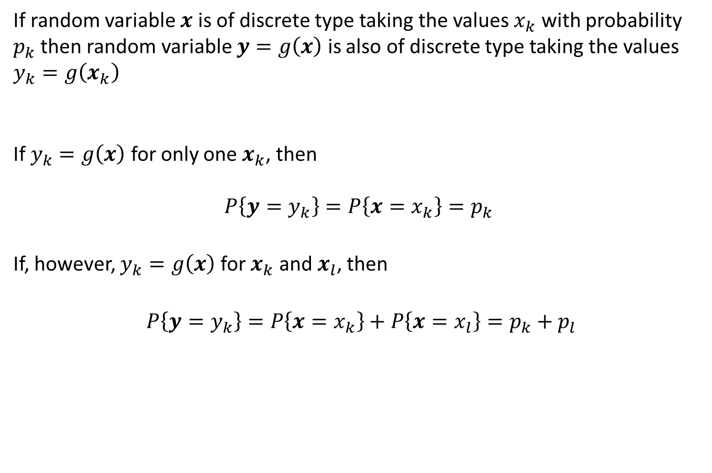

For discrete random variable $x$
If random variable $x$ is of discrete type taking the values $x_{k}$ with probability $p_{k}$ then random variable $y=g\left(x\right)$ is also of discrete type taking the values $y_{k}=g\left(x_{k}\right)$
If $y_{k}=g\left(x\right)$ for only one $x_{k}$, then
$$P\left\{y=y_{k}\right\}=P\left\{x=x_{k}\right\}=p_{k}$$
If, however, $y_{k}=g\left(x\right)$ for $x_{k}$ and $x_{l}$, then
$P\left\{y=y_{k}\right\}=P\left\{x=x_{k}\right\}+P\left\{x=x_{l}\right\}=p_{k}+p_{l}$

Slide 7

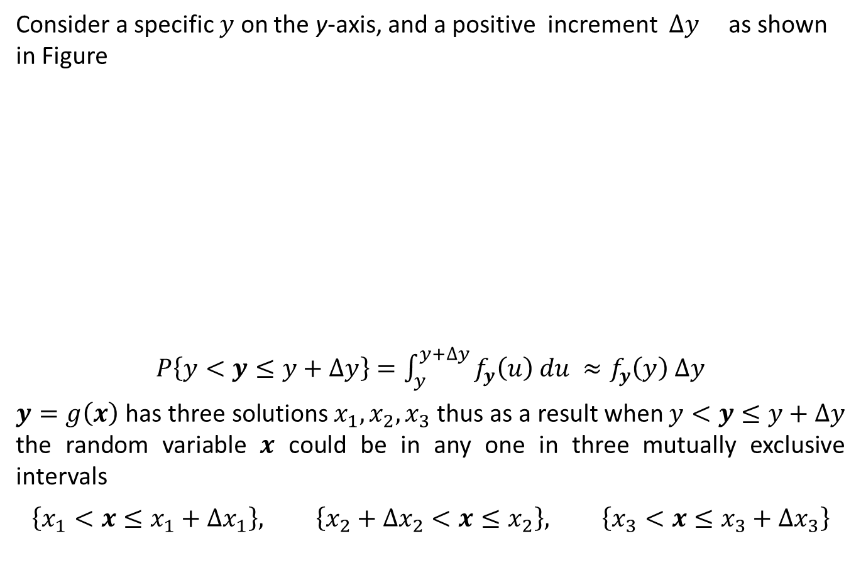
Determination of $f_{y}\left(y\right)$
Consider a specific $y$ on the y-axis, and a positive increment $∆y$ as shown in Figure
$P\left\{y<y≤y+∆y\right\}=\int_{y}^{y+∆y}{f_{y}\left(u\right) du} ≈f_{y}\left(y\right) ∆y$
$y=g\left(x\right)$ has three solutions $x_{1}, x_{2}, x_{3}$ thus as a result when $y<y≤y+∆y$ the random variable $x$ could be in any one in three mutually exclusive intervals
$$\left\{x_{1}<x≤x_{1}+∆x_{1}\right\}, \left\{x_{2}+∆x_{2}<x≤x_{2}\right\}, \left\{x_{3}<x≤x_{3}+∆x_{3}\right\}$$

Slide 8
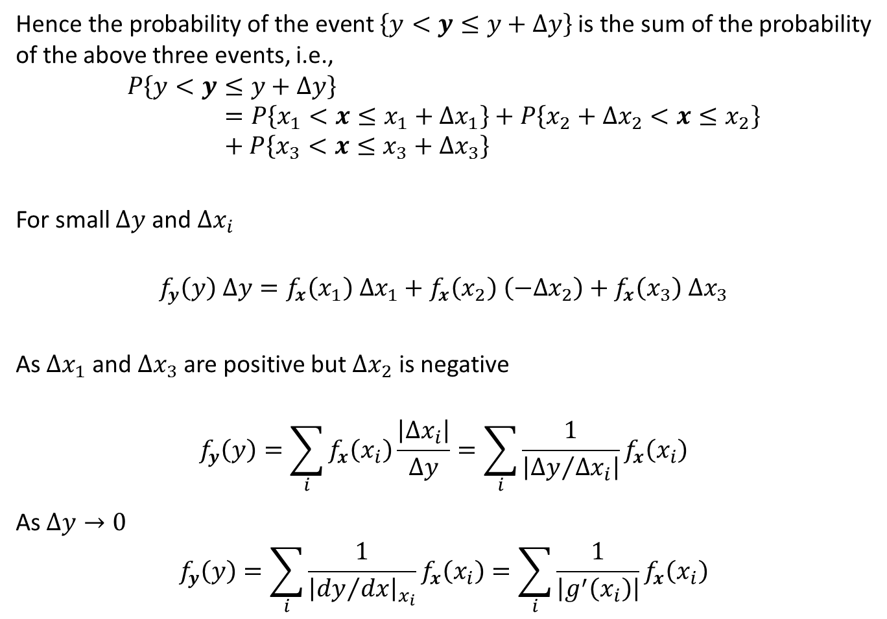

Determination of $f_{y}\left(y\right)$
Hence the probability of the event $\left\{y<y≤y+∆y\right\}$ is the sum of the probability of the above three events, i.e.,
$$P\left\{y<y≤y+∆y\right\}=P\left\{x_{1}<x≤x_{1}+∆x_{1}\right\}+P\left\{x_{2}+∆x_{2}<x≤x_{2}\right\}+P\left\{x_{3}<x≤x_{3}+∆x_{3}\right\}$$
For small $∆y$ and $∆x_{i}$
$$f_{y}\left(y\right) ∆y=f_{x}\left(x_{1}\right) ∆x_{1}+f_{x}\left(x_{2}\right) \left(−∆x_{2}\right)+f_{x}\left(x_{3}\right) ∆x_{3}$$
As $∆x_{1}$ and $∆x_{3}$ are positive but $∆x_{2}$ is negative
$$f_{y}\left(y\right)=\sum_{i}{f_{x}\left(x_{i}\right)\frac{\left|∆x_{i}\right|}{∆y}}=\sum_{i}{\frac{1}{\left|{∆y}/{∆x_{i}}\right|}f_{x}\left(x_{i}\right)}$$
As $∆y→0$
$$f_{y}\left(y\right)=\sum_{i}{\frac{1}{{\left|{dy}/{dx}\right|}_{x_{i}}}f_{x}\left(x_{i}\right)}=\sum_{i}{\frac{1}{\left|g^{′}\left(x_{i}\right)\right|}f_{x}\left(x_{i}\right)}$$

Slide 9
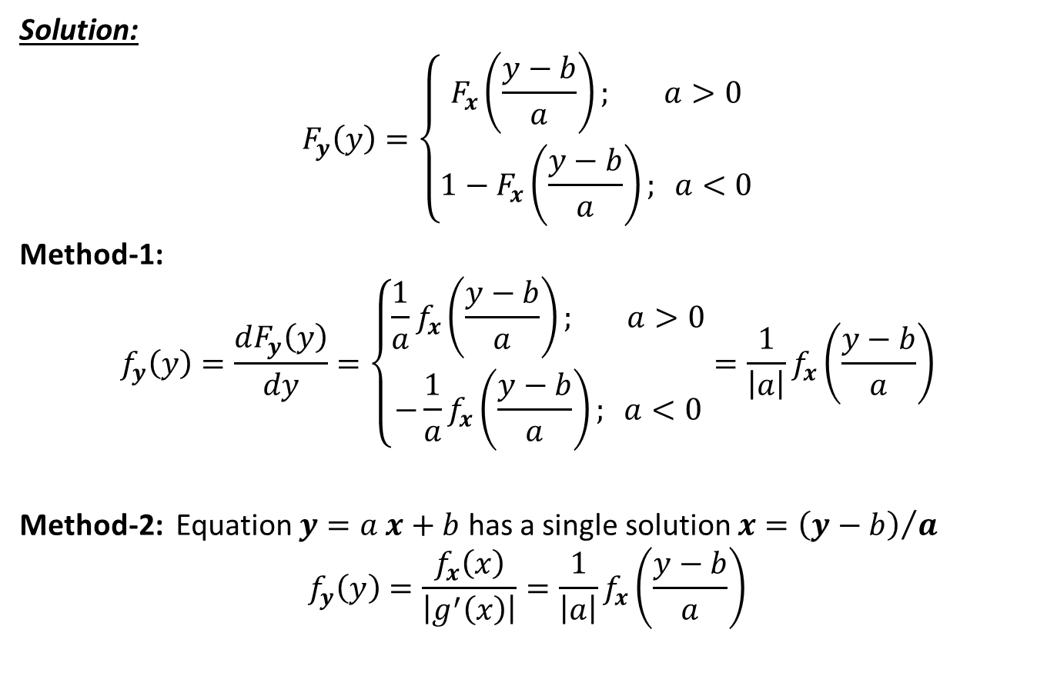
$$y=g\left(x\right)=a x+b$$
Solution:
$$F_{y}\left(y\right)=\left\{\begin{aligned}F_{x}\left(\frac{y−b}{a}\right); a>0 \\ 1−F_{x}\left(\frac{y−b}{a}\right); a<0\end{aligned}\right.$$
Method-1:
$$f_{y}\left(y\right)=\frac{dF_{y}\left(y\right)}{dy}=\left\{\begin{aligned}\frac{1}{a}f_{x}\left(\frac{y−b}{a}\right); a>0 \\ −{\frac{1}{a}f}_{x}\left(\frac{y−b}{a}\right); a<0\end{aligned}\right.=\frac{1}{\left|a\right|}f_{x}\left(\frac{y−b}{a}\right)$$
Method-2: Equation $y=a x+b$ has a single solution $x={\left(y−b\right)}/a$
$$f_{y}\left(y\right)=\frac{f_{x}\left(x\right)}{\left|g^{′}\left(x\right)\right|}=\frac{1}{\left|a\right|}f_{x}\left(\frac{y−b}{a}\right)$$

Slide 10
Reference
Athanasios Papoulis, “Probability, Random Variables, and Stochastic Processes,” 3rd edition, McGraw Hill Publication.

