Slide 1
Lecture-7
Moments, Characteristic Functions of Functions of Random Variable

Slide 2
Moments
The shape of any distribution can be described by its various ‘moments’. The first four are:
The mean, which indicates the central tendency of a distribution.
The second moment is the variance, which indicates the width or deviation.
The third moment is the skewness, which indicates lack of symmetry.
  normal distribution has a skew of zero, while a lognormal distribution, for example, would exhibit some degree of right-skew.
The fourth moment is the Kurtosis, which indicates how heavily the tails of a distribution differ from the tails of a normal distribution.

Slide 3
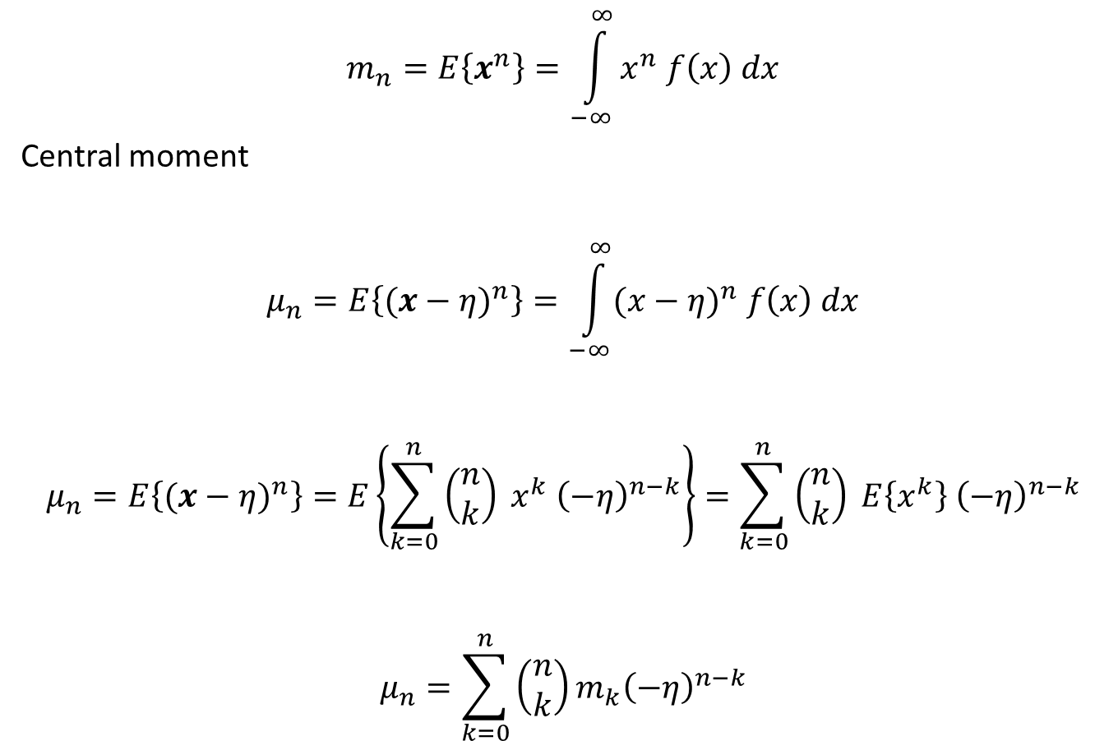
Moments
$$m_{n}=E\left\{x^{n}\right\}=\int_{−∞}^{∞}{x^{n} f\left(x\right) dx}$$
Central moment
$$μ_{n}=E\left\{{(x−η)}^{n}\right\}=\int_{−∞}^{∞}{{(x−η)}^{n} f\left(x\right) dx}$$
$$μ_{n}=E\left\{{(x−η)}^{n}\right\}=E\left\{\sum_{k=0}^{n}{\left(\begin{matrix}n \\ k\end{matrix}\right) x^{k} {\left(−η\right)}^{n−k}}\right\}=\sum_{k=0}^{n}{\left(\begin{matrix}n \\ k\end{matrix}\right) E\left\{x^{k}\right\} {\left(−η\right)}^{n−k}}$$
$$μ_{n}=\sum_{k=0}^{n}{\left(\begin{matrix}n \\ k\end{matrix}\right)m_{k}{\left(−η\right)}^{n−k}}$$

Slide 4

Moments
Similarly
$$m_{n}=E\left\{{\left[\left(x−η\right)+η\right]}^{n}\right\}=E\left\{\sum_{k=0}^{n}{\left(\begin{matrix}n \\ k\end{matrix}\right) {\left(x−η\right)}^{k} {\left(η\right)}^{n−k}}\right\}=\sum_{k=0}^{n}{\left(\begin{matrix}n \\ k\end{matrix}\right) E\left\{{\left(x−η\right)}^{k}\right\} {\left(η\right)}^{n−k}}$$
$$m_{n}=\sum_{k=0}^{n}{\left(\begin{matrix}n \\ k\end{matrix}\right)μ_{k}{\left(η\right)}^{n−k}}$$
In particular
$μ_{0}=m_{0}=1$ $m_{1}=η$ $μ_{1}=0$ $μ_{2}=σ^{2}$
$μ_{3}=m_{3}−3 η m_{2}+2 η^{3}$ $m_{3}=μ_{3}+3 η μ_{2}+2 η^{3}$

Slide 5
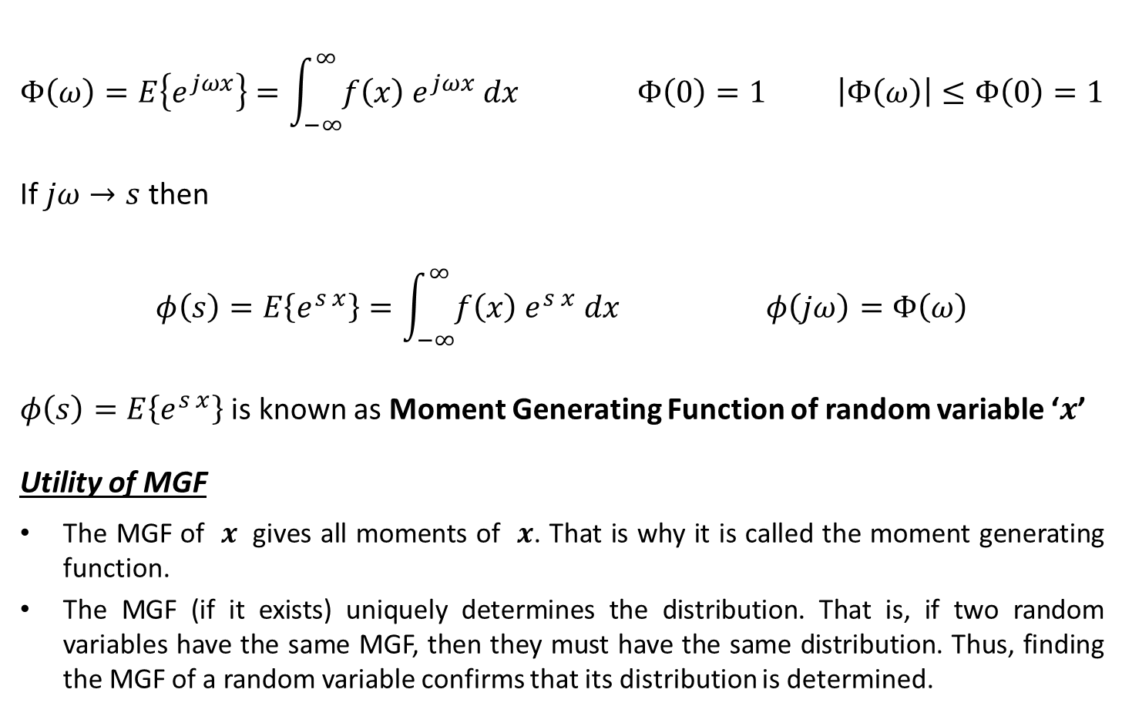
Characteristic Function of a Random Variable
$$Φ\left(ω\right)=E\left\{e^{jωx}\right\}=\int_{−∞}^{∞}{f\left(x\right) e^{jωx} dx} Φ\left(0\right)=1 \left|Φ\left(ω\right)\right|≤Φ\left(0\right)=1$$
If $jω→s$ then
$$φ\left(s\right)=E\left\{e^{s x}\right\}=\int_{−∞}^{∞}{f\left(x\right) e^{s x} dx} φ\left(jω\right)=Φ\left(ω\right)$$
$φ\left(s\right)=E\left\{e^{s x}\right\}$ is known as Moment Generating Function of random variable ‘$x$’
Utility of MGF
The MGF of $x$ gives all moments of $x$. That is why it is called the moment generating function.
The MGF (if it exists) uniquely determines the distribution. That is, if two random variables have the same MGF, then they must have the same distribution. Thus, finding the MGF of a random variable confirms that its distribution is determined.

Slide 6

Moment Generating Function
Ex-1: Determine MGF if $f\left(x\right)=\left\{\begin{matrix}1/3 k=1 \\ 2/3 k=2\end{matrix}\right.$
$φ\left(s\right)=E\left\{e^{s x}\right\}=\frac{1}{3}e^{s}+\frac{2}{3}e^{s}$ which is well defined for $s∈ ℝ$
Ex-2: Determine MGF if $f\left(x\right)$ is Uniform (0, 1) random variable
$φ\left(s\right)=E\left\{e^{s x}\right\}=\int_{0}^{1}{e^{s x} dx}=\frac{e^{s}−1}{s}$ which is well defined for $s∈ ℝ$ as
$$φ\left(0\right)=E\left\{e^{x ∗ 0}\right\}=1$$

Slide 7
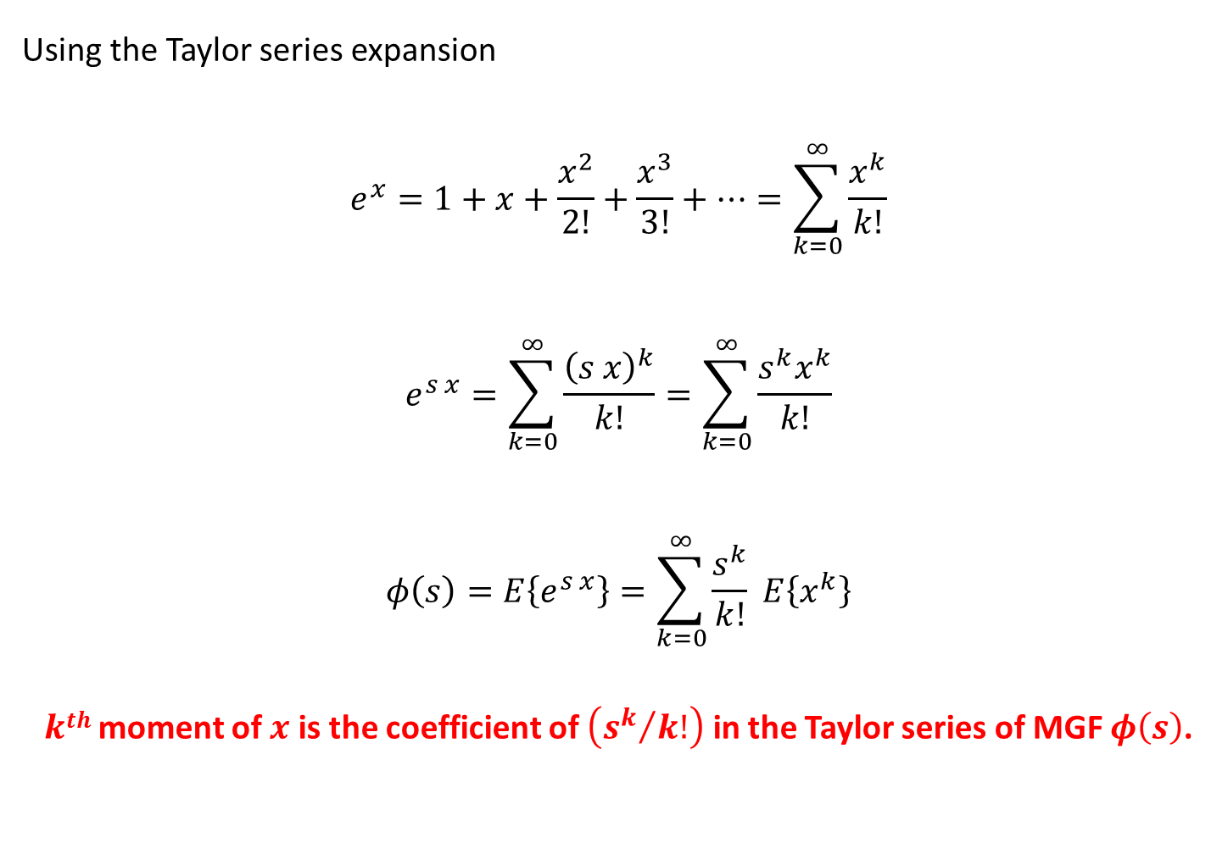
Finding Moment from MGF
Using the Taylor series expansion
$$e^{x}=1+x+\frac{x^{2}}{2!}+\frac{x^{3}}{3!}+…=\sum_{k=0}^{∞}{\frac{x^{k}}{k!}}$$
$$e^{s x}=\sum_{k=0}^{∞}{\frac{{\left(s x\right)}^{k}}{k!}}=\sum_{k=0}^{∞}{\frac{s^{k}x^{k}}{k!}}$$
$$φ\left(s\right)=E\left\{e^{s x}\right\}=\sum_{k=0}^{∞}{\frac{s^{k}}{k!} E\left\{x^{k}\right\}}$$
$kth$ moment of $x$ is the coefficient of $\left({s^{k}}/{k!}\right)$ in the Taylor series of MGF $φ\left(s\right)$.

Slide 8
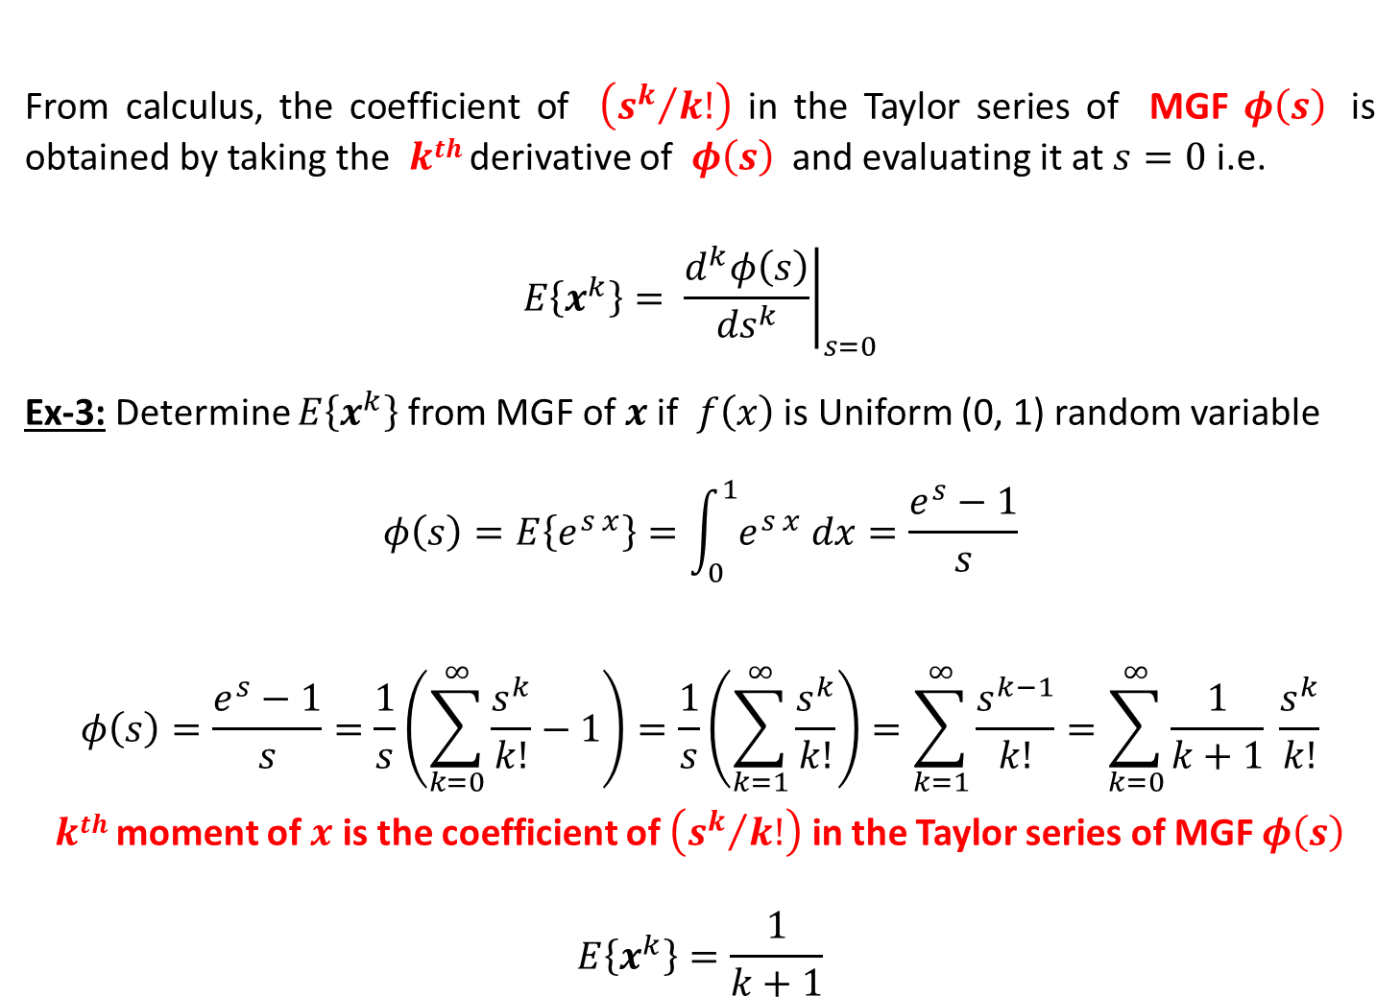
Finding Moment from MGF
From calculus, the coefficient of $\left({s^{k}}/{k!}\right)$ in the Taylor series of MGF $φ\left(s\right)$ is obtained by taking the $kth$ derivative of $φ\left(s\right)$ and evaluating it at $s=0$ i.e.
$$E\left\{x^{k}\right\}= {\left.\frac{d^{k}φ\left(s\right)}{{ds}^{k}}\right|}_{s=0}$$
Ex-3: Determine $E\left\{x^{k}\right\}$ from MGF of $x$if $f\left(x\right)$ is Uniform (0, 1) random variable
$$φ\left(s\right)=E\left\{e^{s x}\right\}=\int_{0}^{1}{e^{s x} dx}=\frac{e^{s}−1}{s}$$
$$φ\left(s\right)=\frac{e^{s}−1}{s}=\frac{1}{s}\left(\sum_{k=0}^{∞}{\frac{s^{k}}{k!}}−1\right)=\frac{1}{s}\left(\sum_{k=1}^{∞}{\frac{s^{k}}{k!}}\right)=\sum_{k=1}^{∞}{\frac{s^{k−1}}{k!}}=\sum_{k=0}^{∞}{\frac{1}{k+1} \frac{s^{k}}{k!}}$$
$kth$ moment of $x$ is the coefficient of $\left({s^{k}}/{k!}\right)$ in the Taylor series of MGF $φ\left(s\right)$
$$E\left\{x^{k}\right\}=\frac{1}{k+1}$$

Slide 9
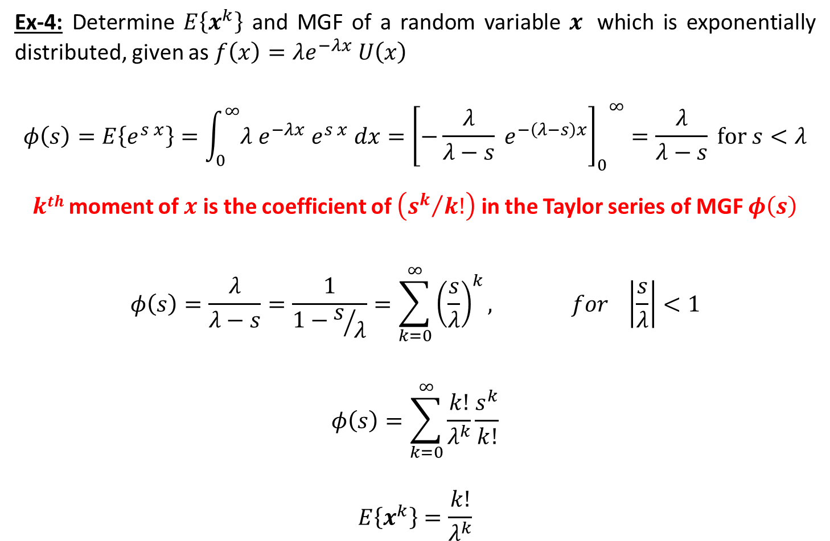
Finding Moment from MGF
Ex-4: Determine $E\left\{x^{k}\right\}$ and MGF of a random variable $x$ which is exponentially distributed, given as $f\left(x\right)=λe^{−λx} U\left(x\right)$
$$φ\left(s\right)=E\left\{e^{s x}\right\}=\int_{0}^{∞}{λ e^{−λx} e^{s x} dx}={{\left[−\frac{λ}{λ−s} e^{−\left(λ−s\right)x}\right]}_{0}^{}}^{∞}=\frac{λ}{λ−s} for s<λ$$
$kth$ moment of $x$ is the coefficient of $\left({s^{k}}/{k!}\right)$ in the Taylor series of MGF $φ\left(s\right)$
$$φ\left(s\right)=\frac{λ}{λ−s}=\frac{1}{1−s/λ}=\sum_{k=0}^{∞}{{\left(\frac{s}{λ}\right)}^{k}, for \left|\frac{s}{λ}\right|<1}$$
$$φ\left(s\right)=\sum_{k=0}^{∞}{\frac{k!}{λ^{k}}\frac{s^{k}}{k!}}$$
$$E\left\{x^{k}\right\}=\frac{k!}{λ^{k}}$$

Slide 10
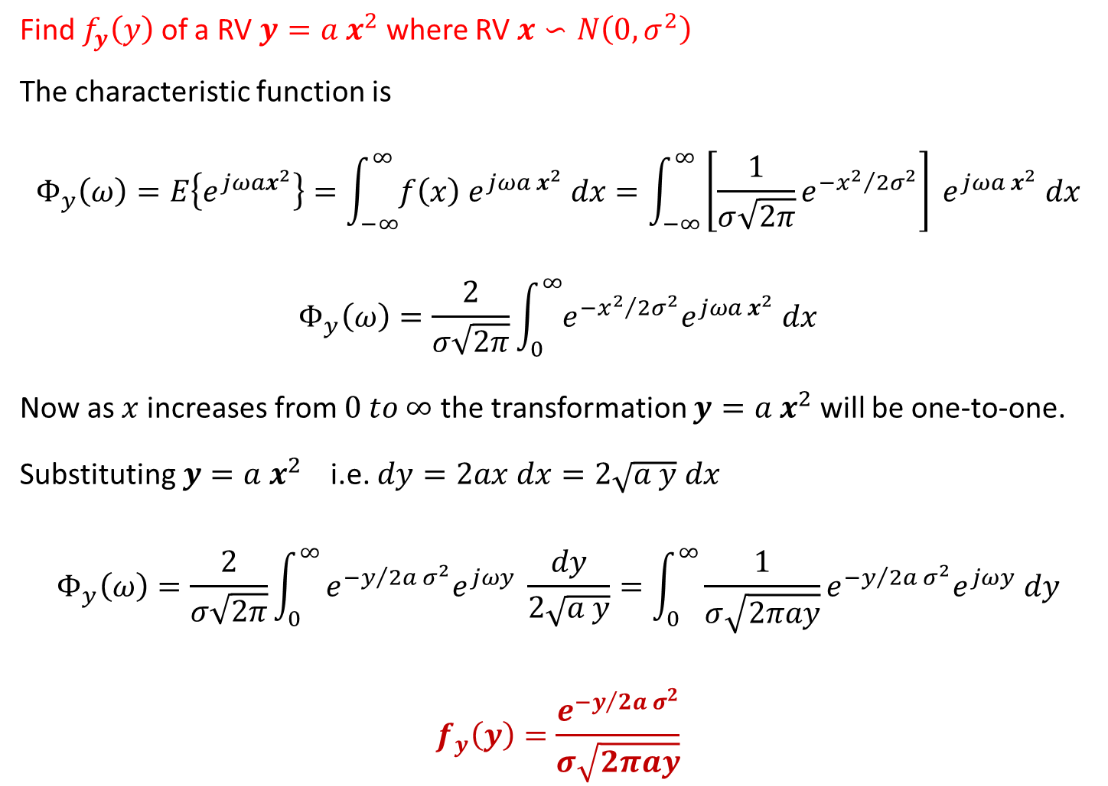
Finding Distribution
Find $f_{y}\left(y\right)$ of a RV $y=a x^{2}$ where RV $x∽N\left(0, σ^{2}\right)$
The characteristic function is
$$Φ_{y}\left(ω\right)=E\left\{e^{jωax^{2}}\right\}=\int_{−∞}^{∞}{f\left(x\right) e^{jωa x^{2}} dx}=\int_{−∞}^{∞}{\left[\frac{1}{σ\sqrt{2π}}e^{{−x^{2}}/{2σ^{2}}}\right] e^{jωa x^{2}} dx}$$
$$Φ_{y}\left(ω\right)=\frac{2}{σ\sqrt{2π}}\int_{0}^{∞}{e^{{−x^{2}}/{2σ^{2}}}e^{jωa x^{2}} dx}$$
Now as $x$ increases from $0 to ∞$ the transformation $y=a x^{2}$ will be one-to-one.
Substituting $y=a x^{2}$ i.e. $dy=2ax dx=2\sqrt{a y} dx$
$$Φ_{y}\left(ω\right)=\frac{2}{σ\sqrt{2π}}\int_{0}^{∞}{e^{{−y}/{2a σ^{2}}}e^{jωy} \frac{dy}{2\sqrt{a y}}}=\int_{0}^{∞}{\frac{1}{σ\sqrt{2πay}}e^{{−y}/{2a σ^{2}}}e^{jωy} dy}$$
$$f_{y}\left(y\right)=\frac{e^{{−y}/{2a σ^{2}}}}{σ\sqrt{2πay}}$$

Slide 11
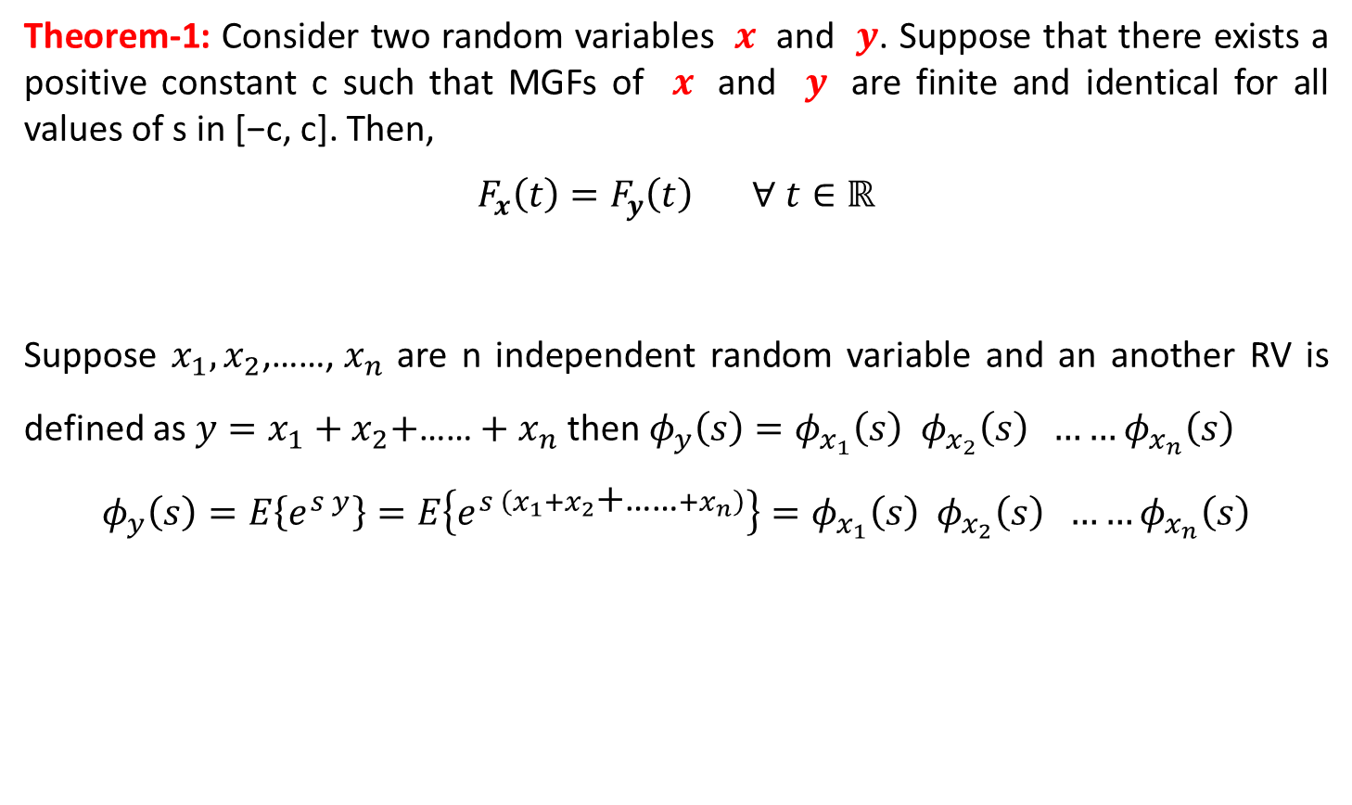
MGF of Function of Random Variables
Theorem-1: Consider two random variables $x$ and $y$. Suppose that there exists a positive constant c such that MGFs of $x$ and $y$ are finite and identical for all values of s in [−c, c]. Then,
$$F_{x}\left(t\right)=F_{y}\left(t\right) ∀ t∈ℝ$$
Suppose $x_{1},x_{2}\text{,……, }x_{n}$ are n independent random variable and an another RV is defined as $y=x_{1}+x_{2}\text{+}\text{……}+x_{n}$ then $φ_{y}\left(s\right)=φ_{x_{1}}\left(s\right){ φ}_{x_{2}}\left(s\right) ……φ_{x_{n}}\left(s\right)$
$$φ_{y}\left(s\right)=E\left\{e^{s y}\right\}=E\left\{e^{s \left(x_{1}+x_{2}\text{+}\text{……}+x_{n}\right)}\right\}=φ_{x_{1}}\left(s\right){ φ}_{x_{2}}\left(s\right) ……φ_{x_{n}}\left(s\right)$$

Slide 12
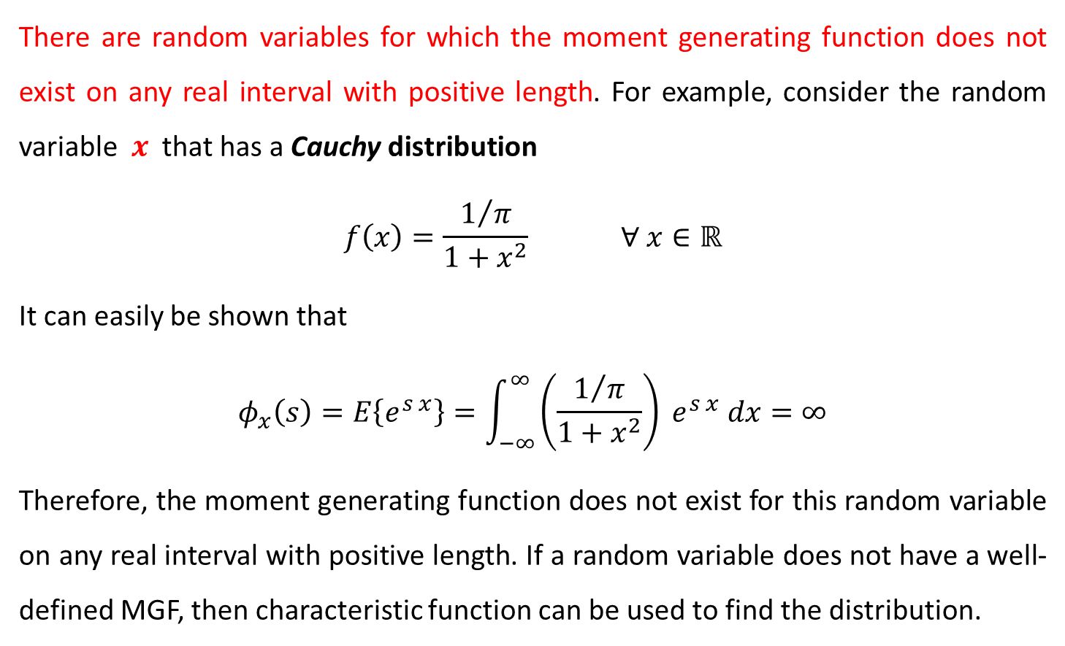
Importance of Characteristic Function
There are random variables for which the moment generating function does not exist on any real interval with positive length. For example, consider the random variable $x$ that has a Cauchy distribution
$$f\left(x\right)=\frac{1/π}{1+x^{2}} ∀ x∈ℝ$$
It can easily be shown that
$$φ_{x}\left(s\right)=E\left\{e^{s x}\right\}=\int_{−∞}^{∞}{\left(\frac{1/π}{1+x^{2}}\right) e^{s x} dx}=∞$$
Therefore, the moment generating function does not exist for this random variable on any real interval with positive length. If a random variable does not have a well-defined MGF, then characteristic function can be used to find the distribution.

Slide 13

Inversion Formula from Characteristic Function
The characteristic function is
$$Φ\left(ω\right)=E\left\{e^{jωx}\right\}=\int_{−∞}^{∞}{f\left(x\right) e^{jωx} dx}$$
Thus, the PDF $f\left(x\right)$ can be written as
$$f\left(x\right)=\frac{1}{2π}\int_{−∞}^{∞}{Φ\left(ω\right) e^{−jωx} dω}$$

Slide 14
Reference
Athanasios Papoulis, “Probability, Random Variables, and Stochastic Processes,” 3rd edition, McGraw Hill Publication.
https://www.probabilitycourse.com/

