Slide 1
Udemy Courses Data Analysis
Data Cleaning, Pivot Tables, Dashboard & Business Insights

Slide 2
Problem Statement
The objective of this analysis is to understand:
- Which subjects attract the most subscribers
- Which course levels generate the highest engagement
- Revenue performance trends over time
- Key drivers of learner engagement and business growth

Slide 3
Data Cleaning Process
- Removed duplicate records
- Standardized column names
- Converted publication dates into date format
- Removed incomplete rows
- Created revenue estimation metric

Slide 4
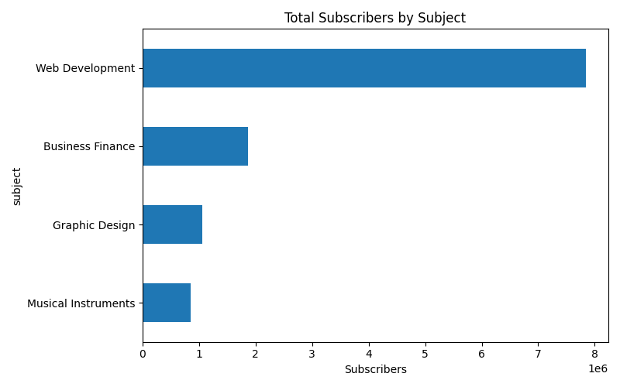
Subscribers by Subject

Slide 5
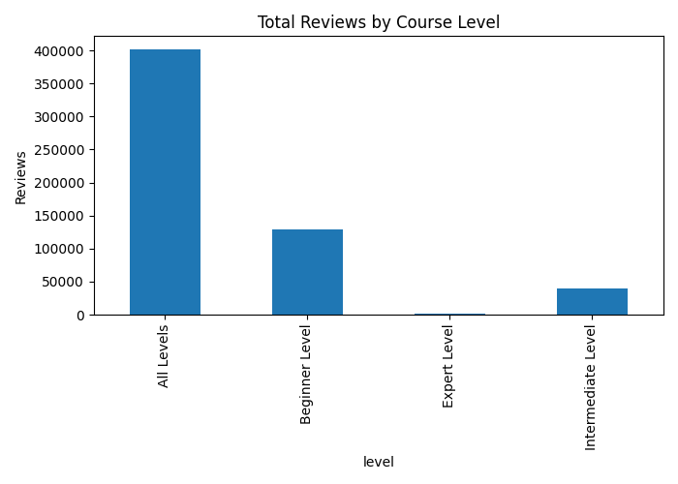
Reviews by Course Level

Slide 6
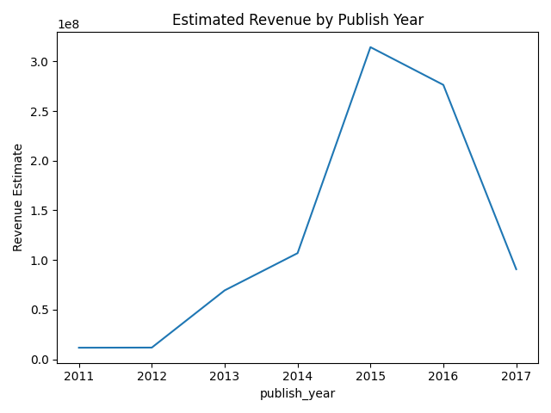
Revenue Trend by Year

Slide 7
Key Insights
The subject with the highest subscribers is Web Development with 7,848,654 subscribers.
All Levels courses receive the highest average engagement based on reviews.
The year with the highest estimated revenue generation was 2015.
Paid courses dominate revenue generation despite free courses attracting larger enrollments.
Course engagement is strongly correlated with the number of lectures and duration.

Slide 8
Recommendations
- Increase investment in high-performing subjects
- Develop more intermediate and advanced level courses
- Improve learner engagement through reviews and interactive content
- Use revenue trend analysis to guide future course launches
- Focus marketing on subjects with strong subscriber growth

