Slide 1
CSE623-Machine Learning
Group - 9 ML Code Crafters
Project title: Offline Track Association Problem [UAV Videos]
Name | Enrollment
Vidhan Nahar | AU2340199
Shubham Mehta | AU2340210
Yashvi Jakharia | AU2340100
Jash Aghicha | AU2320253

Slide 2
INTRODUCTION
Unmanned Aerial Vehicles (UAVs) are widely used in many applications such as:
Traffic monitoring
Public safety and surveillance
Disaster management
Urban planning
These UAVs capture aerial images containing multiple moving objects such as cars, buses, and pedestrians.
Automatically detecting and tracking these objects is important for building intelligent monitoring systems.

Slide 3
Problem Statement
The goal of this project is to build a multi-object tracking system that can detect and track multiple objects in aerial images captured by drones.
The system should:
Detect objects present in each frame
Assign a unique ID to each object
Track the same object across multiple frames
The final output should maintain the trajectory of each object over time

Slide 4
Proposed Methodology
Dataset
VisDrone2019-MOT-train — Bounding box annotations of video sequences of UAVs per frame.
Tracklet Generation
Online greedy tracker with Euclidean distance between bounding box centres.
Detection to closest active tracklet in case of distance of points is less than 60px, otherwise a new tracklet is created.

Slide 5
Proposed Methodology
Offline Track Association (3 Strategies)
Rule based: planar merging when time difference is less than or equal to 5 frames and spatial distance is less than or equal 60px.
Appearance-conscious: contains color-histogram-cosine-similarity test (value 5 0.6)
ML-based: 8 pairwise features (time gap, distance, speed, appearance), were trained by using Logistic Regression.

Slide 6
Proposed Methodology
ML Training
Pairs that have VisDrone GT IDs that are similar but not identical through IoU being the same object = 1 different = 0.
class_weight="balanced" was used to deal with class imbalance.
Evaluation
GT Fragmentation, Prediction, GT Coverage, Identity Switches.
It matched all against ground-truth object IDs all with IoU Ge 0.5 per-frame.

Slide 7
Implementation
Tools and Libraries
Python, NumPy, OpenCV, Pandas, ScikitLearn
Tracklet Structure
Dictionary containing track id, frames, boxes, centers, last center, last frame
Merging Logic
Tracklets To frame sorted greedy forward chaining then ID still used on merge inferred earlier.

Slide 8
Implementation
ML Pipeline
Candidate pair built 8-feature matrix saved via joblib trained in logistic regression pipeline
At Interference: merge if predicted probability >= 0.5
Tuning and Evaluation
Grid search on parameter combinations of 27 parameters → best configuration chosen through composite score.
IoU = 0.5 or above used in all evaluation measures.

Slide 9
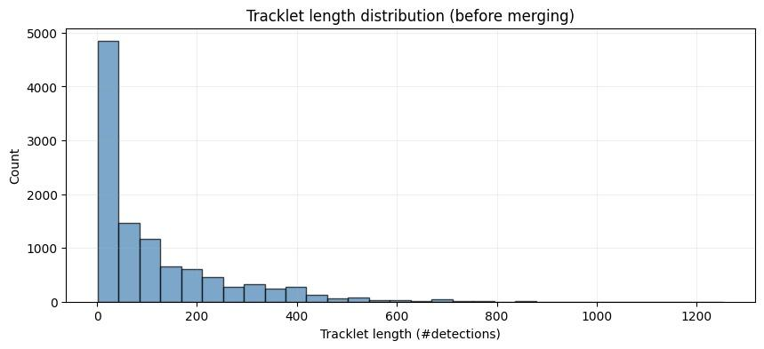
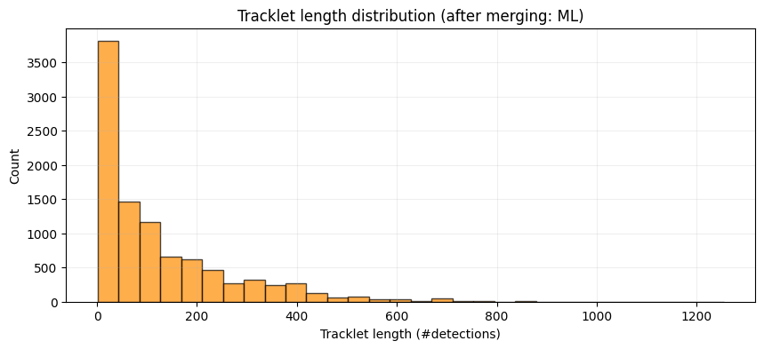
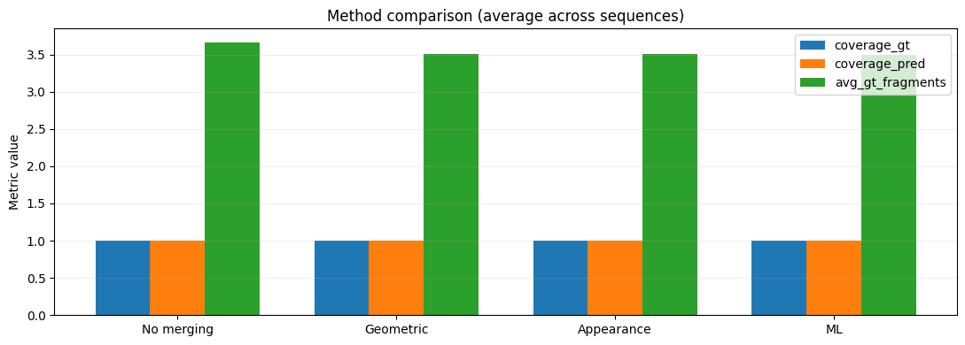
Results

Slide 10
Planning Ahead
Global Optimization: Replace the current greedy merging strategy with a globally optimal solution to prevent irreversible association errors.
Robust Feature Extraction: Upgrade from basic color histograms to appearance descriptors that capture object texture and shape.
Standardized Evaluation: Incorporate industry-standard metrics like MOTA and IDF1 to allow for direct comparison with state-of-the-art research.
Fine Tuning: So we can do out testing on small dataset if required

Slide 11
References
Wojke, N., Bewley, A., & Paulus, D. (2017, March 21). Simple Online and Realtime Tracking with a Deep Association Metric. arXiv.org. https://arxiv.org/abs/1703.07402
Zhu, P., Wen, L., Bian, X., Ling, H., & Hu, Q. (2018, April 20). Vision Meets Drones: a challenge. arXiv.org. https://arxiv.org/abs/1804.07437
Bhavsar, Y., Zaveri, M., Raval, M., Zaveri, S., & University, A. (2026). DRASHTI-HaOBB: Drone nadiR-view Annotated imageS of veHicles dataseT for India - Heading-angle Oriented Bounding Box: Indian Vehicle Oriented-Object-Detection Dataset with 1.3 Million Samples [Dataset]. In Zenodo (CERN European Organization for Nuclear Research). https://doi.org/10.5281/zenodo.18278988

Slide 12
THANK YOU

