Slide 1
CSE623-Machine Learning
Group - 9 ML Code Crafters
Project title: Offline Track Association Problem [UAV Videos]
Name | Enrollment
Vidhan Nahar | AU2340199
Shubham Mehta | AU2340210
Yashvi Jakharia | AU2340100
Jash Aghicha | AU2320253

Slide 2
Problem Statement
Objective: Develop an offline multi-object tracking (MOT) system to handle missing detections and reconstruct object trajectories.
The Challenge: Maintaining continuous trajectories is difficult due to gaps caused by obstructions, sensor malfunctions, and random factors.
Impact: These invasions lead to fragmented tracks, significantly reducing tracking accuracy in UAV surveillance

Slide 3
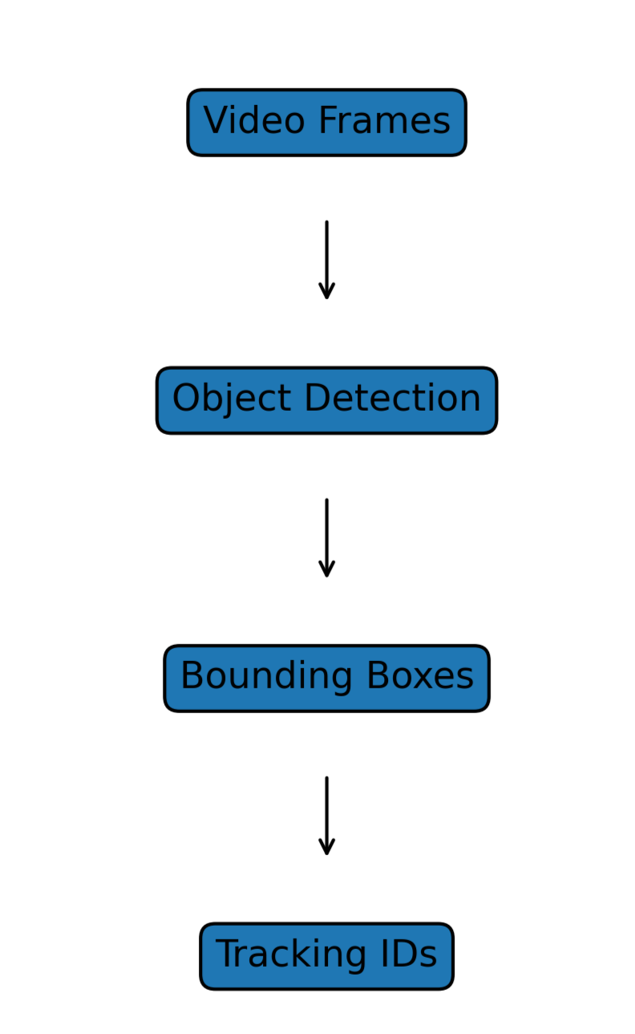
Dataset
We used the VisDrone2019-MOT dataset for training and evaluation
Collected using UAV (drone) cameras in real-world environments
Contains:
Urban streets, intersections, parking areas
Multiple object classes (cars, pedestrians, etc.)
Provides:
Frame-wise image sequences
Ground truth annotations for tracking

Slide 4
Literature Review
Existing MOT methods struggle with handling missing detections effectively
Traditional approaches:
Tracking-by-detection models (limited in gaps)
Kalman Filter (assumes simple motion)
Research highlights:
Hybrid models improve robustness
ML-based prediction helps in complex scenarios
Gap identified:
Lack of adaptive method selection for different gap sizes

Slide 5
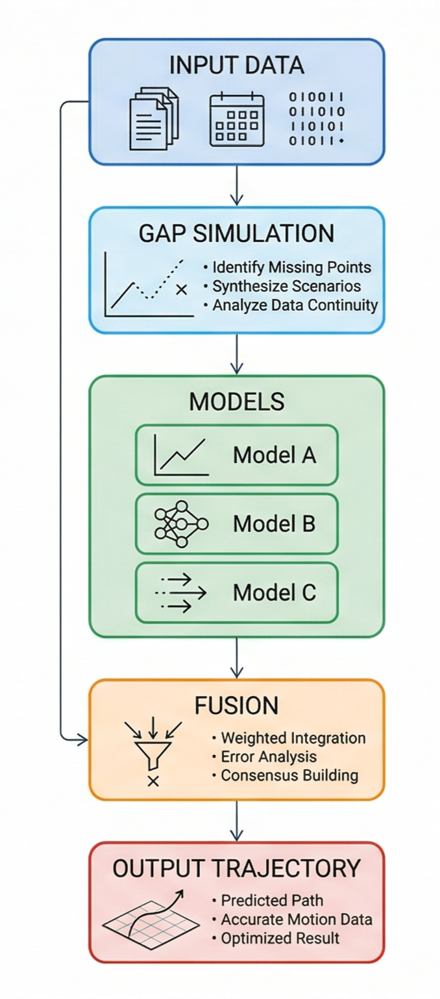
Overview
Developed an offline trajectory reconstruction system
Uses VisDrone2019-MOT dataset
Combines:
Linear Interpolation
Kalman Filtering
Random Forest Regressor
Key idea:
Hybrid Decision Fusion based on gap size

Slide 6
Methodology
Step 1: Data preparation & feature extraction
Step 2: Simulate missing detections
Step 3: Apply predictive models:
Interpolation (small gaps)
Kalman Filter (medium gaps)
ML model (large gaps)
Step 4: Apply smoothing constraints
Step 5: Fuse outputs

Slide 7
Methodology: Core Predictive Models
Linear Interpolation: Geometry based filling between past and future frames for simple gaps.
Kalman Filtering (Constant Velocity): State: [x, y, v_x, v_y, w, h].
Measurement: [x, y, w, h].
Recursively updates when data is present and predicts future states during gaps.
Machine Learning Regressor: Uses a Random Forest Regressor.
Features: Last observed bounding box, historical velocity, and current gap size.
(Wojke et al., 2017)

Slide 8
Methodology: Hybrid Decision Fusion
Dynamic Classification: The system automatically selects the best model based on the "seriousness" of the gap:
Small Gaps (<= 2 frames): Linear Interpolation for high-confidence local recovery.
Medium Gaps (3–5 frames): Kalman Filter combined with Spatio-Temporal smoothing.
Big Gaps (> 5 frames): Weighted Fusion (60% Kalman, 20% Interpolation, 20% Random Forest).
Post-Processing Constraints:
Velocity Clamping: Limits sudden spikes in motion.
Size Consistency: Prevents bounding boxes from ballooning or collapsing.
(Zhu et al., 2018)

Slide 9
Results and Evaluation
Quantitative Metrics Overview:
Intersection over Union (IoU): The system achieved a mean IoU of 0.600, indicating strong geometric alignment between predicted and actual bounding boxes.
Center Error: The mean Euclidean distance between the predicted center and ground truth center is 15 pixels.
Kinematic Realism: Low "Jerk" (acceleration change rate) values confirm physically realistic movement during trajectory reconstruction.
MOTA: Measures overall tracking performance by combining false positives, false negatives, and identity switches into a single metric
IDF1: Measures accuracy of ID consistency by comparing actual and predicted IDs.

Slide 10
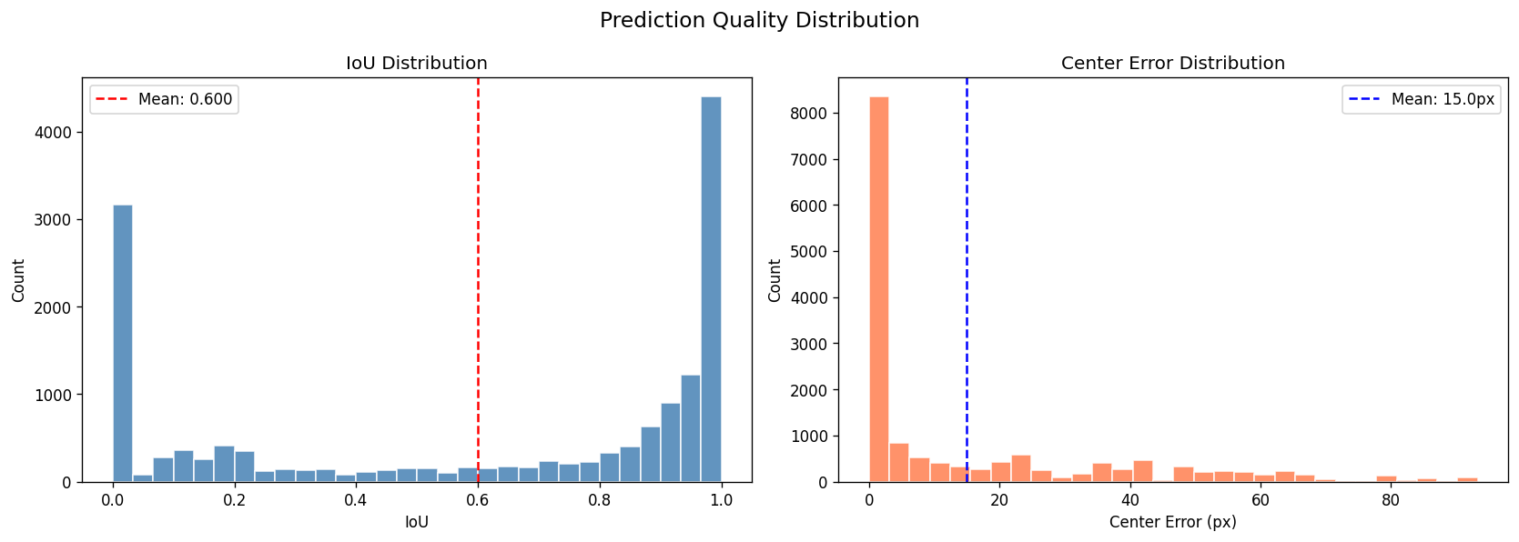
Results and Evaluation

Slide 11
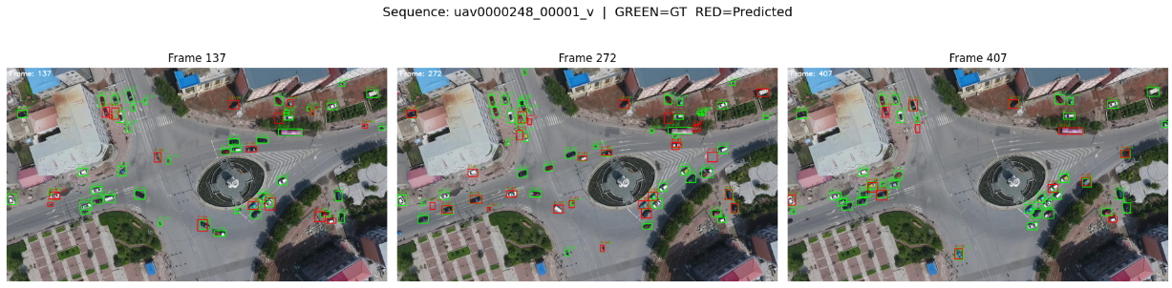
Green bounding boxes represent those that are already included while red ones are the ones predicted from missing detections.
Key Observations:
accurate tracking
Good curvilinear motion
Consistent IDs.
MOTA: 61
IDF1: 58

Slide 12
Future Scope
Non-Linear Dynamics: Implementing Extended or Unscented Kalman Filters to better model complex, sharp drone maneuvers.
Deep Learning Expansion: Moving from Random Forest to architectures like LSTMs or Transformers for better long-term temporal dependencies.
Real-time Deployment: Optimizing the fusion engine for live UAV surveillance rather than strictly offline post-processing.
Multi-Sensor Fusion: Integrating thermal or infrared data to assist in tracking during low-visibility conditions.

Slide 13
References
Bewley, A., Ge, Z., Ott, L., Ramos, F., & Upcroft, B. (2016). Simple online and realtime tracking. In Proceedings of the IEEE International Conference on Image Processing (ICIP).
Bochinski, E., Eiselein, V., & Sikora, T. (2017). High-speed tracking-by-detection without using image information. In Proceedings of the IEEE Conference on Advanced Video and Signal Based Surveillance (AVSS).
Butt, A., & Collins, R. (2013). Multi-target tracking by Lagrangian relaxation to min-cost network flow. In Proceedings of the IEEE Conference on Computer Vision and Pattern Recognition (CVPR).
Kalman, R. E. (1960). A new approach to linear filtering and prediction problems. Journal of Basic Engineering, 82(1), 35–45.
Kuhn, H. W. (1955). The Hungarian method for the assignment problem. Naval Research Logistics Quarterly, 2(1–2), 83–97.
Luo, W., Xing, J., Milan, A., Zhang, X., Liu, W., & Kim, T.-K. (2021). Multiple object tracking: A literature review. Artificial Intelligence, 293, 103448.
Pedregosa, F., Varoquaux, G., Gramfort, A., Michel, V., Thirion, B., Grisel, O., Blondel, M., Prettenhofer, P., Weiss, R., Dubourg, V., Vanderplas, J., Passos, A., Cournapeau, D., Brucher, M., Perrot, M., & Duchesnay, E. (2011). Scikit-learn: Machine learning in Python. Journal of Machine Learning Research, 12, 2825–2830.
Zhu, Z., Luo, H., Wei, X., Ye, Y., Ren, W., Wang, H., & Wen, L. (2019). VisDrone-MOT2019: The vision meets drone multiple object tracking challenge results. In Proceedings of the IEEE/CVF International Conference on Computer Vision (ICCV) Workshops.

Slide 14
THANK YOU

