Slide 1
FILTERING PATTERN ON ELECTION VOTING WITH VISUALISATION PATTERN INTERPRETATION
TEAM MEMBERS :-
Asani Vidhathri: 700732408
Arun Kumar Yeddula: 700739780
Rajesh Adepu: 700741537

Slide 2
ABSTRACT
The Election Voting Systems Assessment is an unprecedented project premised on a collaborative approach that ensures greater citizen input.
This project analyse the election voting in response to the growing voting system needs faced by the Country.
Voters in these studies evaluated the systems based on values associated with accuracy, security, and ease of use.
.
A large part of the survey and focus group research was dedicated to identifying how and what voters prioritize as core values that a voting system should satisfy.
The data is filtered and the data is interpreted with visualization with the help of data analytic tool. The analysis research suggests that voters use their stated values to evaluate and make up their minds about voting systems.
Voters in these studies evaluated the systems based on values associated with accuracy, security, and ease of use.

Slide 3
ROLES AND RESPONSIBILITIES
A large part of the survey and focus group research was dedicated to identifying how and what voters prioritize as core values that a voting system should satisfy.
The data is filtered and the data is interpreted with visualization with the help of data analytic tool. The analysis research suggests that voters use their stated values to evaluate and make up their minds about voting systems.

Slide 4
MOTIVATION
Increase transparency and accountability in the election voting process
Address the need for efficient and reliable voting systems
Enhance public trust and confidence in the electoral process
Facilitate fair and accurate representation of voters' choices

Slide 5
OBJECTIVES
Develop a comprehensive assessment of election voting systems
Evaluate systems based on accuracy, security, and ease of use
Identify areas for improvement in existing voting systems
Propose recommendations for enhancing the voting experience

Slide 6
RELATED WORK
Review existing research and studies on election voting systems
Explore best practices and innovations in the field of voting technology
Analyze case studies of successful voting system implementations
Identify challenges and lessons learned from previous election assessments

Slide 7
PROBLEM STATEMENT
Inefficient and outdated election voting systems hinder the democratic process.
Lack of transparency and accountability in the current voting systems raises concerns about the integrity of elections.
Complex and error-prone voting procedures lead to confusion and disenfranchisement among voters.
Vulnerabilities in existing voting systems pose risks to the security and accuracy of election results.
Limited accessibility options restrict the participation of certain groups in the electoral process.

Slide 8
PROPOSED SYSTEM
Using machine learning algorithm to find trend setting strategies from the overall positive strategies and would help parties to win the current trend elections.
To create an attribute people survey percentage compare with result, and also using Linear Regression Algorithm..

Slide 9
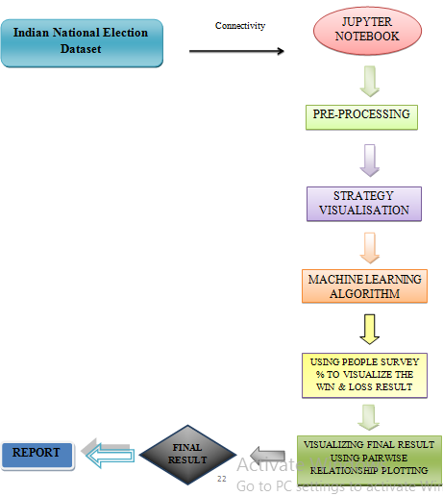
DATA FLOW DIAGRAM

Slide 10
PROJECT DESCRIPTION
Identifying and pre-processing parties for customizing them and removing null values.
Taking the past election result into account; analysing their winning/losing ways and visualising the comparison therefore, predicting the strategy of winners.
Visualising Final Result using pair wise relationship plotting and calculate the accuracy score for logistic , polynomial and linear regression.
the data is filtered and the data is interpreted with visualization with the help of data analytic tool. The analysis research suggests that voters use their stated values to evaluate and make up their minds about voting systems

Slide 11
SYSTEM CONFIGURATION
HARDWARE REQUIRMENTS:
Device name- WINDOES-74PPV22
Processor - Intel(R) Core(TM) i3-7020U CPU@ 2.30GHz 2.30 GHz
Installed RAM- 4.00 GB (3.43 GB usable)
System type- 64-bit Operating system, x64-based processor
Pen and touch-No pen or touch input is available for this display
HARDWARE REQUIRMENTS:
Operating system: Windows* 7 or later, macOS, and Linux
Python* version: 3.8.5
Front-end Tool: Jupyter Notebook 6.1.4

Slide 12
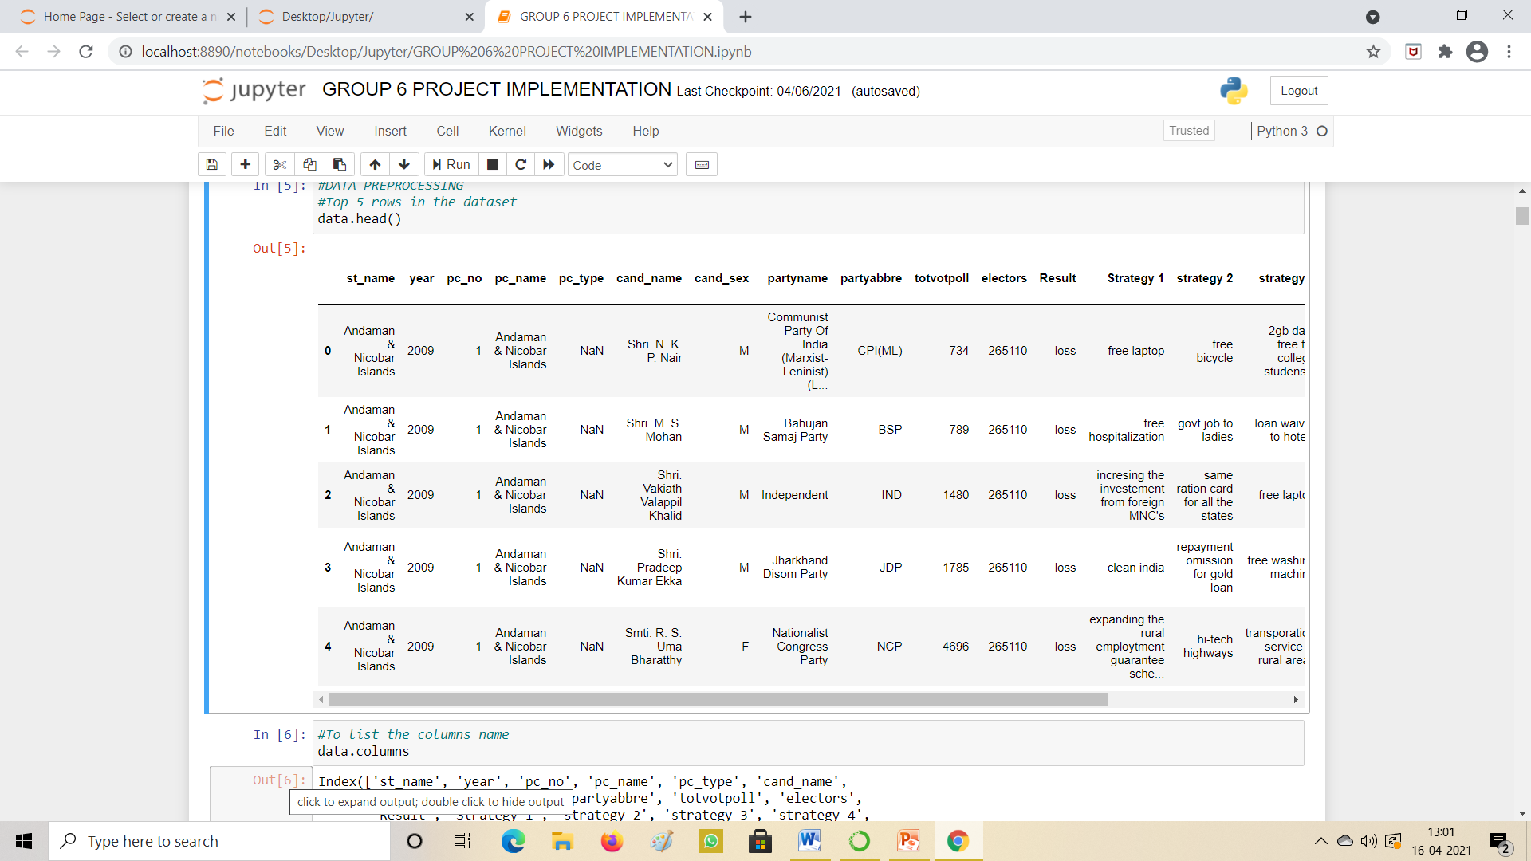
EXPERIMENTAL OUTPUT :DATASET

Slide 13
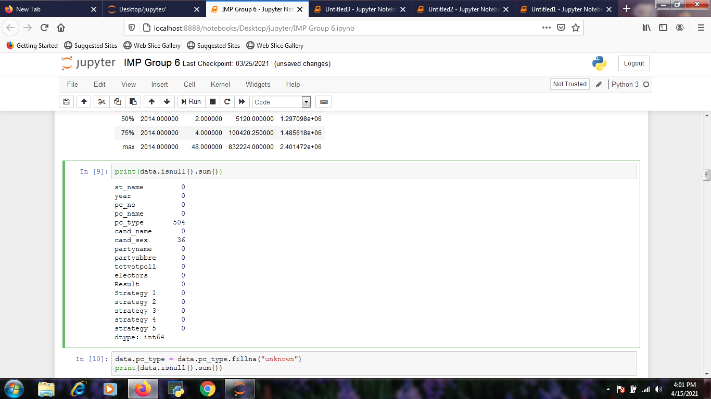
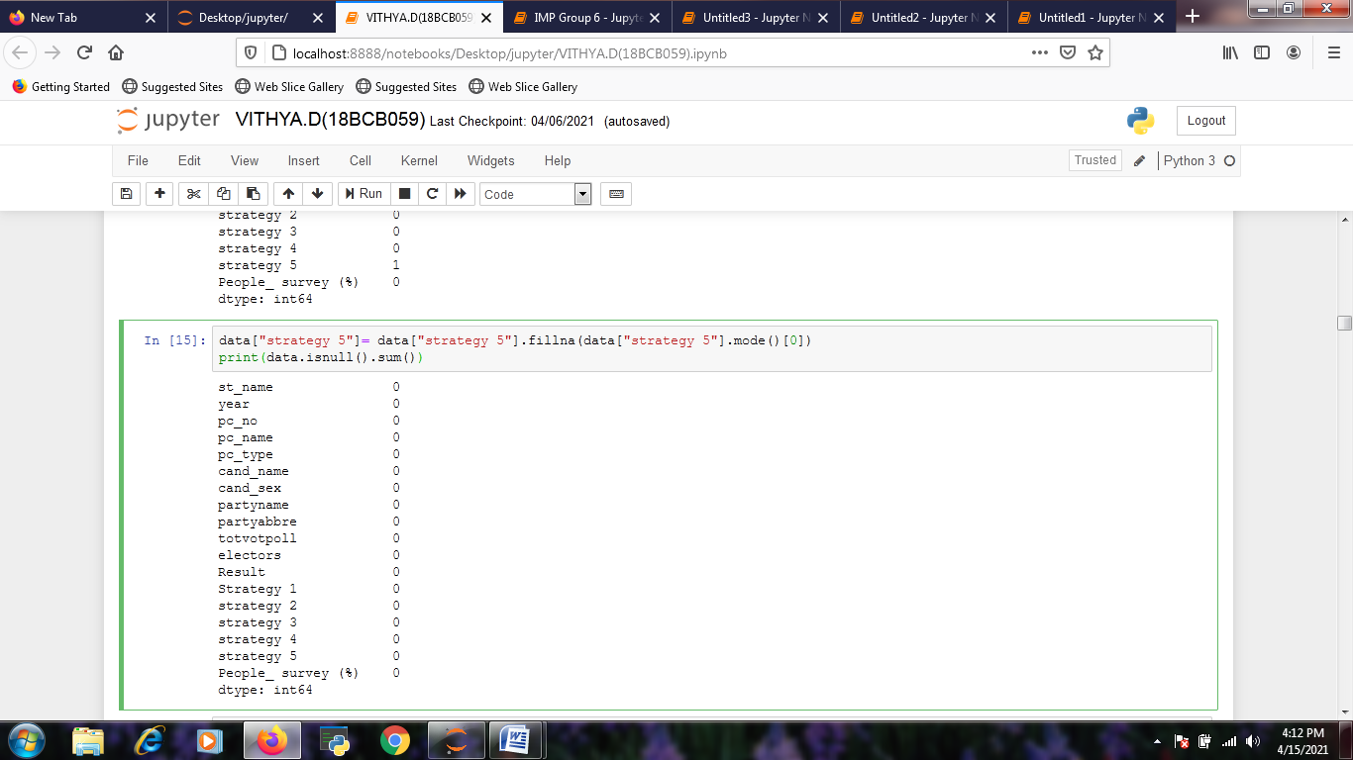
DATA PRE- PROCESSING
DISPLAY HOW MANY NULL VALUES:
REMOVE NULL VALUES:

Slide 14
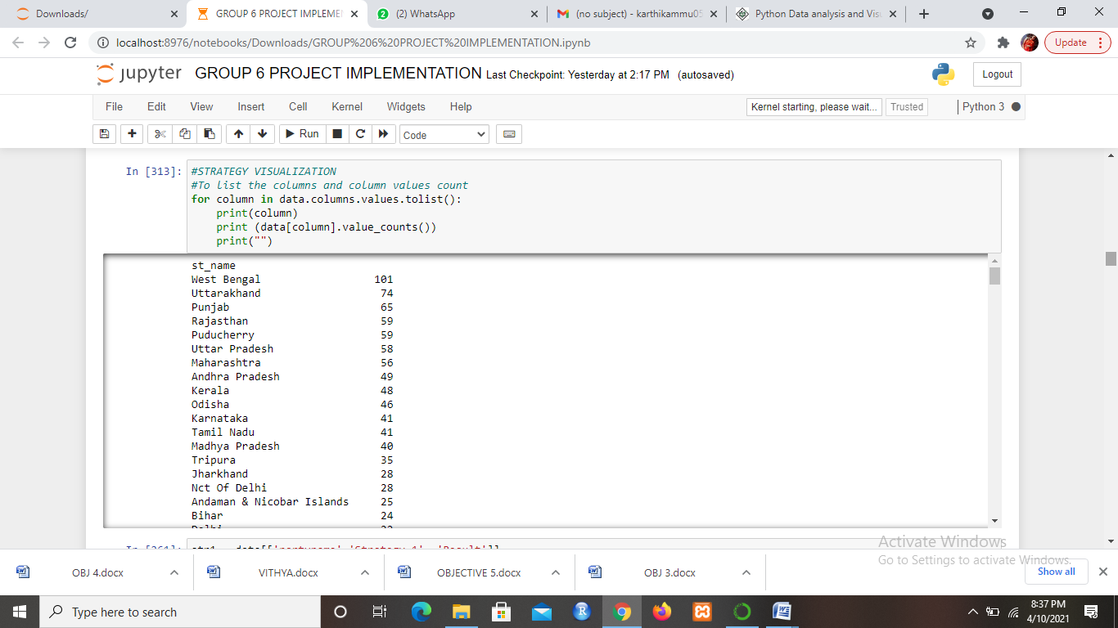
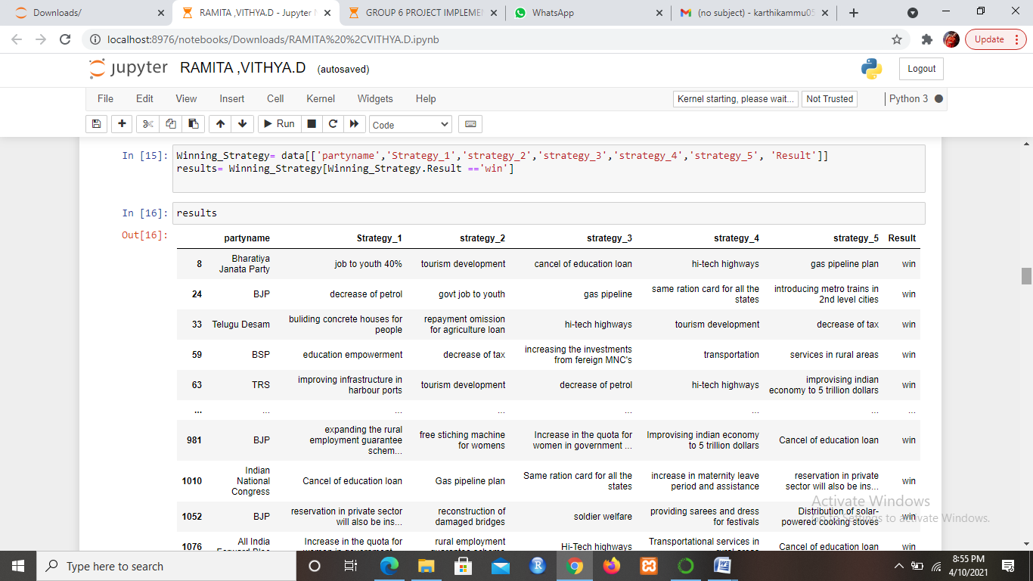
STRATEGY VISUALISATION
TO LIST THE COLUMNS AND COLUMN VALUES COUNT:
VISUALIZING THE STRATEGY 1-5

Slide 15
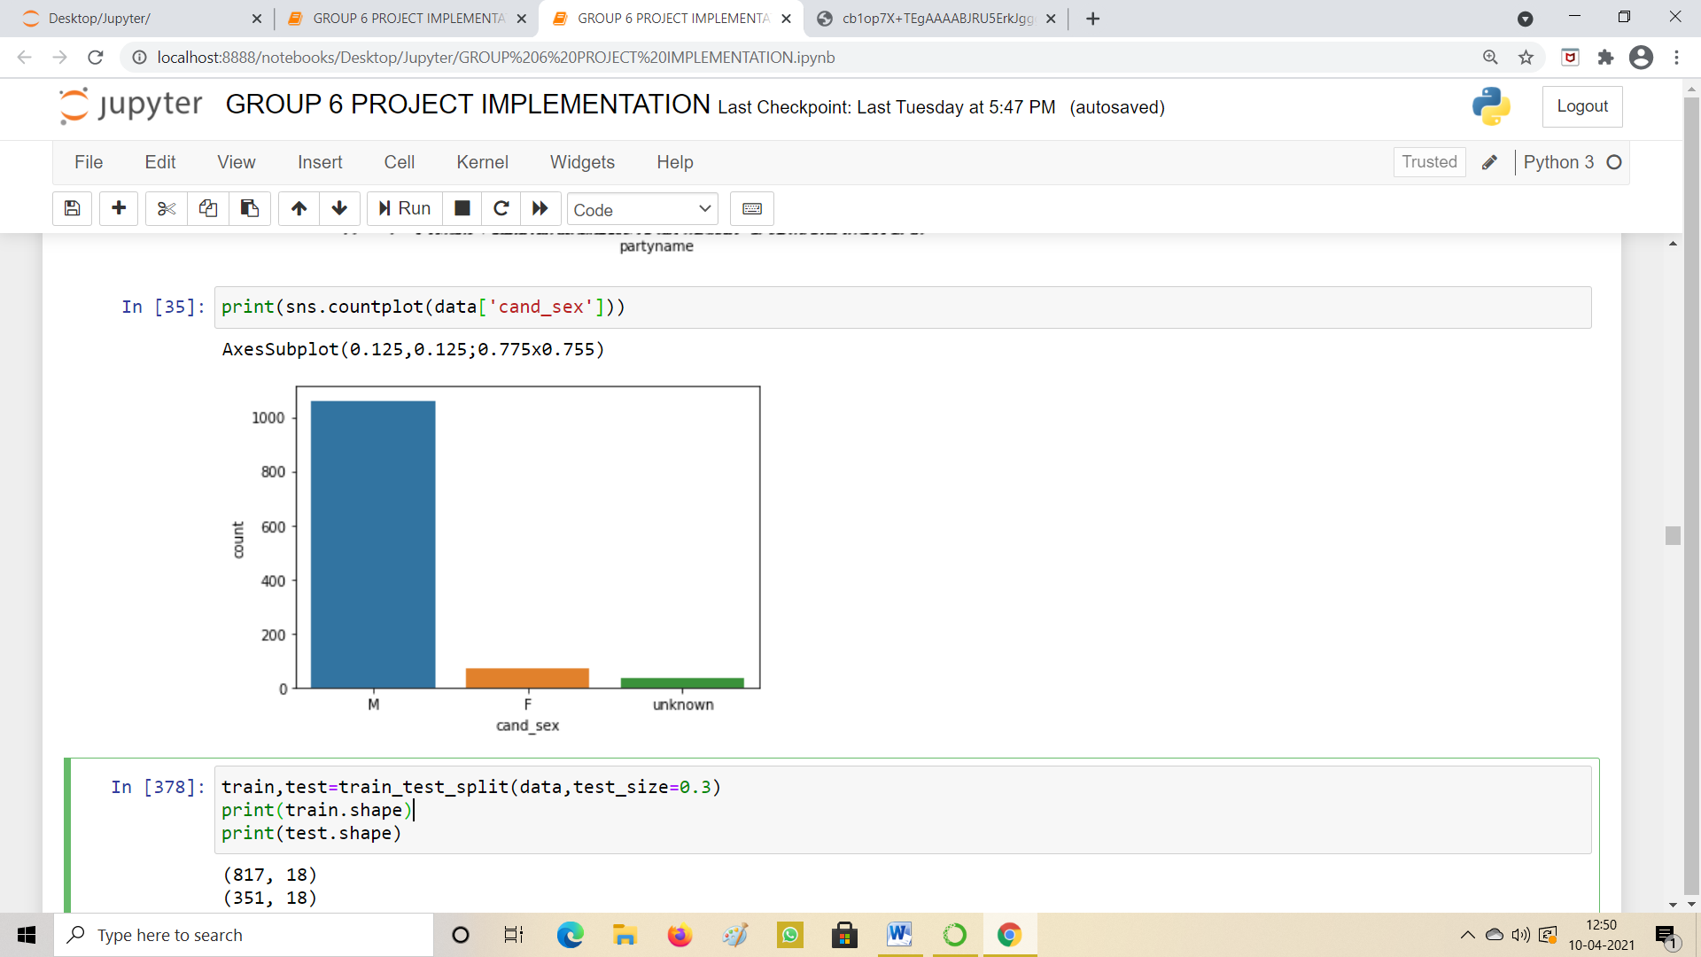
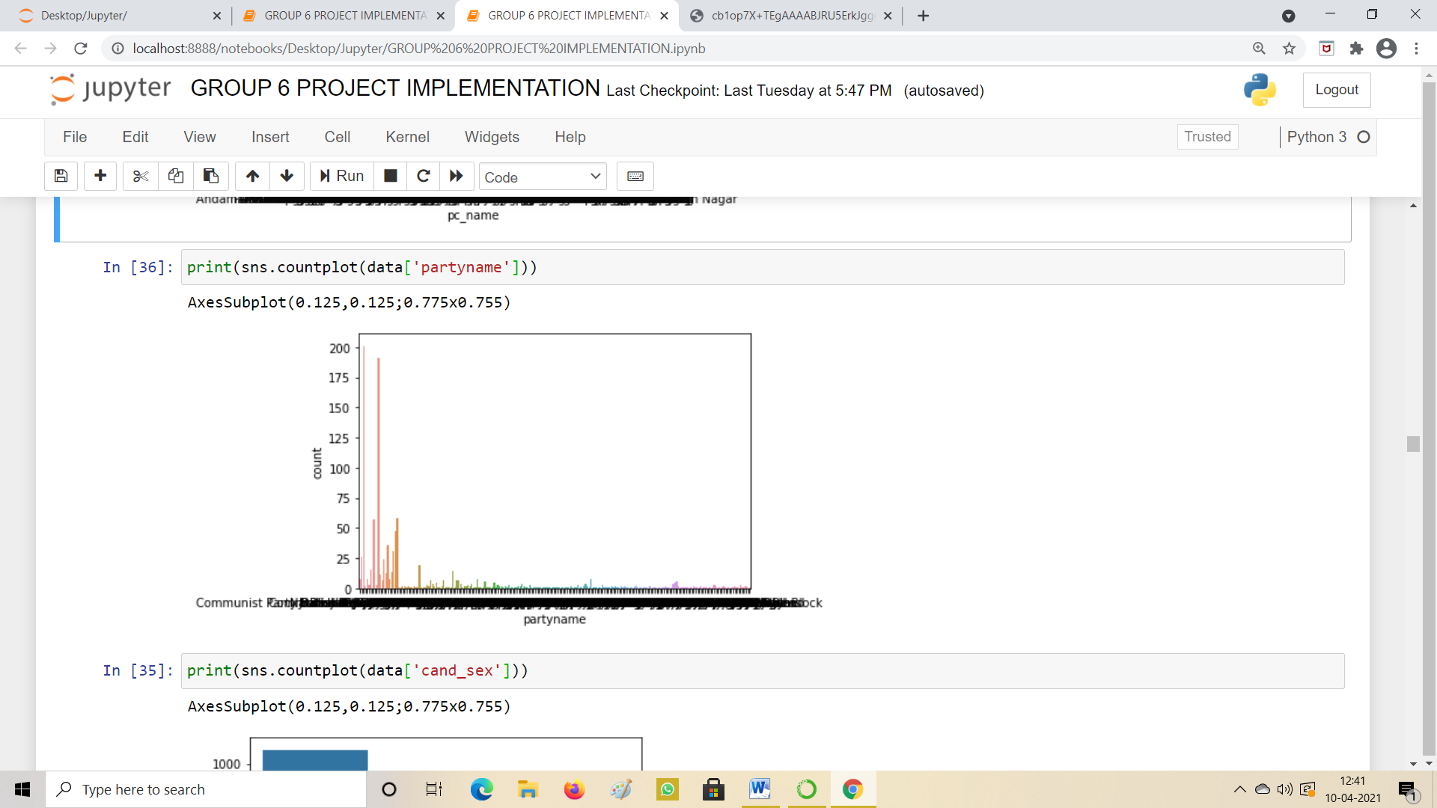
SEABORN PLOTS
COUNT OF MALE AND FEMALE CANDIDATES
COUNT OF PARTY

Slide 16
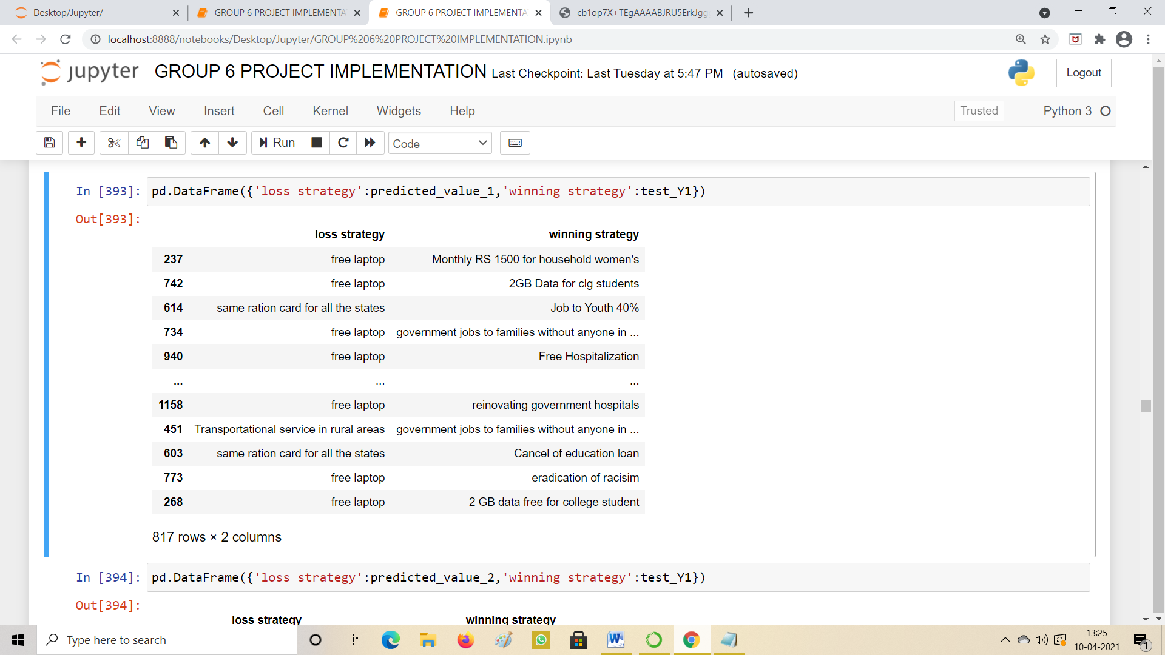
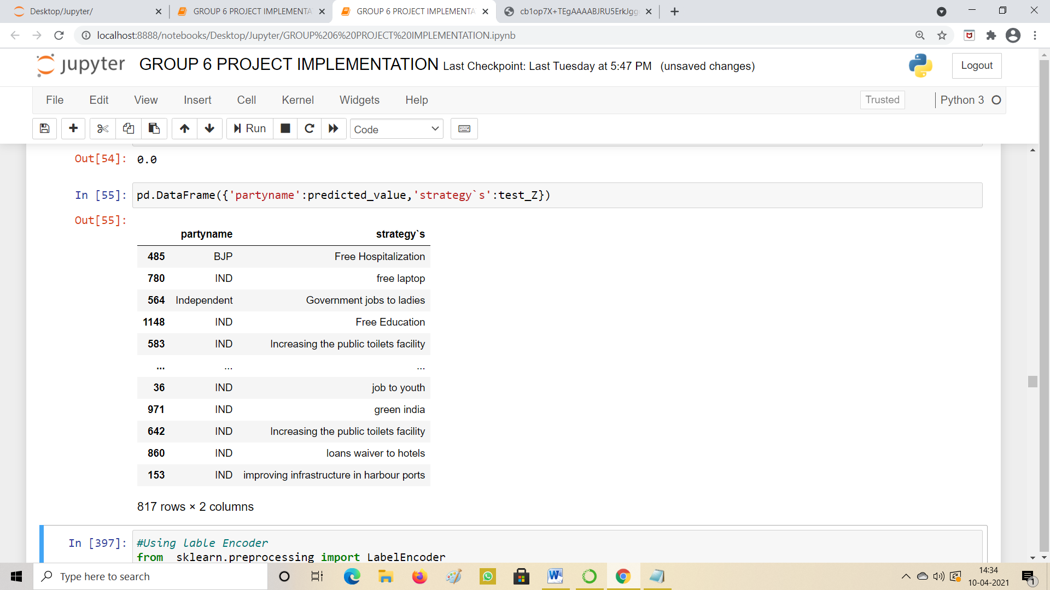
Logistic Regression
ANALYSING THE STRATEGY USING LOGISTIC REGRESSION
TO ANALYSE BEST TREND SETTING STRATEGY

Slide 17
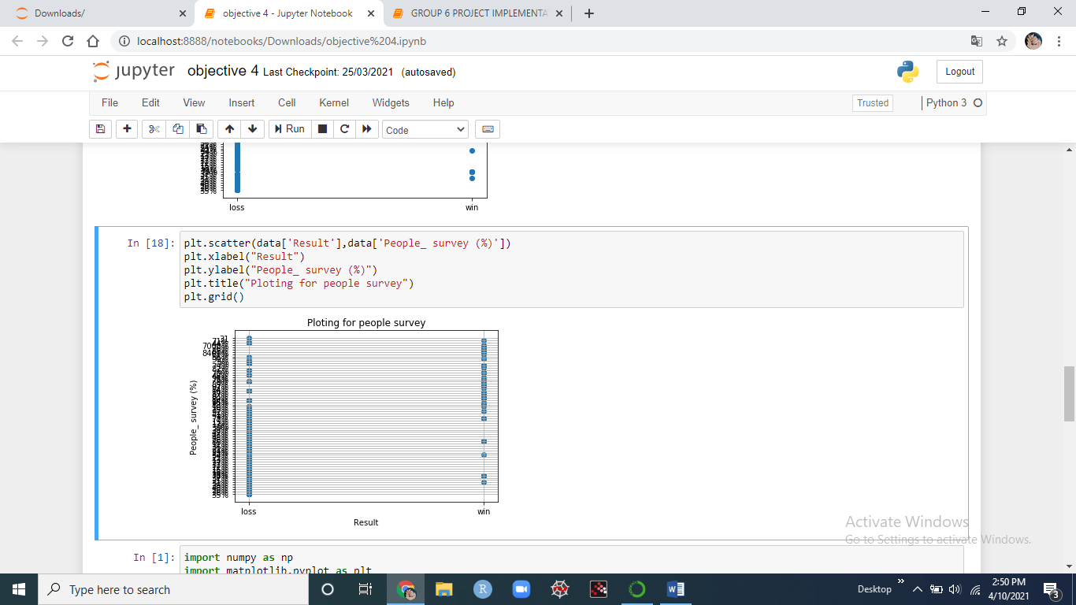
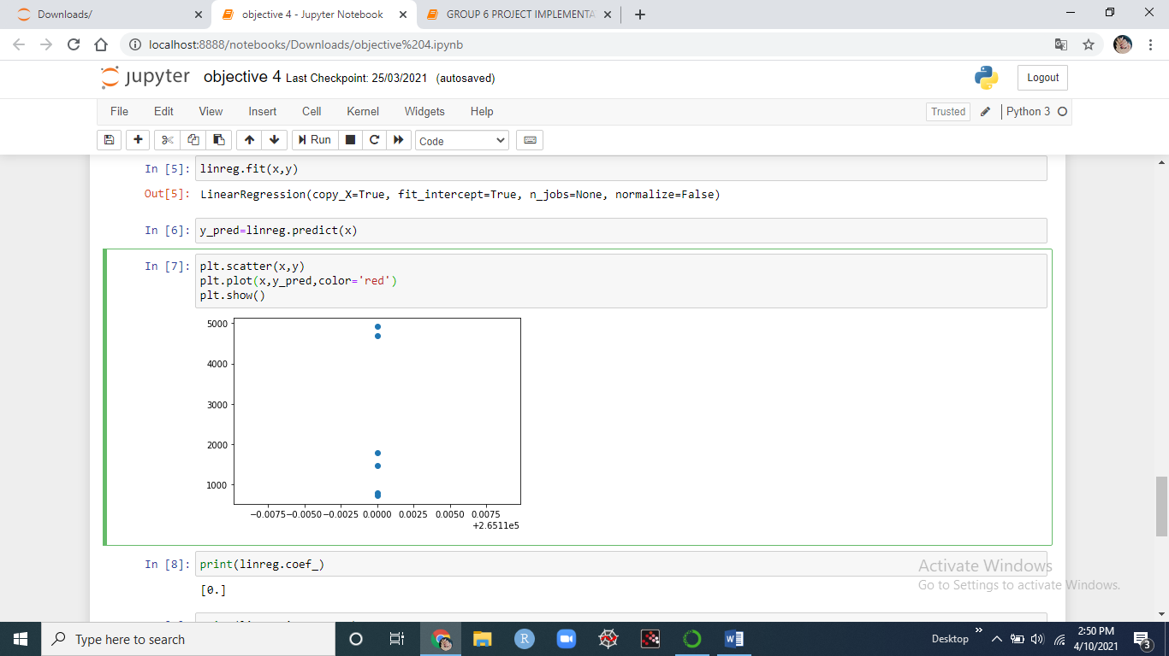
Using People Survey % To Visualise the win and loss result
COMPARISION OF TWO ATTRIBUTES
LINEAR REGRESSION

Slide 18
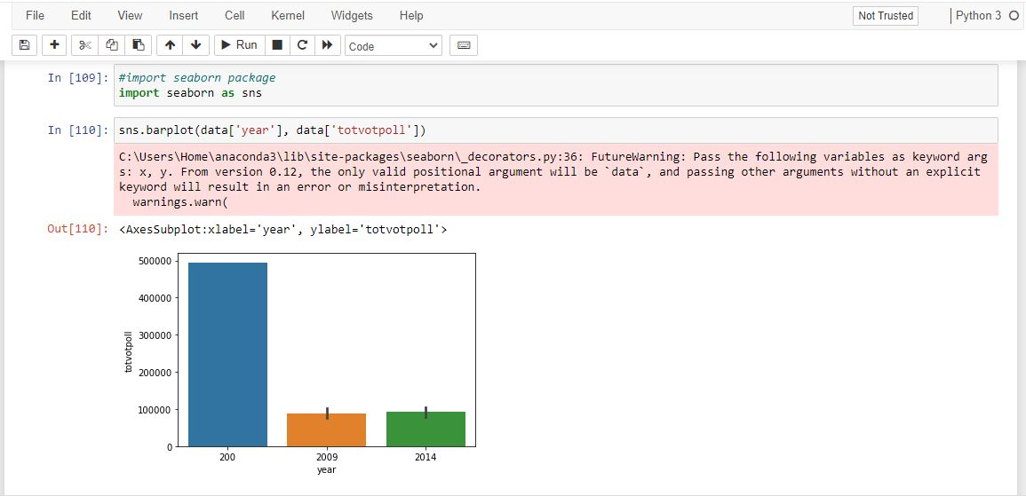
VISUALISING THE FINAL RESULT USING PAIR WISE RELATIONSHIP PLOT

Slide 19
CONCLUSION
In this project we used python as backend and jupyter notebook as frontend for better analysis and visualizing the result.
With the election data of the year 2009 and 2014 we analyzed in which state which party used what kind of strategies to win the election. In the analysis we found that winning strategies may help in the current election situation.
Before suggesting the usage of winning strategies we must need the peoples opinion about those strategies to check whether the strategies are useful in real life or not.
So we added the people survey percentage to make sure analysis is correct.
In this project we visualized the year, state name, party participated in the election, number of electors, and the votes secured by each parties using the strategies are visualized to give a better view about the analysis.

Slide 20
REFERENCES
[1] Aswini Varna V V ,Research Scholar, Dept. of Politics and International Studies Pondicherry University, Puducherry, India
[2] Alex Halderman's .j Security Analysis of India’s Electronic Voting MachinesSeptember 2010 DOI: 10.1145/1866307.1866309SourceDBLP Conference: Proceedings of the 17th ACM Conference on Computer and Communications Security, CCS 2010, Chicago, Illinois, USA, October 4-8, 2010
[3] Bibek Debroy1 and Kishore Desai2
[4] BirajHazarika (2015), Voting Behaviour In India and Its Determinants, Journal of Humanities and Social Science 20:10,pp 22-25
[5] Dr. Gagandeep Jagdev, Mahabli Mann, 3Dr. Dinesh Kumar Dept. of Computer Science, Punjabi University Guru Kashi College, Damdama Sahib (PB) 2Research Scholar (M.Phil. Comp. Applications), Guru Kashi University, Talwandi Sabo (PB) 3Associate Professor, Guru Kashi University, Talwandi Sabo (PB)
[6] Dr. MeenaRathaur Principal, Shri BhawaniNiketan Girls P.G. College, University of Rajasthan, India.meenarathaur74@gmail.com
[7] Gautam Chikermane Foreword by Rakesh Mohan© 2018 by Observer Research Foundation
[8] GayatriSunkad, Department of Political Science, Shri Kalidas Degree College, Badami, Bagalkot, Karnataka, India.gayatri.sunkad@gmail.com
[9] Hardeep Kaur Assistant Professor, Department of political science B.L.M Girls College, Nawanshahr Punjab,India.
[10] India 2014 A Reference Annual, Publications Division, Ministry of Information and
Broadcasting, Government of India; P.67

Slide 21
THANK YOU

