Slide 1



Title: HOUSE PRICE PREDICTION MODEL USING MACHINE LEARNING
Subtitle: Leveraging IBM Cloud and Watson Studio
Presented by: Vidhi Dave
College: SAL Institute of Technology and Engineering Research
IBM AI-ML Internship Project

Slide 2
Introduction:
Purpose: To automatically predict house prices using machine learning based on property features such as area, locality, number of rooms, and amenities.
How it works: The model learns patterns from historical property data and predicts a realistic price using algorithms like Random Forest. It considers key features such as built-up area, locality, furnishing, floor, and premium amenities like gym or swimming pool.
Benefit: Helps buyers, sellers, and real estate agents by providing instant, fair, and data-driven house price estimations — reducing reliance on subjective or outdated valuations.

Slide 3
Problem Statement:
Objective:
The primary objective of this project is to develop a House Price Prediction Model using Machine Learning techniques that can automatically estimate the price of residential properties in India based on key features such as area, number of rooms, locality, and amenities.
Specific Goals:
Predict house prices using structured property data.
Ensure accurate and realistic pricing (up to ₹5 crore).
Speed up the property evaluation process.
Learn patterns from location and amenity-based features.
Assist buyers and sellers in making quick, data-driven decisions.

Slide 4

Data Collection and Preprocessing:
Feature Selection and Engineering:
Data Source: Simulated or real property data collected from online real estate platforms (e.g., MagicBricks, 99acres), public housing datasets, or manually curated CSVs.
Features Included: House age, built-up area, number of bedrooms and washrooms, locality tier, property type, floor level, total floors, and amenities like parking, lift, gym, power backup, swimming pool.
Preprocessing Steps:
Handling missing values (if any).
Encoding categorical variables like locality and property type.
Scaling features using StandardScaler to normalize input for better model performance
Feature Selection: The following features are chosen for their strong influence on house price:
Structural: Area, bedrooms, washrooms, house age
Locational: Locality tier, property type, floor, total floors
Amenities: Parking, lift, gym, pool, power backup, security
Feature Engineering:
Ordinal encoding for locality (Tier-3 < Tier-2 < Tier-1).
Combining related amenities to better reflect luxury impact on pricing.

Slide 5
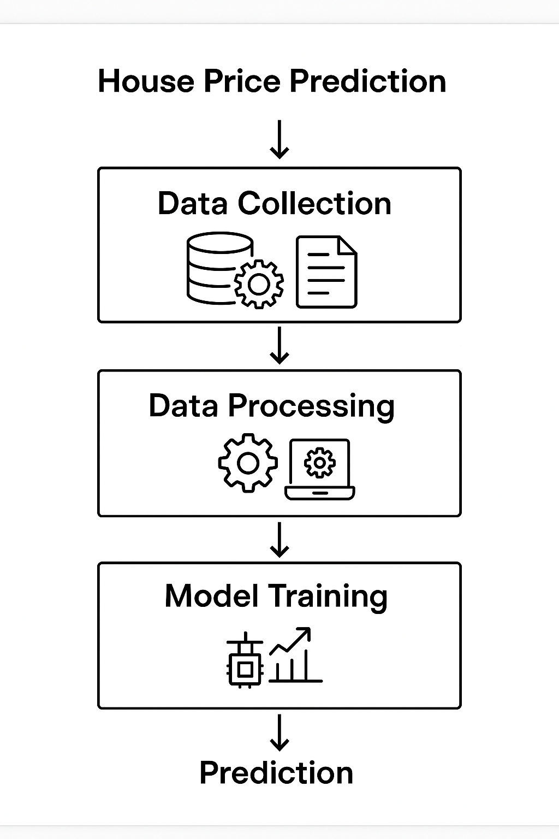
Model Development:
Algorithm Used:
A Random Forest Regressor was selected for its ability to handle nonlinear relationships and multiple input features efficiently. It builds an ensemble of decision trees and outputs the average prediction, improving accuracy and reducing overfitting.
Model Training: The model is trained on structured tabular data containing house features such as area, locality, number of bedrooms, and amenities. The data is split into training and testing sets (80/20), and features are normalized using StandardScaler.
Parameter Optimization: Key hyperparameters tuned include:
n_estimators: Number of decision trees in the forest
max_depth: Maximum depth of each tree
random_state: For reproducibility These parameters were adjusted using grid search and cross-validation to achieve the best balance between bias and variance.
Price Range Constraint: The model output is clipped to a maximum of ₹5 crore to ensure predictions remain within realistic upper bounds for most urban Indian properties.

Slide 6

Tools and Resources:
IBM Cloud and Watson Studio:
Description:
IBM Cloud provides a comprehensive cloud platform with various tools and services.
Watson Studio is a powerful tool for data science and machine learning.
Usage:
Use IBM Cloud for data storage, processing, and model deployment.
Use Watson Studio for model development, training, and evaluation.

Slide 7
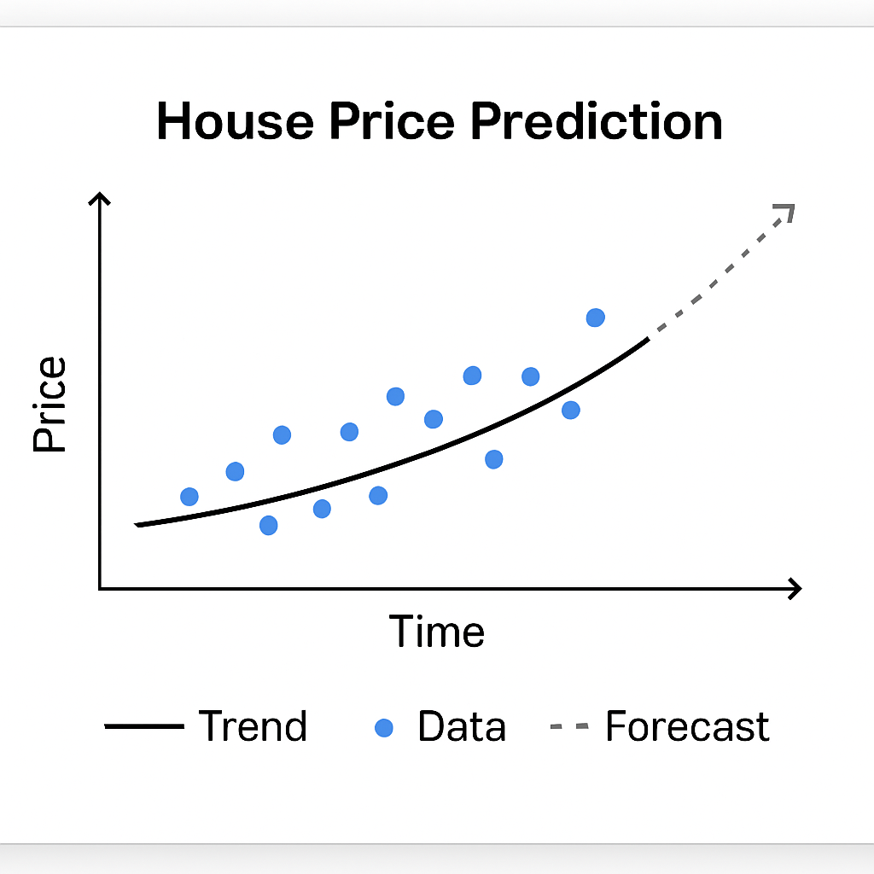
Model Impact and Effectiveness:
Problem Solving:
Accurate Pricing Guidance The model offers realistic, data-driven property price predictions based on inputs like area, location, and amenities — removing guesswork and manual bias.
Time-Efficient Evaluation Manual property valuation is time-consuming. This model enables instant price estimation, helping users make decisions quickly.
User-Friendly Interface Built with Streamlit, the app allows users to input property features easily and receive immediate price predictions — no coding or technical knowledge required.
Accessible to All The system can be used by home buyers, sellers, real estate agents, or even integrated into larger platforms — improving access to property insights even in underserved or rural areas.
Dynamic and Scalable The model architecture is flexible and can scale to include real-time data or city-specific pricing models for even more accuracy.

Slide 8
Why It Will Work:
Strong Feature Understanding The model effectively learns how property features like area, locality tier, amenities, and property type influence price, allowing for accurate and interpretable predictions.
Well-Structured Training Data The dataset includes a wide range of house types and conditions (e.g., villas, apartments, penthouses), ensuring the model generalizes well across different property types.
Reliable and Tuned Algorithm The Random Forest Regressor is a robust machine learning algorithm that minimizes overfitting and performs well even with complex, nonlinear data.
Efficient Development and Deployment The model was built using Python’s scikit-learn library and deployed with Streamlit, enabling quick testing, user-friendly interaction, and easy updates.
Scalability and Flexibility The app can scale to include:
Location-specific models
Integration with real-time data APIs (e.g., from real estate portals)
Customizations for commercial or rental properties

Slide 9
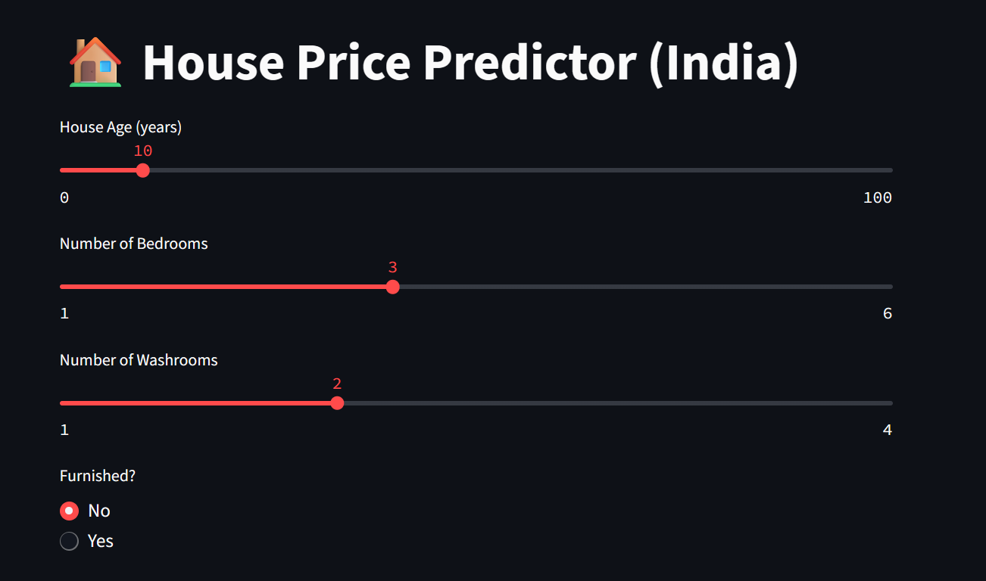
Results or Outcome:
Streamlit:-

Slide 10
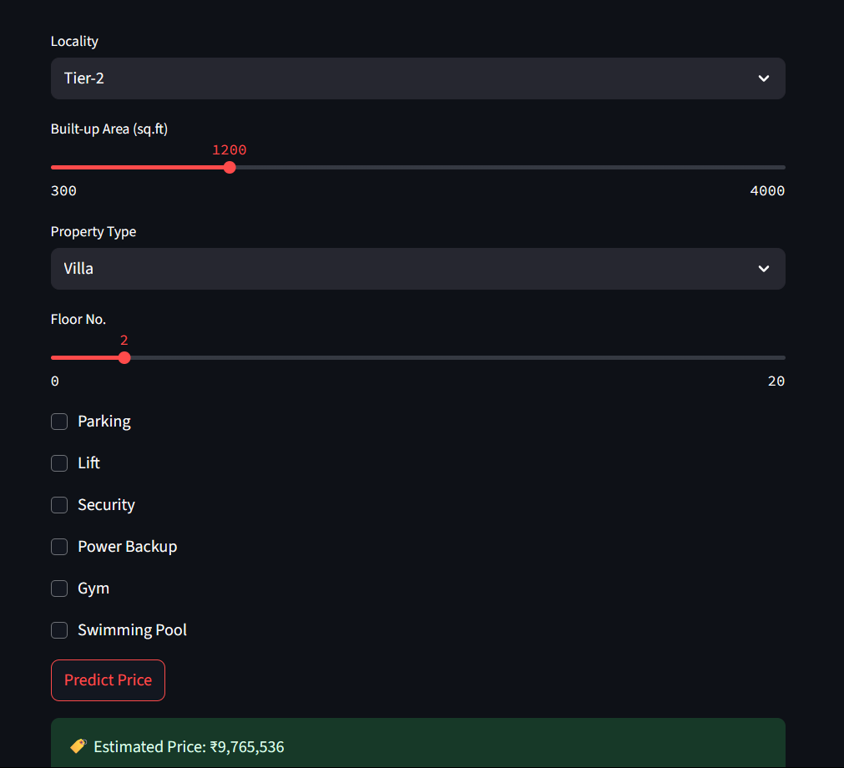
For Villa, Row-house:-

Slide 11
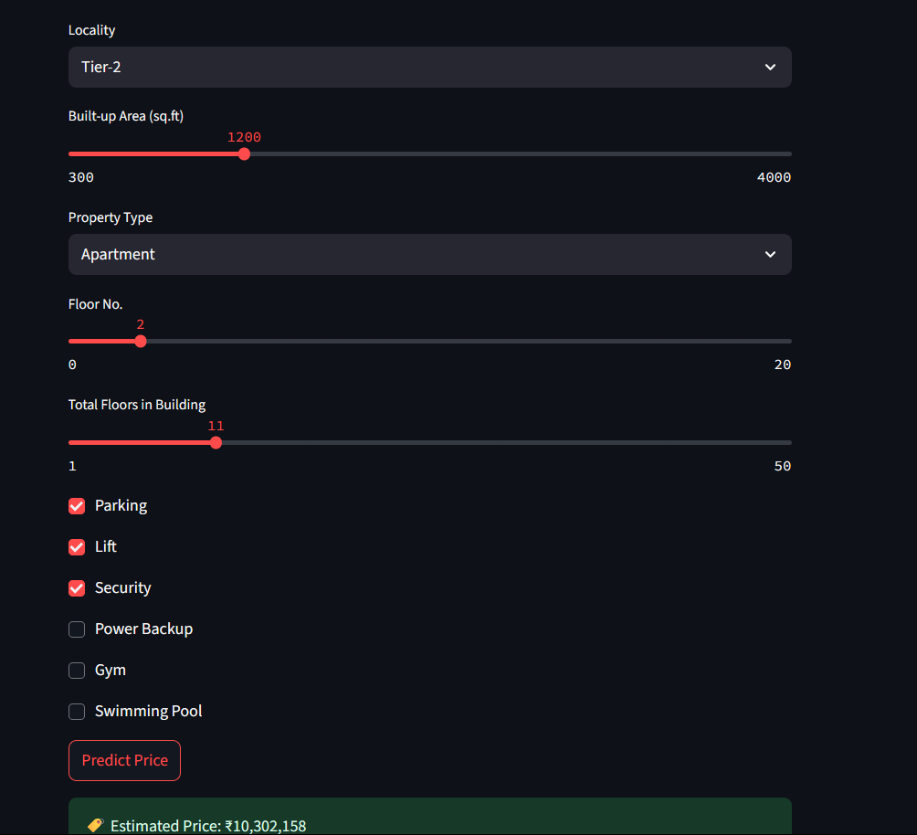
Appartments:-

Slide 12
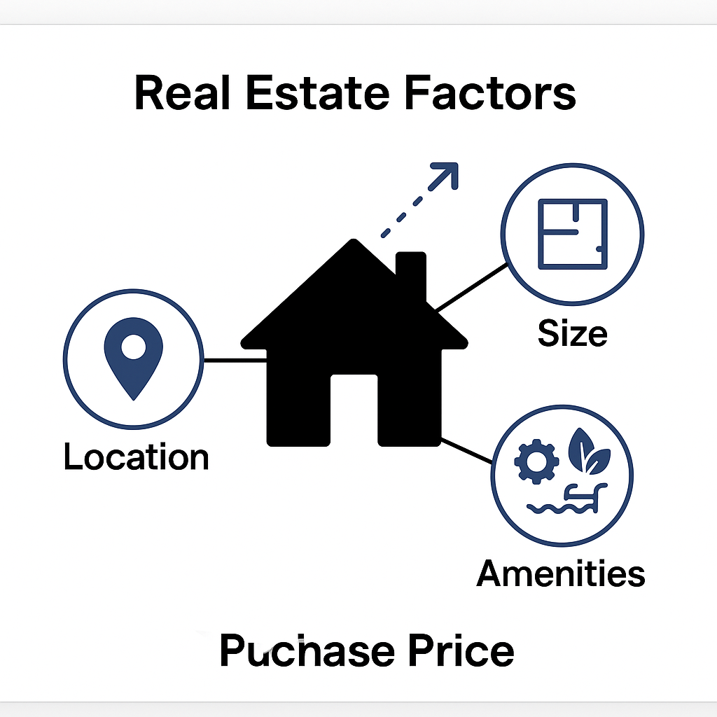

Link to ML Model:
Direct Link:
GIT_HUB:-
https://github.com/Vidhi-1106/ML_Projects.git

Slide 13
Conclusion:
This House Price Prediction system provides an intuitive and accurate way to estimate real estate prices in India. The model is trained to understand the impact of locality, size, and amenities on the price and is capped at ₹5 Crore to maintain realistic predictions. By using Streamlit, the model is made accessible for anyone — buyers, sellers, and agents — to estimate property value instantly.

