Slide 1

Subject Code:3CA1301

Slide 2

System Programming & Operating Systems
D. M. Dhamdhere
Chapters : 1 to 8
Device Drivers

Slide 3
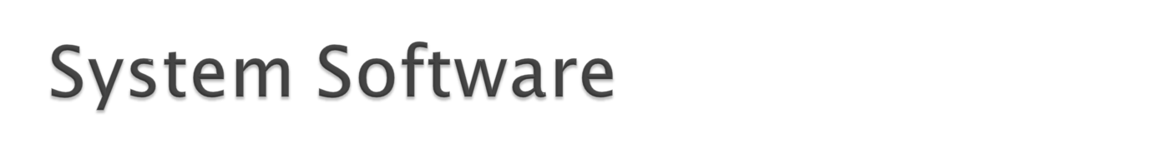
System:
Software :
Computer software, or simply software, refers to the non-tangible components of computers, known as computer programs. The term is used to contrast with computer hardware, which denotes the physical tangible components of computers.

Slide 4

Software can be classified into
  System software:
  System software (or systems software) is computer software designed to operate and control the computer hardware and to provide a platform for running application software.
    System software is collection of software program that perform a variety of functions like IO management, storage management,generation and execution of programs etc.
      Operating Systems
      Compiler / Assembler (utility softwares)
      Device Drivers
  Application software:
    Application software is kind of software which is designed for fulfillment specialized user requirement.
      MS Office
      Adobe Photoshop

Slide 5

The system software work as middleware between application software and hardware.
Application software
System Software
Hardware

Slide 6


Slide 7
Language processors (Why?)
  Language processing activities arise due to the differences between the manner in which a software designer describes the ideas concerning the behavior of software and the manner in which these ideas are implemented in computer system.
  The designer expresses the ideas in terms related to the application domain of the software.
  To implement these ideas, their description has to be interpreted in terms related to the execution domain.

Slide 8
Semantic gap
The term semantics to represent the rules of meaning of a domain, and the term semantic gap to represent difference between the semantics of two domains.
Application domain
Execution domain

Slide 9
The semantic gap has many consequences, some of the important are
  Large development times
  Large development effort
  Poor quality software.
these issues are tackled by software engneering thru’ use of methodologies and programming languages.

Slide 10
Specification gap
Execution gap
s/w development team
Programing language processor
Application domain
PL
domain
Execution domain

Slide 11
Language processor: A language processor is software which bridge a specification or execution gap.
  A Language Translator
  De-translator
  Preprocessor
  Language migrator

Slide 12

Errors
C++ Program
C++ Preprocessor
C
Program
Errors
C++ Program
C++ Translator
Machine language program

Slide 13

An interpreter is language processor which bridges an execution gap without generating a machine language program that means the execution gap vanishes totally.
Interpreter domain
Application domain
PL
domain
Execution domain

Slide 14

Three consequences of the semantic gap are in fact the consequences of specification gap.
A classical solution is to develop a PL such that the PL domain is very close or identical to the application domain.
Such PLs can only used for specific applications, they are problem oriented languages.

Slide 15

A procedure oriented language provides general purpose facilities required in most application domains.
Specification gap
Execution gap
Problem oriented language
domain
Application domain
Execution domain

Slide 16

Fundamental activities divided into those that bridge the specification gap and execution gap.
  Program generation activities
  Program execution activities

Slide 17
Program generation activities
  A program generation activity aims at automatic generation of a program.
  A source language is a specification language of an application domain and the target language is procedure oriented PL.
  Program generator introduces a new domain between the application and PL domain , call this the program generator domain.
  Specification gap now between Application domain and program generation domain, reduction in the specification gap increases the reliability of the generated program.

Slide 18
This arrangement also reduces the testing effort.
Errors
Program specification
Program generator
Program in target PL

Slide 19
Program Execution
  Two popular model
    Program Translation
    Program Interpretation

Slide 20
The program translation model bridges the execution gap by translating a sources program into program in the machine or assembly language of the computer system, called target program.
Errors
Data
Source program
Translator
m/c Language program
Target program

Slide 21
Characteristics of the program translation model:
  A program must be translated before it can be executed
  The translated program may be saved in a file. The saved program may be executed repeatedly.
  A program must be retranslated following modifications.

Slide 22
Program interpretation: during interpretation interpreter takes source program statement, determines its meaning and performs actions which implement it.
The function of an interpreter is same as the execution of machine language program by CPU.

Slide 23
Interpreter
Memory
CPU
Memory
PC
Source Program
+
Data
PC
Machine language Program
+
Data
Errors
Interpretation
Program execution

Slide 24
Characteristics
  The source program is retained in the source form itself, no target program form exists,
  A statement is analyzed during its interpretation.
Comparison
  In translator whole program is translated into target and if modified the source program, whole source program is translated irrespective to size of modification.
  That not the in case of interpreter, interpretation is slower than execution of m/c language program.

Slide 25

Language Processing = Analysis of SP + Synthesis of TP.
Analysis phase of Language processing
Lexical rules which govern the formation of valid lexical units in the source language.
Syntax rules which govern the formation of the valid statements in the source language.
Semantic rules which associate meaning with the valid statements of the language.

Slide 26
The synthesis phase is concerned with the construction of target language statement which have same meaning as a source statement.
  Creation of data structures in the target program(memory allocation)
  Generation of target code.(Code generation)
Language Processor
Source Program
Analysis Phase
Synthesis Phase
Target Program
Errors
Errors

Slide 27
percent_profit = (profit*100) / cost_price;
Lexical Analysis
Syntax Analysis
Semantic Analysis

Slide 28
Forward references: for reducing execution gap the language processor can performed on a statement by statement basis.
Analysis of source statement can be immediately followed by synthesis of equivalent target statements. But this may not feasible due to :Forward reference
“A forward reference of a program entity is a reference to the entity which precedes its definition in the program.”

Slide 29
Language processor pass: “A language processor pass is the processing of every statement in a source program, or its equivalent representation, to perform a language processing function.”
Intermediate representation(IR): “An intermediate representation is a representation of a source program which reflects the effect of some, but not all, analysis and synthesis tasks performed during language processing.”

Slide 30
Language Processor
Source Program
Front end
Back end
Target Program
Intermediate representation (IR)

Slide 31
Semantic Action: “All the actions performed by the front end, except lexical and syntax analysis, are called semantic action.
  Checking semantic validity of constructs in SP
  Determining the meaning of SP
  Constructing an IR

Slide 32

The Front End
  The front end performs lexical, syntax and semantic analysis of the source program, each kind of analysis involves the following functions:
    Determine validity of source statement from the view point of the analysis.
    Determine the ‘content’ of a source statement
      For lexical, the lexical class to which each lexical unit belongs.
      Syntax analysis it is syntactic structure of source program.
      Semantic analysis the content is the meaning of a statement.
    Construct a suitable representation of source statement for use by subsequent analysis function/synthesis phase.

Slide 33
Source Program
Scanning (Lexical Analysis)
Symbol table
Constants table
Etc..
Parsing (Syntax Analysis)
Semantic Analysis
IC
IR

Slide 34
Out put of front end produced two components: (IR)
  Table of information
    The symbol table which contain information concerning all identifier used in the source program.
  An intermediate code (IC) which is a description of the source program.
    The IC is a sequence of IC units, each IC unit representing the meaning of one action in SP. IC units may contain references to the information in various table.

Slide 35
Lexical Analysis (Scanning):
  Lexical analysis identifies the lexical units in source statement
  it then classifies the unit into different classes
  Ex. Id’s, Constant reserved id’s etc. and enters them into different tables.
  This classification may be based on the nature of a string or on the specification of the source language.
  Lexical analysis build descriptor called token, for each lexical unit. It contain two fields class code and number in class
    Class code: identifies the class to which a lexical unit belongs.
    Number in class: entry number of lexical unit in the relevant table.

Slide 36
Syntax Analysis(Parsing)
  Syntax analysis process the string token built by lexical analysis to determine the statement class e.g. assignment statement, if statement, etc.
  Syntax Analysis builds an IC which represents the structure of the statement.
  IC is passed to semantic analysis to determine the meaning of the statement.

Slide 37
Semantic analysis
  Semantic analysis of declaration statements differs from the semantic analysis of imperative statements.
  The former results in addition of information to the symbol table e.g. Type, length and dimensionality of variables.
  The latter identifies the sequence of action necessary to implement the meaning of a source statement.
  When semantic analysis determines the meaning of a sub tree in the IC, it adds information to a table or adds an action to sequence of the action.
  The analysis ends when the tree has been completely processed. The update tables and the sequence of action constitute the IR produced by the analysis phase.

Slide 38
Front end
Scanning
LEX
Parsing
YACC
Semantic Analysis
Language Processor
Source Program
Front end
Back end
Target Program
Intermediate representation (IR)

Slide 39

Lex accepts an input specification which consist of three components.
  1. Definations
  2. Rules
  3. User Code
  This components are seprated by %% symbol.

Slide 41
Defination Section
It contains declaration of simple name defination to simplify scanner specification or in simple words it contains the variables to hold regular expressions.
For example, if you want to define D as a numerical digit, you would write the following: D [0-9]

Slide 42
Rules Section
Once you have defined your terms, you can write the rules section. It contains strings and expressions to be matched by the yylexsubroutine, and C commands to execute when a match is made.
This section is required, and it must be preceded by the delimiter %%(double percent signs), whether or not you have a definitions section. The lex command does not recognize your rules without this delimiter.

Slide 43
Defining Patterns in Lex
X
match the character `x‘
.
any character except newline.
[xyz]
a "character class"; in this case, the pattern matches either an `x', a `y', or a `z‘.
r*
zero or more r's, where r is any regular expression
r+
one or more r's

Slide 44
User Code Section
This section can contain any C/C++ program code that user want to execute.
Yylex() function is used to flex compiler , which is embeded in this section so user need to include this function.

Slide 45
Sample flex program
%{
#include <iostream>
%}
%%
[ \t] ;
[0-9]+\.[0-9]+ { cout << "Found a floating-point number:" << yytext << endl; }
[0-9]+ { cout << "Found an integer:" << yytext << endl; }
[a-zA-Z0-9]+ { cout << "Found a string: " << yytext << endl; }
%%
main() {
// lex through the input:
yylex();
}

Slide 46

Each string specification in the input to yacc resembles a grammar production.
The parser generated by yacc performs reductions according to this grammar.
The action associated with a string specification are executed when a reduction is made according to specification.

Slide 47
Finite Automata
A recognizer for a language is a program that takes a string x as an input and answers "yes" if x is a sentence of the language and "no" otherwise.
One can compile any regular expression into a recognizer by constructing a generalized transition diagram called a finite automation.
A finite automation can be deterministic means that more than one transition out of a state may be possible on a same input symbol.
Both automata are capable of recognizing what regular expression can denote.

Slide 48
Nondeterministic Finite Automata (NFA)
A nondeterministic finite automation is a mathematical model consists of :
a set of states S;
a set of input symbol, ∑, called the input symbols alphabet.
a transition function move that maps state-symbol pairs to sets of states.
a state so called the initial or the start state.
a set of states F called the accepting or final state

Slide 49
Deterministic Finite Automata (DFA)
A deterministic finite automation is a special case of a non-deterministic finite automation (NFA) in which
no state has null transition
for each state s and input symbol a, there is at most one edge labeled a leaving s.
A DFA has at most one transition from each state on any input. It means that each entry on any input. It means that each entry in the transition table is a single state (as oppose to set of states in NFA).

Slide 50
Syntax Analysis
During the first Scanning phase i.e Lexical Analysis Phase of the compiler,symbol table is created by the compiler which contain the list of leximes or tokens.
It is also Called as Hierarchical Analysis or Parsing.
It Groups Tokens of source Program into Grammatical Production
In Syntax Analysis System Generates Parse Tree

Slide 51
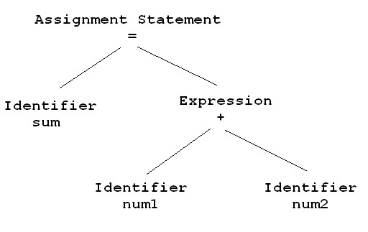
Parse Tree Generation :
sum = num1 + num2

Slide 52
Explanation : Syntax Analysis
We know , Addition operator plus (‘+’) operates on two Operands
Syntax analyzer will just check whether plus operator has two operands or not . It does not checks the type of operands.
Suppose One of the Operand is String and other is Integer then it does not throw error as it only checks whether there are two operands associated with ‘+’ or not .
So this Phase is also called Hierarchical Analysis as it generates Parse Tree Representation of the Tokens generated by Lexical Analyzer

Slide 53
Semantic Analysis
Syntax analyzer will just create parse tree. Semantic Analyzer will check actual meaning of the statement parsed in parse tree. Semantic analysis can compare information in one part of a parse tree to that in another part (e.g., compare reference to variable agrees with its declaration, or that parameters to a function call match the function definition).

Slide 54
Semantic Analysis is used for the following -
Maintaining the Symbol Table for each block.
Check Source Program for Semantic Errors.
Collect Type Information for Code Generation.
Reporting compile-time errors in the code (except syntactic errors, which are caught by syntactic analysis)
Generating the object code (e.g., assembler or intermediate code)

Slide 56
Now In the Semantic Analysis Compiler Will Check -
Data Type of First Operand
Data Type of Second Operand
Check Whether + is Binary or Unary.
Check for Number of Operands Supplied to Operator Depending on Type of Operator (Unary | Binary | Ternary)

Slide 57
Fundamentals of Lang. Specification
Terminal Symbol
Denotes character set with all symbols.
this all are metasymbols.
Differentiate from terminal symbol
String – finite sequence of symbols
Nonterminal symbol- name of syntax category of symbol
denoted by single capital letter
eg. Noun,verb …

Slide 58
Productions
  A productions also called a rewriting rule, is a rule of of grammar.
  A production has the form
  A Nonterminal symbol = String of Ts and NTs
  Example
  <Noun Phrase> ::= <Article> <Noun>
  <Article> ::= a | an | the
  <Noun>::= boy | apple
Distinguished symbol/start NT of grammer

Slide 59
Programming Language Grammars
Grammar (G)
  A grammar G of a language L_{G} is a Quadruple (Σ, SNT, S, P) where
  Σ = is the set of Ts
  SNT= is the set of NTs
  S = is the distinguished symbols /starting symbol
  P= is the set of productions

Slide 60
Derivation
  A grammar G is used for two purpose
    To generate valid strings of L_{G}
    To recognized valid strings of L_{G}
  The derivation operations helps to generate valid strings.
Derivation -- Example
  <Noun Phrase> ::= <Article> <Noun>
  <Article> ::= a | an | the
  <Noun>::= boy | apple
  Suppose we want to derivate strings “the boy”
  “⇒” denote direct derivation.

Slide 61
  <Noun Phrase> ⇒<Article> <Noun>
  ⇒the <Noun>
  ⇒the boy Leftmost Derivation
  <Noun Phrase> ⇒<Article> <Noun>
  ⇒<Article> boy
  ⇒the boy Rightmost Derivation

Slide 62
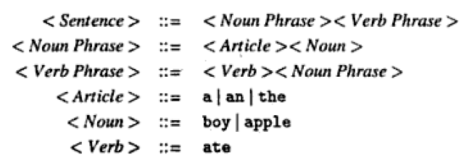
  <Sentence> ⇒<Noun Phrase> <Verb Phrase>
  ⇒<Article> <Noun><Verb Phrase>
  ⇒the <Noun><Verb Phrase>
  ⇒the boy<Verb Phrase>
  ⇒the boy<Verb><Noun Phrase>
  ⇒the boy ate <Noun Phrase>
  ⇒the boy ate <Article> <Noun>
  ⇒the boy ate an <Noun>
  ⇒the boy ate an apple

Slide 63
Reductions
  The reductions operation helps to recognize valid strings.

Slide 64
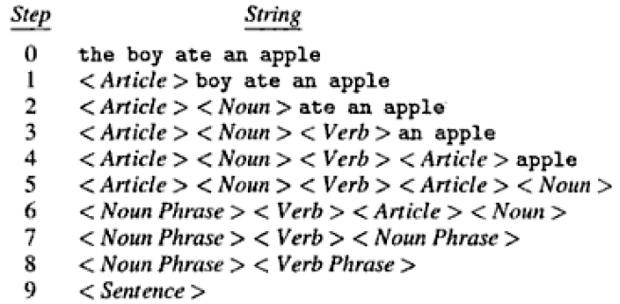

Slide 65
Parse tree
A parse tree is used to depict syntactic structure of a valid string as it emerges during a sequence of derivations or reductions
Recursive Specification
  A grammar is in recursive specification, if NT being defining in a production, itself occurs in a RHS string of the production, e..g. X::=AXB
  The RHS alternative employing recursion is called recursive rules.

Slide 66
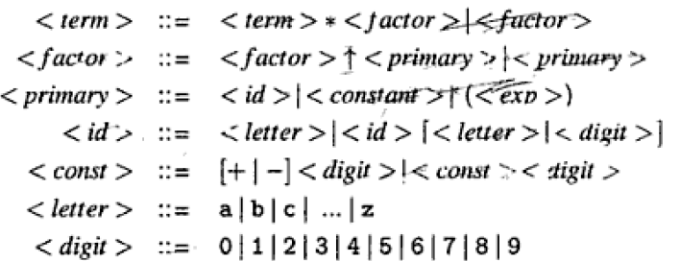
Recursive Specification
  Consider the grammar G

Slide 67

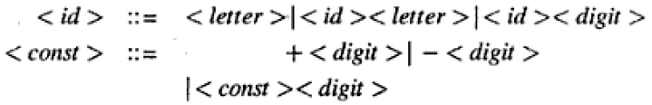
Recursive Specification
  [..] denotes an optional specification

Slide 68
Recursive Specification
  Two types of recursive rules
  Left recursive rule → NT appears on the extreme left in the recursive rule
  Right recursive rule → NT appears on the extreme right in the recursive rule

Slide 69
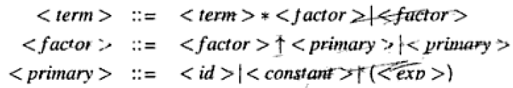
Recursive Specification
  Indirect recursion
    Occurs when two or more NTs are defined in terms of one another.
    Such recursion is useful for specifying nested constructs in a language

Slide 70
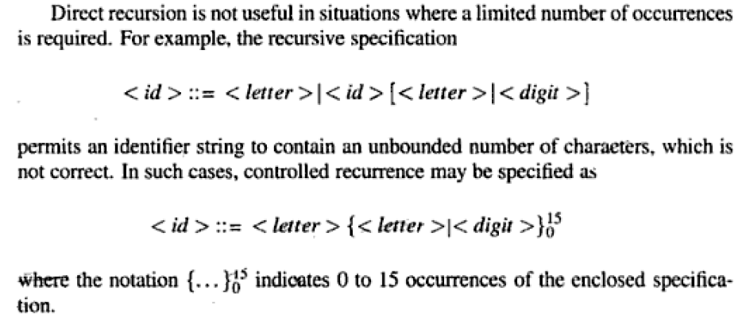
Recursive Specification

Slide 71
Grammars are classified as
  Type–0 (Phrase structure grammar)
  α=β (strings of Ts and NTs)
  -Permits arbitrary substitutions of strings
  -No limitation on production rules: at least one nonterminal on LHS.
  -not relevant to specification of PLs.
  Example:
  Start = <S>
  <S> ⇒<S> <S> <A><B> ⇒<B><A>
  <S> ⇒<A> <B> <C> <B><A> ⇒<A><B>
  <A> ⇒ a <A><C> ⇒<C><A>
  <B> ⇒b <C><A> ⇒<A><C>
  <C> ⇒ c <B><C> ⇒<C><B>
  <S> ⇒ ε
  Strings generated:
  ε, abc, aabbcc, cabcab, acacacacacacbbbbbb, ...

Slide 72
Type–1 (Context sensitive grammar)
  αA β = α Πβ
  -not relevant to specification of PLs.

Slide 73
Type–2 (Context free grammar)
      A = Π
      Limit production rules to have exactly one nonterminal on LHS, but anything on RHS.
-suited for programming language specification
  Example:
  <PAL> ⇒ 0 <PAL> 0 Start = <PAL>
  ⇒ 1 <PAL> 1
  ⇒ 0
  ⇒ 1
  ⇒ ε
  Strings generated:
  ε, 1, 0, 101, 001100, 111010010111, …

Slide 74
Type–3 (regular grammar/ linear grammar)
    A= tB|t or Bt|t
  <id> = l|<id>l|<id>|d
  -Limit production rules to have exactly one nonterminal on LHS and at most one nonterminal and terminal on RHS:
  - restricted to the specification of lexical units
  - nesting of construct or matching parenthesis can
  not be specified
  Example:
  <A>⇒<B> 0 Start = <A>
  <B> ⇒<A> 1
  <A> ⇒ ε
  Strings generated:
  ε, 10, 1010, 101010, 10101010, …

Slide 75
Operator Grammar (OG)
    An Operator grammar is a grammar none of whose productions contain two or more consecutives NTs in any RHS alternatives.
  Operator Grammar (OG)
    An Operator grammar is a grammar none of whose productions contain two or more consecutives NTs in any RHS alternatives.

Slide 76

Ambiguity in Grammatic specification
  For a given string and grammar, two distinct parse tree exists then grammar known as ambiguous grammar.
  For example
  Two parse tree exist for string a+b*c

Slide 77
<exp> ⇒<exp>*<exp> ⇒<exp>+<exp>*<exp>
  <id>+<exp>*<exp>
  ⇒a+<exp>*<exp>
  ⇒a+<id>*<exp>
  ⇒a+b*<exp>
  ⇒a+b*<id>
  ⇒a+b*c
<exp> ⇒<exp>+<exp>
  ⇒ <id>+<exp>
  ⇒ a+<exp>
  ⇒ a+<exp>*<exp>
  ⇒ a+<id>*<exp>
  ⇒ a+b*<exp>
  ⇒ a+b*<id>
  ⇒ a+b*c

Slide 78
Eliminating ambiguity
  An ambiguous grammar should be rewritten to eliminate ambiguity.
  The grammar must be rewritten such that reduction of ‘*’ precedes the reduction of ‘+’ in string a+b*c
  The normal method of achieving this is to use a hierarchy of NTs in the grammar and to associate the derivation or reduction of an operator with an appropriate NT.

Slide 79
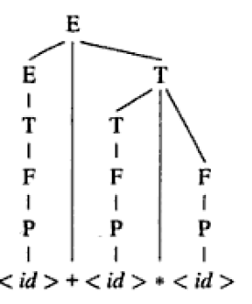
Programming Language Grammars
Unambiguous Grammar
  E:=E+T|T
  T:=T*F|F
  F:=P
  P:=a|b|c

Slide 80
Binding
“A Binding is the association of an attribute of a program entity with a value”
Binding time is the time at which a binding is performed.
Different Binding times:
  Language definition time of L
    The keywords of the programming language L are bounded to their meanings. Example: main, for, while
  Language implementation time of L
    The time when language translator designed example the size of type int could be bounded to 2 or 4 bytes, its determined by the architecture of the target machine.

Slide 81
Cont.
  Compilation time of P
    The binding of the attributes of variables is performed. Example the int is bounded with a variable var.
  Execution init time of Proc
    Memory addresses of local variables of procedure are bound at every execution init time of proc.
  Execution time of Proc
    Value attribute binding may be done more then one during the execution of the procedure or function.

Slide 82
Importance of binding time
The binding time of an attribute of program entity determines the manner in which a language processor can handle the use of the entity.
This affect execution efficiency of the target program.
Type of binding
  Static binding:
    Static binding is a binding performed before the execution of program begins.
  Dynamic binding
    Dynamic binding is a binding performed after the execution of program has begun

Slide 83
Lex program for symbol table
%{
#include<stdio.h>
int flag=0,flag2=0,flag3=0,value;
char *id,*datatype;
%}
datatype int|float|double|char;
%%
{datatype} {flag=1;datatype=yytext;}
([(A-Za-z)]+[(\_*)]*[0-9]*)* {if(flag==1){flag2=1;id=yytext;}else{return 0;}}
[(\=?)] {if(flag2==1){flag3=1;}}
([0-9])* {if(flag3==1){createsymboltable(datatype,id,yytext);}}
%%

Slide 84
createsymboltable(datatype,id,value)
{
printf("datatype=>%s\nid=>%s\nvalue=>%s",datatype,id,value);
}
main()
{
yylex();
}

