Slide 1
Chapter 2
Process Models
Slide Set to accompany
Software Engineering: A Practitioner’s Approach, 7/e
by Roger S. Pressman
Slides copyright © 1996, 2001, 2005, 2009 by Roger S. Pressman
For non-profit educational use only
May be reproduced ONLY for student use at the university level when used in conjunction with Software Engineering: A Practitioner's Approach, 7/e. Any other reproduction or use is prohibited without the express written permission of the author.
All copyright information MUST appear if these slides are posted on a website for student use.
These slides are designed to accompany Software Engineering: A Practitioner’s Approach, 7/e (McGraw-Hill, 2009). Slides copyright 2009 by Roger Pressman.

Slide 2

A Generic Process Model
These slides are designed to accompany Software Engineering: A Practitioner’s Approach, 7/e (McGraw-Hill, 2009). Slides copyright 2009 by Roger Pressman.

Slide 3

Process Flow
These slides are designed to accompany Software Engineering: A Practitioner’s Approach, 7/e (McGraw-Hill, 2009). Slides copyright 2009 by Roger Pressman.

Slide 4
Identifying a Task Set
A task set defines the actual work to be done to accomplish the objectives of a software engineering action.
  A list of the task to be accomplished
  A list of the work products to be produced
  A list of the quality assurance filters to be applied
These slides are designed to accompany Software Engineering: A Practitioner’s Approach, 7/e (McGraw-Hill, 2009). Slides copyright 2009 by Roger Pressman.

Slide 5
Prescriptive Models
Prescriptive process models advocate an orderly approach to software engineering
That leads to a few questions …
If prescriptive process models strive for structure and order, are they inappropriate for a software world that thrives on change?
Yet, if we reject traditional process models (and the order they imply) and replace them with something less structured, do we make it impossible to achieve coordination and coherence in software work?
These slides are designed to accompany Software Engineering: A Practitioner’s Approach, 7/e (McGraw-Hill, 2009). Slides copyright 2009 by Roger Pressman.

Slide 6
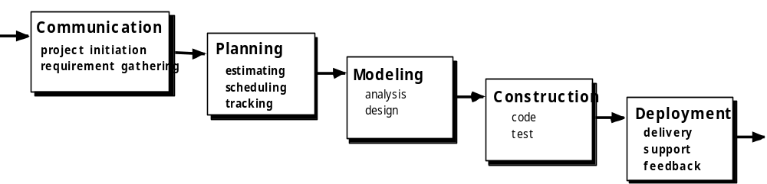
The Waterfall Model
These slides are designed to accompany Software Engineering: A Practitioner’s Approach, 7/e (McGraw-Hill, 2009). Slides copyright 2009 by Roger Pressman.

Slide 7

The V-Model
These slides are designed to accompany Software Engineering: A Practitioner’s Approach, 7/e (McGraw-Hill, 2009). Slides copyright 2009 by Roger Pressman.

Slide 8
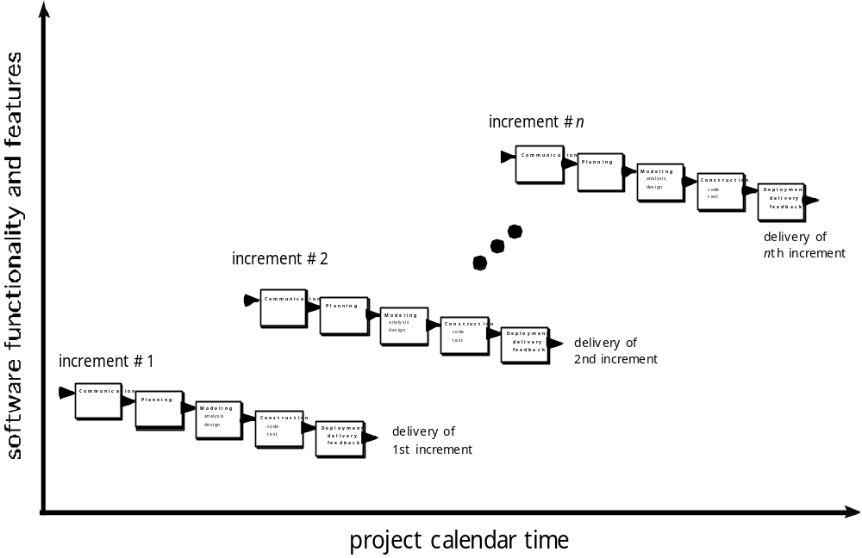
The Incremental Model
These slides are designed to accompany Software Engineering: A Practitioner’s Approach, 7/e (McGraw-Hill, 2009). Slides copyright 2009 by Roger Pressman.

Slide 9

Evolutionary Models: Prototyping
Quick
plan
communication
Modeling
Quick design
Deployment
delivery &
feedback
Construction
of prototype
Construction
of prototype
These slides are designed to accompany Software Engineering: A Practitioner’s Approach, 7/e (McGraw-Hill, 2009). Slides copyright 2009 by Roger Pressman.

Slide 10
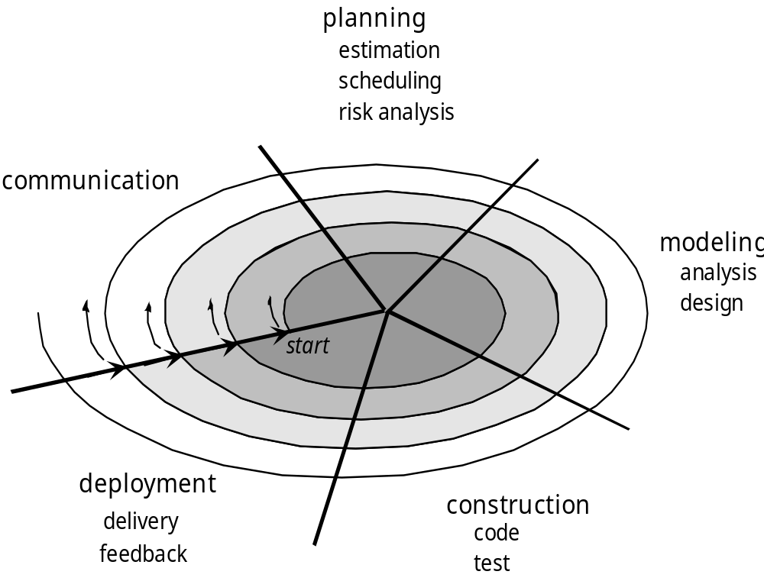
Evolutionary Models: The Spiral
These slides are designed to accompany Software Engineering: A Practitioner’s Approach, 7/e (McGraw-Hill, 2009). Slides copyright 2009 by Roger Pressman.

Slide 11
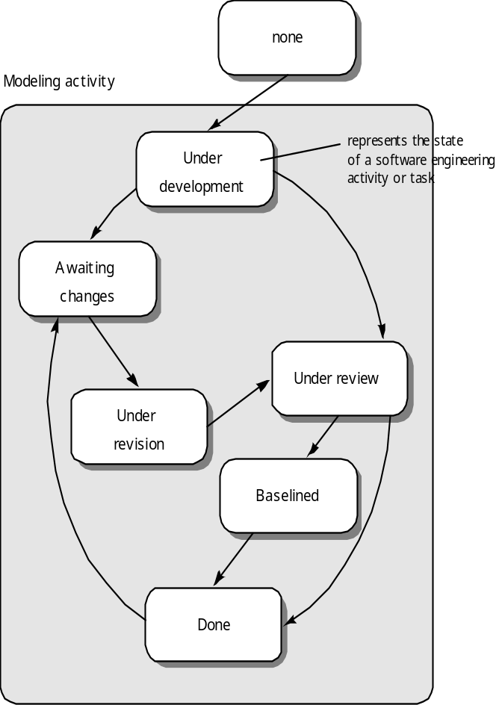
Evolutionary Models: Concurrent
These slides are designed to accompany Software Engineering: A Practitioner’s Approach, 7/e (McGraw-Hill, 2009). Slides copyright 2009 by Roger Pressman.

